Slide 1
Credentialing Training
Fresno County Managed Care

Slide 2
Becoming a Contracted Provider
The Managed Care Division of the Department of Behavioral Health processes credentialing applications for contracted providers and in-house providers.
Find the credentialing application on the Fresno County Website
Become A Contract Provider | County of Fresno
The Fresno County Credentialing Committee reviews and approves (or denies) credentialing applications for all providers, in-house and contracted providers.

Slide 3
Managed Care
Who Needs to Be credentialed
How to contact Managed CAre
Staff members in your organization who are Licensed, Licensed-Eligible or Associate-Level, Waivered, Certified or Registered should be credentialed.
Staff members providing billable services should be credentialed.
The Managed Care team can be emailed at mcare@fresnocountyca.gov
Phone: 559-600-4645
Fax 559-455-4633
Applications can also be mailed to:
Managed Care Division
1925 E Dakota Ave
Fresno CA 93726

Slide 4
Types of Applications
Organizational Providers.
Group or Individual Providers.
DBH In-house Application (County Employees Only).
Mental Health Rehabilitation Specialist.
Non-credentialed/ non-clinical staff.
Re-credentialing Application.

Slide 5
The Fresno County Organizational Application
Most mental health providers and all substance use providers will complete the Organizational Provider application.
Once applications are completed, they can be submitted by email, fax or mail.
Applications are usually returned for missing information, incomplete information or a combination of both.
This presentation is designed to help avoid some common mistakes so applications can be processed in a timely manner.

Slide 6
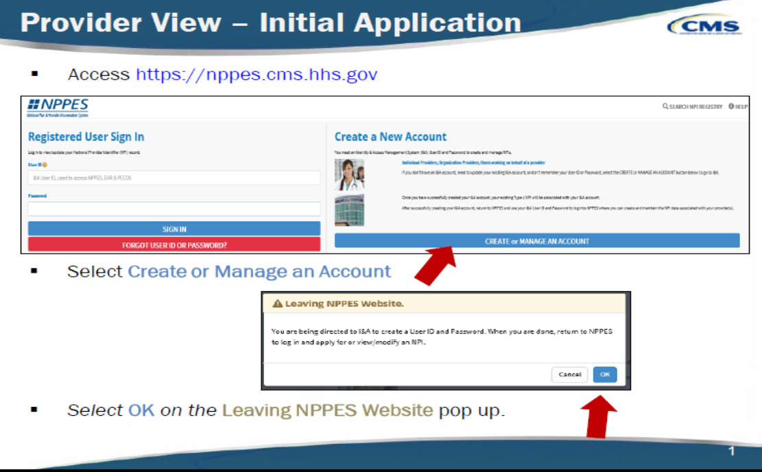
getting an NPPES account
Every applicant must have an active account.
Federal Data Base.
DBH cannot provide technical support.
Required for every provider.

Slide 7
All Fresno County Credentialing applications come with instructions.
Read these over before completing your Application.

Slide 8
Required documentation
In addition to the application, there are documents each credentialing applicant must provide.
The required documents vary depending on the application and the provider type.

Slide 9
Section A of the application is the organizational provider information. Please be sure to complete the top portion of the application as well with dates and type of provider info. Also of note, “Have you previously applied for credentialing with FCMHP or DMC-ODS” is new to the application. Please answer this question.
The organizational provider information can be standardized for your program. Complete Section A for your applicants; they do not usually have access to this information and this section cannot be left blank.

Slide 10
Section B identifying information
Please include the applicant’s name, birthdate, gender and practice address. The practice address is where the services will be provided. That same address must be on the applicant’s NPI profile.
Answer all the questions, including the ADA question, and whether the applicant has worked under any other names.
All questions should be answered, include N/A where applicable.
Unlicensed and registered staff must indicate a supervisor. That supervisor must be credentialed by the FCMHP.

Slide 11
Sections C-H
Section C-NPI and Taxonomy-This information will be verified on the NPPES website. Make certain staff update their NPI accounts to include the practice address indicated on the application, their licensing number and state.
Section D-Work history needs to encompass the past 10 years and match resumes.
Section E-Professional Education.
Sections F-H should be completed as applicable. Most applicants will not have information for F-H.

Slide 12
Section I-Data Attestation
Staff should answer all 21 questions with Yes/No/or NA (don’t leave any blank).
Questions 1-14, if answered yes, should be accompanied with an explanation.
Associate Level (unlicensed) staff and registered SUD counselors should Mark N/A to question 15.
Make certain staff sign and date the page attesting the information they provided was true to the best of their knowledge.

Slide 13
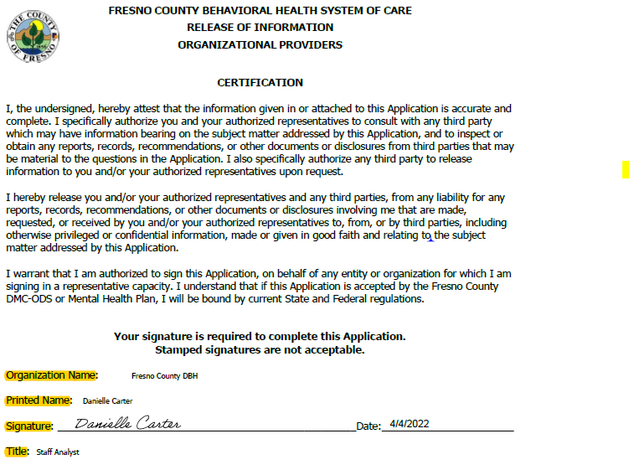
Release of information Certification
Make certain staff complete the entire release of information page, with a signature, date and title. The title of the staff is the role they will be occupying inside your organization, for example, admissions specialist, rather than SUD counselor.

Slide 14
Clinical Profile
All licensed staff must complete a clinical profile.
Any specialties listed required additional certifications and documentation to verify the specialties.
Registered and/or unlicensed staff need not complete a clinical profile. Either omit the clinical profile pages or leave them blank.

Slide 15
Individual and Group Provider Applications
These application must be completed as thoroughly as organizational provider applications.
A few different items will be requested.

Slide 16
Individual and Group Provider Applications
Insurance information is required.
Along with the availability of all the individuals who work for the group.

Slide 17
In-house application
For DBH employees only.
All document requirements are the same.
No work history section, so county application required.
Used for new employees as well as internal promotions.

Slide 18
Mental Health Rehabilitation Specialist
Applications
The Mental Health Rehabilitation Specialist (MHRS) is usually responsible for providing therapeutic behavioral interventions and replacement skill-building strategies for clients, assisting as a mental health worker with intake summaries, case management services to in accordance with client treatment plans.
Specific educational and experience requirements according to CCR Title 9 § 630:
  A mental health rehabilitation specialist shall be an individual who has a baccalaureate degree and four years of experience in a mental health setting as a specialist in the fields of physical restoration, social adjustment, or vocational adjustment. Up to two years of graduate professional education may be substituted for the experience requirement on a year-for-year basis; up to two years of post associate arts clinical experience may be substituted for the required educational experience in addition to the requirement of four years' experience in a mental health setting.
Not all applicants will qualify for this specialized position.
Use the MHRS application.
Applicant must include proof of academic degrees earned.

Slide 19
Mental Health Rehabilitation Specialist
The MHRS application is a shorter application.
The academic degrees and transcripts must be clear and match the resume and application.
The resume must clearly communicate the applicant's work history.

Slide 20
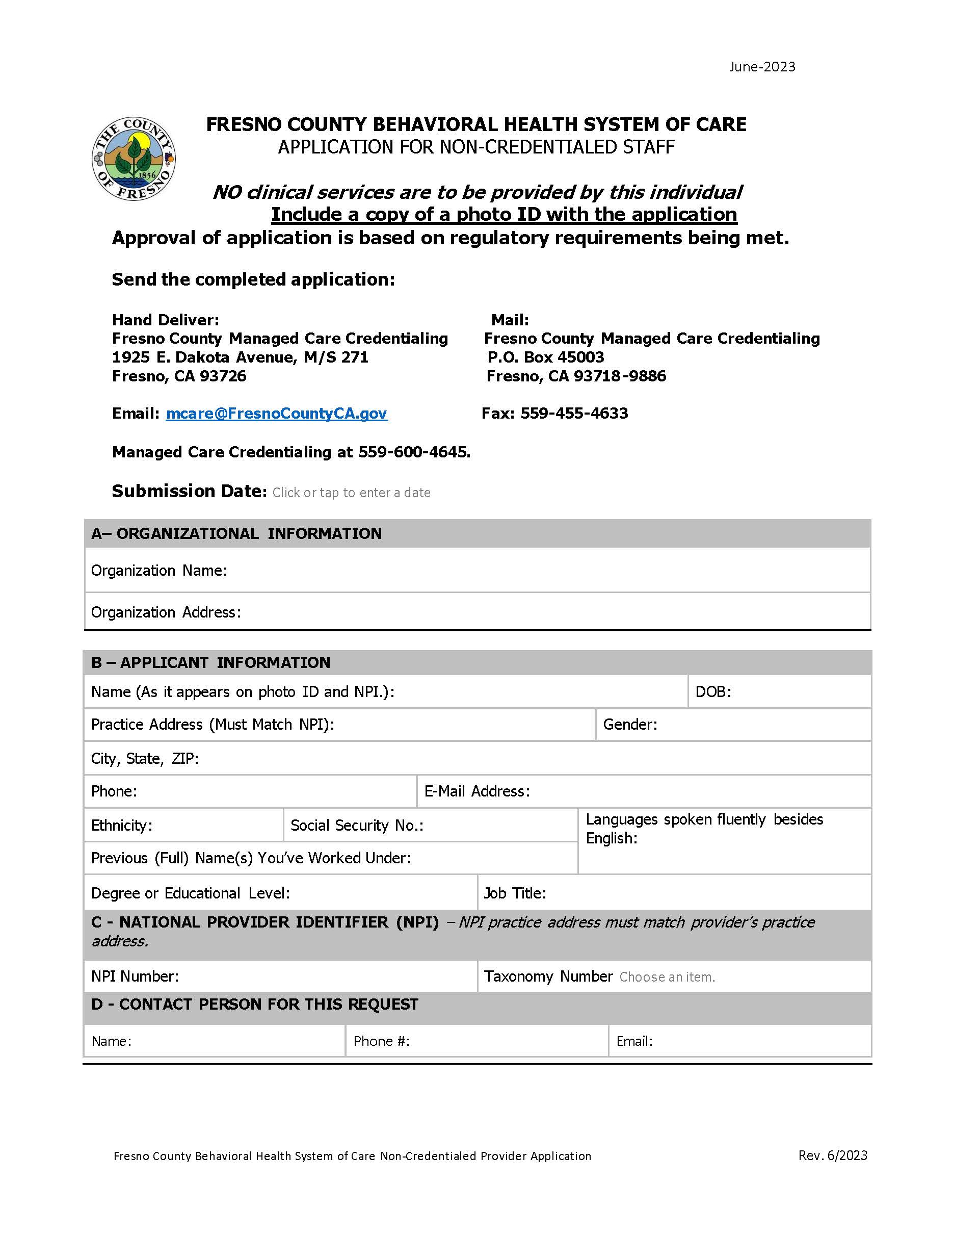
Non-Credentialing Application
Non-Clinical and Non-Credentialed Staff
Used for CMHS or Pre-reg UMHC
National Plan and Provider Enumeration System (NPPES) profile and NPI number required.
No clinical services can be provided by these applicants.
Will allow applicant to receive an Avatar number and bill for case management or counselor services.

Slide 21
The process
Once the application and all accompanying documentation are received, the credentialing process can begin. Department staff will contact contracted entities if there are questions or missing information. Contracted entities will have 10 business days to resubmit missing or inaccurate information before the application is withdrawn and will need to be resubmitted in its entirety.
When all documentation has been verified and processed, the application is sent to a Credentialing Committee Member who will review the application.
Applications which contain an affirmative answer to questions 1-14 on the data attestation will need to be approved by the credentialing committee at large.
When the application is approved by the committee member, the applicant will be notified. An Avatar number will be requested for the provider.
If the application is pended, the provider will be notified and given an opportunity to make the needed corrections.
If applications are denied by the committee, staff will be notified in writing. Instructions will be included with the denial on how to appeal the committee’s decision if that is an available option.

Slide 22
