Slide 1
Individual and Group Providers
Announcements
CSI Standalone Assessment Form
ATD Form

Slide 2
CSI Standalone Assessment Form
CSI Assessment Form is replacing Mental Health Access Forms.
For new clients/clients who have not received services within 12 months:
Send submit completed CSI form and facesheet to our Managed Care mail/email/fax:
Mail: P. O. Box 45003
Fresno, CA. 93718-9886
Email: mcare@fresnocountyca.gov
Fax: (559) 455-4633
NOTE: These forms should accompany or be sent prior the claims.

Slide 3
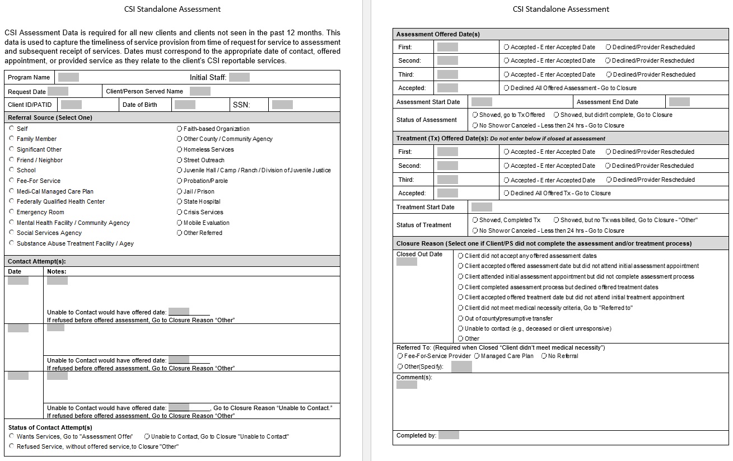
CSI Standalone Assessment Form

Slide 4
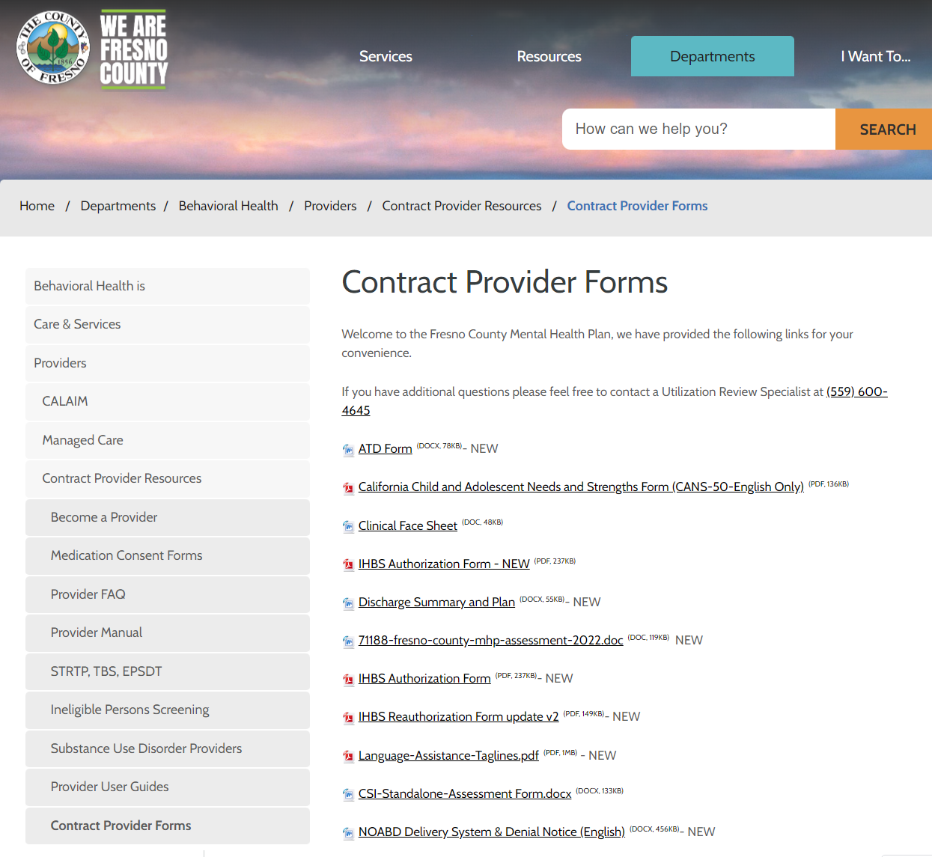
CSI STANDALONE ASSESSMENT ELECTRONIC FORM
Available on Fresno County DBH Website:
Contract Provider Forms
Name: CSI Standalone Assessment Form
https://www.fresnocountyca.gov/Departments/Behavioral-Health/Providers/Contract-Provider-Resources/Contract-Provider-Forms

Slide 5
ATD FORM
ATD Form is no longer required
For discharges, please complete the Discharge Summary and Plan form.
All located in the same link provided.

Slide 6
Questions
If you have any questions, please contact Managed Care Mailbox.
Thank you!

