Slide 1
Full User SmartCare Training
Mental Health Providers
Updated 7/2025

Slide 2
Log In to SmartCare
Link to Live/PROD system (blue ribbon)
  https://fresno.smartcarenet.com/FresnoSmartcareProd/Login.aspx
Link to Train system (green ribbon)
https://calmhsafresnosctt.smartcarenet.com/FresnoCntySmartcareTrain/Login.aspx
    This is a train system to practice
    You can use the generic login but do not reset the password as it is going to be used by others.

Slide 3
SmartCare Basics
User Login Process
  Changing Your Password: https://2023.calmhsa.org/changing-your-password/
  Setting up Your Security Questions: https://2023.calmhsa.org/setting-up-your-security-questions/
  Multi-Factor Authentication: https://2023.calmhsa.org/logging-in-to-smartcare/
    Occurs every 2 weeks
Login Help
  How to Recover Your Username: https://2023.calmhsa.org/how-to-recover-your-username/
  How to Reset Your Password: https://2023.calmhsa.org/how-to-reset-your-password/
    If you lock yourself from SmartCare please email helpdesk@fresnodbh.freshservice.com

Slide 4

Staff Dashboard, QuickLink & Favorite
Dashboard (My Office): Is a screen where a specific staff will have different widgets with hyperlinks and information at a glance.
QuickLink: A way to access screens/reports/documents in the system without having to search for it. While in your Dashboard click on the triangle next to your name to access the Manage QuickLinks to add or remove forms. https://2023.calmhsa.org/making-a-quicklink/
Favorite: Clicking on this icon will allow you to save commonly used screens and list pages to your favorites list. Your favorites list is located on the header area, next to the search icon.

Slide 5

Client Dashboard and SmartView
Client Dashboard (Client): Is the home screen for a client, it has different widgets with hyperlinks and information about the specific client.
SmartView: While in the Client Dashboard click this icon , this will bring up the SmartView with different information for the client including a Summary, Allergies, Treatment Team, Client tracking, Care Team. The information on this depends on your user role.

Slide 6

Widgets
Widgets: These are windows of information at a glance. The Widgets available depend on your user role ex. LPHA, Clinical Supervisor, Prescribers etc. You can move your widgets using the icon (paper and pencil), you can add widgets using the icon (circle with a plus sign) and click save after the changes.
  Important Clinical Widgets:
    New Alerts/Messages: If another SmartCare user sends you who sent it, when it was received and the subject.
    Assigned Documents: This will show the number of documents in different categories including In progress, Notes to be co-sign, to sign and others.
    Service Needing Attention: This will show a number if there are notes/clients that have an error and can’t bill.
    Caseload: This will show you number indicating how many people are on your caseload under Primary, the total includes people you have written a note/completed a document for but are not in your caseload.
    Appointments for Today: Shows the appointments you have for today, time, status, you can click on the time and you will be taken to the note for the date of service.

Slide 7
Reports to Review Your Programs and Roles
  Fresno 201 Staff Setup (My Office): This is a report that shows the setup information for all staff including CDAG, Program assignments, License/Degree and assigned roles.
    If a staff member is not assigned to the appropriate CDAG and program, they cannot bill under a program or see information for that program
    Provides the Smartcare staff ID
    You may run this by staff member name or by email domain (i.e. @fresnocountyca.gov)
    Please note that you will see several county and admin names as we need to have access to all programs

Slide 8
Reports to Review Your Programs and Roles (continue)
  Staff Roles and Permissions 2: This report will list the User Roles that staff are assigned, the screens/documents you are granted access too or denied. Double check filters to ensure the all the information is pulled.
    Each role has different permissions to view and/or edit specific forms and screens
    Some users may need multiple roles

Slide 9
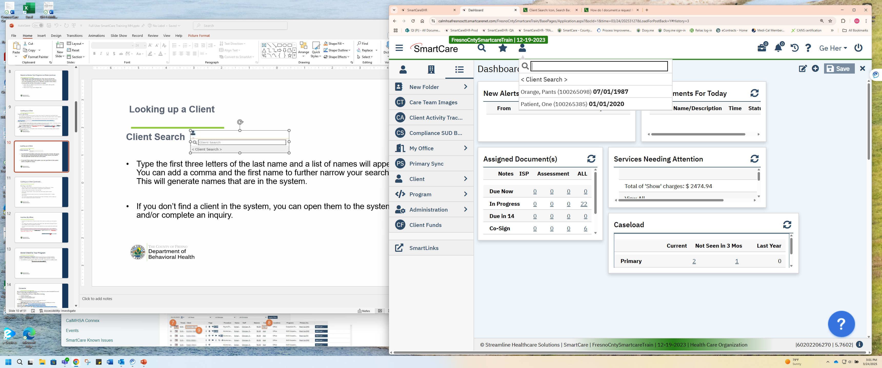
Looking up a Client
Client Search
Type the first three letters of the last name and a list of names will appear. You can add a comma and the first name to further narrow your search. This will generate names that are in the system.
If you don’t find a client in the system, you can open them to the system and/or complete an inquiry.
If the client is in the system, you can select their name.

Slide 10
Looking up a Client (continued)…
Creating a new client
Click on the client search icon (head and shoulders) to bring up the ‘<client search>’ option. Select ‘<client search>’ to bring up the search detail box.
Enter the client’s last & first name, DOB and SSN.
Click on the ‘Broad Search,’ ‘DOB Search’ and ‘SSN Search’ with the client’s information. This step must be done before being able to open a new client.
If the client is not in the system, proceed to “Create New Potential Client” or “Inquiry (New Client)”.
The ‘Create New Potential Client’ option will open “Client Information” screen so that you can enter in additional information, such as address change, phone numbers, parent/guardian, etc. *For minors, you can designate the legal guardian on this screen.

Slide 11
Inquiries (My Office)
Complete an Inquiry when a request is made (if the request is a walk-in you can skip this step)
The Inquiry form will allow you to link a client with an ID#, mark if this is an urgent request, check eligibility​, input demographic information
You will need to search by Name, DOB, and SSN before you can create a new client in the system
How do I document a request for services received via the Access Line? - 2023 CalMHSA
When completing the inquiry form, DO NOT USE the ‘register client’ option, ONLY USE ‘Link/Create Client’ and ‘Save’

Slide 12

Enroll Client to Your Program
Client Programs (Client): On this screen you can see a list of client’s program history including, enrollment dates, discharge dates and date of service.
To enroll them to your program, click on the icon and enter the enrollment date
Do not put an Assigned Staff

Slide 13
Consents
We recommend to use the SmartCare Consents, but you can upload completed consent forms using the Scanning/Upload process.
There are multiple Consent forms in SmartCare including
  Consent to Treat (Client)
  Consent for Telehealth (Client)
  Consent for Email Communication (Client)
  Consent for Text Communication (Client)
Co-Signing:
  Provider will sign first and the cosigner(s)’ name will populate on the form
  SmartCare automatically makes the client a Co-Signer
  Options to sign: Signature Pad, Mouse/Touchpad, Client Signed Paper Document, and verbally Agreed Over Phone
How to complete Consent forms: https://2023.calmhsa.org/how-to-complete-a-consent/
How to Revoke Consent: https://2023.calmhsa.org/how-to-document-a-revoked-consent/
How to View What Consents a Client has Signed: https://2023.calmhsa.org/how-to-view-what-consents-a-client-has-signed/

Slide 14
Consent for Minors, Conservatorship and Guardians
Minor Consent, Conservatorship, and Guardians you will need to complete setting individuals to Contacts on the ‘Client Information’ screen for the appropriate person to be added to as a co-signer
  Minor Consent, Conservatorship, and Guardians - 2023 CalMHSA
Co-Signing:
  Provider will sign first and the cosigner/s’ name will populate on the form
  SmartCare automatically makes the client a Co-Signer
  Options to sign: Signature Pad, Mouse/Touchpad, Client Signed Paper Document, and verbally Agreed Over Phone
Checklist to Determine Minor’s Ability to Consent to MH Treatment:
No Equivalent form in SmartCare
  Use paper version and Scan/Upload to SmartCare

Slide 15
Release of Information (Client)
*Currently DBH Internal programs are using PDF ROI and scanning into SmartCare
How to Document a Release of Information (Authorization to Disclose Confidential Information): https://2023.calmhsa.org/how-to-document-a-release-of-information-authorization-to-disclose-confidential-information/
How to Revoke a Standard Release of Information/Authorization to Disclose Information: https://2023.calmhsa.org/how-to-revoke-a-standard-release-of-information-authorization-to-disclose-information/
How to View What Disclosure Authorizations (ROI the client has signed):
https://2023.calmhsa.org/how-to-determine-what-disclosure-authorizations-release-of-information-the-client-has-signed/
How to Add Scanned ROI to Release of Information Log: https://www.fresnocounty.how-to-add-a-scanned-release-of-information-to-the-release-of-information-log-in-smartcare.docx

Slide 16
Coordinated Care Consent (Client)
How to Complete a Coordination Care Consent:
https://2023.calmhsa.org/how-do-i-complete-a-coordinated-care-consent/
How to Revoke Coordinated Care Consent:
https://2023.calmhsa.org/what-do-i-do-if-the-client-wants-to-revoke-their-coordinated-care-consent/
How to Determine if the Client has Signed a Coordinated Care Consent:
https://2023.calmhsa.org/how-to-determine-if-the-client-has-signed-a-coordinated-care-consent/
By default, SmartCare enforces privacy regulations, including HIPAA and 42 CFR. This means that people working in mental health programs are not able to see any of the client’s treatment information for substance use programs and vice versa. This limitation is enforced by each user’s CDAG. In essence, there is a wall between CDAGs.
When a client signs the Coordinated Care Consent, this wall is removed. Users will be able to see all the client’s treatment information, regardless of their CDAG. This includes historical information and future appointments. You’ll still be required to select your program when creating a new document. This is to ensure that all documents are appropriately sorted in case the client revokes their consent, as is their right.

Slide 17
Calendar Management
Staff Calendar (My Office)
Basic Navigation of the Staff Calendar
https://2023.calmhsa.org/basic-navigation-of-the-staff-calendar/
How to Create an Appointment from Your Calendar:
https://2023.calmhsa.org/how-to-create-an-appointment-from-your-calendar/
How to schedule Non-Client Time on Your Calendar:
https://2023.calmhsa.org/how-to-schedule-non-client-time-on-your-calendar/
We are only using New Calendar Entry or New Service Entry

Slide 18


Caseloads
Treatment Team (Client): This form allows you to add/remove a client to your caseload
Click on the new icon , select type of treatment team member and complete the relevant information including Start Date, Name, Role Program and any other information needed.
You can add an external person to the client’s treatment team including a caregiver, family member or PCP
You can access the hyperlink to Treatment Team on the Smartview icon when you are in the Client’s dashboard
To remove a client, input an End Date and unclick the “Active” check box

Slide 19
Caseloads Continued…
Caseload (My Office): This list page display selected staff member’s caseload.
It also includes the clients that the staff has completed a note for, even if they are not on the staff’s caseload.
      https://2023.calmhsa.org/caseload-list-page/
Caseload Reassignment (My Office): This is a functional list page where supervisors and administrators can reassign a staff’s in progress documents, to acknowledge documents, to be reviewed documents, to co-sign documents, to do, and to sign documents to another staff member.
You can reassign a staff’s flags, inquiry, and most importantly their primary clients to another staff member. For the list page to pull up any data, either the Staff search needs to be set to a staff or the Client search have a client selected.
    https://2023.calmhsa.org/the-caseload-reassignment-list-page/

Slide 20
Mental Health Timeliness Record
Complete a MH Non-Psychiatric SMHS Timeliness Record (client) when a request for MH services is made AND​
  They are not currently enrolled in a treatment program; mobile crisis program exception (program #4763) You can check program enrollment on the Client Programs page or the Client Dashboard – Treatment Team widget.
  or
  2) If this is an urgent request for service.​

Slide 21
CSI Standalone Collection (Client)
Complete a CSI Standalone Collection form
  when the person served is newly enrolled in SMHS (i.e., new to the MHP).
          OR
  when the person served is re-enrolling in treatment after being discharged from ALL programs within the Mental Health Plan (MHP).
The program providing the initial service will be responsible for completing the form regardless of level of SmartCare access (Lite and Full Users) and/or level of care (outpatient and crisis).
Verification of enrollment can be determined by accessing the Client Programs (Client) list page.
https://2023.calmhsa.org/how-to-complete-a-csi-demographic-record/

Slide 22
Notice of Adverse Benefit Determination (NOABD)
Forms are available in SmartCare:
https://2023.calmhsa.org/how-to-complete-a-noabd/
Forms relevant to clinical staff:
NOABD- Delivery System (Client)
NOABD- Denial (Client)
NOABD-Timely Access Notice (Client)
NOABD- Termination Notice (Client)
*You must print the NOABD form and add the required enclosure documents before sending it to the Person Served
You can use this link to access the enclosure requirements: Contract Provider Forms - County of Fresno (fresnocountyca.gov)

Slide 23
SmartCare Screening and Assessment
Screening Tools
Youth Medi-Cal Screening Tool (Client)
  How to Complete a Youth Medi-Cal Screening Tool - 2023 CalMHSA
Adult Medi-Cal Screening Tool (Client)
  How to Complete the Adult Medi-Cal Screening Tool - 2023 CalMHSA
Complete these screening tools as applicable to your program’s workflow, these tools are mainly used at an access program

Slide 24
SmartCare Screening and Assessments (continue)
PSC 35 - California Pediatric Symptom Checklist (client)
Pediatric Symptom Checklist (PSC) - 2023 CalMHSA
A PSC-35 should be completed for person served ages 3-18
Flowsheet (Client): This report allows you to see the PS total score over a period of time
  How to View PSC scores Over Time - 2023 CalMHSA

Slide 25
SmartCare Screening and Assessments (continue)
California CANS (Client)
Child and Adolescent Needs and Strengths (CANS) Tool - 2023 CalMHSA
You must complete the ‘Initial’ tab then hit ‘save’ before all other tabs will appear
A CANS should be completed for PS ages 6-20.
CANS can only be completed by a LPHA who has been trained and certified by our MC department

Slide 26
SmartCare Screening and Assessment (continue)
CalAIM Assessment (Client)
(Equivalent to STRTP MH Assessment)
  Mental Status Exam (MSE)
  Having a MSE is a requirement for your assessment. The standalone form is available as an option, or you can include it in the narrative of your assessment
A Service Note needs to be completed to capture the service time for billing purposes.
A “Diagnosis Document (Client)” is required prior to completing a Service note for billing.

Slide 27

Diagnosis
Use the “Diagnosis Document (Client)” form to enter diagnosis for the PS
  Star the frequently used diagnosis with the star plus icon
  Use the same form to remove an old diagnosis or modify a current diagnosis.
  Non-LPHAs can't complete this form
https://2023.calmhsa.org/how-to-document-a-diagnosis-for-a-client/
If your diagnosis is not showing up on your service note, double check your ‘effective date’
*Reminder: A diagnosis is required to complete a Service note. You can add a diagnosis using the Diagnosis Document (Client) or on the Diagnosis Tab on a service note

Slide 28
Problem List
Use the ‘Client Clinical Problems (Client)’ to complete the problem list
https://2023.calmhsa.org/how-to-add-a-problem-to-the-problem-list/
  Perinatal certified program will need to have the SNOMED code 248985009 for Pregnancy on Problem List. Description Name: Presentation of pregnancy(finding), for billing purposes​
CalMHSA Client Missing Clinical Problems Report (My Office): This report will show what client have no problems listed on the Client Clinical Problem list, filtered by date frame, program and to show all or only those missing a problem on the form.
Any staff member, or person served, can identify problems to the client clinical problems list. Staff will document within the Service Note reason for adding problem to problem list.

Slide 29
Treatment Plan
A standalone treatment plan is no longer required for most SMHS (per Cal AIM)
  A treatment plan is still required for STRTPs, TBS, IHBS, ICC & TFC
  FSP programs will need to upload/scan their required ISSP
Most providers (including STRTPs) can enter care plans/treatment plans in a progress note in the “Care Plan” section of the service note. Care Plans will pull forward to future notes depending on the procedure codes.

Slide 30
Individual Progress Notes: Service Note (Client)
Individual Progress Note for:
  Scheduled appointment
  https://2023.calmhsa.org/how-to-write-a-progress-note-for-a-scheduled-service/
  Unscheduled appointment
  https://2023.calmhsa.org/how-to-write-a-progress-note-for-an-unscheduled-service/
  Document a No Show
  How to Document a No-Show Appointment - 2023 CalMHSA

Slide 31
Service Note (Client) for STRTPs
This is equivalent to STRTP MH progress note/Daily progress note.
This is also where you can document the treatment plan in the care plan section.
This should also be used to document significant event notes whether its billable or non-billable.
This form is also used to document the 30 days Treatment Plan Review and the 90 days Clinical Review. Be sure to include the required elements when documenting. Service code for this is plan development.

Slide 32
Service Note (Client)
Available procedure codes are based on the staff credentials (NonLPHA, LPHA, MD).
A progress note must be completed for each individual or group counseling service provided (Intake, Assessment, Care Plan, etc.) and the progress note shall provide sufficient detail to support the service code selected.​
Each Service Note (progress note) shall include the following: ​
  A brief description of how the service addressed the PS behavioral health needs (e.g., symptom, condition, diagnosis, and/or risk factors). ​
  A brief description of the PS response to the service. ​
  A brief summary of next steps.

Slide 33
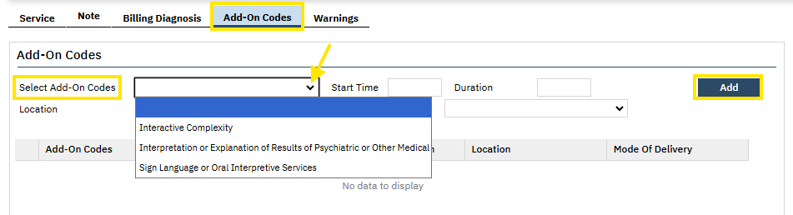
Service Note: Add-On Code
Add-on codes are services performed in addition to a “primary” or “parent” procedure/service. For example, using an interpreter for your session.
On the Service Detail screen fill out the required fields, including the primary procedure.
Once the primary procedure has been selected, the Add-On Codes tab will be displayed; select the tab.
Using the dropdown menu, choose the add-on code. The remaining fields (Start Time, Duration, etc.) auto-fills from the 'service' tab. Double check to make sure the information is correct.
Click Add
Click Save
*Please note, add-on codes
varies by procedure and
licenses, please consult your
Supervisor with any questions.

Slide 34
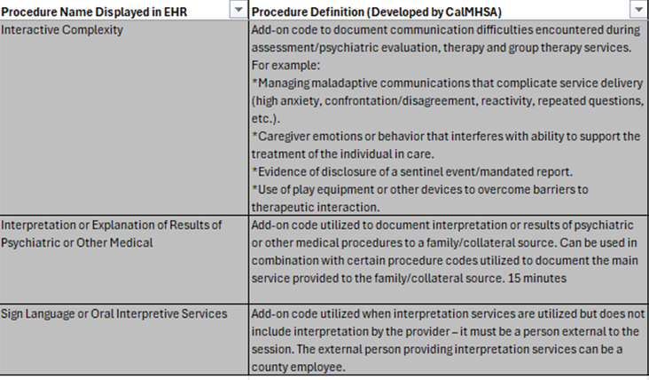
Add-on Codes: When to Use

Slide 35
Amending or Correcting a Service Note
Amending the content of a note is possible even if you have signed it. You will need to click on the edit
icon. It will ask you if you would like to create a new version of the note, select yes.
The Service information (top of the note) can be edited by the author, if it has not gone through the billing process with the service status as “complete”.
Once a note has been billed with the “complete” status, you will need to enter a “My Report Errors” request to edit the service information. When completing this form, be very specific on identifying the error and indicate what the correct information should be.
  The billing team will mark the note as an error. This will allow for the error to be corrected either by our billing department or you will be able to make corrections. Timeframe of when the corrections are completed depends on what part of the billing process the service is at.
If a service note needs to be deleted, enter a “My Reported Errors” request.
Edit a note: https://2023.calmhsa.org/how-to-amend-a-note/
How to Correct an Error for Individual Note when they have gone through billing process: https://2023.calmhsa.org/how-to-report-an-individual-service-note-error/
How to Review an Error that has been reported: https://2023.calmhsa.org/how-to-review-reported-errors/

Slide 36
Creating Groups
Create a New Group: use Managing Groups (My Office)
https://2023.calmhsa.org/how-to-set-up-a-group/
When making a reoccurring group there is a “Create Immediately checkbox” if you click on that it will create an appointment with a service note attached in your Staff Calendar. If you do not click on “Create Immediately check box” it will create a placeholder for that group on the staff calendar.
When creating a reoccurring group and adding clients to this group be mindful how far out the reoccurring services you input on the “end date” especially for groups that are created with service notes attached, if a client discharges from your program you will need to edit your group to remove the client or else you will have a list of services that are scheduled for that client.

Slide 37
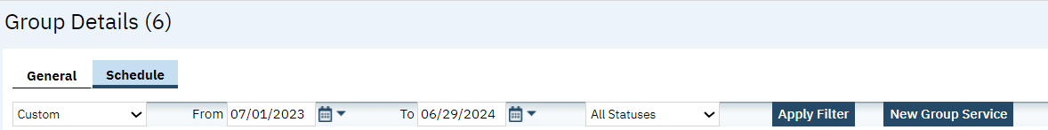
Writing a Group Note
Once you create a group on "Managing Groups" screen
Click on the Schedule tab
Click on New Group Service,
The pop-up window "Group Service Clients" will appear, complete the date of service, select the clients for the group, click select and the Group Service Detail screen will appear to complete the note
Video on how to write a group note: https://2023.calmhsa.org/how-to-write-a-group-progress-note/

Slide 38
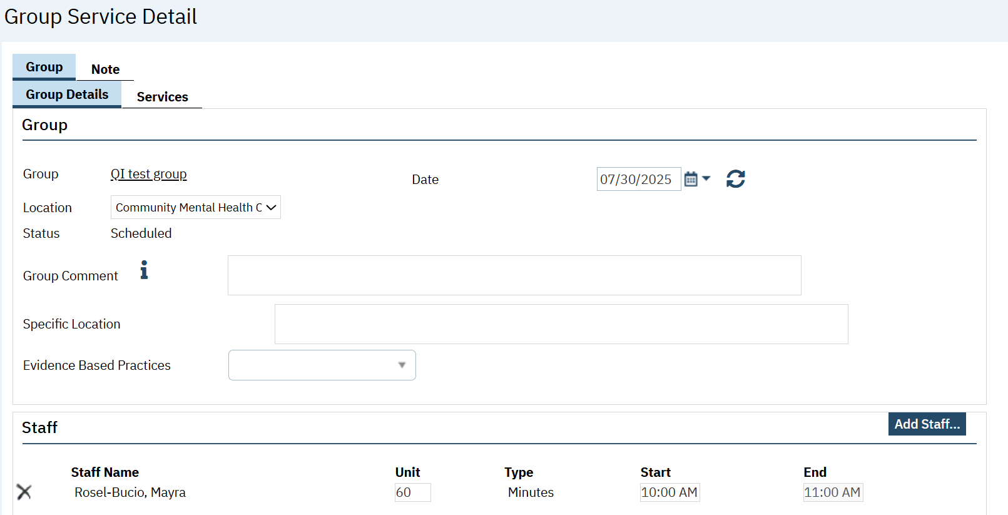
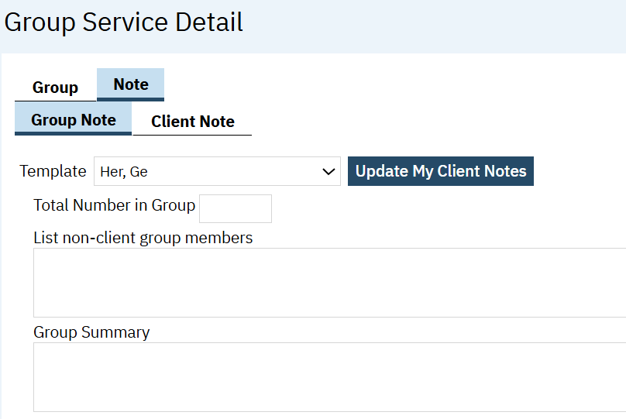
Writing a Group Note (continued) …
In “Group Service Detail Screen”, there are two tabs, “Group” and “Note”.
  The “Group” tab is where you can enter information regarding the Group, Staff, Clients and the Service Information.
  The “Note” tab is where you can enter the Group Summary and the Individualized Client Note.

Slide 39
Group Note exceptions for STRTPs
If your group includes a mixture of Fresno county youth, presumptive transfer and out of county placement youth (non-presumptive transfer), only add the Fresno county and presumptive transfer youth. Out of county placement youth should not be in SmartCare.
Total number in group: count all youths that attended the group, including the out of county placement youth.
List non-client group members: indicate the out of county placement youth in this text box by listing which county they are from. For example, Riverside County 1, Riverside County 2, San Mateo County, and Kern County.

Slide 40
Group notes
How to Edit Group Note: Video Titled “How to Edit a Single Recurring Group Appointment” and “How to Edit Multiple Recurring Groups by Using the Recurring Scheduler”
  If you want to edit a group for that one time you can make the changes in the Date of Service group note
  If you want to edit a group for that service and future services go to “Managing Groups (My Office)”
How to fix a Group Error: Video Titled “Errors and Deleting a Scheduled Group Service”
Group Documentation Videos - 2023 CalMHSA
Group Sign In Sheet: No Equivalent
  Sign in Sheets will need to be stored outside of SmartCare if your program requires one

Slide 41
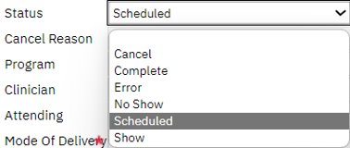
Group Note: Common Errors
Missing a Diagnosis Error: A diagnosis document needs to be completed prior to completing a group note.
If you get this message, check the Diagnosis Document for a “ diagnosis”, correct “effective date”, and “Type/Order”. If this is complete go to the “Group Service Detail screen” of your group note, “Clients section”,
1) High light the client that has the diagnosis error
2) Click on the Billing Diagnosis tab
3) Click Refresh Diagnosis and Attempt to sign note again
Duration not Matching Error: This error will occur if the Status is marked “Complete” instead of “Show”, make sure you are selecting the correct status, do not use “Complete”

Slide 42
Scan/Upload Documents to SmartCare
Scanned files can be seen in Client’s Chart in “Documents” screen. Double check your filters to ensure they are pulled within the appropriate timeframe. Scanned documents have "(Scanned)" in the name.
Scanning Separator is available when using the “Batch Scanning” feature which is scanning multiple documents.
Scan in any required documents that are not available in SmartCare, including ICC/IHBS screening tools.
How to Scan or Upload Documents: How to Scan or Upload Documents into the Client’s Record - 2023 CalMHSA
Scanning and Uploading Documents Guide by Fresno ISD: Attachment in Email

Slide 43
Scan/Upload Documents to SmartCare for STRTPs
STRTP specific documents, not in SmartCare, that will need to be scanned:
  Admission Statement
  CFT Meeting Notes
  Physician’s orders related to mental health care, medication reviews, if applicable, and written informed consent for prescribed medication, pursuant to applicable law, for example: Medication Review
  A copy of any available court orders or judgments regarding: custody of the child, conservatorship or guardianship of the child, the child’s probation, or the child’s juvenile court dependency or wardship, for example: JV220 or presumptive transfer information
  Discharge Plan/Transition Determination Plan

Slide 44
Discharge Process
Client Programs (Client): Use this form to discharge from your program. This is the same form used to admit a client. You click back into the status “enrolled” link, change the status from “enrolled” to “discharge”, enter the discharge date and discharge reason.
How to Close a Client to a Program
Note: Once the person served has been discharged from the program, you can no longer complete service notes for that person served.
If being transition to Managed Care Plan (MCP): for ongoing mental health services (e.g., Calviva or Anthem), complete Transition of Care (CalMHSA) (Client) form and send to the respective health care plan.
Transition of Care Tool

Slide 45
Added Features in SmartCare: Client Flags
Client Flags
How to Add Flags: https://2023.calmhsa.org/how-to-create-a-flag-to-alert-treatment-team-members-to-important-client-information/
Client Flags (List Page)
Allows you to see any flag that was created and associated with the client
Examples include minor consent, early intervention services, high risk, safety risk
Some flags will pop up and others will be next to the client name when selected
DBH Required Flags
  Minor consent
  Early Intervention Services
DBH Recommended Flags
  Client’s parent/guardian does not speak English
  Client also has private insurance
    Use in cases of any other health coverage
  Court Order
  Deceased
  Do NOT disclose info/SB24 in place
  Staff safety concern
  Use in cases where safety of staff may be compromised; be specific
  Receptionist Flags:
  Two missed appointments
  Scheduling notes

Slide 46
Added Features in SmartCare: Messaging
Message (My Office)
How to Send a Message - 2023 CalMHSA
We are using the messaging feature for referrals within the MHP until further notice.
There is a template with what referral information to be include in the body of the message.
  This process does not apply to FSP, AOT, and Child Welfare Referrals
Make sure to mark “make message part of client record” before sending the message
  Refer to the list of SmartCare Referral Contacts form
You can use this messaging feature to contact your program regarding person served

Slide 47
Added Features in SmartCare: Associating Documents
Associating Documents
How to Associate Two or More Documents - 2023 CalMHSA
You can use this feature to associate two documents together. For example, A client has provided verbal consent for a document, which is documented in a service note. You want to associate the document and the service note together.
An assessment references a mental status exam. Both documents were created in SmartCare and you’d like to associate them so it’s clear to auditors which Assessment the MSE belongs to.
Two staff members worked with a client on the same day as part of a crisis response team. For clinical care, you want to associate these two notes so a person reading one note can also easily read the other note.

Slide 48
Added Features in SmartCare: Special Populations
SmartCare can tag clients with a Special Population label. Some of these Special Population labels have a billing modification code that will affect billing.
Before adding a Special Population label read the News You Can Use regarding Special Populations current protocol that has identified specific DBH Departments/Programs to add some of these labels.
1) You need to be aware if a client has a Special Population tag
2) In some cases, you may need to remove the Special Population tag.
Special Population (Client): A list page of the Special Population tags a client has been assigned.
CalMHSA Special Report (My Office): A report of the of Special Populations that are assigned to the clients in the system based on a timeframe and type of Special Populations. https://2023.calmhsa.org/calmhsa-special-populations-report/
Fresno CalMHSA Special Population Report (My Office): A report of the Special Populations that are assigned to the clients in the system based on a timeframe, type and program.

Slide 49
Added Features in SmartCare: Key Phrases
Key Phrases allow for users to create pre-set templated text/phrases and place them into a textbox without losing existing text. It will place the pre-set template where the mouse cursor is located.
Key phrase functionality is available only in service notes, assessment, messages and safety/crisis plan documents currently.
There are multiple categories currently in SmartCare. QM Team is only adding Key Phrases in the Personal Key Phrases (per User) and MSE/PE Key Phrases.
CalMHSA also has a CalMHSA Key Phrases (DO NOT EDIT) category, currently they seem to have only Medication Consent templates. We will let you know if they add more.
End users can request an agency phrase to be added by emailing your template to DBH QM for consideration at dbhqualitymangement@fresnocountyca.gov

Slide 50
Reports and List Pages
There are several standard reports available under “My Reports”
Not all reports may work or be useful to all staff
  Some reports may work after services are entered
  Some reports may have been built for other providers
Reports/List pages are based on user roles (LPHA, Reception) You may not have access to all the reports
Reports that are written by CalMHSA will start with CalMHSA (only CalMHSA can fix an error on these reports)
Reports that are written by DBH Fresno ISD start with Fresno (DBH IT can adjustment these reports if there’s an error)

Slide 51
Reports and List Pages (continue)
Program Assignments (List Page): Provides an overview of all persons requested, enrolled, or discharged in your program
  Allows for several filters: By program, By clinician/counselor, By date range, and By enrollment
  You can use this to determine existing census
  If a person served is not showing as enrolled here, they need to be enrolled in your program
  The date of enrollment must be prior to the first date of service being billed
  This will clear the “client not enrolled in program” error
Service Report Excel Format (My Office): Provides all services for a program
Service Diagnosis Errors (My Office): Shows all services that have errors related to diagnosis. Diagnosis must be fixed before services will be billed.

Slide 52
Reports and List Pages (continue)
CalMHSA Program Charge Error (My Office): Shows all services that have errors with coverage plans. Coverage plans must be updated and corrected before services can be billed.
Fresno 301 Program Enrollment and Coverage Plan Setup (My Office): Shows all coverage plans for persons currently enrolled in your program.
Staff Programs (My Office): Will list the staff that have been assigned to specific program
Fresno 204 Program and Staff Procedure Codes (My Office): Shows all staff assigned to each program and the procedure codes available for each staff member.
Fresno 102 Expiring CANS & PSC-35 Report (My Office): Shows the client’s most recent CANS and PSC-35 completed dates. The colors will indicate the expiring status: Green (recently completed), yellow (completed 6-8 months ago and will need to be updated soon), and red (expired or missing).

Slide 53
Reports and List Pages continued…
My Services (My Office): Shows all services entered in SmartCare.
Allows for several filters: Client, Status of the Service, Procedure Code, Program (depending on user role), Date, Service Type, Staff (depending on user role)
Services/Notes (Client): Shows all services entered for the selected client.
Allows for several filters: Clinicians, Status of the Service, Procedure Code, Program (depending on user role), Date, Service Type, Staff (depending on user role)
Documents (Client): Shows all documents that has been created (including any scanned documents) for the selected client.
CalMHSA Progress Note Timeliness Report (My Office): Shows timeliness of documentation by program and percentage of services documented within 72 business hours and 24 business hours for procedure codes. Must have the Clinical Supervisor Role to access

Slide 54
Questions?
For Assistance:
CalMHSA user guides: https://2023.calmhsa.org/clinical-documentation/ *Additional issues with SC, contact your Clinical Supervisor/Expert User or DBH Contract Analyst
Medical Records Children: dbhmedicalrecordschild@fresnocountyca.gov Adults: dbhmedicalrecordsadult@fresnocountyca.gov
Clinical Questions DBHQualityManagement@fresnocountyca.gov

