Slide 1
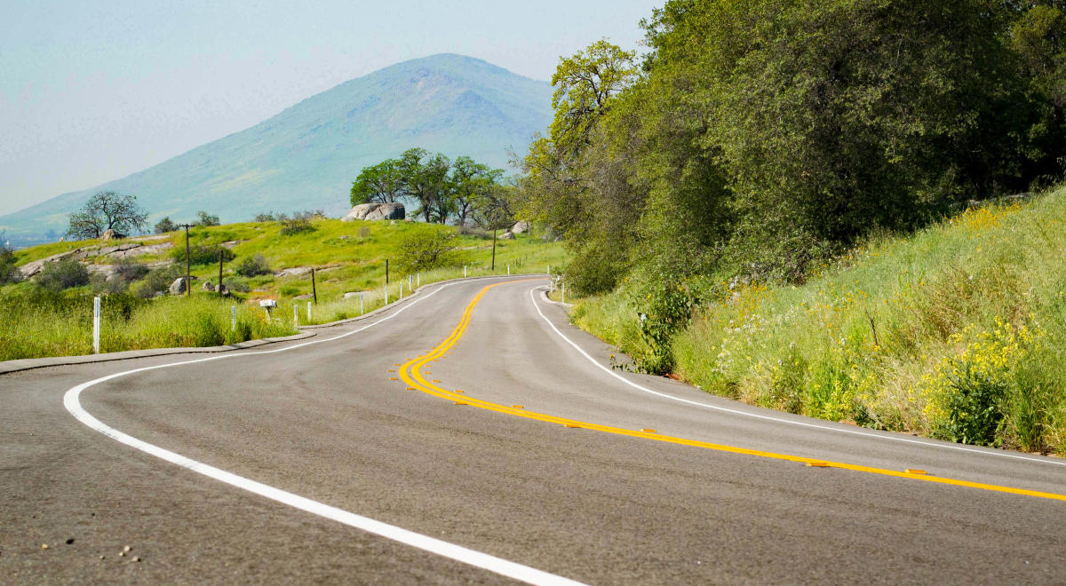
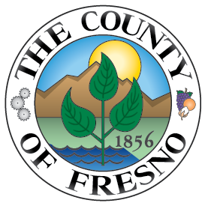


Safe Streets for All (SS4A) Action Plan
Virtual Community Workshop #2
April 22, 2026

Slide 2
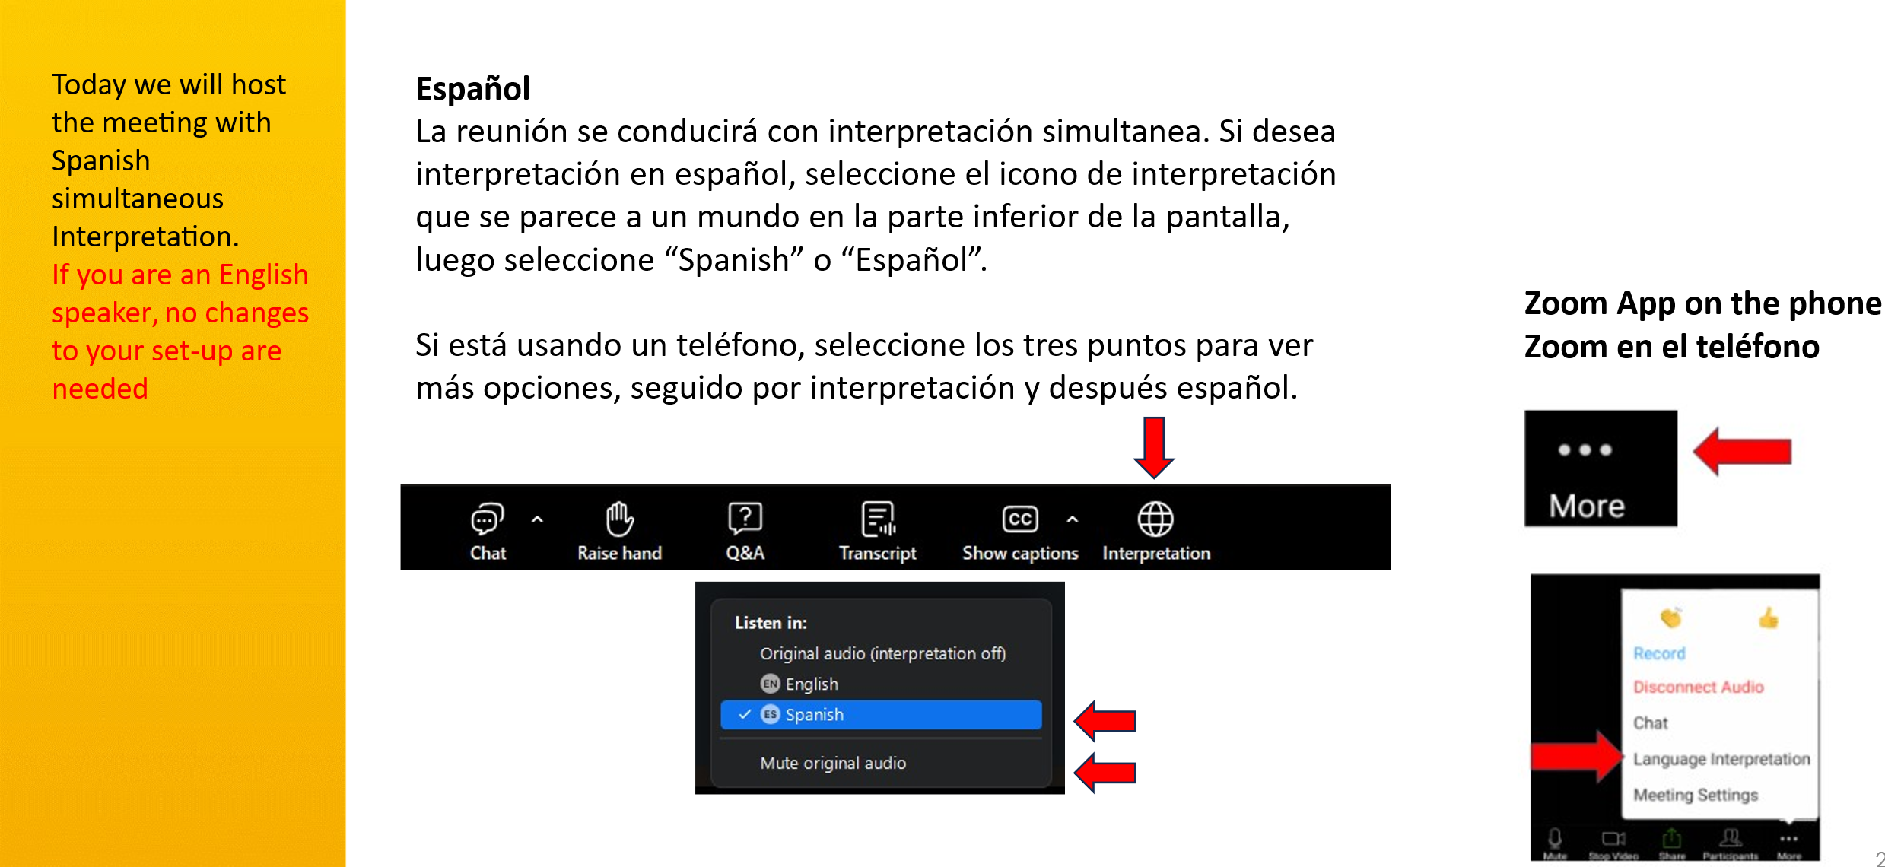
Audio

Slide 3
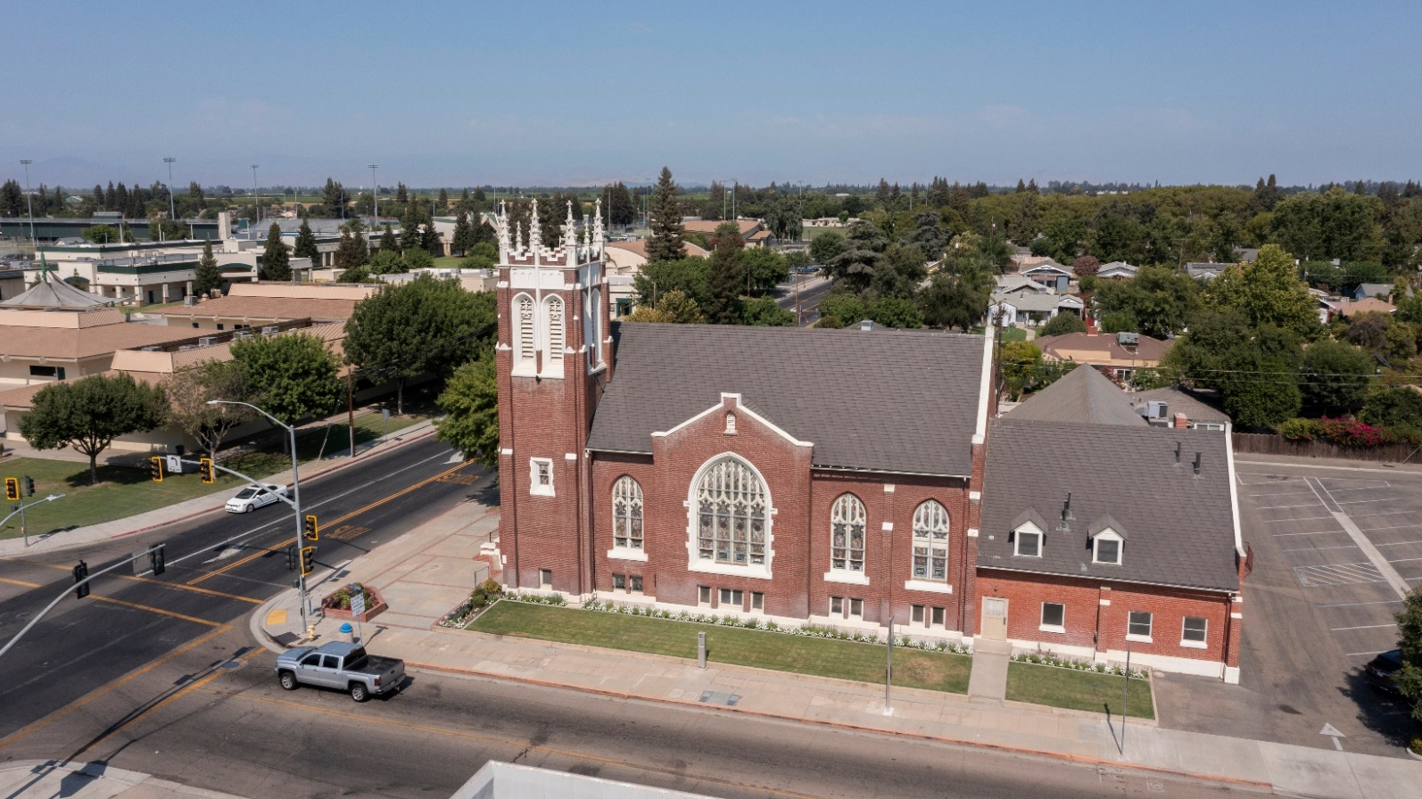
Agenda
Brief Recap
  Project Timeline
  Collision Analysis (Unincorporated County)
  High Injury Network (Unincorporated County)
  Collision Profiles (Unincorporated County)
Participating Cities
  High Injury Network
  Potential Safety Countermeasures
Community Survey Summary
Draft Safety Projects (Unincorporated County)
Discussion/Questions
Next Steps

Slide 4
Project Timeline
Stakeholder Input/
Community Input
Community Workshop #1: Oct 29, 2025
Pop-up Events
April 10th, 2025
Project Kick-off
Data Collection
(6 years –
2019 -2024)
Collision Trend Analysis
Identification of High-Risk Network
Develop Safety Countermeasures
Not limited to Caltrans Approved
Based on highest number of Fatal and Severe Injury collisions
Report
Action Plan
Integrate Plans & Prioritize Improvements
County Board Adoption
Stakeholder Input/
Community Input
You are here
Community Workshop #2: April 22, 2026

Slide 5
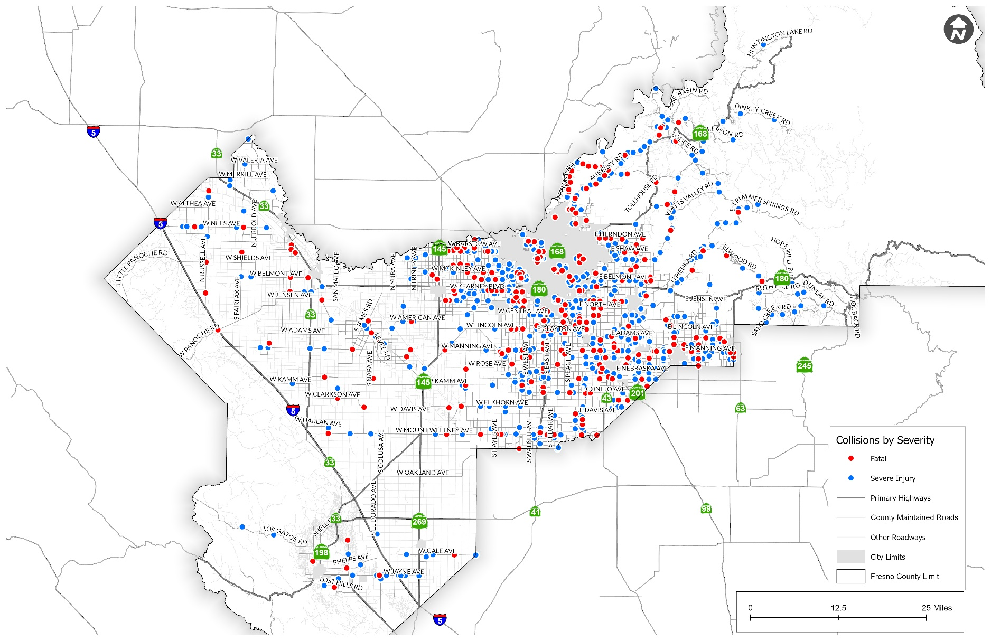
Unincorporated Fresno County
Collision Analysis Findings (2019– 2024)
1,095 KSI Collisions
Notes:
All Injury Collisions and KSI

Slide 6
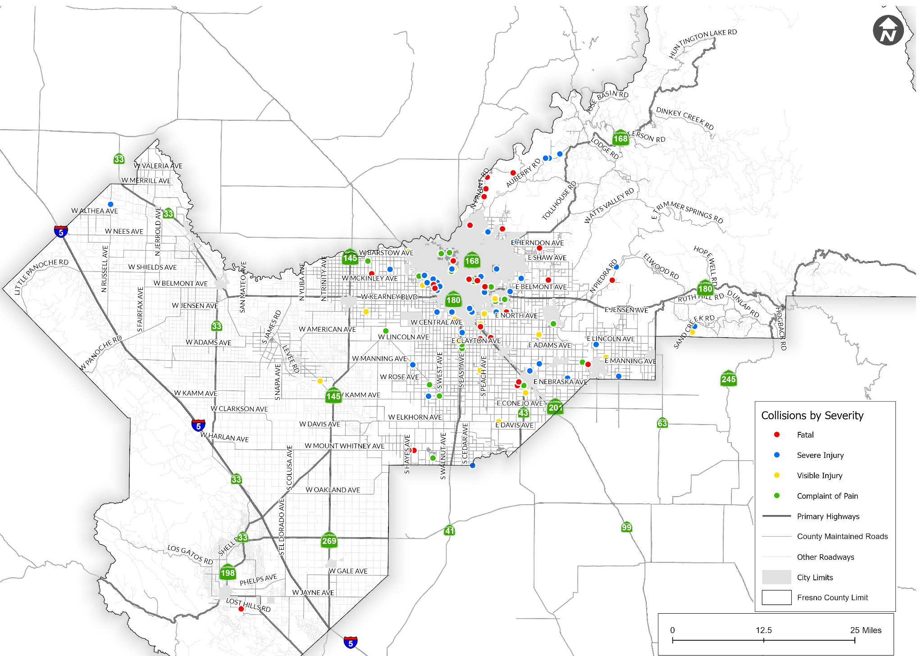
Unincorporated Fresno County - Pedestrian
70 KSI Collisions
Notes:
All Injury Collisions –Ped/Bike-Add

Slide 7
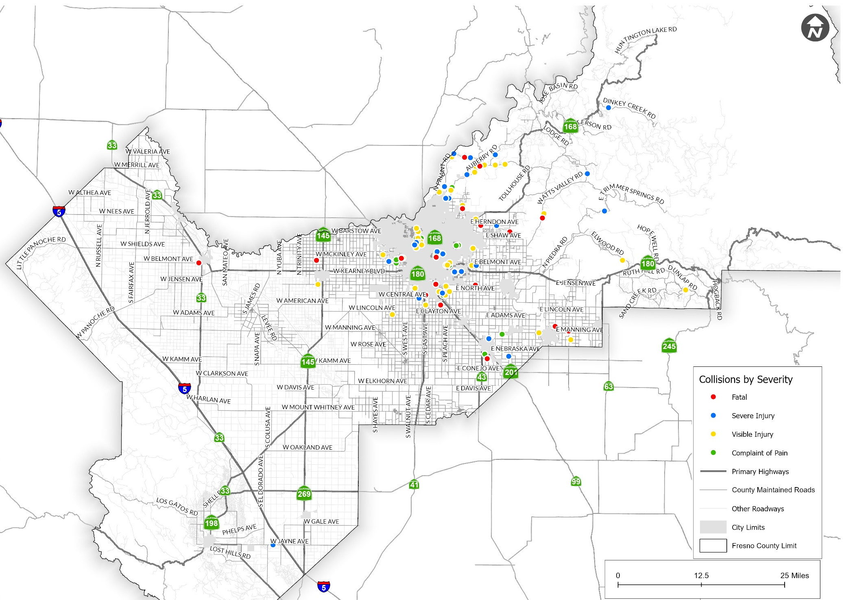
Unincorporated Fresno County - Bicycle
43 KSI Collisions
Notes:
All Injury Collisions –Ped/Bike-Add

Slide 8
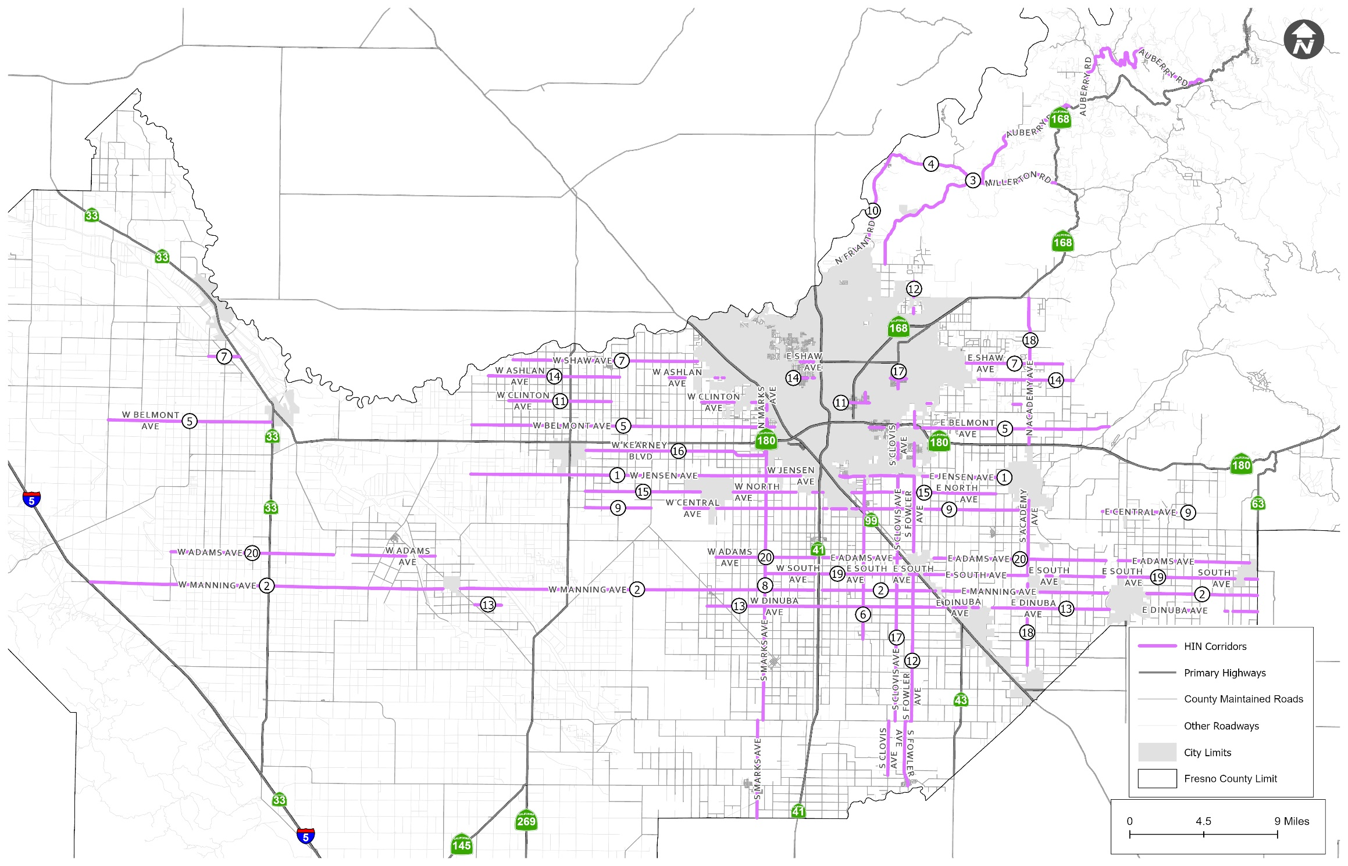
High-Injury Corridors (Unincorporated Fresno County)
HIN Rank | Corridor | KSI Collisions
1 | Jensen Avenue | 48
2 | Manning Avenue | 54
3 | Auberry Road | 40
4 | Millerton Road | 35
5 | Belmont Avenue | 27
6 | Chestnut Avenue | 17
7 | Shaw Avenue | 28
8 | Marks Avenue | 22
9 | Central Avenue | 21
10 | Friant Road | 17
11 | Clinton Avenue | 14
12 | Fowler Avenue | 22
13 | Dinuba Avenue | 22
14 | Ashlan Avenue | 19
15 | North Avenue | 22
16 | Kearney Boulevard | 26
17 | Clovis Avenue | 21
18 | Academy Avenue | 13
19 | South Avenue | 18
20 | Adams Avenue | 19
Notes:
Sliding window method:

Slide 9
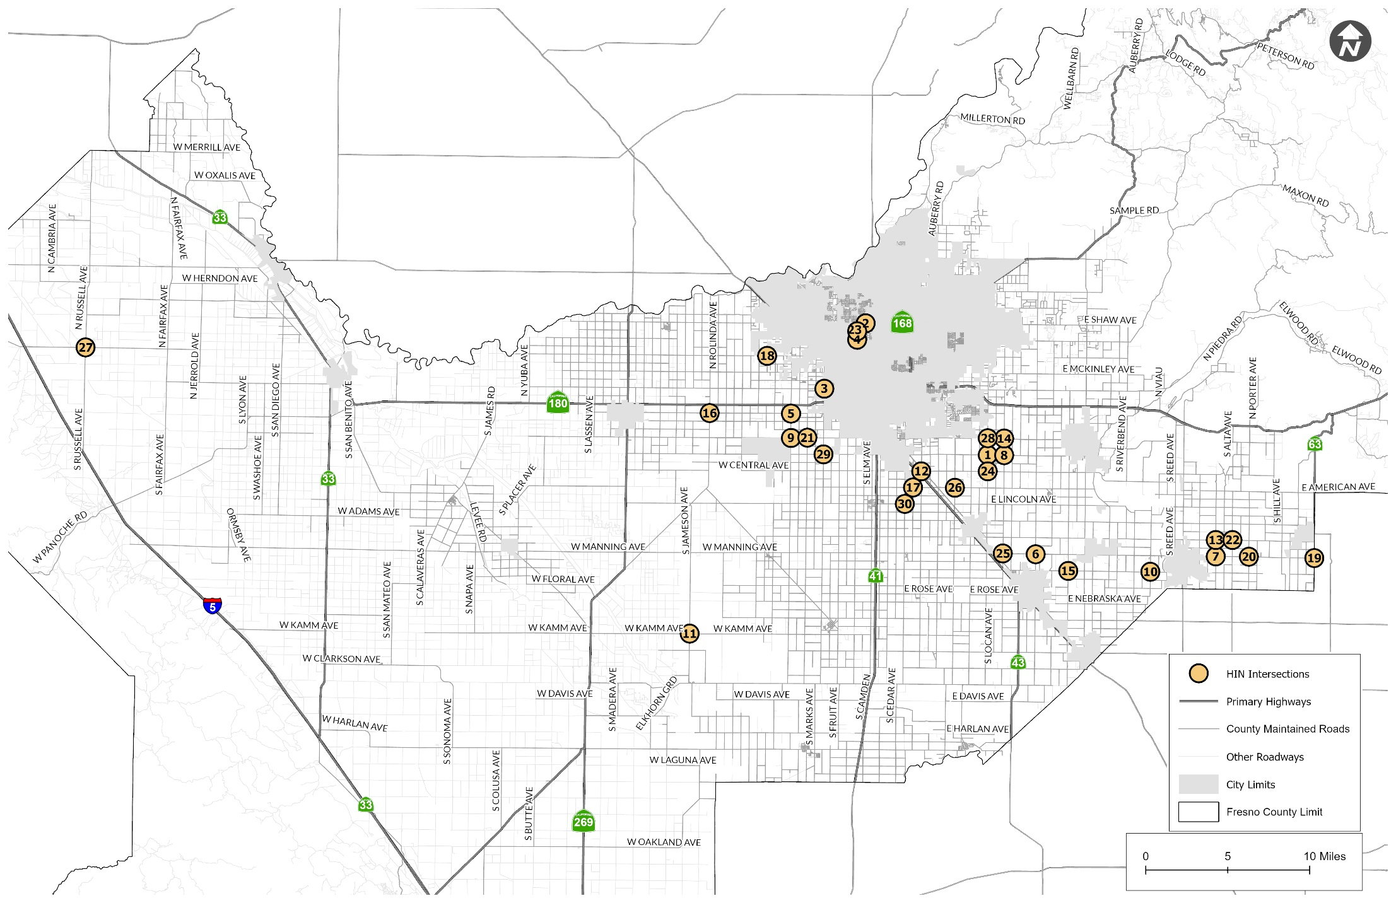
High-Injury Intersections (Unincorporated Fresno County) (1-15)
RANK | INTERSECTION NAME | KSI Collisions
1 | E North Avenue & S Temperance Avenue | 8
2 | E Dinuba Avenue & S Zediker Avenue | 5
3 | N Marks Ave & Belmont Ave | 5
4 | W Ashlan Avenue & N Palm Avenue | 4
5 | W Jensen Avenue & S Marks Avenue | 4
6 | E Rose Avenue & S Zediker Avenue | 4
7 | E North Avenue & De Wolf Avenue | 4
8 | W Jensen Avenue & S Cornelia Avenue | 4
9 | Manning Avenue & S Leonard Avenue | 4
10 | S Lac Jac Ave & E Dinuba Ave | 4
11 | S Jameson Ave & W Kamm Ave | 4
12 | E Central Avenue & S Chestnut Avenue | 3
13 | E Dinuba Avenue & S Mendocino Avenue | 3
14 | E Clinton Avenue & N Maple Avenue | 3
15 | W Kearney Blvd & S Dickenson Avenue | 3
Continued…
Notes:
Sliding window method:

Slide 10
High-Injury Intersections (Unincorporated Fresno County)(16-30)
RANK | INTERSECTION NAME | KSI Collisions
16 | E Jensen Avenue & De Wolf Avenue | 3
17 | Belmont Avenue & N Grantland Avenue | 3
18 | E Adams Avenue & Crawford Avenue | 3
19 | Manning Ave & S Hills Valley Rd | 3
20 | Manning Ave & Crawford Ave | 3
21 | S Brawley Ave & W Jensen Ave | 3
22 | S Alta Ave & E South Ave | 3
23 | E Gettysburg Ave & N Palm Ave | 3
24 | E Central Ave & S Temperance Ave | 3
25 | De Wolf Ave & Manning Ave | 3
26 | S Clovis Ave & E American Ave | 3
27 | N Ruscell Ave & W Shields Ave | 3
28 | E Jensen Ave & S Temperance Ave | 3
29 | W North Ave & S Marks Ave | 3
30 | E Lincoln Ave & S Cedar Ave | 3
Notes:
Sliding window method:

Slide 11
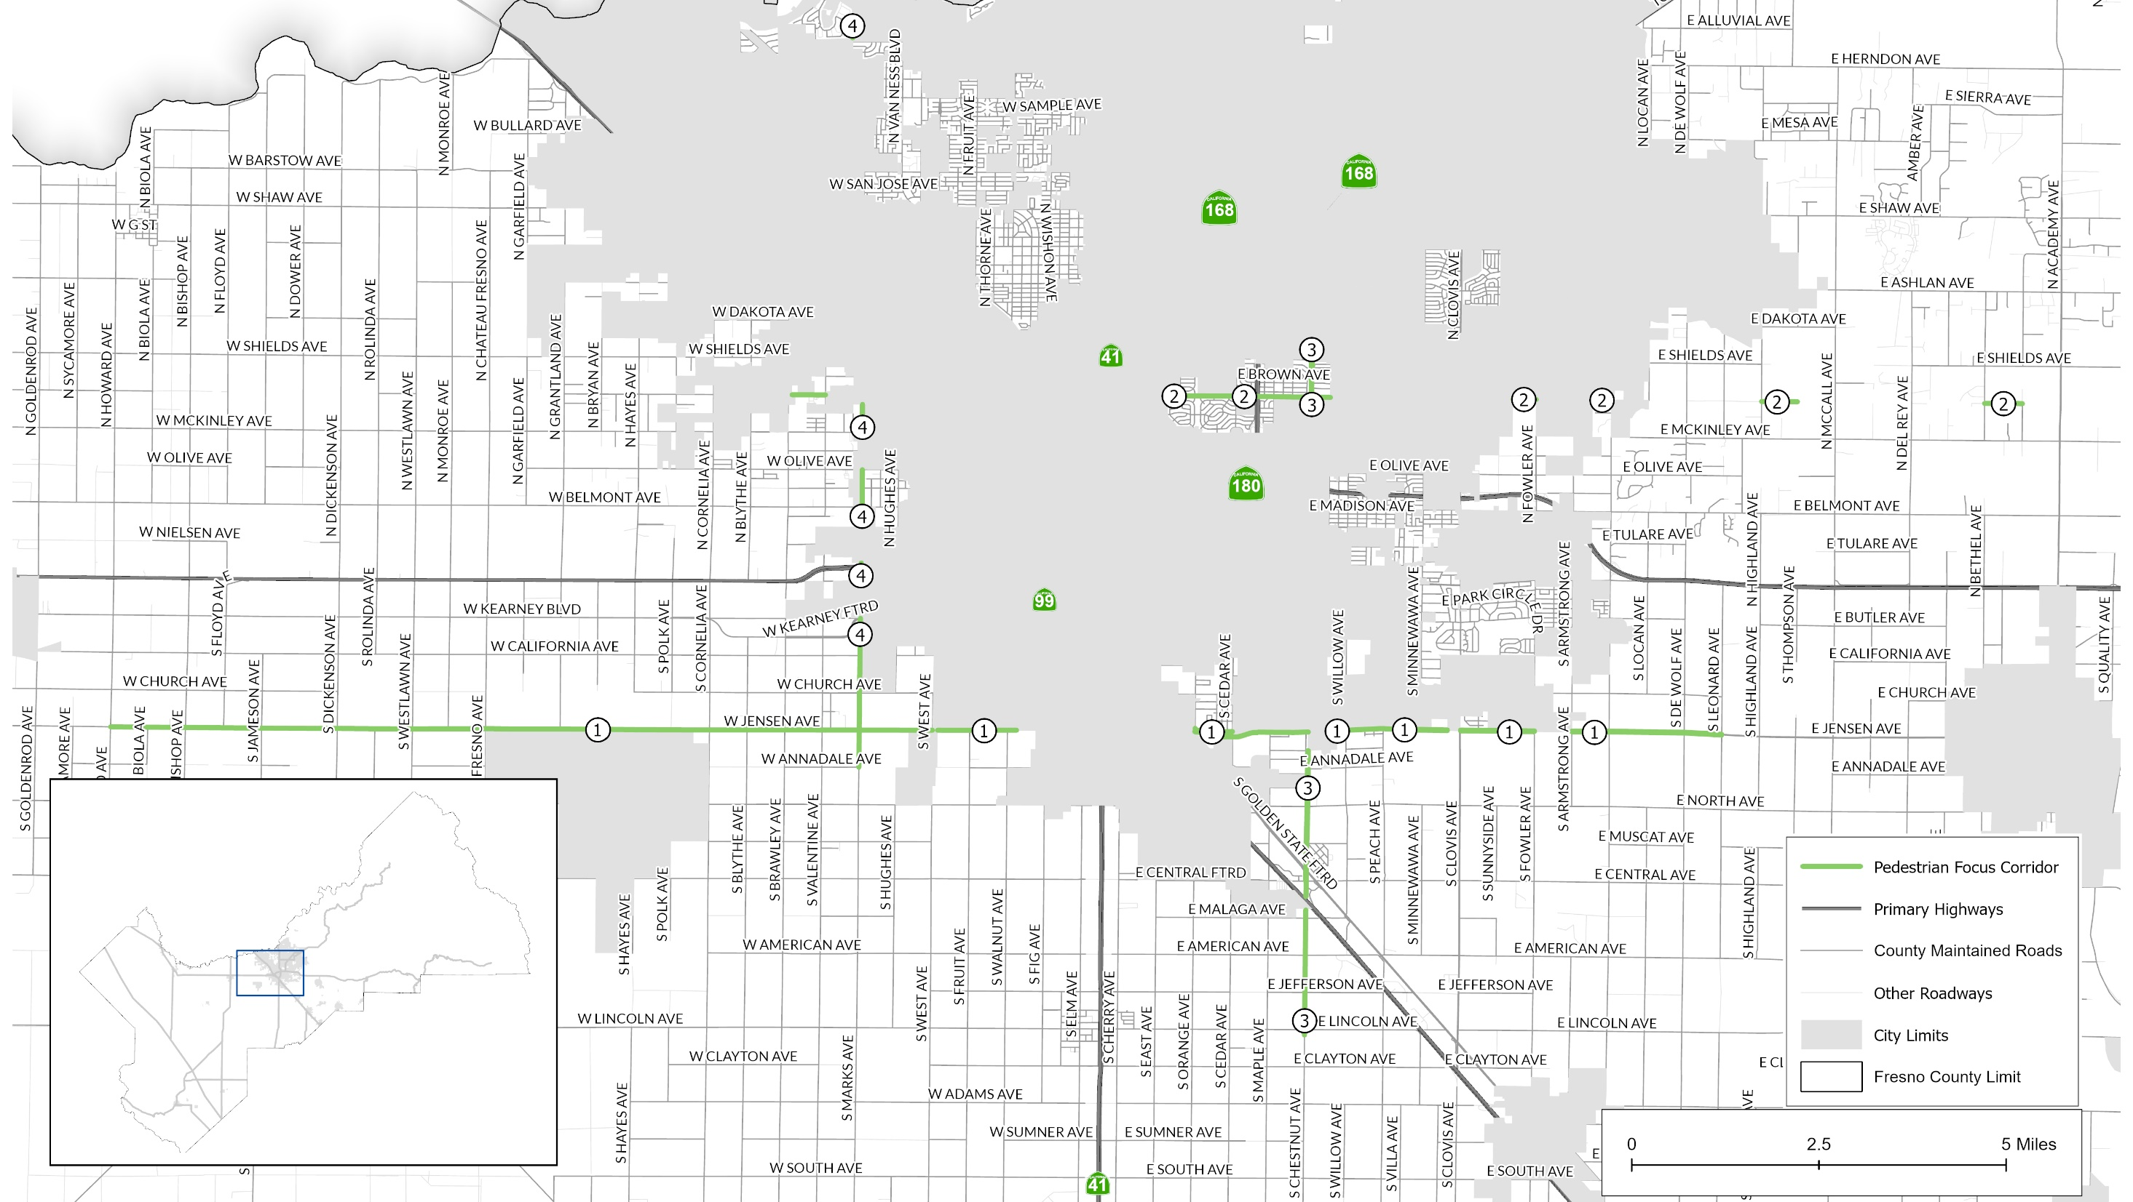
Pedestrian High Risk Corridors (Unincorporated Fresno County)
Rank | Corridor | KSI Collisions
1 | Jensen Avenue | 7
2 | Clinton Avenue | 4
3 | Chestnut Avenue | 3
4 | Marks Avenue | 2
Notes:
Sliding window method:

Slide 12
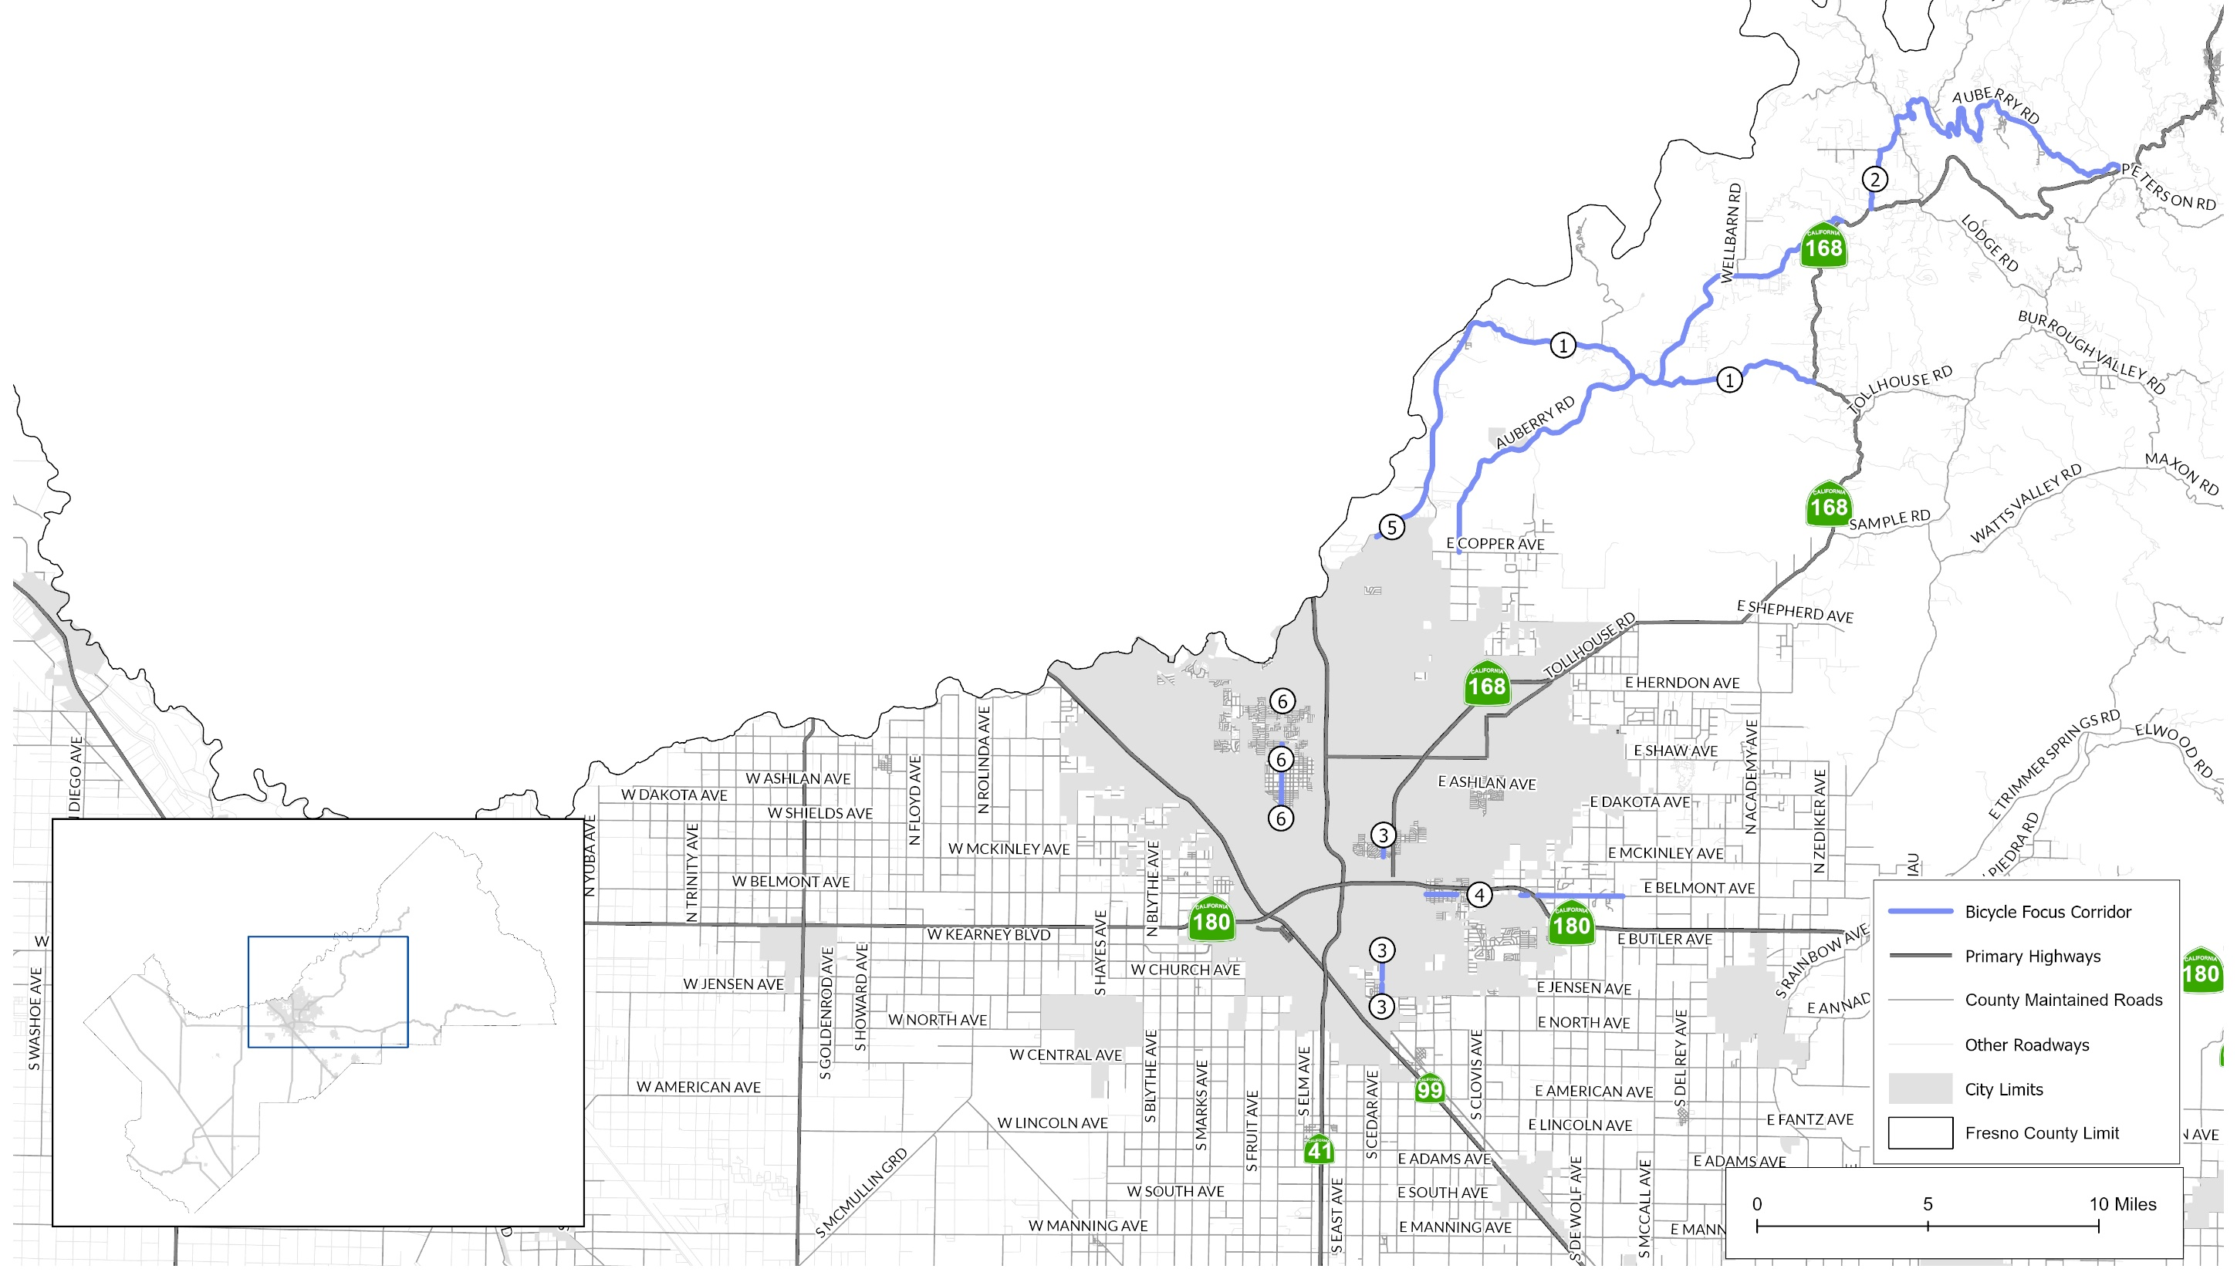
Bicycle High Risk Corridors (Unincorporated Fresno County)
Rank | Corridor | KSI Collisions
1 | Millerton Road | 4
2 | Auberry Road | 3
3 | Cedar Avenue | 3
4 | Belmont Avenue | 2
5 | Friant Road | 1
6 | Palm Avenue | 1
Notes:
Sliding window method:

Slide 13
Collision Profiles (Unincorporated Fresno County)
1. Intersection collisions
2. Improper turning collisions
3. DUI collisions
4. Unsafe speed collisions
5. Broadside collisions
6. Hit object collisions
7. Nighttime collisions
8. Motorcycle collisions
9. Pedestrian collisions
10. Bicycle collisions
11. School area collisions (within ¼ mile)
12. Collisions involving Age Group (20-29)
Notes:
Sliding window method:

Slide 14

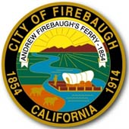

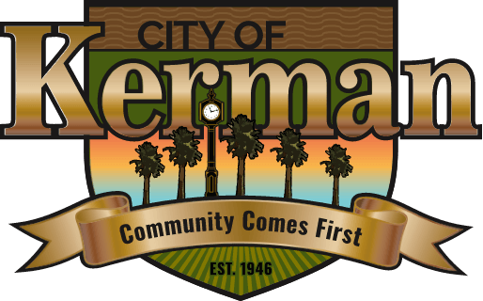


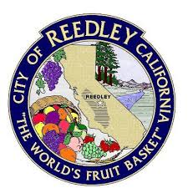
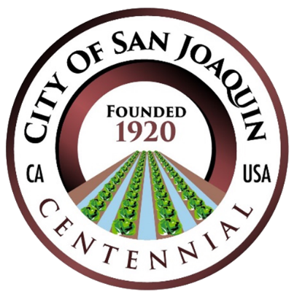

SS4A Action Plan Participating Cities
Coalinga
Firebaugh
Kerman
Kingsburg
Mendota
Orange Cove
Reedley
San Joaquin
Selma
Notes:
Sliding window method:

Slide 15
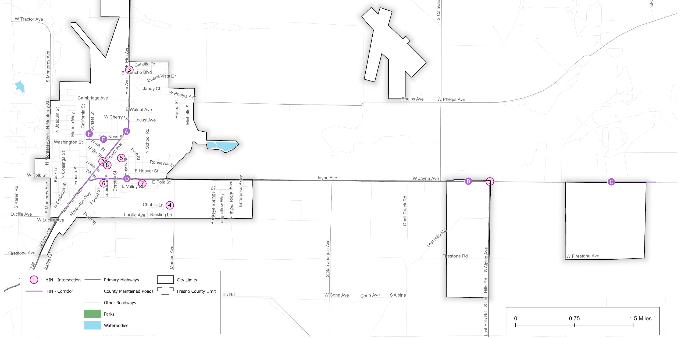
Coalinga High-Injury Network
Notes:
All Injury Collisions and KSI

Slide 16
Coalinga – Potential Safety Countermeasures
HIN Rank | HIN Corridor | Potential Countermeasures | Right of Way
A | Elm Ave: Pacific St to Cherry Ln | - Install chevron signs on horizontal curves between Van Ness and Cherry Ln - Install Speed safety cameras | Caltrans
B | W Jayne Ave (State Hwy 33): Calaveras Ave to Alphine Ave | - Install Edgeline rumble strips - Install raised median at intersection approaches - Add segment lighting | Caltrans
C | W Jayne Ave: Pleasant Valley State Prison Entrance to 500’ East of Department of State Hospital Entrance | - Install Edgeline rumble strips | County
D | E Polk Ave (State Hwy 33): Elm Ave to Garfield St | - Add segment lighting - Pavement Resurfacing - Upgrade to High Visibility Crosswalks (Polk St & Forest Ave) | Caltrans
E | Van Ness St: Elm Ave to Sunset St | - Add segment lighting - Pavement Resurfacing - Pavement Marking and Striping - Install Rectangular Rapid Flashing Beacon (RRFB) (Van Ness St & Sunset St) - Improve Sight Distance to intersection (Clear Sight Triangles) (Van Ness and Elm Ave) | City
F | Sunset St: Van Ness St to Cambridge Ave | - Add segment lighting - Pavement Resurfacing - Upgrade Pavement Marking and Striping - Install Center Yellow Line | City
HIN Rank | HIN Intersection | Potential Countermeasures | Right of Way
1 | W Jayne Ave & S Alpine Ave | - Upgrade intersection pavement markings - Add left turn pocket for WB traffic - Add intersection lighting - Install 'Two Direction Large Arrow' sign for T-intersection - Install raised medians on approaches | Caltrans
2 | Elm Ave & 5th St | - Install signals (subject to warrant study) - Install pedestrian countdown signals with LPI | City
3 | Elm Ave & El Rancho Blvd | - Install raised median on approaches - Upgrade intersection pavement markings - Install 'Two Direction Large Arrow' sign for T-intersection | City
4 | Burgundy Way & Chardonnay Ln | - Add stop sign and stop bar | City
5 | E Glenn Ave & S 3rd St | - Install pedestrian crossings at uncontrolled locations (new signs and markings only) | City
6 | E Valley St & Louisiana St | - Add stop sign and stop bar - No street parking near intersection approaches | City
7 | E Valley St & S Hachman St | - Add stop sign and stop bar - Install pavement markings with delineation | City
8 | 5th St & Forest Ave | - Upgrade intersection pavement markings - Pavement Resurfacing - Install/upgrade larger or additional stop signs or other intersection warning/regulatory signs | City
Notes:
All Injury Collisions and KSI

Slide 17
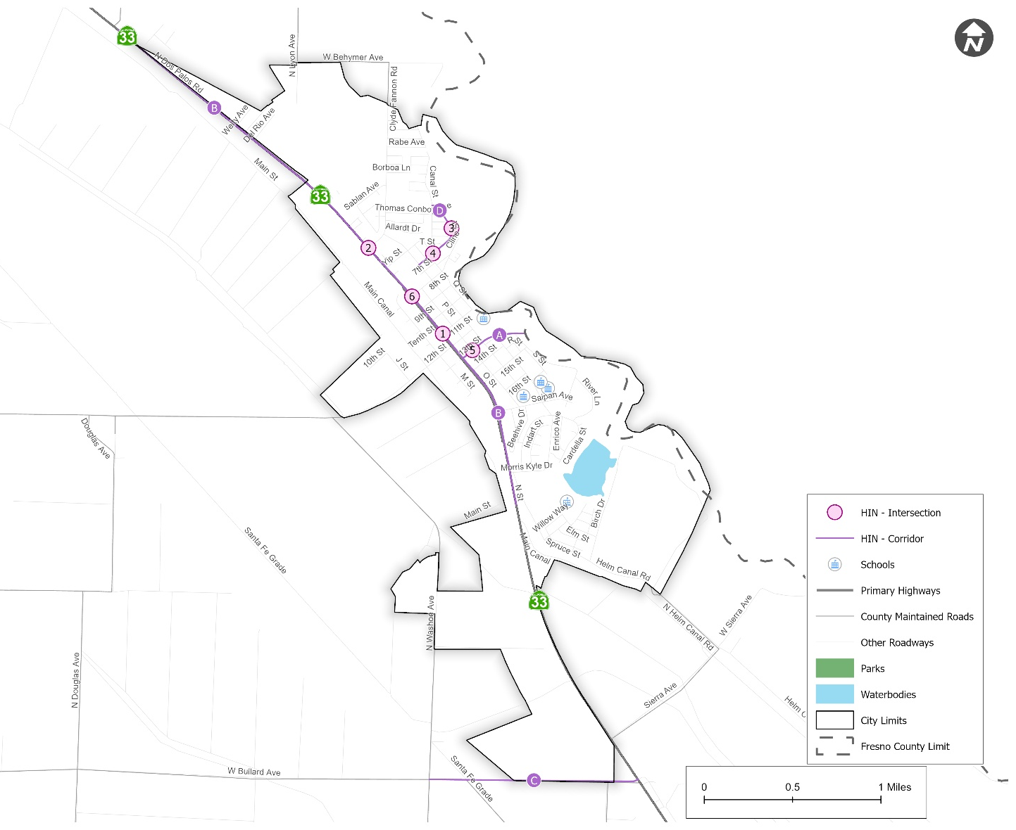
Firebaugh High-Injury Network
Notes:
All Injury Collisions and KSI

Slide 18
Firebaugh – Potential Safety Countermeasures
HIN Rank | HIN Intersection | Potential Countermeasures | Right of Way
1 | State Hwy 33 & 11th St | - Upgrade intersection pavement markings - Install edge-lines and centerlines on 11th St - Pavement resurfacing - Install high visibility crosswalk (to provide safe crossing for bus stops and supermarket/retail) - Install/upgrade larger or additional stop signs or other intersection warning/regulatory signs | Caltrans
2 | State Hwy 33 & Clyde Fannon Dr | - Upgrade intersection pavement markings on Clyde Fannon Dr - Install/upgrade larger or additional stop signs or other intersection warning/regulatory signs - Install left turn lane on SH 33 - Install raised medians on approaches | Caltrans
3 | Cline St & Mendoza Dr | - Install edge-lines and centerlines - No street parking near intersection approaches - Improve sight distance to intersection (Clear Sight Triangles) - Install curve advisory speed sign on Cline St | City
4 | Cline St & R St | - Install edge-lines and centerlines - No street parking near intersection approaches - Install stop sign on R St - Improve sight distance to intersection (Clear Sight Triangles) | City
5 | 13th St & O St | - Upgrade intersection pavement markings - Pavement resurfacing - Install/upgrade larger or additional stop signs or other intersection warning/regulatory signs - Install raised medians on approaches - Add all way stop sign on all intersection median for better visibility | City
6 | State Hwy 33 & 8th St | - No street parking near intersection approaches - Install/upgrade larger or additional stop signs or other intersection warning/regulatory signs | Caltrans
HIN Rank | HIN Corridor | Potential Countermeasures | Right of Way
A | 13th St: N St to East City limit | - Upgrade pavement marking and striping - Pavement resurfacing - Install/upgrade larger or additional stop signs or other intersection warning/regulatory signs - Improve signal hardware: lenses, back-plates with retroreflective borders, mounting, size, and number (N St & 13th St) - Install Edgeline rumble strips (from San Joaquin river bridge to East City limit) - Install delineators and object markers - Add segment lighting | City
B | N St (State Hwy 33): N Douglas Ave to Main Canal Rd | - Upgrade pavement marking and striping - Pavement resurfacing - Install delineators and object markers - Install Speed feedback sign | Caltrans
C | Bullard Ave: N Washoe Ave to State Route 33 | - Install edge-lines and centerlines - Install edgeline rumble stripes - Add segment lighting - Install shoulder | City/County
D | Cline St: P St to Canal St | - Install edge-lines and centerlines - No street parking near intersection approaches - Install curve warning sign with advisory speed | City
Notes:
All Injury Collisions and KSI

Slide 19
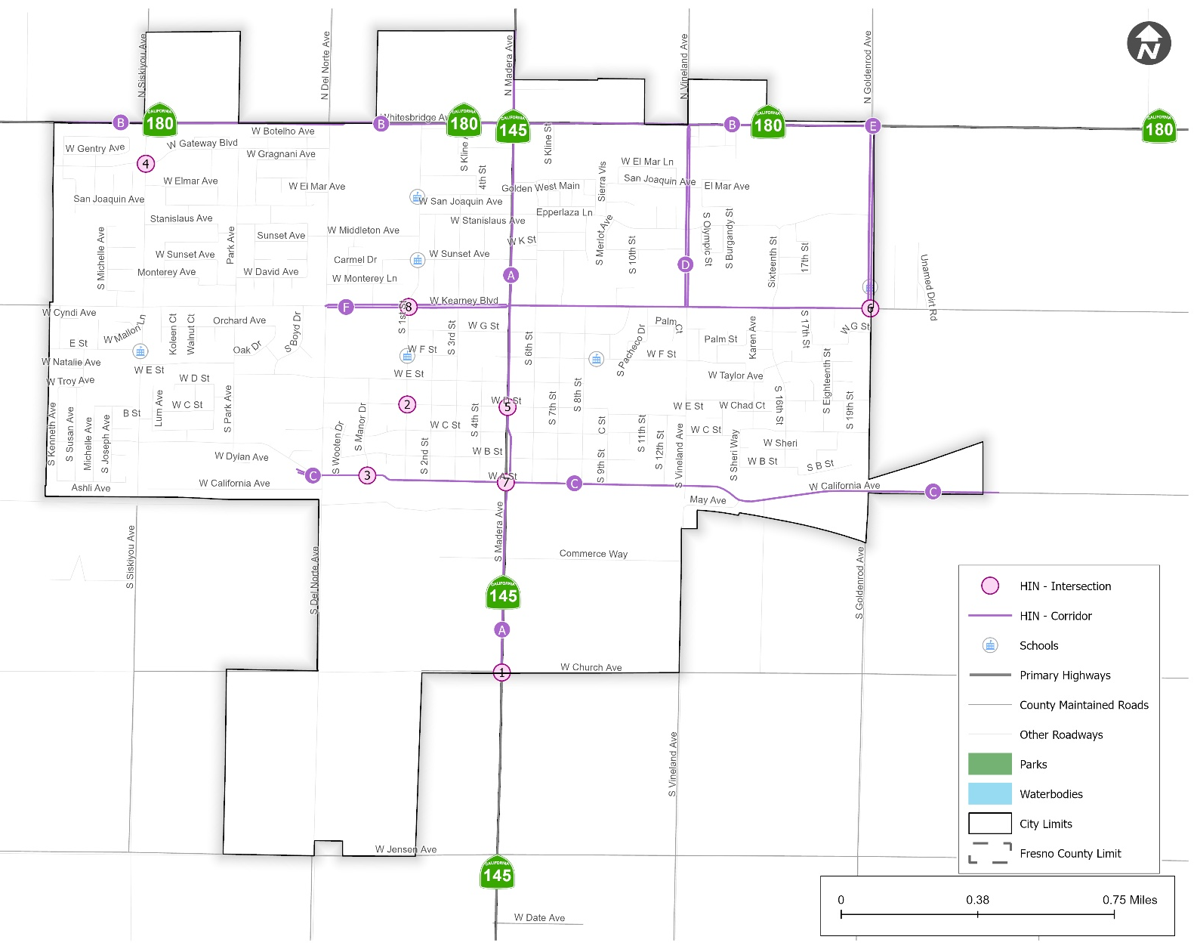
Kerman High-Injury Network
Notes:
All Injury Collisions and KSI

Slide 20
Kerman – Potential Safety Countermeasures
HIN Rank | HIN Corridor | Potential Countermeasures | Right of Way
A | Madera Ave (State Hwy 145): Church Ave to North City Limit | - Upgrade pavement marking and striping - Pavement resurfacing - Install/upgrade larger or additional stop signs or other intersection warning/regulatory signs | Caltrans
B | Whitebridge Ave (State Hwy 180): West City limit to Goldenrod Ave | - Install Speed Feedback signs - Install/upgrade larger or additional stop signs or other intersection warning/regulatory signs - - Improve signal hardware: lenses, back-plates with retroreflective borders, mounting, size, and number (Whitesbridge Ave & Madera Ave, Whitesbridge Ave & Goldenrod Ave) - Install raised medians (Del Norte to 1st St) | Caltrans
C | California Ave: Del Norte Ave to East City limit | - Install chevron signs on horizontal curves between Manor Dr and 1st St - Upgrade pavement marking and striping (California Av & Madera Av) - Upgrade edgelines and centerlines - Class I Shared-use Path (Madera Ave to Goldenrod Ave) | City
D | Vineland Ave: Whitesbridge Ave to Kearney Blvd | - Pavement resurfacing - Upgrade pavement markings and striping including bike lane striping | City
E | Goldenrod Ave: Whitesbridge Ave to Kearney Blvd | - Pavement resurfacing - Upgrade pavement markings and striping - Upgrade to High-Visibility Crosswalk (Goldenrod Ave & Stanislaus Ave- school crossing) | City
F | Kearney Blvd: Del Norte Ave to Goldenrod Ave | - Restripe the bike lane - Upgrade edgelines and centerlines - Upgrade the crosswalks markings (faded stripes) - Install/upgrade larger or additional stop signs or other intersection warning/regulatory signs - Improve pavement friction (High Friction Surface Treatments) | City
HIN Rank | HIN Intersection | Potential Countermeasures | Right of Way
1 | State Hwy 145 & W Church Ave | - Upgrade intersection pavement markings - Install/upgrade larger or additional stop signs or other intersection warning/regulatory signs - Add transverse rumble strips on SH-145 - Install double-arrow sign at T-intersection facing eastbound traffic - Improve sight distance to intersection (Clear Sight Triangles) | Caltrans
2 | S 1st St & W D St | - Upgrade intersection pavement markings - No street parking near intersection approaches - Install/upgrade larger or additional stop signs or other intersection warning/regulatory signs - Install pedestrian crossing at uncontrolled locations (new signs and markings only) | City
3 | S Manor Dr & W A St | - Install raised medians on approaches - Improve sight distance to intersection (Clear Sight Triangles) - No street parking near intersection approaches | City
4 | S Siskiyou Ave & W Gateway Blvd | - Install High visibility crosswalks - Install RRFB - Install raised median on approaches of Siskiyou Ave | City
5 | State Hwy 145 & W D St | - Upgrade intersection pavement markings - Install/upgrade larger or additional stop signs or other intersection warning/regulatory signs | Caltrans
6 | S Goldenrod Ave & W Kearney Blvd | - Upgrade intersection pavement markings - Pavement resurfacing - Install raised median on approaches - Advance stop bar on approaches with crossing - Install signals (subject to warrant study) | City
7 | State Hwy 145 & W California Ave | - Convert intersection to Roundabout - Upgrade intersection pavement markings - No street parking near intersection approaches | Caltrans
8 | S 1st St & W Kearney Blvd | - Upgrade intersection pavement markings - Install/upgrade larger or additional stop signs or other intersection warning/regulatory signs - Add intersection lighting - Install Advance stop bar on approaches | City
Notes:
All Injury Collisions and KSI

Slide 21
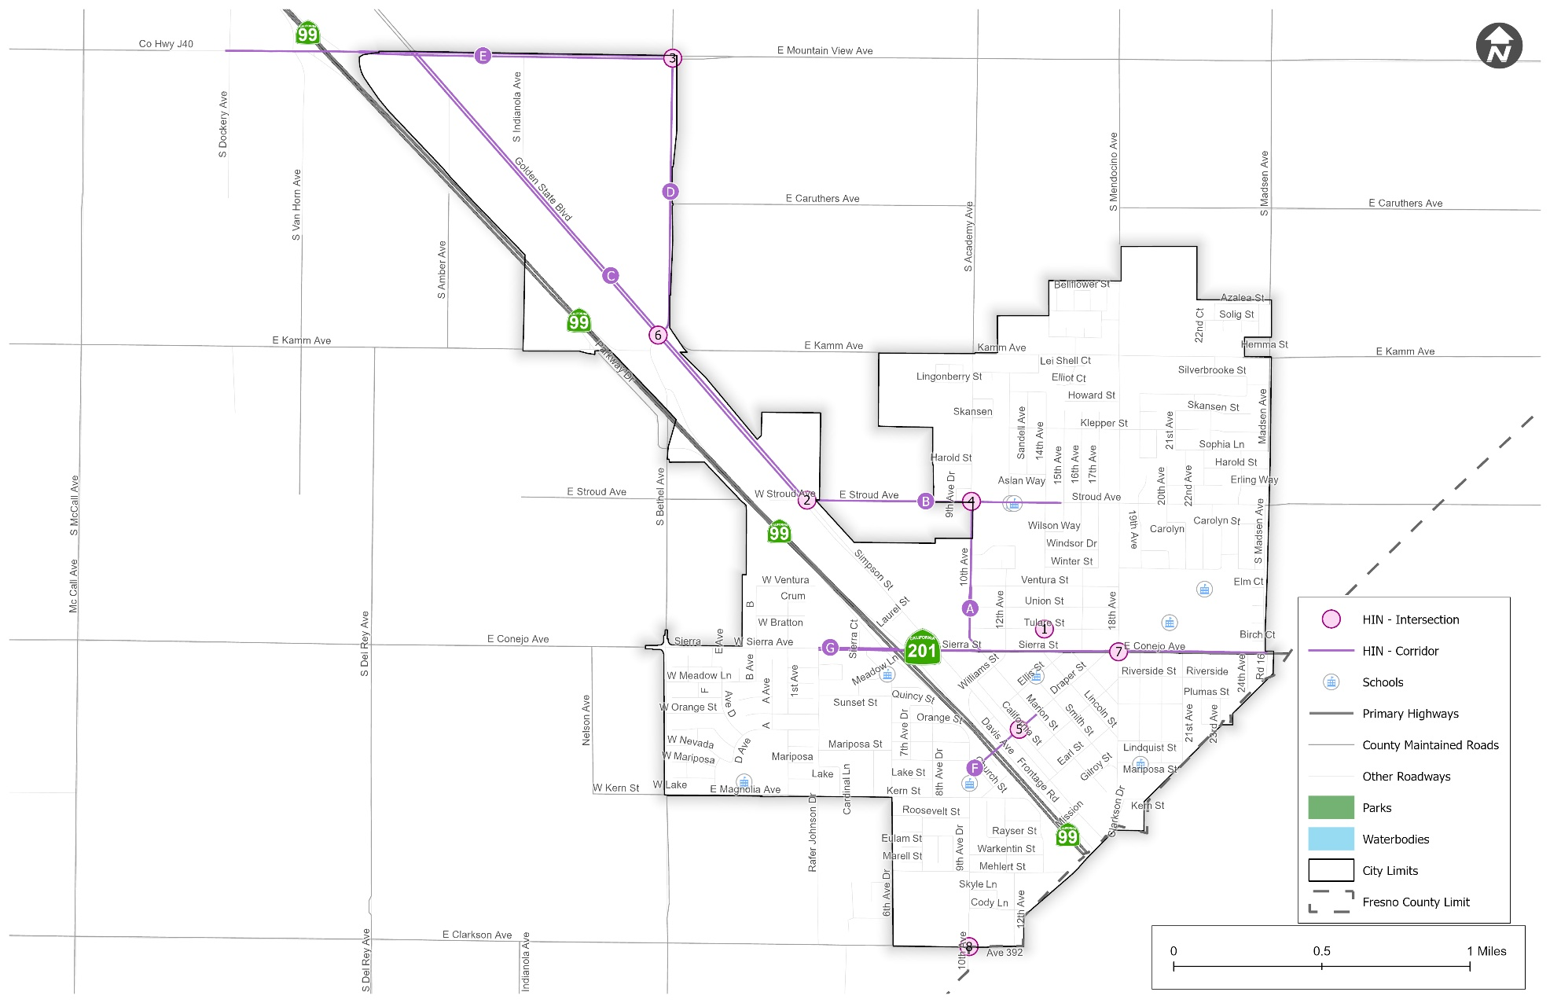
Kingsburg High-Injury Network
Notes:
All Injury Collisions and KSI

Slide 22
Kingsburg – Potential Safety Countermeasures
HIN Rank | HIN Intersections | Potential Countermeasures | Right of Way
1 | 14th Ave & Tulare St | - Convert to all-way STOP control (subject to warrant study) - Install/upgrade larger or additional stop signs or other intersection warning/regulatory signs - No street parking near intersection approaches - Improve sight distance to intersection (Clear Sight Triangles) | City
2 | E Stroud Ave & Golden State Blvd | - Install signals (subject to warrant study) - Upgrade pavement marking and striping - Pavement resurfacing - Install/upgrade larger or additional stop signs - Upgrade intersection lighting - Install delineators and object markers | Caltrans
3 | E Mountain View Ave & S Bethel Ave | - Improve signal hardware: lenses, back-plates with retroreflective borders - Install delineators and object markers - Install median on major approaches - Install intersection left turn guidelines - Install Flashing Beacons at Stop-Controlled Intersections | City
4 | 10th Ave & E Stroud Ave | - Install raised median on approaches - Install/upgrade larger or additional stop signs - Pavement resurfacing - Convert intersection to mini-roundabout (subject to traffic study) | City
5 | California St & Draper St | - Upgrade to High-visibility crosswalk - Pavement resurfacing | City
6 | Golden State Blvd & S Bethel Ave | - Install signals (subject to warrant study) - Upgrade pavement marking and striping - Pavement resurfacing near railroad grade crossing | Caltrans
7 | 18th Ave & E Sierra St (State Hwy 201) | - Upgrade to high-visibility crosswalk - Install advanced stop bar before crosswalk - Reduce curb radii for traffic calming (north intersection leg) - Install raised median on approaches - Modify signal phasing to implement a Leading Pedestrian Interval (LPI) | Caltrans
8 | 10th Ave & E Clarkson Ave | - Upgrade pavement markings and striping - Pavement resurfacing - Install/upgrade larger or additional stop signs or other intersection warning/regulatory signs - Install transverse rumble stripes on 10th Ave | City
HIN Rank | HIN Corridor | Potential Countermeasures | Right of Way
A | 10th Ave: E Sierra St to Stroud Ave | - Modify signal phasing to implement a Leading Pedestrian Interval (LPI) (10th Ave & Sierra St) - Install chevron signs on horizontal curve near Sierra St - Install edgelines - Install delineators and object markers - Install raised median | City
B | Stroud Ave: Simpson St to 15th St | - Pavement resurfacing - Upgrade Pavement Marking & Striping - Install RRFB (Stroud Ave & 12th Ave; Stroud Ave & 14th St- school crossing) - Install/upgrade larger or additional stop signs or other intersection warning/regulatory signs (Stroud Ave & 15th Ave) - Install edgelines and shoulders (between Simson St and 10th St) | City
C | Golden State Blvd: Stroud Ave to E Mountain View Ave | - Install radar speed feedback signs - Remove or relocate fixed objects outside of Clear Recovery Zone | Caltrans
D | Bethel Ave: E Mountain View Ave to Golden State Blvd | - Upgrade pavement markings and striping - Pavement resurfacing - Install edgelines - Install edgelines rumble stripes - Install shoulders - Install chevron signs on horizontal curve - Add segment lighting - Remove or relocate fixed objects outside of Clear Recovery Zone | City
E | E Mountain View Ave: S Dockery Ave to S Bethal Ave | - Improve pavement friction (High Friction Surface Treatments) - Install radar speed feedback signs - Enforcement for overspeeding - Advance intersection warning signs | City
F | Draper St: 10th Ave to Marion St | - Back-in angle parking conversion - Install Traffic Calming measures | City
G | Sierra St (State Hwy 201): Madsen Ave to Rafer Johnson Dr | - Improve pavement friction (High Friction Surface Treatments) - Enforcement for overspeeding - Install raised medians on approaches - Remove or relocate fixed objects outside of Clear Recovery Zone | Caltrans
Notes:
All Injury Collisions and KSI

Slide 23
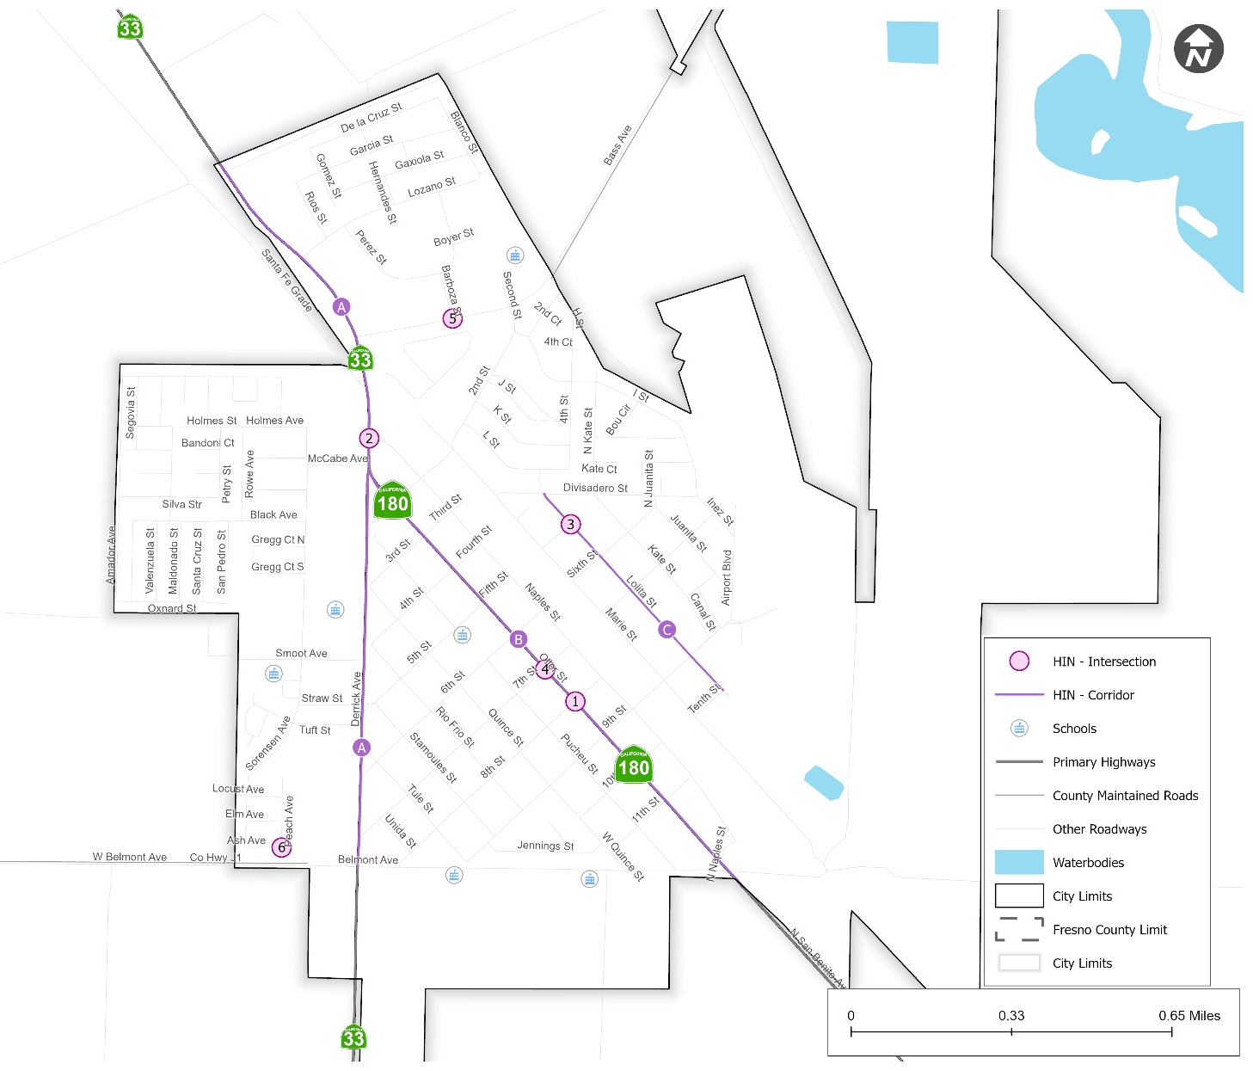
Mendota High-Injury Network
Notes:
All Injury Collisions and KSI

Slide 24
Mendota – Potential Safety Countermeasures
HIN Rank | HIN Corridor | Potential Countermeasures | Right of Way
A | Derrick Ave (State Hwy 33): North City Limit to Belmont Ave | - Upgrade pavement marking & striping including bike lane striping - Install Rectangular Rapid Flashing Beacon (RRFB) (Derrick Ave & 6th St) - Pavement resurfacing - Install raised medians at intersection approaches - Install delineators and object markers | Caltrans
B | Oller St (State Hwy 180): Derrick Ave to South City Limit | - Upgrade pavement marking & striping including bike lane striping - Install Rectangular Rapid Flashing Beacon (RRFB) (Oller St & 5th St, Oller St & 7th St) - Pavement resurfacing - Install raised medians at approaches - Install delineators and object markers | Caltrans
C | Lolita St: Divisadero St to Tenth St | - Upgrade pavement marking & striping - Pavement resurfacing - No street parking near intersection approaches - Install delineators and object markers | City
HIN Rank | HIN Intersection | Potential Countermeasures | Right of Way
1 | Oller St (State Hwy 180) & 8th St | - Install high visibility crosswalk across Oller St - Install Rectangular Rapid Flashing Beacon (RRFB) - Upgrade pavement marking and striping - Install/upgrade larger or additional stop signs or other intersection warning/regulatory signs - Install raised medians on approaches on Oller St | Caltrans
2 | Derrick Ave (State Hwy 33) & Naples St | - Install stop bar and centerline on Naples St - Upgrade the signage to retroreflective signs - Install raised medians at approaches on Derrick Ave - Install left turn lane on Derrick Ave - Pavement resurfacing on Naples St | Caltrans
3 | 5th St & Lolita St | - Install intersection pavement marking - Install edgelines and centerlines - Upgrade the signage to retroreflective signs - Pavement resurfacing - Install intersection lighting - Install pedestrian crossing at uncontrolled locations (new signs and markings only) | City
4 | Oller St (State Hwy 180) & 7th St | - Install signals or convert to all way stop control (subject to warrant study) | Caltrans
5 | Barboza St & Bass Ave | - Roundabout education in the community | City
6 | Ash Ave & Peach Ave | - No street parking near intersections approaches - Add speed humps and bulb outs for traffic calming - Install centerlines | City
Notes:
All Injury Collisions and KSI

Slide 25
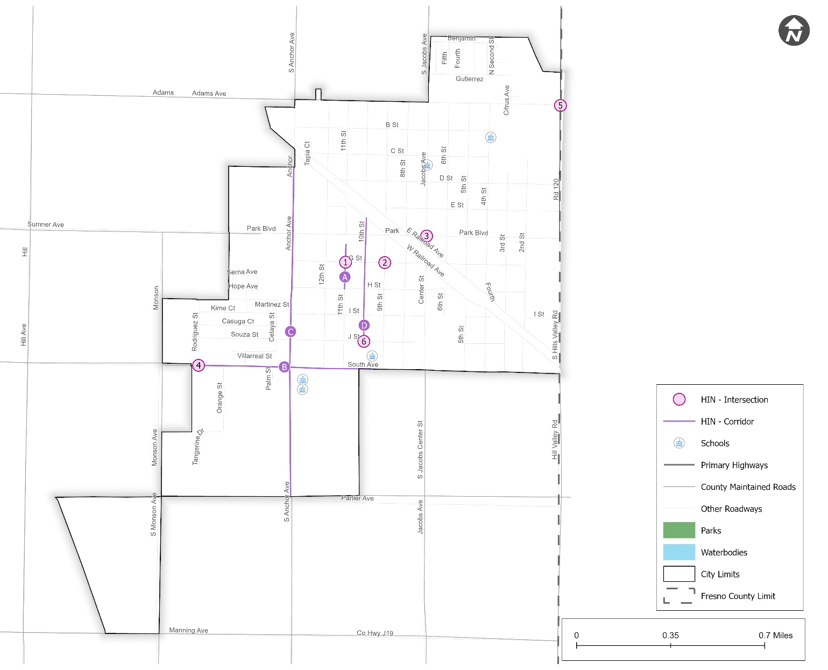
Orange Cove High-Injury Network
Notes:
All Injury Collisions and KSI

Slide 26
Orange Cove – Potential Safety Countermeasures
HIN Rank | HIN Intersection | Potential Countermeasures | Right of Way
1 | 11th St & G St | - Install a stop sign with stop bar - Install pedestrian crossing at uncontrolled locations (new signs and markings only) - Install sidewalk - Pavement resurfacing - Install edge-lines and centerlines | City
2 | 9th St & G St | - Install a stop sign with stop bar - Install pedestrian crossing at uncontrolled locations (new signs and markings only) - Install sidewalk - Install edge-lines and centerlines | City
3 | Center St & Jacobs Ave & Park Blvd | - Install signals (subject to warrant study) - Install Bulbouts - Upgrade to High-Visibility crosswalk with advance stop bar - No street parking near intersections approaches - Upgrade intersection pavement markings | City
4 | Rodriguez St & South Ave | - Upgrade intersection pavement markings - Improve sight distance to intersection (Clear Sight Triangles) - No street parking near intersections approaches | City
5 | Adams Ave & S Hills Valley Rd & State Hwy 63 | - Install/upgrade larger or additional stop signs or other intersection warning/regulatory signs - Upgrade intersection pavement markings - Pavement resurfacing - Convert to all-way STOP control (warrant study needed) | Caltrans
6 | 10th St & J St | - Pavement resurfacing - Install intersection pavement markings - Improve sight distance to intersection (Clear Sight Triangles) - No street parking near intersection approaches - Remove ADA curd ramp (there is no crosswalk connecting to curb ramp) | City
HIN Rank | HIN Corridor | Potential Countermeasures | Right of Way
A | 11th St: A C Market parking lot to H St | - Pavement resurfacing - Install edge-lines and centerlines | City
C | South Ave: West City limit to 9th St | - Upgrade pavement marking and striping - Pavement resurfacing - No street parking near intersections and driveways | City
B | Anchor Ave: North Citylimit to South Citylimit | - Upgrade pavement marking and striping - Pavement resurfacing - Roadside clear zone audit (for hit object collisions) - Reflective raised pavement markers at edge lines - Install Street parking markings - No street parking near intersections and driveways | City
D | 10th St: Park Blvd to J St | - Upgrade pavement marking and striping - Pavement resurfacing - Install edge-lines and centerlines | City
Notes:
All Injury Collisions and KSI

Slide 27
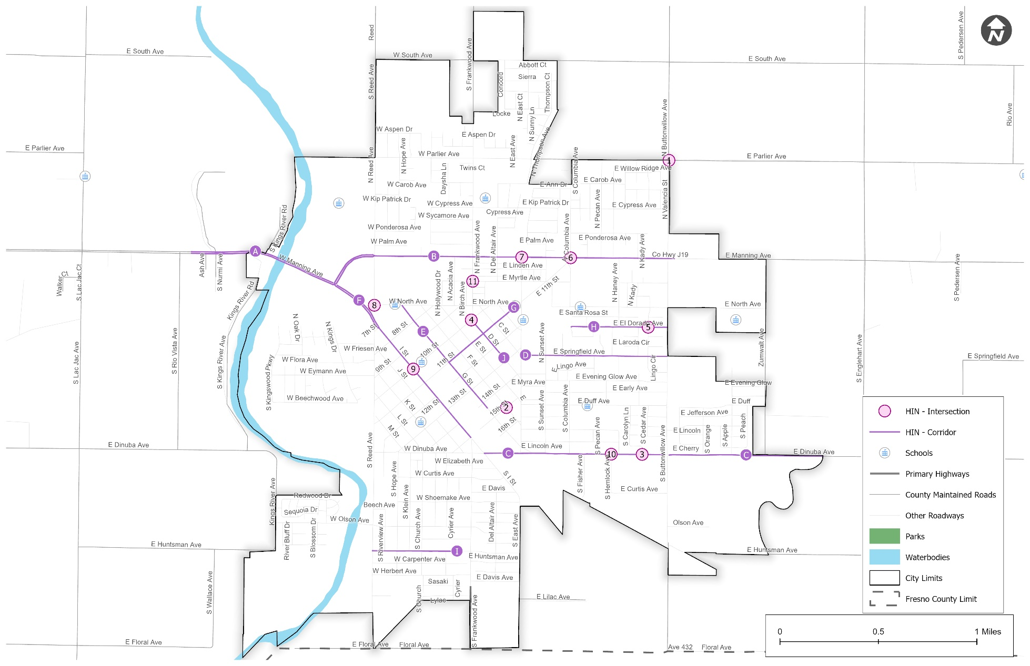
Reedley High-Injury Network
Notes:
All Injury Collisions and KSI

Slide 28
Reedley – Potential Safety Countermeasures
HIN Rank | HIN Intersection | Potential Countermeasures | Right of Way
1 | E Parlier Ave & Buttonwillow Ave | - Add intersection lighting - Install transverse rumble strips on approaches - Install advance intersection warning signs - Improve sight distance to intersection (Clear Sight Triangles) - Convert intersection to roundabout | City/County
2 | 15th St & F St | - Upgrade intersection pavement marking - Install pedestrian crossing at uncontrolled locations (new signs and markings only) - Install/Upgrade larger or additional stop signs or other intersection warning/regulatory signs - No street parking near intersection approaches | City
3 | E Carolyn Ln & E Dinuba Ave | - Pavement resurfacing - Install High visibility crosswalk - Install Rectangular Rapid Flashing Beacon (RRFB) | City
4 | 10th St & D St | - Convert intersection to roundabout mini-Roundabout or All-way STOP control (subject to warrant study) | City
5 | E El Dorado Ave & N Cedar Ave | - Upgrade intersection pavement marking - Install pedestrian crossing at uncontrolled locations (new signs and markings only) - Convert to all-way STOP control (subject to warrant study) | City
6 | E Manning Ave & N Columbia Ave | - Improve signal hardware: lenses, back-plates with retroreflective borders, mounting, size, and number - Install median on major approaches | City
7 | E Manning Ave & N East Ave | -Upgrade to high visibility crosswalk | City
8 | N Reed Ave & W North Ave | - Community education on roundabout | City
9 | 10th St & I St | - Install raised medians on approaches - Install signals (subject to warrant study) | City
10 | E Dinuba Ave & S Hemlock Ave | - Pavement resurfacing - Improve sight distance to intersection (Clear Sight Triangles) | City
11 | N Frankwood Ave & Myrtle Ave | - Upgrade intersection pavement marking - Install/upgrade larger or additional stop signs or other intersection warning/regulatory signs - No street parking near intersection approaches | City
12 | N Reed Ave & W Parlier Ave | - Convert intersection to roundabout or install signals (subject to warrant study) - Install two-way arrow sign for T-intersection - Install Object markers on trees - Install/upgrade larger or additional stop signs or other intersection warning/regulatory signs - Remove/Relocate the tree at the entrance of the agricultural lab | City/County
HIN Rank | HIN Corridor | Potential Countermeasures | Right of Way
A | W Manning Ave: S Rio Vista Ave to I St | - Remove or relocate fixed objects outside of Clear Recovery Zone - Install Edgeline rumble strips (Rio Vista to Kings River Rd) - Install sidewalk (Rio Vista to Kings River Rd) | City/County
B | Manning Ave: I St to S Buttonwillow Ave | - Improve pavement friction (High Friction Surface Treatments) - Install Speed Feedback Signs - Enforcement for overspeeding | City
C | E Dinuba Ave: I St to East City limit | - Pavement resurfacing - Upgrade pavement markings and striping - Audit and remove or relocate fixed objects within the recovery zone - Install retroreflective raised pavement markers - Install Speed Feedback Signs - Targeted DUI and overspeeding enforcement - Road Diet (from S East Ave to Buttonwillow Ave) | City/County
D | E Springfield Ave: East Ave to Buttonwillow Ave | - Pavement resurfacing - Add speed humps for traffic calming (between Sunset Ave and Justin Ave) - Install High-Visibility Crosswalk at Justine Ave & Springfield Ave - No street parking near intersections/major driveways | City
E | G St: W North Ave to 14th St | - Back-in angle parking conversion - Upgrade pavement markings and striping - Install raised crosswalks at intersections | City
F | I St: Manning Ave to 15th St | - Road diet (reduce lanes to add two way left turn lane and bike lanes) - Clear Zone Audit (to identify fixed objects involved in collisions) - Upgrade to High-Visibility Crosswalk (11th St & F St) - Add LPI (Leading Pedestrian Interval) to signalized intersection croswalks - Signal coordination and progression re-timing | City
G | 11th St: G St to North Ave | - Pavement resurfacing - Upgrade/Replace pedestrian crossing signs - Upgrade pavement markings and striping - Upgrade to High-Visibility Crosswalk (11th St & F St) - Install Speed feedback sign | City
H | E El Dorada Ave: N Columbia Ave to S Buttonwillow Ave | - Install centerlines with reflective markers - Install pavement marking and striping - Install speed limit signs | City
I | W Huntsman Ave: S Reed Ave to S Frankwood Ave | - Install edgelines and centerlines - Upgrade pavement marking and striping - Install stop signs and stop bar at intersection (Huntsman Ave and Hope Ave) | City
J | D St: 10th St to 13th St | - Install edgelines and centerlines - Upgrade pavement marking and striping - Pavement resurfacing - Install/Upgrade signs with new fluorescent sheeting (regulatory or warning) | City
Notes:
All Injury Collisions and KSI

Slide 29
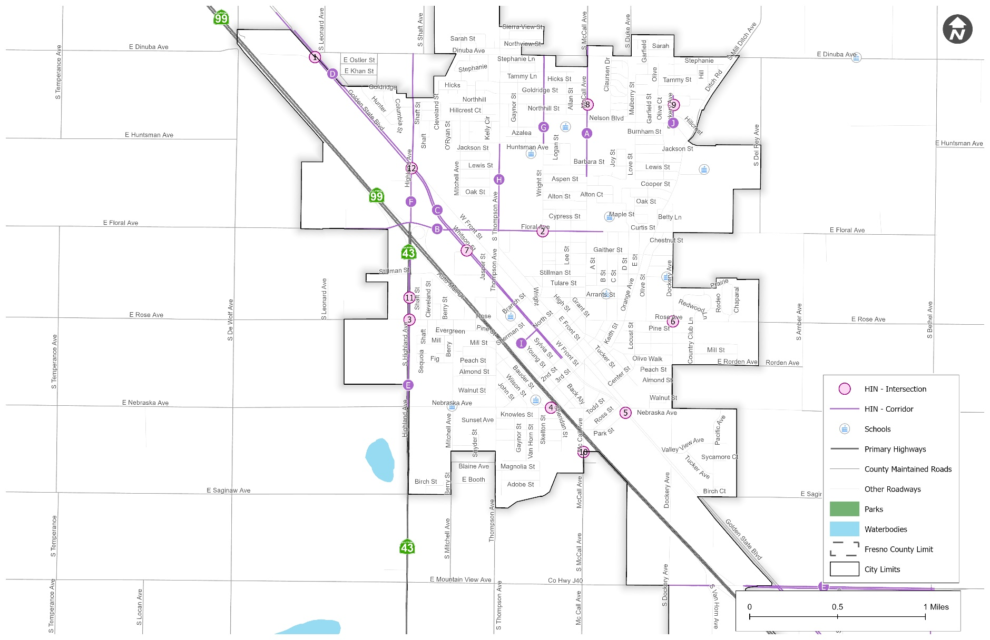
Selma High-Injury Network
Notes:
All Injury Collisions and KSI

Slide 30
Selma – Potential Safety Countermeasures
No. | HIN Intersection | Potential Countermeasures | Right of Way
1 | Floral Ave & Wright St | - Improve signal hardware: lenses, back-plates with retroreflective borders, mounting, size, and number - Install raised pavement markers and striping | City
2 | E Rose Ave & Highland Ave (State Hwy 43) | - Install signals (subject to warrant study) - Install flashing beacons as advance warning | Caltrans
3 | Golden State Blvd & Park St & Whitson St | - Upgrade pavement markings and striping near rail grade crossing - Install flashing beacons as advance warning - Improve sight distance to intersection (Clear Sight Triangles) | Caltrans
4 | Dockery Ave & Rose Ave | - Install raised median on approaches of Rose Ave - Upgrade to large stop sign (add additional stop sign on median of Rose Ave) - Upgrade intersection lighting | City
5 | Cinema Way & Whitson St | - Install a high visibility crosswalk - Install Rectangular Rapid Flashing Beacon (RRFB) - Targeted DUI enforcement - Install stop sign coming out of the driveway | City
No. | HIN Corridor | Potential Countermeasures | Right of Way
1 | McCall Ave: Dennis Dr to North City Limit | - Install/upgrade larger or additional stop signs or other intersection warning/regulatory signs - Improve signal hardware: lenses, back-plates with retroreflective borders, mounting, size, and number (Barbara St & McCall Ave) - Install High visibility crosswalk at intersections (McCall Ave & Dinuba Av, McCall Ave & Nelson Blvd, McCall Ave & Barbara St, McCall Ave & Northhill St) | City
2 | Floral Ave: S Leonard Ave to B St | - Install/Upgrade to high visibility crosswalks at intersections (Floral Ave & Wright St, Floral Ave & Front St, Floral Ave & Whitson St) - Install raised medians at signalized intersection approaches - Enforcement for overspeeding | City
3 | Whitson St: Highland Ave to 2nd St | - Remove or relocate fixed objects outside of Clear Recovery Zone - Improve signal hardware: lenses, back-plates with retroreflective borders, mounting, size, and number | City/County
4 | Highland Ave (State Hwy 43): Floral Ave to Nebraska Ave | - Improve signal hardware: lenses, back-plates with retroreflective borders, mounting, size, and number - Enforcement for overspeeding (e.g. speed cameras) | Caltrans
5 | Highland Ave: Floral Ave to Dinuba Ave | - Install a radar speed feedback sign - Improve signal hardware: lenses, back-plates with retroreflective borders, mounting, size, and number - Install edge-lines and centerlines - Enforcement for overspeeding - Improve pavement friction (High Friction Surface Treatments) at intersection approaches with high rear-end collisions - Remove or relocate fixed objects outside of Clear Recovery Zone | City
Notes:
All Injury Collisions and KSI

Slide 31

Community Input
Online Community Input
Maptionnaire
Questionnaire
(193 Responses)
Map Input
(247 Traffic Safety Concerns)
Pin a location
(166 Responses)
Draw a line
(81Responses)
Highlight of Community Feedback on Map Input Survey:
Top 10 Traffic Concerns from Community | Number of Responses
Lack of Sidewalk | 25
Speeding Vehicles | 23
Poor Pavement Condition (e.g. Potholes) | 22
Traffic Congestion | 17
Install/Upgrade Crosswalks | 13
Poor Lighting | 13
Bike Lane Improvements | 12
Flooding | 12
Add All Way Stop Control | 10
Stop Sign Violations | 10
Notes:
All Injury Collisions and KSI

Slide 32
Community Input Summary
Notes:
All Injury Collisions and KSI

Slide 33
Draft Safety Projects
Advance Warning Signs
Speed Feedback Signs (including speed limit)
Improve/Install Striping (including intersection Corners)
Install Rumble Stripes (Centerline & Edgeline)
Curve ahead Warning Signs (with flashing beacons), chevron signs for curves, Increase the Signage Size to Freeway Sign Size, and update object markers
Street Lighting
Intersection Safety Improvements
Safe Routes to School
Bike Lane Improvements
Notes:
All Injury Collisions and KSI

Slide 34
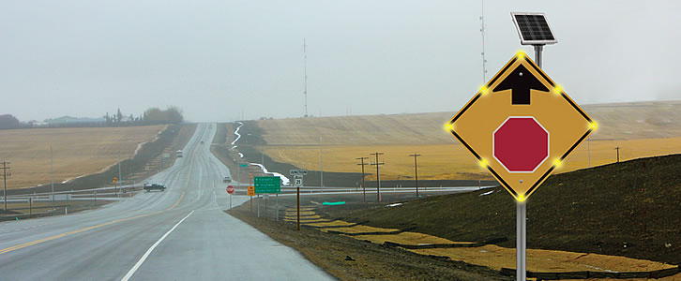
1. Advance Warning Signs
Sr.No. | Corridors | District No
1 | Jensen Ave (Entire Corridor) | 1,3,4,5
2 | Manning Ave (Entire Corridor) | 1,4
3 | Millerton Ave (Entire Corridor) | 5
4 | Auberry Rd (Entire Corridor) | 5
5 | Belmont Ave (Entire Corridor) | 1,3,5
6 | Kearney Blvd (Entire Corridor) | 1
7 | Fair Ave: Kearney Blvd to W California Ave | 1
8 | Fowler Ave (Entire Corridor) | 4,5
9 | North Ave: S Dickenson Ave to N Grantland Ave, S Brawley Ave to S Marks Ave, S Armstrong Ave to S Temperance Ave | 1,4
10 | Friant Rd: N Fork Rd to N Willow Ave | 2,5
11 | Chestnut Ave: E Annadale Ave to E Central Ave, E Jefferson Ave to E Clayton Ave | 1,3,4
12 | Shaw Ave: N Monroe Ave to N Grantland Ave; N Thompson Ave to N Indianola Ave | 1,5
13 | Marks Ave: Jensen Ave to North Ave, Lincoln Ave to Dinuba Ave, W Caruthers Ave to W Conejo Ave | 1,4
14 | Central Ave: S Chestnut Ave to S Clovis Ave, S Temperance Ave to S De Wolf Ave, S Fig Ave to S East Ave | 1,3,4
15 | Dinuba Ave: Golden State Blvd to McCall Ave (at border of city of Selma), S Mendocino Ave to S Lac Jac Ave, S Englehart Ave to S Crawford Ave | 4
16 | Ashlan: McCall Ave to N Indianola Ave | 5
17 | Academy Ave: E Sierra Ave to E Shields Ave | 5
18 | South Ave: Elm Ave to Chestnut Ave, SR99 to Academy Ave, S Buttonwillow Ave to S Alta Ave | 1,4
19 | Adams Ave: S Pederson Ave to Hill Ave | 4
Advance Warning Sign
Notes:
All Injury Collisions and KSI

Slide 35
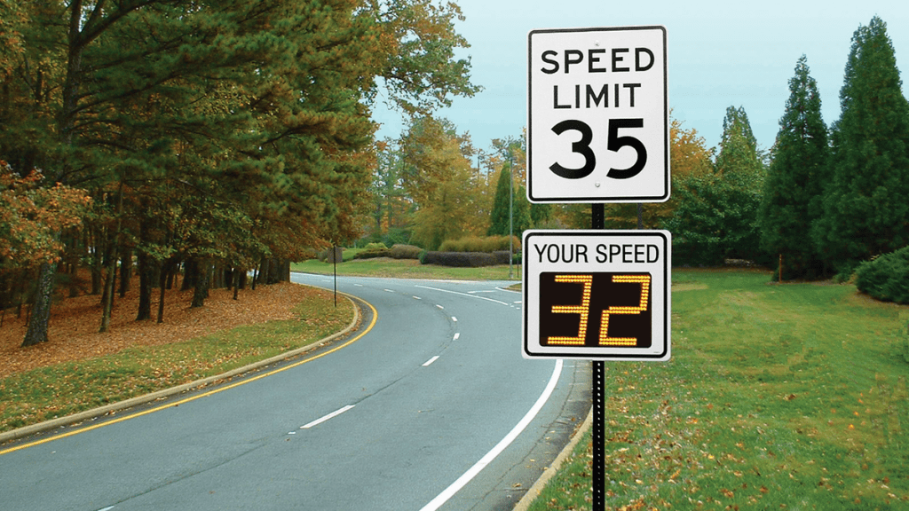
2. Speed Feedback Signs (including speed limit)
Sr.No. | Locations | District No
1 | Jensen Ave: Cornelia Av to Marks Av, S Clovis Ave to S De Wolf Ave | 1
2 | Millerton Ave (Entire Corridor) | 5
3 | Auberry Rd (Entire Corridor) | 5
4 | Fowler Ave: E Dinuba Ave to E Clarkson Ave | 4
5 | Clovis Ave: E Central Ave to E Adams Ave | 4
6 | Shaw Ave: N Thompson Ave to N Indianola Ave | 5
7 | Central Ave: S Fig Ave to S East Ave | 1,3
8 | Dinuba Ave: S Mendocino Ave to S Lac Jac Ave, S Englehart Ave to S Crawford Ave | 4
9 | Adams Ave: S Greenwood Ave to S Newmark Ave | 4
Speed Feedback Sign
Notes:
All Injury Collisions and KSI

Slide 36
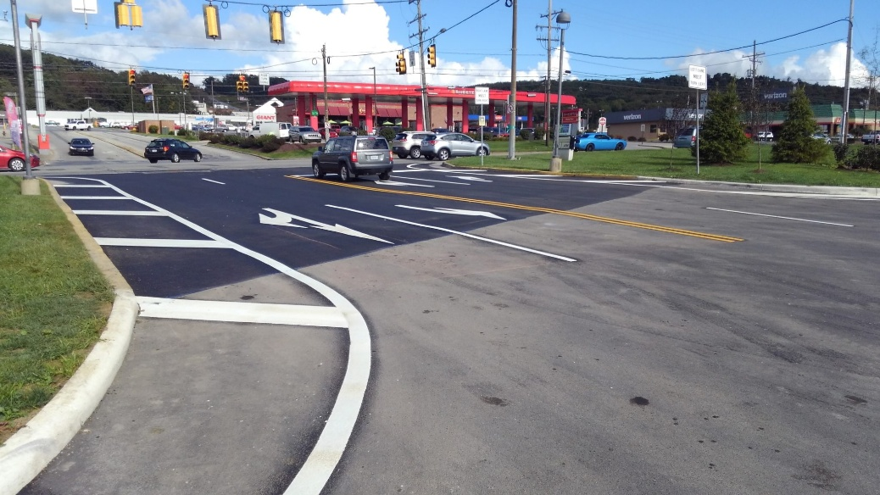
3. Improve/Install Striping (including intersection Corners)
Sr.No. | Locations | District No
1 | Jensen Ave (Entire Corridor) | 1,3,4,5
2 | Manning Ave (Entire Corridor) | 1,4
3 | Belmont Ave (Entire Corridor) | 1,3,5
4 | Kearney Blvd (Entire Corridor) | 1
5 | Fowler Ave (Entire Corridor) | 4,5
6 | North Ave: S Dickenson Ave to N Grantland Ave, S Brawley Ave to S Marks Ave, S Armstrong Ave to S Temperance Ave | 1
7 | Friant Rd: N Fork Rd to N Willow Ave | 2,5
8 | Chestnut Ave: E Annadale Ave to E Central Ave, E Jefferson Ave to E Clayton Ave | 1,3,4
9 | Shaw Ave: N Goldenrod Ave to N Floyd Ave, N Monroe Ave to N Grantland Ave. N Thompson Ave to N Indianola Ave | 1,5
10 | Marks Ave: Jensen Ave to North Ave, Lincoln Ave to Dinuba Ave, W Caruthers Ave to W Conejo Ave | 1,4
11 | Central Ave: S Chestnut Ave to S Clovis Ave, S Temperance Ave to S De Wolf Ave, S Fig Ave to S East Ave | 1,3,4
12 | Dinuba Ave: Golden State Blvd to McCall Ave (at border of city of selma), S Mendocino Ave to S Lac Jac Ave, S Englehart Ave to S Crawford Ave | 4
13 | Ashlan: McCall Ave to N Indianola Ave | 5
14 | Academy Ave: E Sierra Ave to E Shields Ave | 5
15 | South Ave: Elm Ave to Chestnut Ave, SR99 to Academy Ave, S Buttonwillow Ave to S Alta Ave | 1,4
16 | Adams Ave: S Pederson Ave to Hill Ave | 4
Improve/Install Striping
Notes:
All Injury Collisions and KSI

Slide 37
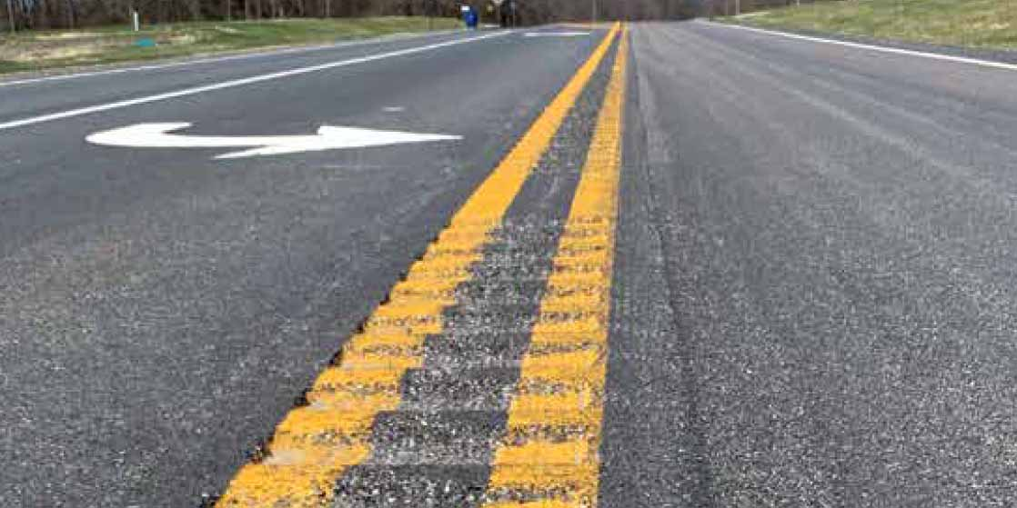
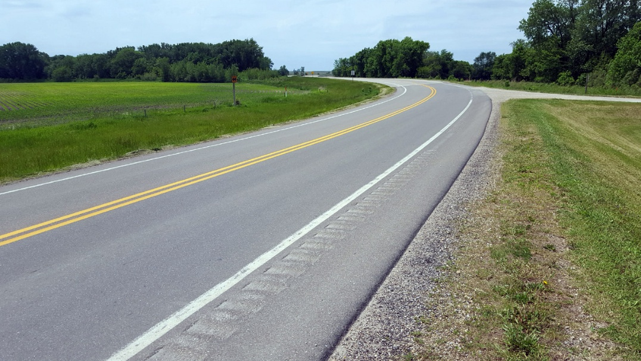
4. Install Rumble Stripes (Centerline & Edgeline)
Sr.No. | Locations | District No
1 | Jensen Ave: Goldenrod Ave to Bishop Ave, Cornelia Av to Marks Av | 1
2 | Manning Ave: S Maple Ave to S Bethel Ave | 4
3 | Belmont Ave: N Westlawn Ave to N Lafayette Ave | 1
4 | Kearney Blvd: S Blythe Ave to S Westlawn Ave (Kearney Park Safety Improvement) | 1
5 | Fowler Ave: E Dinuba Ave to E Clarkson Ave, E Elkhorn Ave to De Woody Ave | 4
6 | Clovis Ave: E Central Ave to E Adams Ave, E Davis Ave to E Riverdale Ave | 4
7 | Shaw Ave: N Goldenrod Ave to N Floyd Ave, N Monroe Ave to N Grantland Ave | 1
8 | Marks Ave: Lincoln Ave to Dinuba Ave, W Caruthers Ave to W Conejo Ave | 4
9 | Ashlan Ave: Maddsen Ave to Watts Valley Rd | 5
10 | Academy Ave: E Adams Ave to E South Ave, E Dinuba Ave to E Mountain View Av | 4
Centerline Rumble Stripes
Edgeline Rumble Stripes
Notes:
All Injury Collisions and KSI

Slide 38
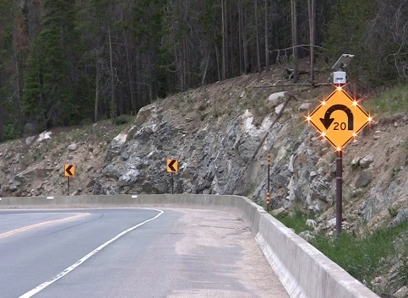
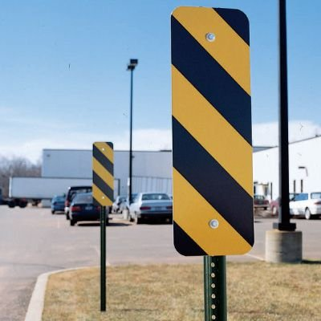
5. Curve ahead Warning Signs (with flashing beacons), chevron signs for curves, Increase the Signage Size to Freeway Sign Size, and update object markers
Sr.No. | Locations | District No
1 | Millerton Ave (Entire Corridor) | 5
2 | Auberry Rd (Entire Corridor) | 5
3 | Kearney Blvd (Entire Corridor) | 1
4 | Fowler Ave (Entire Corridor) | 4
Curve advance warning signs (flashing beacon)
Object Markers
Notes:
All Injury Collisions and KSI

Slide 39
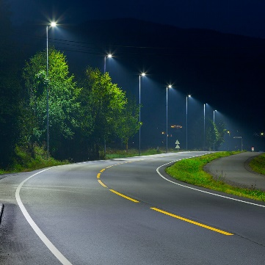
6. Install/Improve Street Lighting
Sr.No. | Locations | District No
1 | Jensen Ave: S Clovis Ave to S De Wolf Ave | 4,5
2 | Belmont Ave: N Westlawn Ave to N Lafayette Ave | 1
3 | Kearney Blvd: S Blythe Ave to S Westlawn Ave (Kearney Park Safety Improvement) | 1
4 | Fowler Ave: E Behymer Ave to Perrin Ave | 5
5 | Friant Rd: N Fork Rd to N Willow Ave | 2,5
Install/Improve Street Lighting
Notes:
All Injury Collisions and KSI

Slide 40
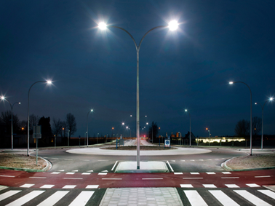
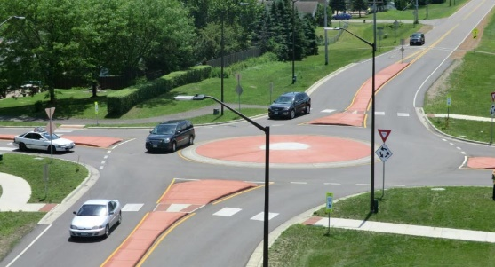
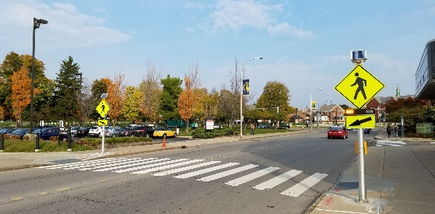
7. Intersection Safety Improvements
Sr.No. | Intersection/Corridor Safety Improvements | Potential Improvements | District No
1 | Jensen Ave & Valentine Ave | Bulbouts, High-Visibility Crosswalk, RRFB, Intersection Lighting, Roundabout | 1
2 | Cornelia Ave & Kearney Blvd | Intersection Lighting, Roundabout | 1
3 | Valentine Ave: Jensen Ave to North Ave | Parking and Paved Shoulders | 1
Intersection Lighting
Roundabout
Rectangular Rapid Flashing Beacon
Notes:
All Injury Collisions and KSI

Slide 41
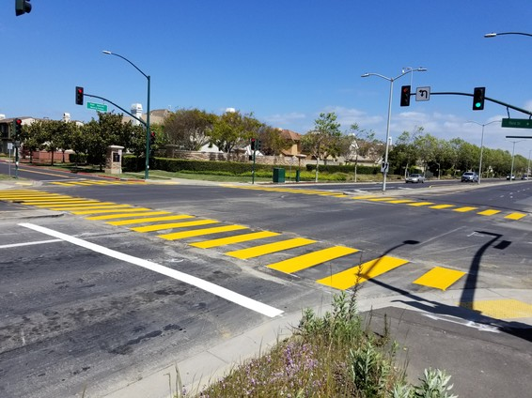
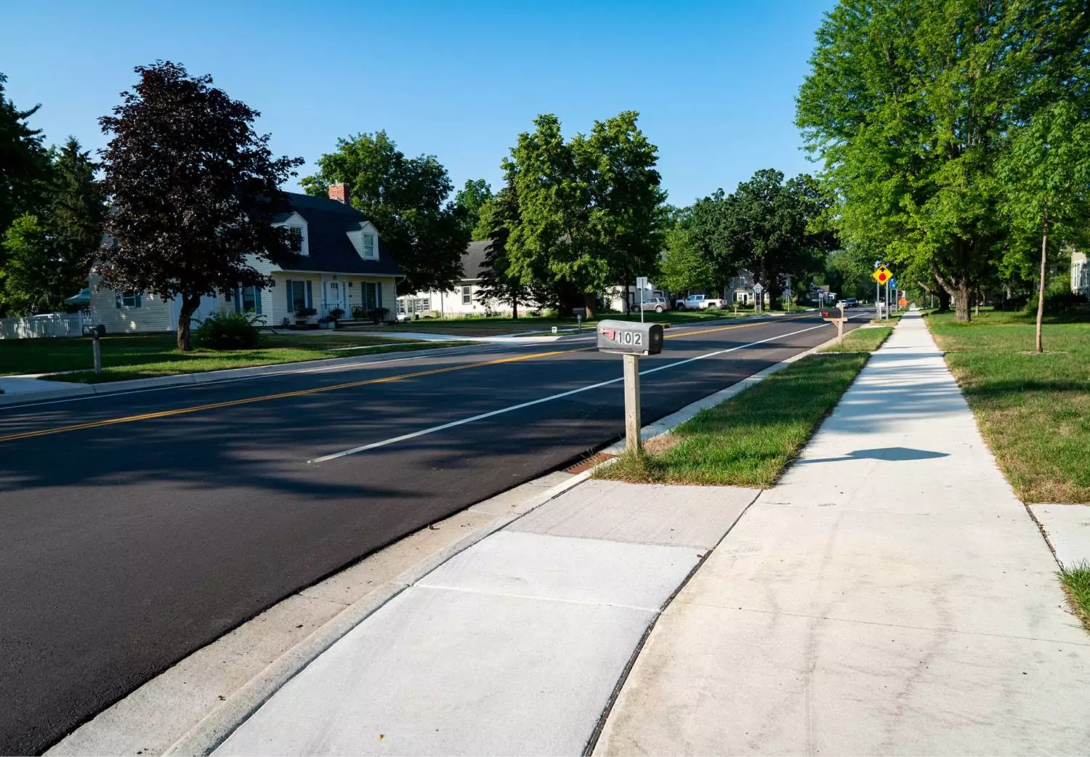
8. Safe Route to School (SRTS) Projects
Associated School | Location | Type of Improvement
Biola-Pershing Preschool | Shaw Ave from N 3rd St to N 7th St | Signage
 | W E Ave from N 3rd St to N 5th Ave | Sidewalk
 | W F Ave from N 3rd St to N 7th Ave | Sidewalk
 | N 7th St from W C St to W G St | Sidewalk
Raisin City State Preschool; Raisin City Elementary | W Bowles Ave from S Bryan Ave to School | Sidewalk
 | W Bolwles Ave and S Ring Ave | High-Visibility Crosswalk
 | Ormus Ave from Manning Ave to W Springfield Ave | Sidewalk
 | S Ring Ave From Manning Ave to W Fike Ave | Sidewalk
Washington Colony Elementary | Lincoln Ave and Geneva Ave | High-Visibility Crosswalk
 | Lincoln Ave and Elm Ave | High-Visibility Crosswalk
 | Lincoln Ave and Elm Ave | Pavement Marking
 | E Lincoln Ave- W of Lotus Ave | Mid-block High-Visibility Crosswalk
 | S Elm Ave from E Fantz Ave to Lincoln Ave | Sidewalk
 | S Elm Ave from E Fantz Ave to Larsen Ave | Pavement Marking
 | S Elm Ave and E Crooks Ave | Mid-block Crosswalk
 | Williamette Ave from Elm Ave to Lily Ave | Sidewalk
Endeavor Charter | Palm Ave and Shaw Ave | High-Visibility Crosswalk
 | Palm Ave from Shaw Ave to Rialto Ave | Sidewalk
Orange Center School | S Cherry Ave from S of North Ave to W Central Ave | Bike Lane
 | S Cherry Ave from S of North Ave to W Central Ave | Edgeline Striping
High-Visibility Crosswalk
Sidewalk
Notes:
All Injury Collisions and KSI

Slide 42
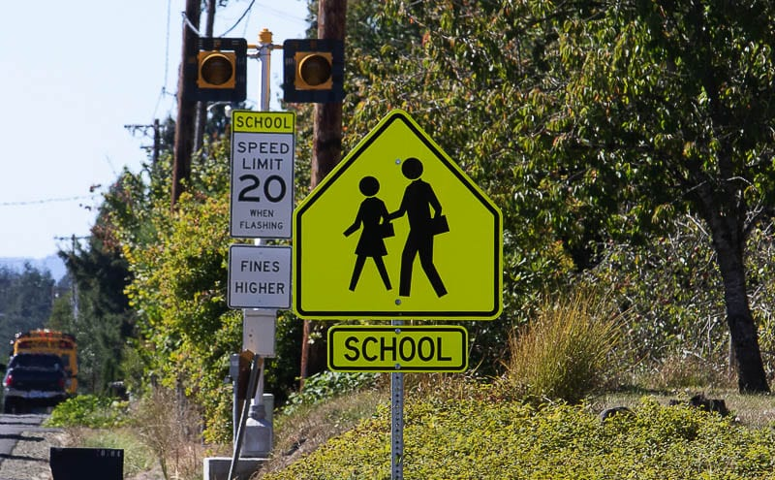
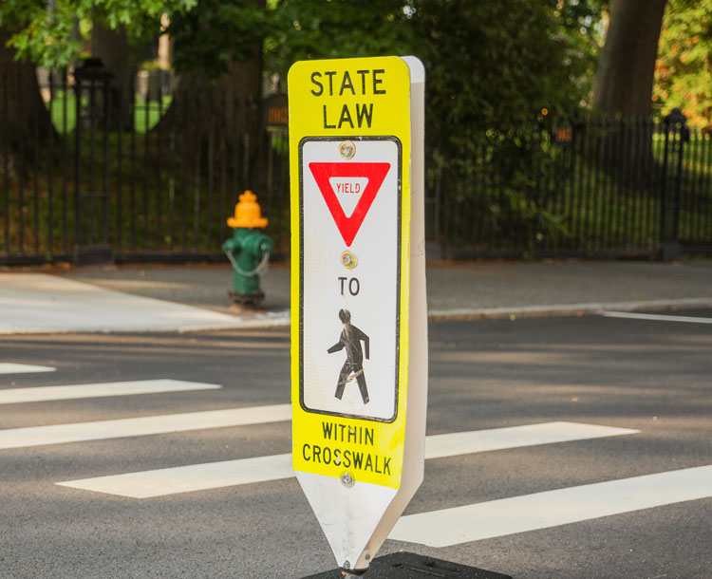
8. SRTS Projects
Associated School | Location | Type of Improvement
Alta Elementary | S Alta Ave from E Parlier Ave to Manning Ave | Advance Warning Signs
Quail Lake Environmental Charter | E Ashlan Ave and N Quail Lake Dr | High-Visibility Crosswalk
 | E Ashlan Ave from Quail lake dr to N Del Rey Ave | Sidewalk
 | E Ashlan Ave and N Del Rey Ave | High-Visibility Crosswalk
 | N Quail Lake Dr from E Ashlan Ave to N Waterside Dr | Sidewalk
Laton Elementary School | E Latonia Ave from E Mount Whitney Ave to Bliss Ave | Sidewalk
 | Latonia Ave and Bliss Ave | High-Visibility Crosswalk
 | Latonia Ave and Gonser St | High-Visibility Crosswalk
 | Latonia Ave and Fowler Ave | High-Visibility Crosswalk
 | Fowler Ave and De Woody Ave | High-Visibility Crosswalk
Terry Elementary School | Fowler Ave from E Saginaw Ave to Murphy Ave | Edgeline Striping
 | Fowler Ave and Mountain View Ave | Pavement Marking
Malaga Elementary School | Central Ave and Chestnut Ave | Pavement Marking
 | Central Ave and Chestnut Ave | High-Visibility Crosswalk
 | Central Ave and Chestnut Ave | Speed Feedback Signs
 | E Gould Ave and S Ward Ave | High-Visibility Crosswalk
Sequoia Elementary | Jensen Ave from S Armstrong Ave to S Temperance Ave | Advance Warning Signs and Speed Feedback Signs
 | Lodge Rd from Black Maountain Rd to SE of Sierra High School | School Warning Signs
School Zone Warning Sign
High Visibility Crosswalk
Notes:
All Injury Collisions and KSI

Slide 43
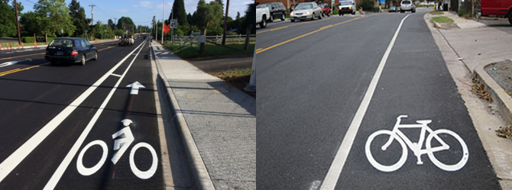
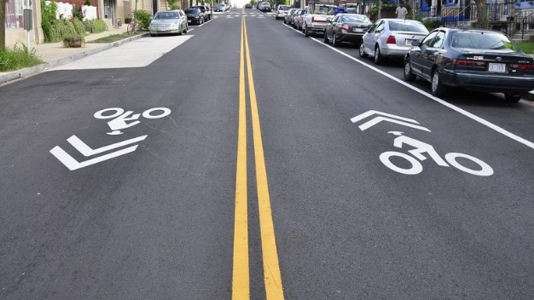
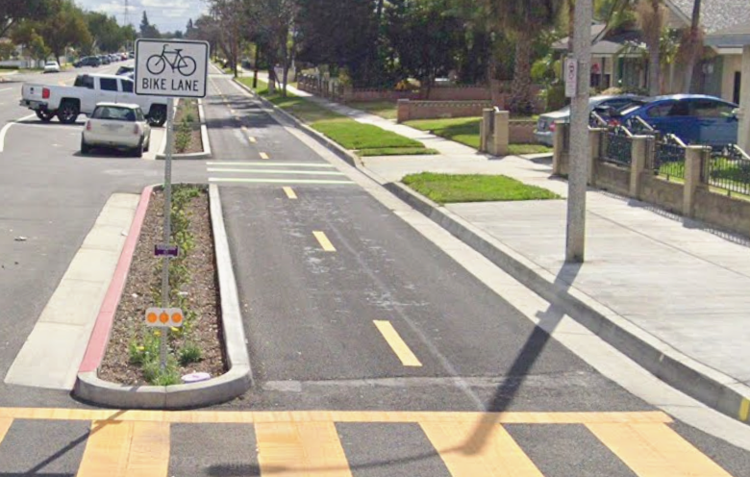
9. Bicycle Facility Projects
Sr.No. | Bicycle Facility Recommendations | Bike Facility
1 | E Manning Ave: S Zediker Ave to S Kings River Rd | Class II Buffered
2 | E Manning Ave: Placer Ave to McMullin Grade | Class II
3 | Jensen Ave: S Fowler Ave to S McCall Ave | Class III
4 | Kearney Blvd : W of Grantland Ave to Goldenrod Ave | Class I
5 | Chestnut Ave: Jensen Ave to S Golden State Blvd | Class II Buffered
6 | Dinuba Ave: S Del Rey Ave to Kings River Rd | Class II
7 | Academy Ave: Mountain View Ave to Kamm Ave | Class II
8 | South Ave: Frankwood Ave to Hill Ave | Class II
9 | North Ave: Chestnut Ave to McCall Ave | Class II
10 | Auberry Rd: SR 168 (Big Sandy Valley) to SR 168 (Pineridge) | Class III
Class II Bike Lane
Class IV Separated Bikeway
Class III Bike Route
Notes:
All Injury Collisions and KSI

Slide 44
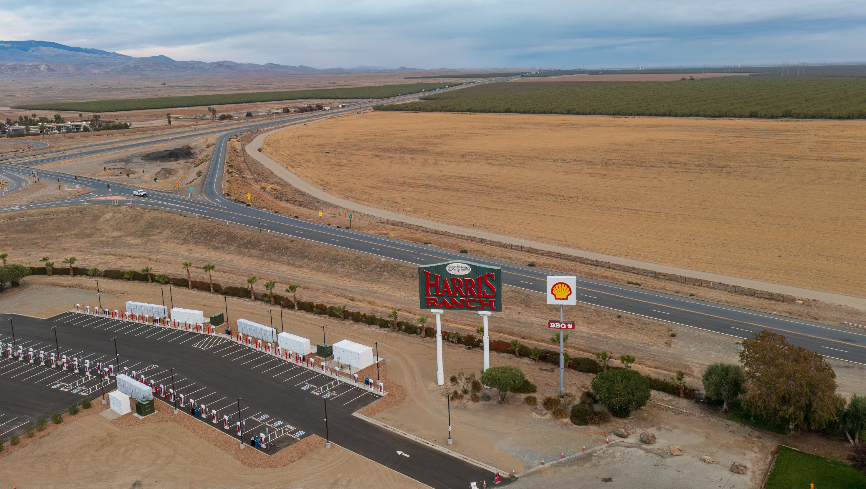
Discussion/Questions

Slide 45
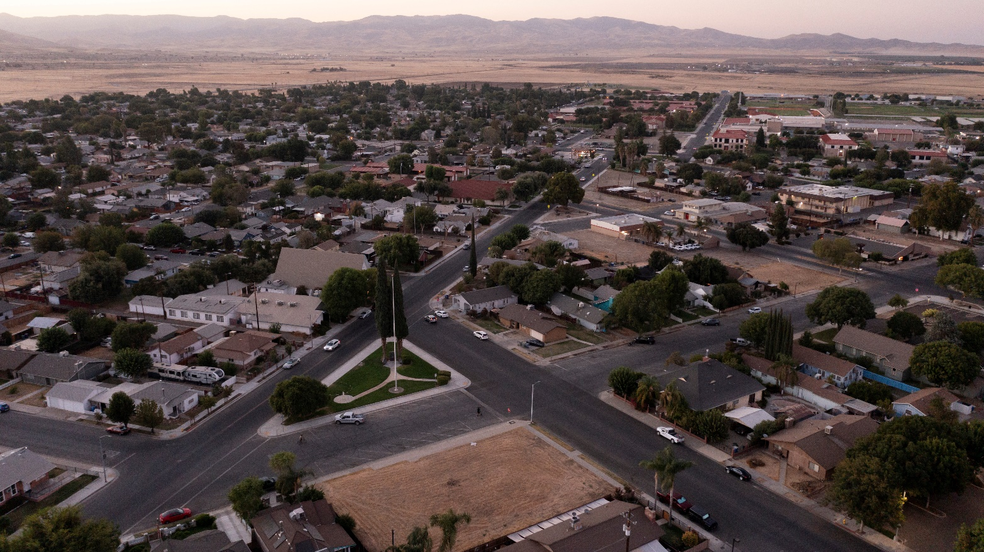
Next Steps
Finalize Safety Projects based on inputs received
Draft and Final SS4A Action Plan
SS4A Action Plan adoption by County Board on May 19

