Slide 1
County of Fresno Redistricting Workshop
Ryder Todd Smith, President, Tripepi Smith
Jeff Tilton, Senior Consultant, National Demographics Corporation
Notes:
Ryder

Slide 2
Traducción al Español Disponible Meeting is Being Recorded
Notes:
Ryder

Slide 3
Introductions
Notes:
Ryder

Slide 4
Today’s Goals
You Learn From the Experts
Experts Listen to You
Mapping Tools Training
You Leave Empowered to Give Effective Feedback

Slide 5
Today’s Schedule
AGENDA: Start at 6 p.m.; Close at 8 p.m.
Process, Rules and Goals
Neighborhoods/Communities of Interest
Mapping Tools
Next Steps
Notes:
Ryder

Slide 6
Redistricting Process
Step | Description
Pre-Draft Public Hearing August 12, 6:30 p.m. Health and Wellness Center | Advisory Commission Public Hearing Held prior to release of draft maps Educate, solicit input on the communities in the Districts
Census Data Release Mid/Late August | Census Bureau releases official 2020 Census population data
California Data Release Early October 2021 | California Statewide Database releases California’s official ‘prisoner-adjusted’ 2020 redistricting data
Engagement Workshops | July 14, 6-8 p.m. (Riverdale Unified School District) August 3, 6-8 p.m. (Gaston Middle School) August 4, 6-8 p.m. (Fresno High School) August 21, 9:30-11:30 a.m. (Woodward Park Regional Library) August 21, 2:30-4:30 p.m. (Clovis Veterans Memorial Center)
Dates/locations subject to change

Slide 7
Redistricting Process (continued)
Step | Description
Pre-Draft Public Hearing October 21, 6:30 p.m. Health and Wellness Center | Advisory Commission Public Hearing Recommend communities of interest, neighborhoods to Board of Supervisors Recommend draft maps for Board of Supervisors Deadline to submit maps: October 20, 2021, 5 p.m.
Draft Map Public Hearing November 2, 1 p.m. Board Chambers | Board of Supervisors Public Hearing Discuss, revise the draft maps Discuss the election sequence Deadline for maps to be posted to website: October 27, 2021, 5 p.m.
Draft Map Public Hearing November 16, 1 p.m. Board Chambers | Board of Supervisors Public Hearing Select final map and election sequence Deadline to submit maps: November 2, 2021, 5 p.m. Deadline for maps to be posted to website: November 9, 2021, 5 p.m.
Dates/locations subject to change

Slide 8
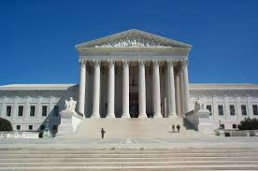
Redistricting Rules and Goals
1. Federal Laws
2. California Criteria for Counties
3. Other Traditional Redistricting Principles
Equal Population
Federal Voting Rights Act
No Racial Gerrymandering
1. Geographically contiguous
2. Undivided neighborhoods and “communities of interest” (Socio-economic geographic areas that should be kept together)
3. Cities and CDPs
4. Easily identifiable boundaries
5. Compact (Do not bypass one group of people to get to a more distant group of people)
Prohibited:
“Shall not favor or discriminate against a political party.”
Minimize voters shifted to different election years
Respect voters’ choices / continuity in office
Future population growth
Preserving the core of existing districts

Slide 9
Estimated Data: Current Districts

Slide 10
Defining Neighborhoods
1st Question: What is your neighborhood?
2nd Question: What are its geographic boundaries?
Examples of physical features defining a neighborhood boundary:
Natural neighborhood dividing lines, such as highway or major roads, rivers, canals and/or hills
Areas around parks or schools
Other neighborhood landmarks
In the absence of public testimony, planning records and other similar documents may provide definition.

Slide 11
Beyond Neighborhoods: Defining Communities of Interest
1st Question: What defines your community?
Geographic Area, plus
Shared issue or characteristic
Shared social or economic interest
Impacted by county policies
Tell us “your community’s story”
2nd Question: Would this community benefit from being “included within a single district for purposes of its effective and fair representation”?
Or would it benefit more from having multiple representatives?
Definitions of Communities of Interest may not include relationships with political parties, incumbents, or political candidates.

Slide 12
Possible Neighborhoods / Communities
From July 14, 2021, public workshop:
Riverdale
Lanare
East of CA 41/West of CA 41
Type of crops; no trees
Size of farms and corporations
Family farms
Housing type; access to resources
Unincorporated communities
Lack access to water
Farmworker community
Data collected from the August 2021 public workshops will be shared at the October 2021 Public Hearing.
Data collected from all public workshops will be posted on the redistricting website.
Submissions edited for clarity and brevity

Slide 13
Possible Neighborhoods / Communities
From August 3, 2021, public workshop:
Parlier
Southeast Fresno (water quality)
Parlier (sewer systems/storm water systems)
Clovis to the foothills (east)
West Fresno, west of 99 (new construction)
Old West, historically recognized
African American communities
Sanger (infrastructure investments)
Water services (how accessible to residents)
Rural communities (high Latino populations)
Foothills (remain unified w/ services)
East vs. Urban
Submissions edited for clarity and brevity

Slide 14
Possible Neighborhoods / Communities
From August 4, 2021, public workshop:
Food deserts, lack access to food quality options
Shopping areas
Communities without transportation
Accessibility to jobs
Loma Vista – existing and future growth
West:
East: McCall
Heritage Grove
Willow, Sheppard, Copper
Parlier:
water quality issues, access to water for low income communities, water rates going up
Transportation issues, traffic around school zones
Policy issues
Communities centered around schools, enrollment boundaries for each of the schools
Submissions edited for clarity and brevity

Slide 15
Possible Neighborhoods / Communities
From August 4, 2021, public workshop (continued):
Sunnyside
Community Planning areas
Tower District
Southwest Fresno
East side Fresno, Kings Canyon
Pinedale
Districts according to Police Departments
Public safety response times
County of Fresno as well as police within limits of City
County Islands within city limits
Mayfair / “Lake Don Pedro”
Muscatel / West Central Fresno
Central District
Language spoken
Historic Districts
Historic Tracts
GIS data on Fresno website
Canals, railways, freeways
Recognizable boundaries
Renters, homeowners
Historically redlined communities
Submissions edited for clarity and brevity

Slide 16
Q&A With Your Hosts
Notes:
Ryder

Slide 17
Neighbor Chats
15 minutes to review maps, thinks about communities of interest, talk with your fellow community members
Experts will be available to answer your questions
After 10-15 minutes, we will swing by each group and ask you to share your thoughts on communities of interest
Your thoughts and ideas will become part of the record and be recorded / written down
Notes:
Ryder

Slide 18
Break
Notes:
Ryder

Slide 19
Share Your Thoughts
Website: www.co.fresno.ca.us/resources/redistricting
Phone: 559.600.1221 | Email: FresnoCounty2021Redistricting@fresnocountyca.gov

Slide 20
Public Mapping and Map Review Tools
Different tools for different purposes
Different tools for different levels of technical skill and interest
Simple “review draft maps” tool
Easy-to-use “Draw your neighborhood” tool
Paper- and Excel-based simple “Draw a draft map” tools
Powerful, data-rich “Draw a draft map” tool
Whether you use the powerful (but complicated) online mapping tool, Excel, the paper kit, or just draw on a napkin, we welcome your maps!
Notes:
Jeff

Slide 21
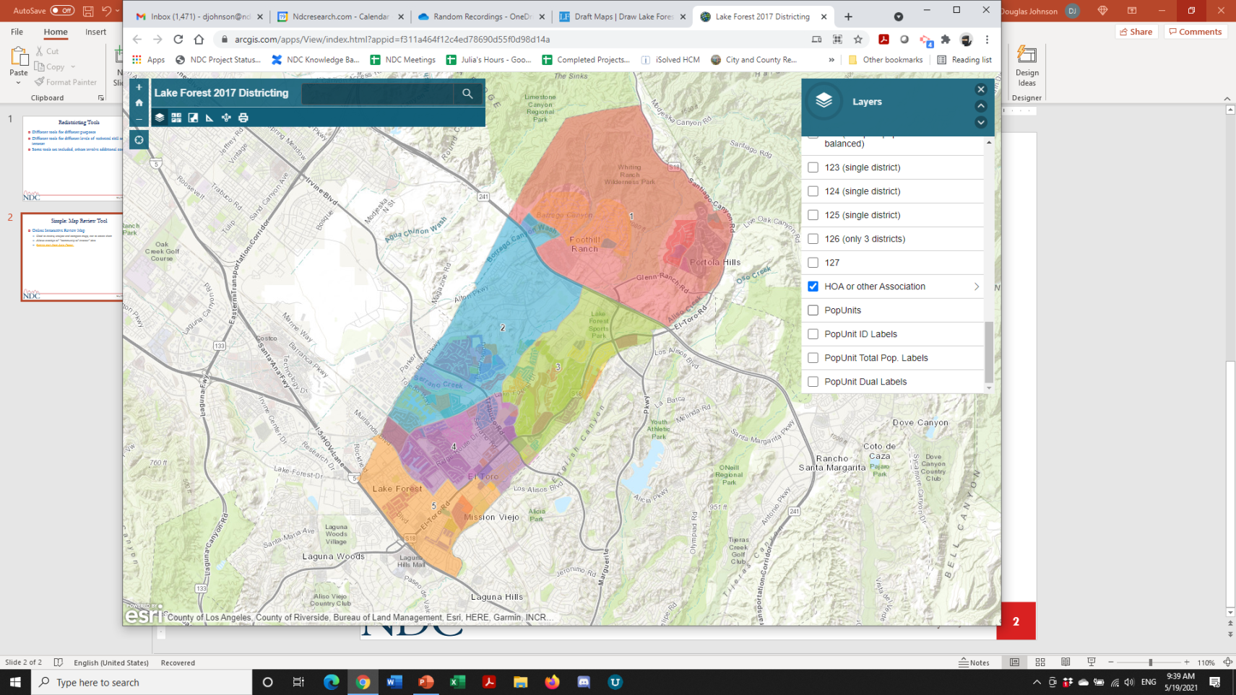
Simple Map Review Tool
Online Interactive Review Map
ESRI’s “ArcGIS Online” – similar to Google Maps in ease of use
Used to review, analyze and compare maps, not to create them
Includes overlays of “community of interest” and other Story Map data
Sample map from Lake Forest

Slide 22
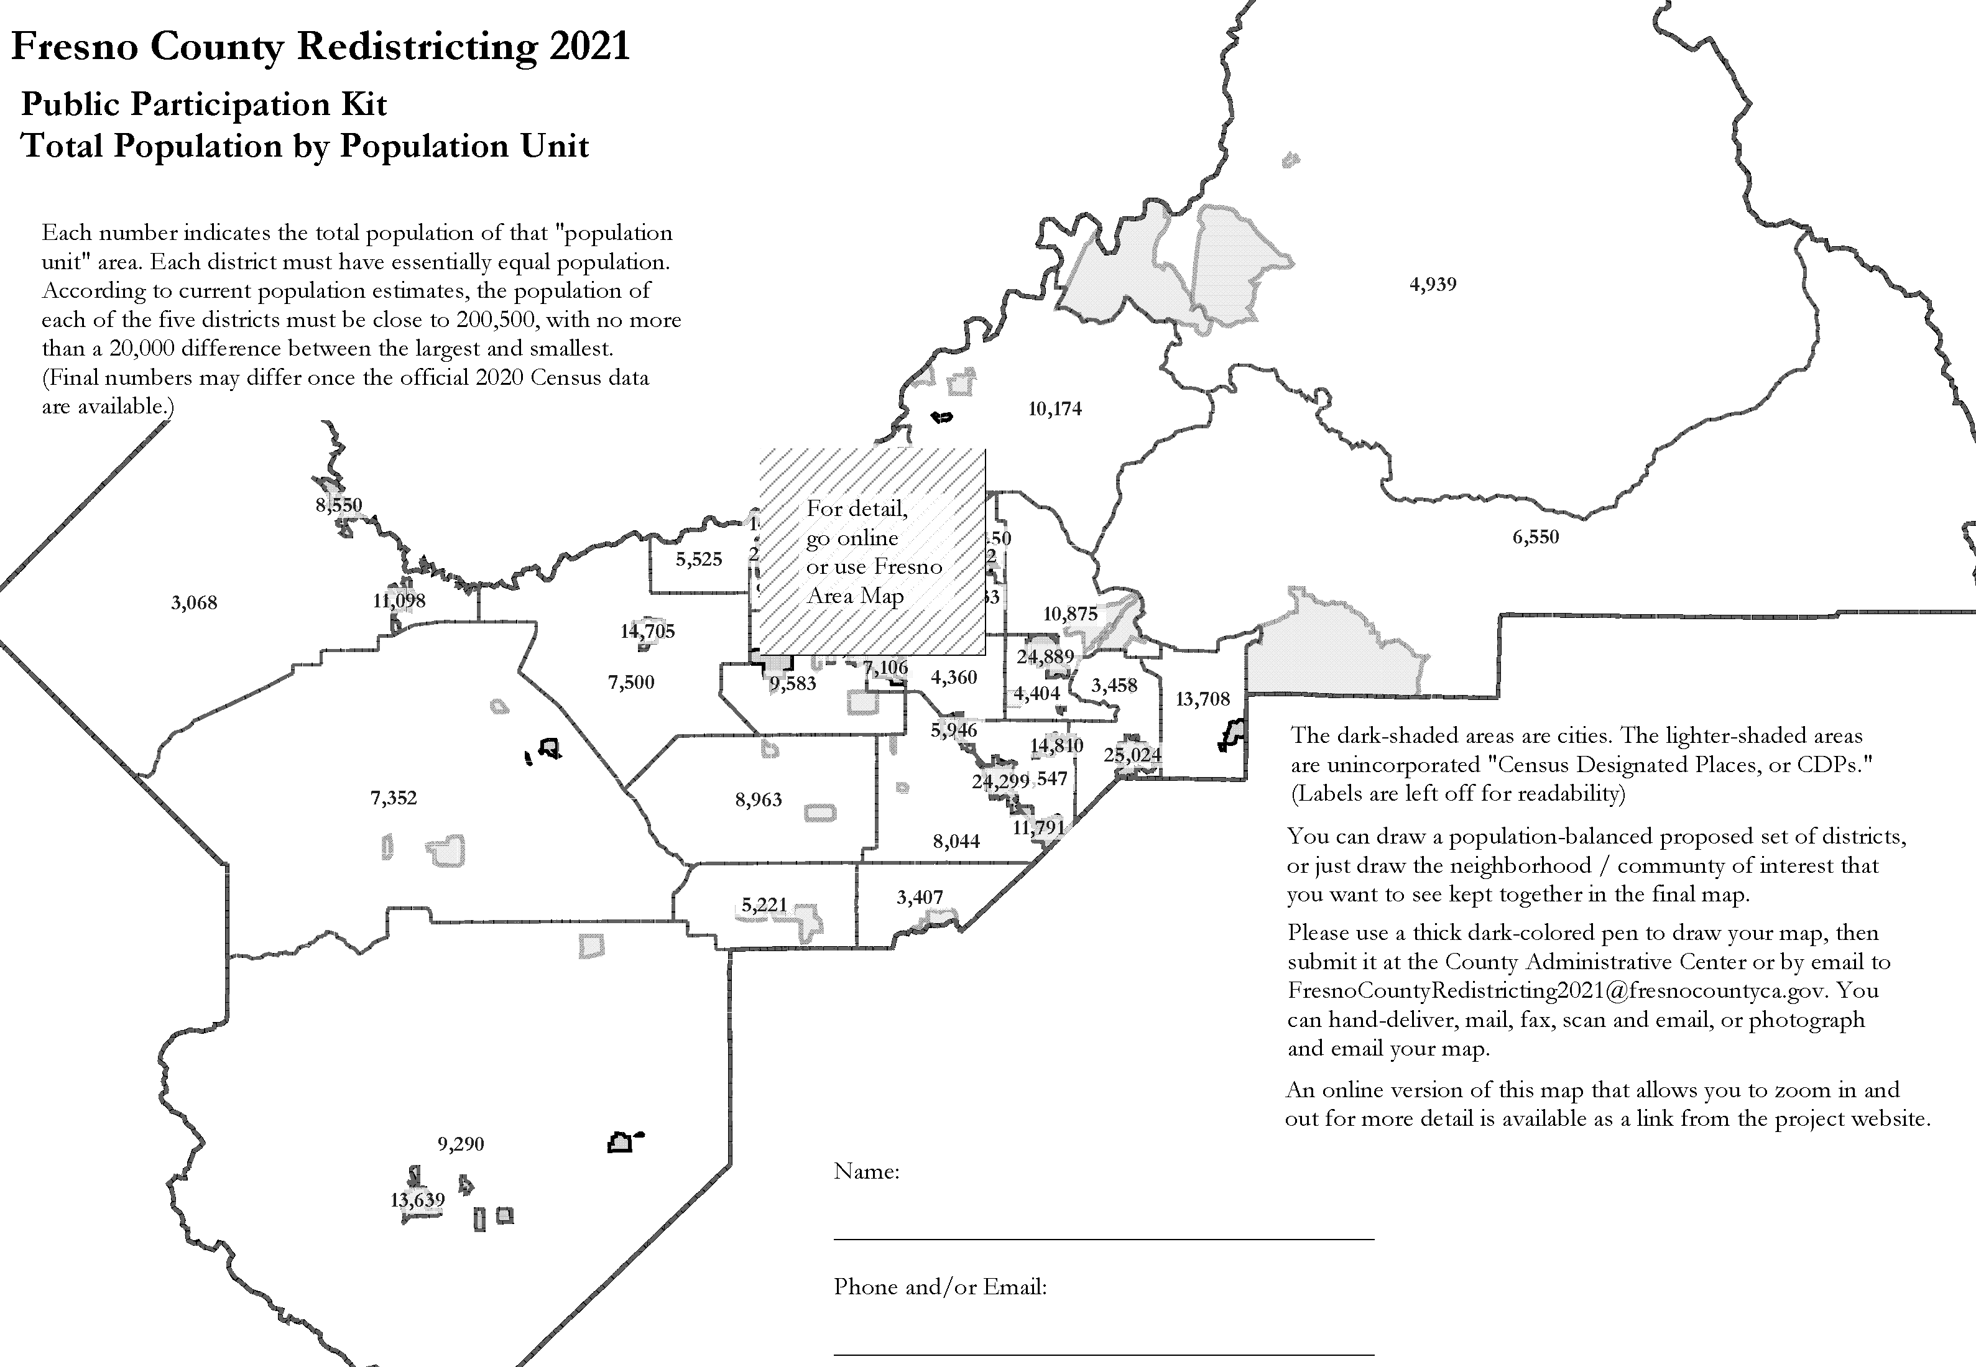
Simple Map Drawing Tool
Paper “Public Participation Kit”
For those without internet access or who prefer paper
Total Population Counts only – no demographic numbers
Geographic units would be tracts, CDP’s and smaller cities

Slide 23
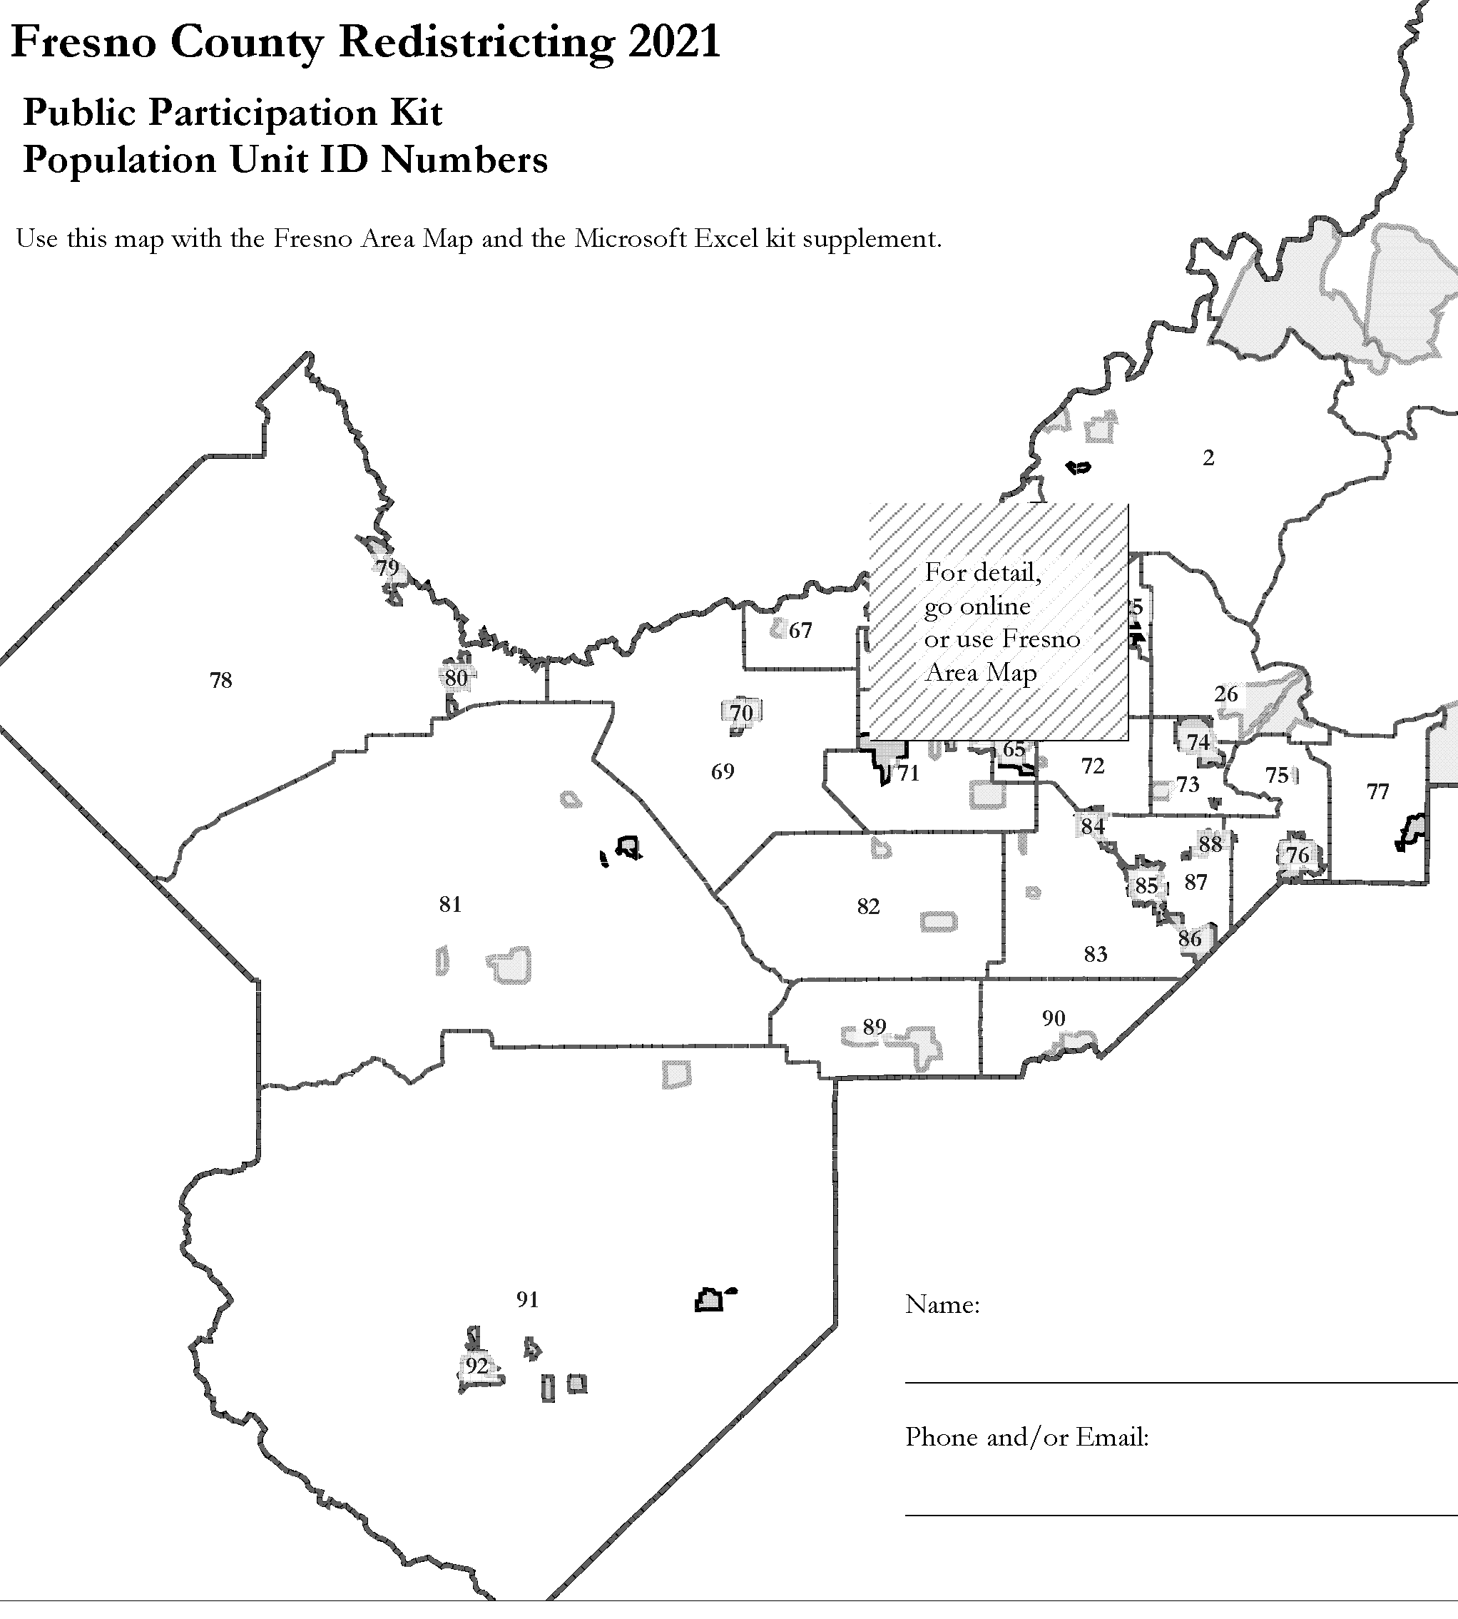
Simple Map Drawing Tool + Excel Supplement
“Public Participation Kit”
For those who know Excel and do not wish to use online tools
Adds CVAP data
Excel does the math
Geographic units would be tracts, CDP’s and smaller cities

Slide 24
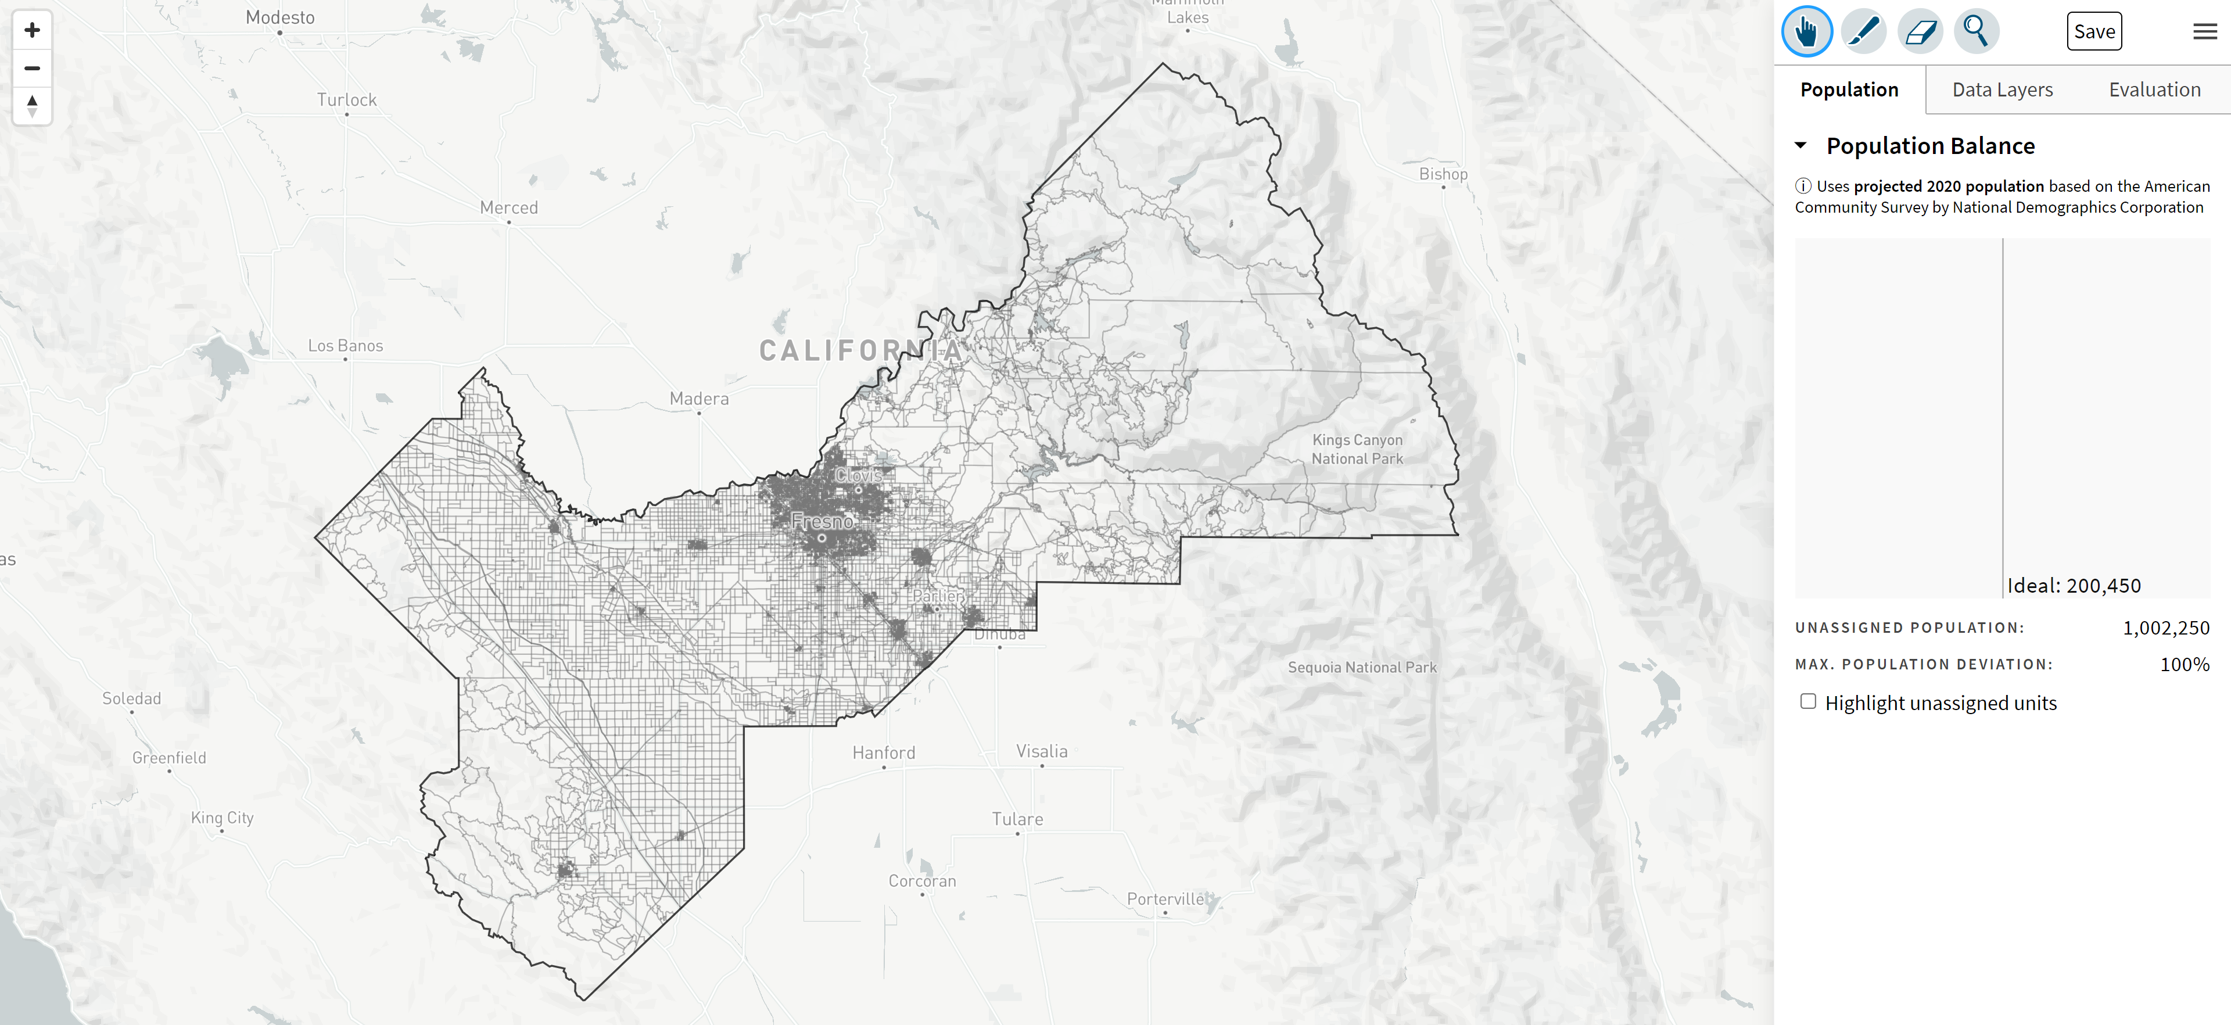
DistrictR
“Draw Your Community of Interest” focus
districtR.org/tag/Fresno
Also includes simple district-mapping tool; Only available in English
Similar external options: Representable.org, DrawMyCACommunity.org

Slide 25
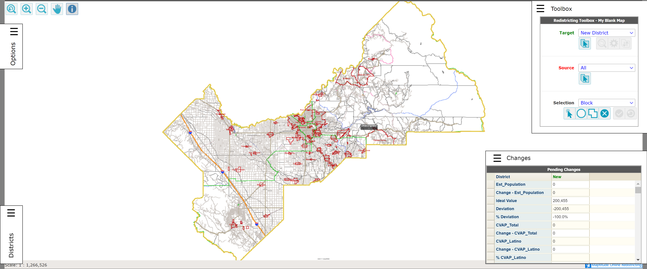
Caliper’s “Maptitude Online Redistricting”
Full Database, Powerful Online Mapping Tool
https://inzolia.caliper.com/FresnoCounty/Default.aspx
Powerful, common, data-rich online tool
Six language options: English, Spanish, Portuguese, Vietnamese, Mandarin and Korean

Slide 26
Share Your Thoughts
Website: www.co.fresno.ca.us/resources/redistricting
Phone: 559.600.1221 | Email: FresnoCounty2021Redistricting@fresnocountyca.gov

