Slide 1
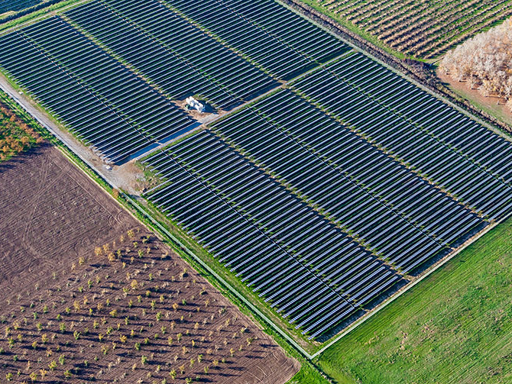
Fifth Standard Solar Project Complex
EIR Scoping Meeting
Applicant: EC&R Solar Development, LLC
Lead Agency: County of Fresno
September 27, 2017

Slide 2
Introduction and Welcome
Tonight's purpose:
To provide information on the EIR Process.
To give you a brief overview of the proposed project.
To get your input on the SCOPE OF THE EIR .
To get your feedback on the list of topics to be analyzed in the EIR.
To get your feedback on the alternatives to be analyzed in the EIR.
Separate hearings will be held on the merits of the proposed project.
September 27, 2017

Slide 3
Safety Moment
Safe Exit Routes
Dial 911

Slide 4
Agenda
1 Introduction
2 Overview of the Process
3 Explanation of the Project
4 Preliminary Scope of the EIR
5 Public Input on the Scope of the EIR

Slide 5
What is an EIR / CEQA
An informational document designed to inform the public and decision-makes about potential environmental impacts of a project.
A problem solving document that identifies ways to avoid or lessen impacts:
Mitigation Measures
Alternatives
Environmental impacts are just one of the factors considered by the decision-makers when deciding whether or not to approve a project.

Slide 6
Role of the EIR Consultant
To work with County staff to prepare a technical document that analyzes the environmental impacts of the proposed project, identify ways to lessen impacts, and which clarifies the environmental issues and choices.
The EIR Consultant is not an advocate for a particular decision.

Slide 7
Our Goal
To produce and EIR which accurately assesses the potential impacts of the proposed project.
Identifies mitigation measures, to reduce impacts.
Identifies impact-reducing alternatives.
Addresses community comments and concerns.
Provide the County's decision-makers with the information necessary to understand the environmental consequences of the proposed project, and the environmental trade-offs associated with the proposed project and the alternatives.

Slide 8
Steps in the EIR Process and Opportunities for Input
NOP
Develop Project Description and NOP
Project DEIR
Admin Draft EIR
Project FEIR
Admin Draft Response to Comments
30 Day Public Review
Public Scoping Hearing (THAT’S TONIGHT 9-27-2017)
Public Draft EIR
45 Day Public Comment Period
Public Hearing
MMRP
Public Draft FEIR
15 Day Public Review
FEIR Certification Hearing and Project Approval
Agency Permitting
Year 1
Estimated Timeline

Slide 9
How to Keep Informed
Notices will be published in the local paper: Hanford Sentinel and Business Journal.
The Draft EIR will be available at the County Government Building
The NOP is currently available at the County Government Building. Copies have been sent to adjacent property owners.
If you specifically request Notice in writing, the County will send you Notice.

Slide 10
Fifth Standard Solar Project Complex
The primary components of the proposed project include:
Fifth Standard Solar Facility (Fifth Standard):
150 MW PV solar
Approximately: 1,400 acres
Stonecrop Solar Facility (Stonecrop):
20 MW PV solar
Approximately 200 acres
Blackbriar Battery Storage Facility (Blackbriar):
20 MW battery storage facility
Approximately 5 acres
Other Project Improvements:
Onsite substation
0.3-mile-long 230KV transmission line connecting to PG&E’s Gates Substation
Project site security fencing
Access roads and electrical equipment

Slide 11
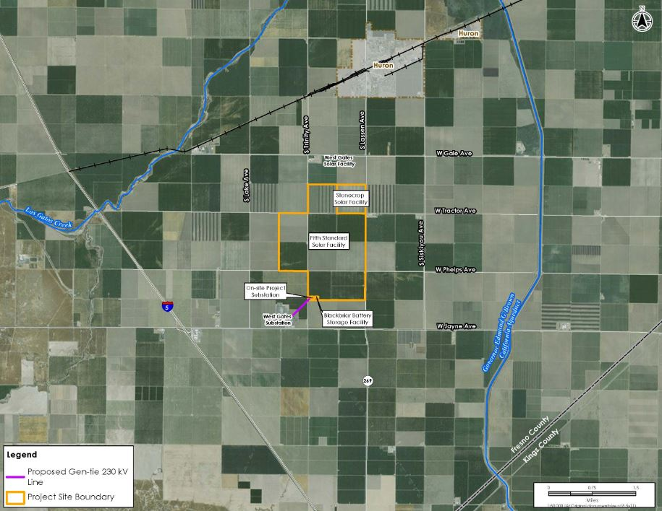
Project Location

Slide 12
Topics Identified in NOP to be Addressed in the EIR
Aesthetics
Agricultural
Air Quality
Biological Resources
Cultural Resources
Geology, Soils, and Seismicity
Greenhouse Gas Emissions
Hazards / Hazardous Materials
Hydrology and Water Quality
Land Use and Planning
Mineral Resources
Noise
Public Services
Transportation and Traffic
Tribal Cultural Resources
Utility and Service Systems
* Certain criteria within the topics listed above have been scoped out of further analysis.

Slide 13
Helping Us with the Scope
If you think the NOP missed something, your comments help us most when you specify:
The specific environmental topic you think needs to be addressed:
Example: Potential impact of project on farming equipment movement.
Why you think the project has the potential to result in a significant impact:
Example: You know of a recent published report showing that an endangered species is present on the site that was not discussed in the NOP.

Slide 14
Next Steps….
Comment on the Scope of the EIR:
NOP review and comment period begins September 15, 2017, and ends October 16, 2017, at 5:00 p.m. All comments must be received within the comment period.
Next Opportunity to Comment: Draft EIR
County Project Website: http://www.co.fresno.ca.us/viewdocument.aspx?id=74079
County Planner Contact:
Fresno County Department of Public Works and Planning
Attention: Christina Monfette
2220 Tulare Street, 6th Floor
Fresno, CA 93721
cmonfette@co.fresno.ca.us

