Slide 1
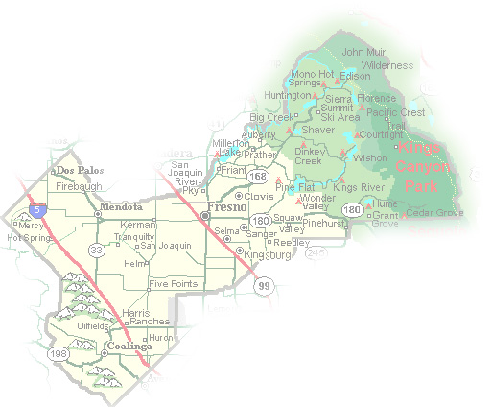
DEPARTMENT of PUBLIC WORKS and PLANNING
DEVELOPMENT SERVICES DIVISION
CUP 3618

Slide 2
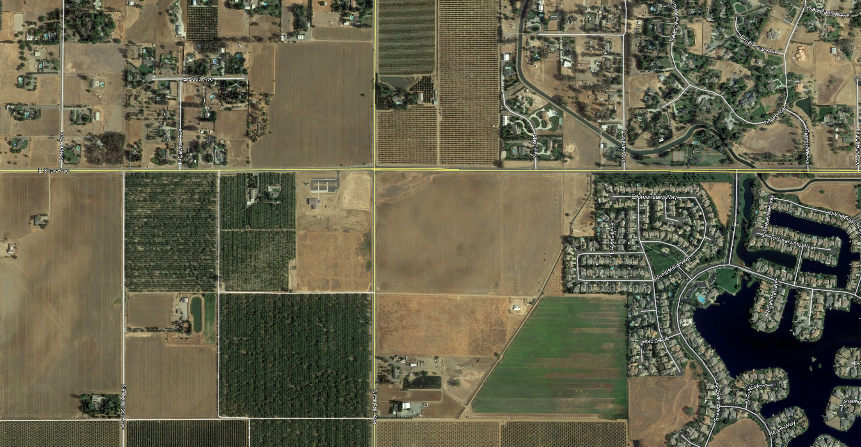
N
Shaw Ave.
Project site
Quail Lakes
McCall Ave.

Slide 3
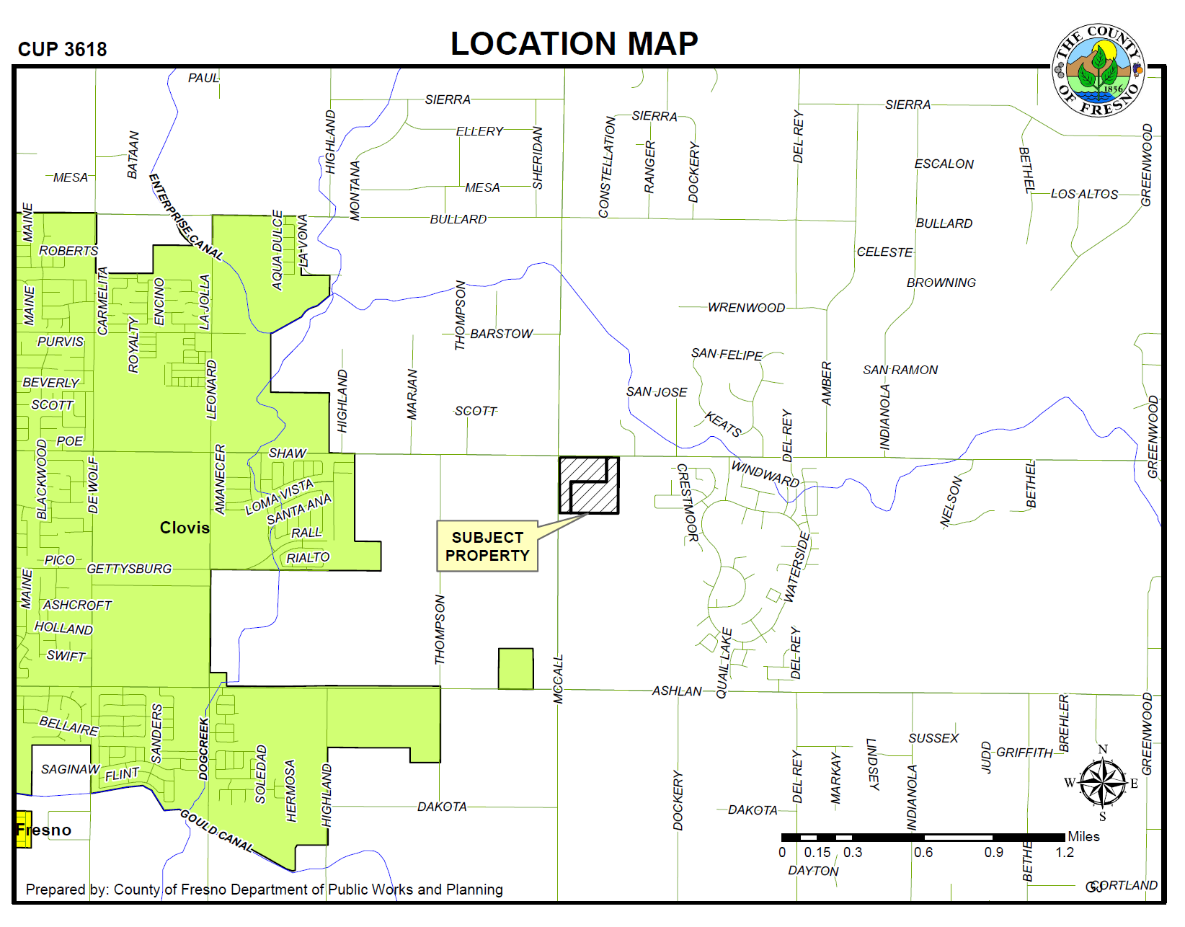

Slide 4
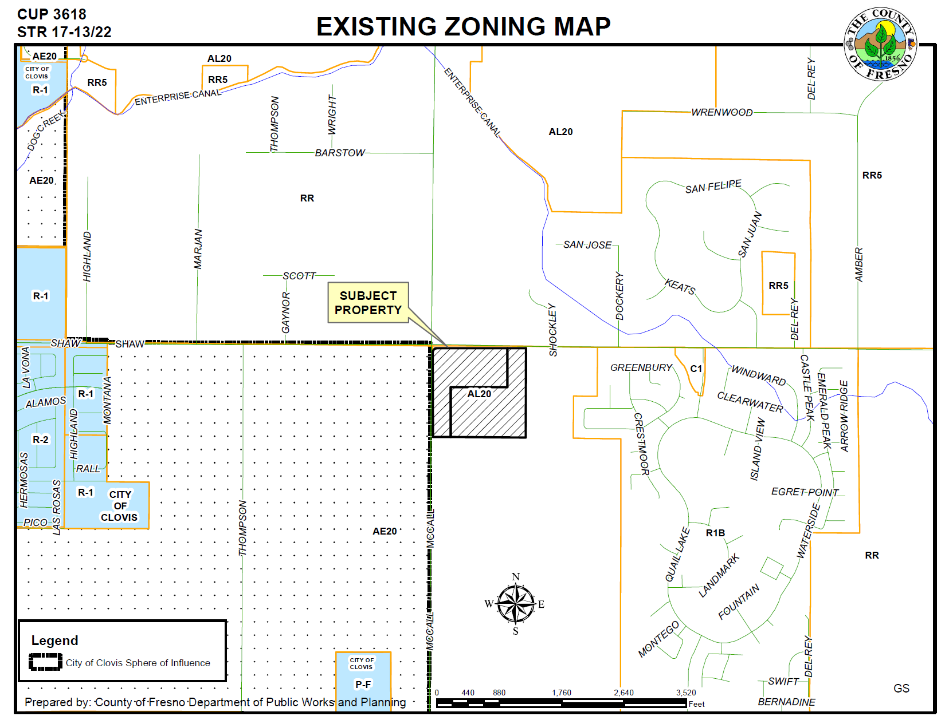

Slide 5
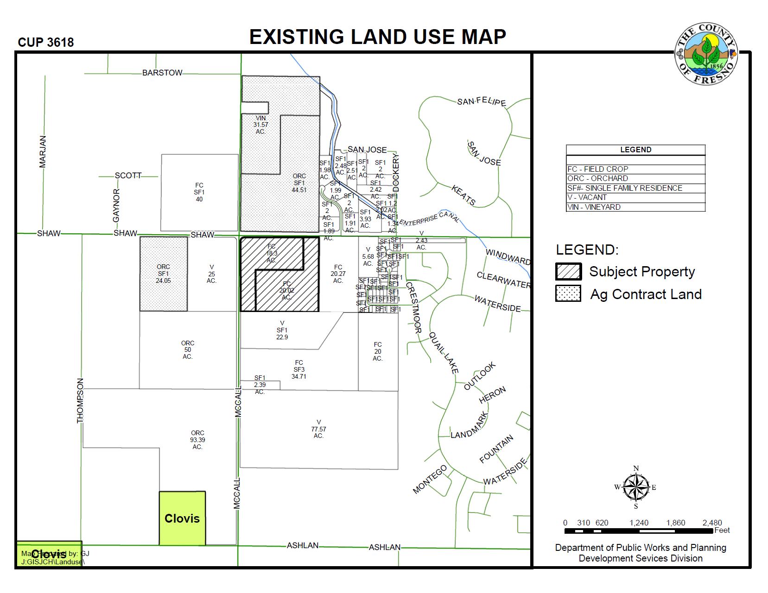

Slide 6
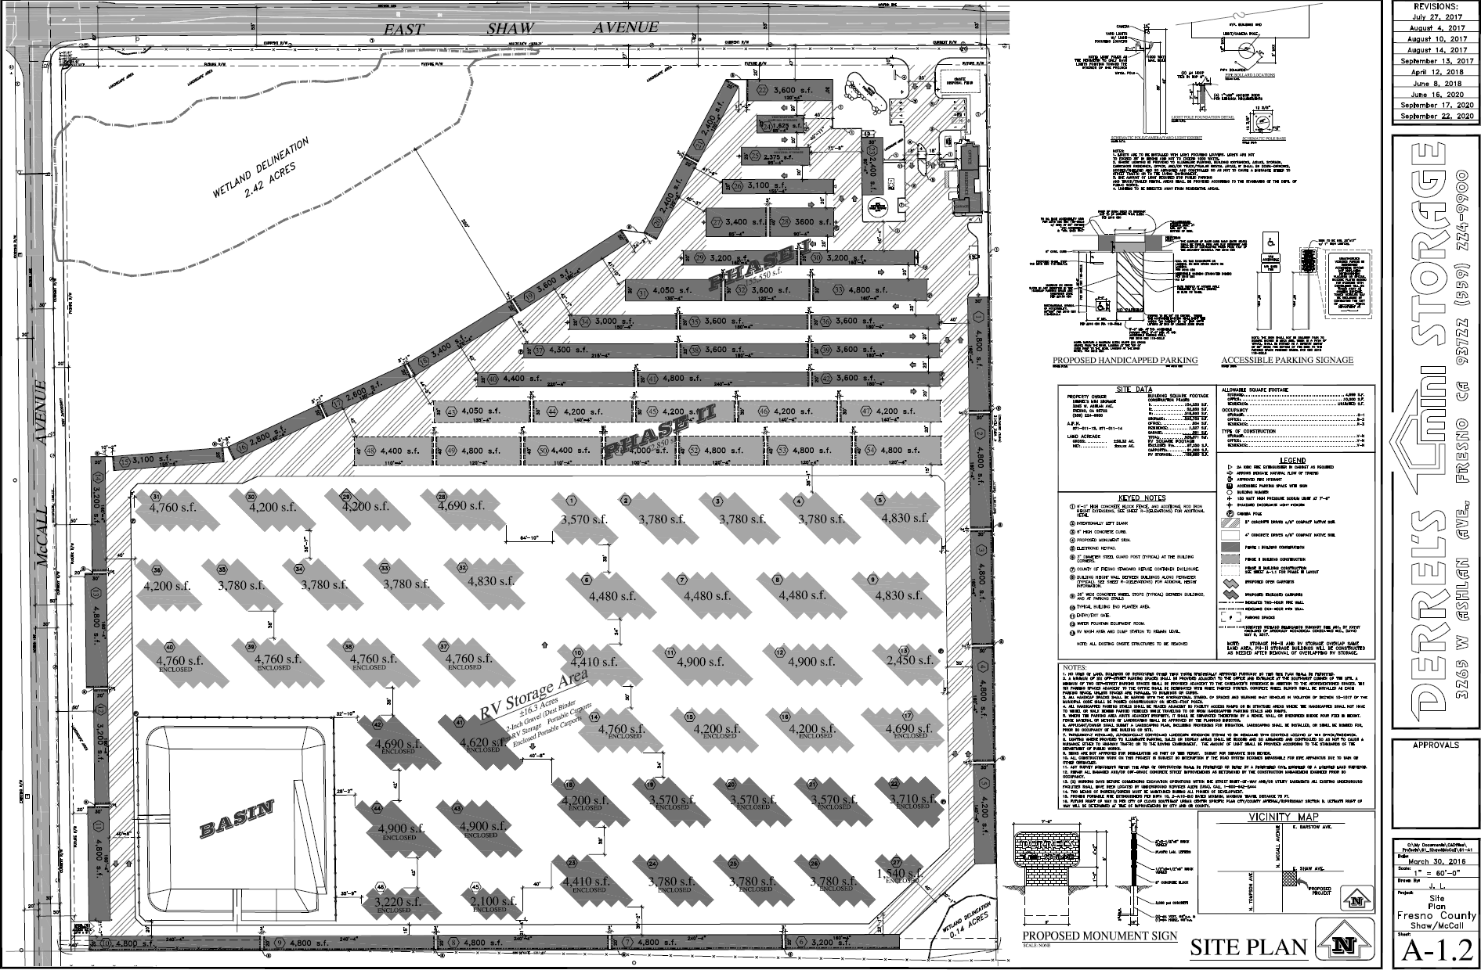

Slide 7
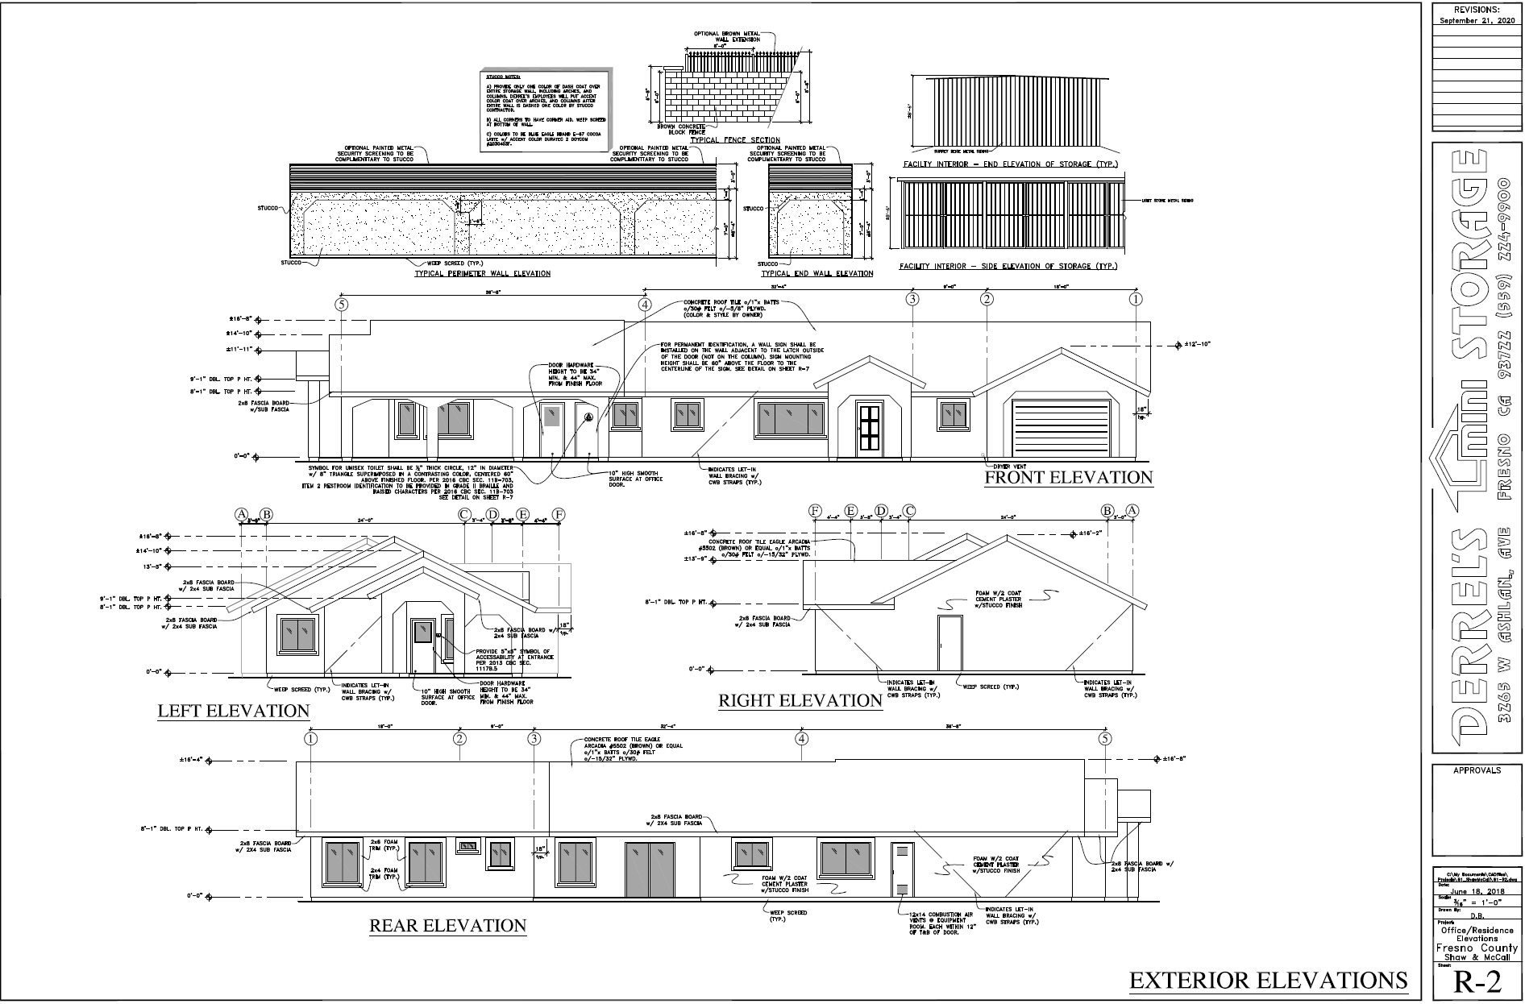

Slide 8
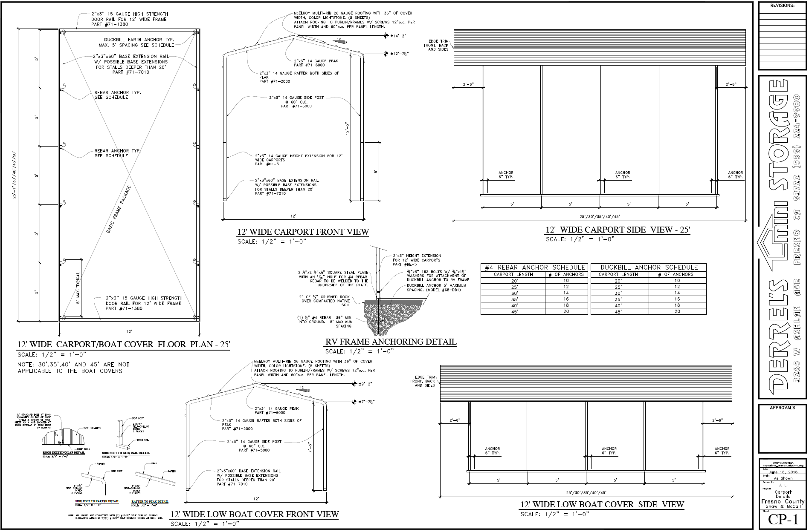

Slide 9
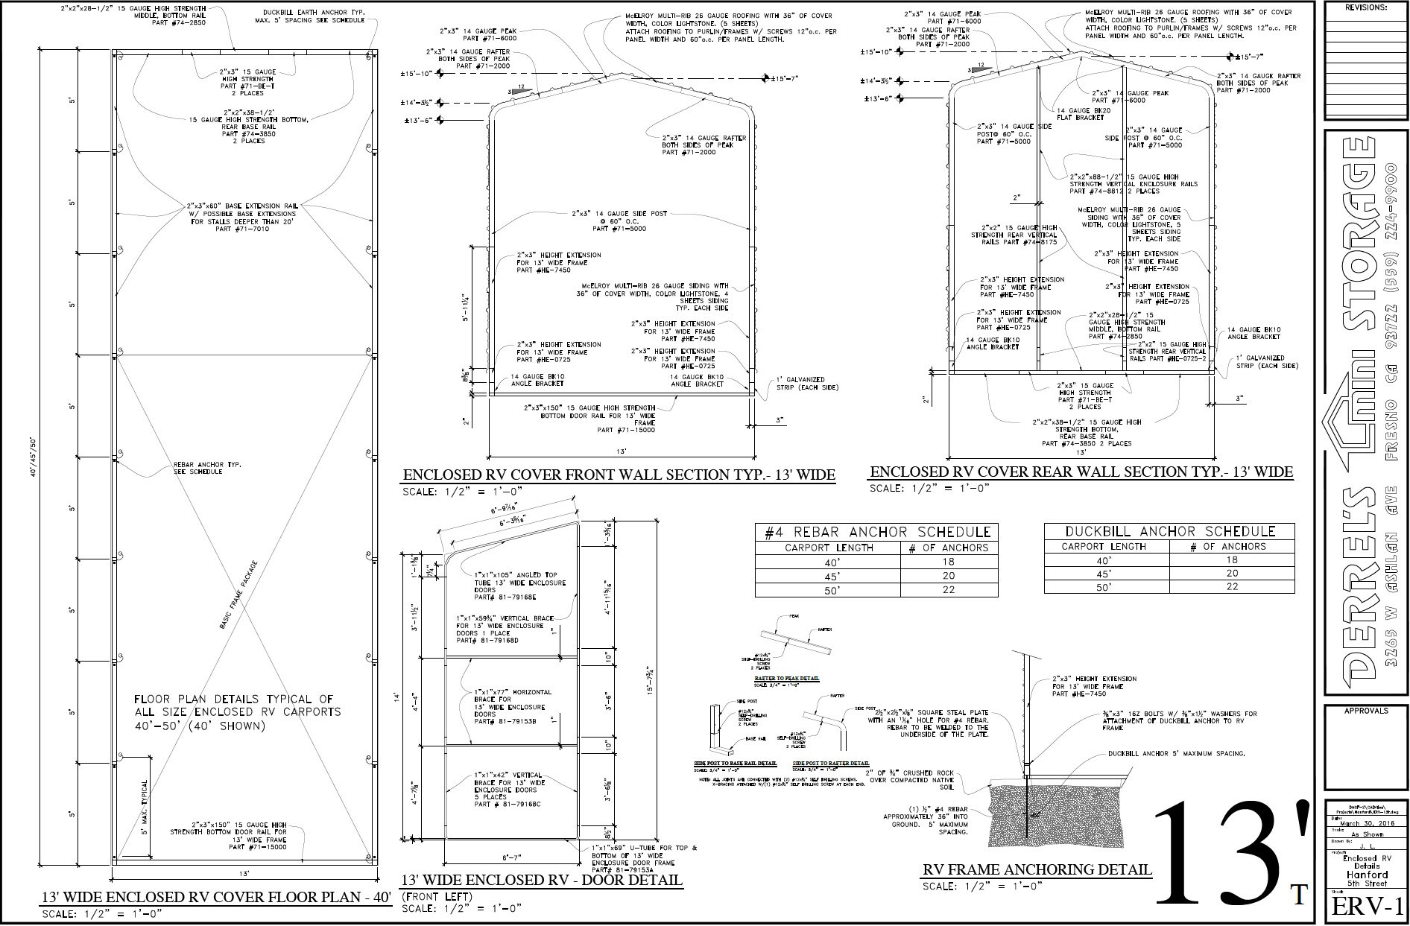

Slide 10
N
Shaw Ave.
Project site
Quail Lakes
McCall Ave.
FINDINGS
Adequate Size and Shape of the parcel
Adequacy of Streets and Highways serving the parcel
No Adverse Effects Upon surrounding property
Consistency with the General Plan
That the conditions stated in the resolution are deemed necessary to protect the public health, safety and general welfare.

Slide 11
DEPARTMENT of PUBLIC WORKS and PLANNING
DEVELOPMENT SERVICES DIVISION
CUP 3618

Slide 12
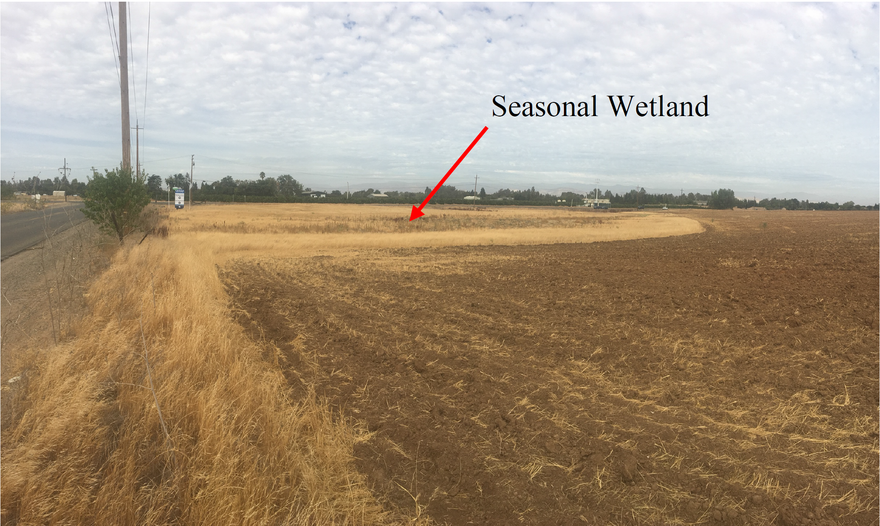

Slide 13
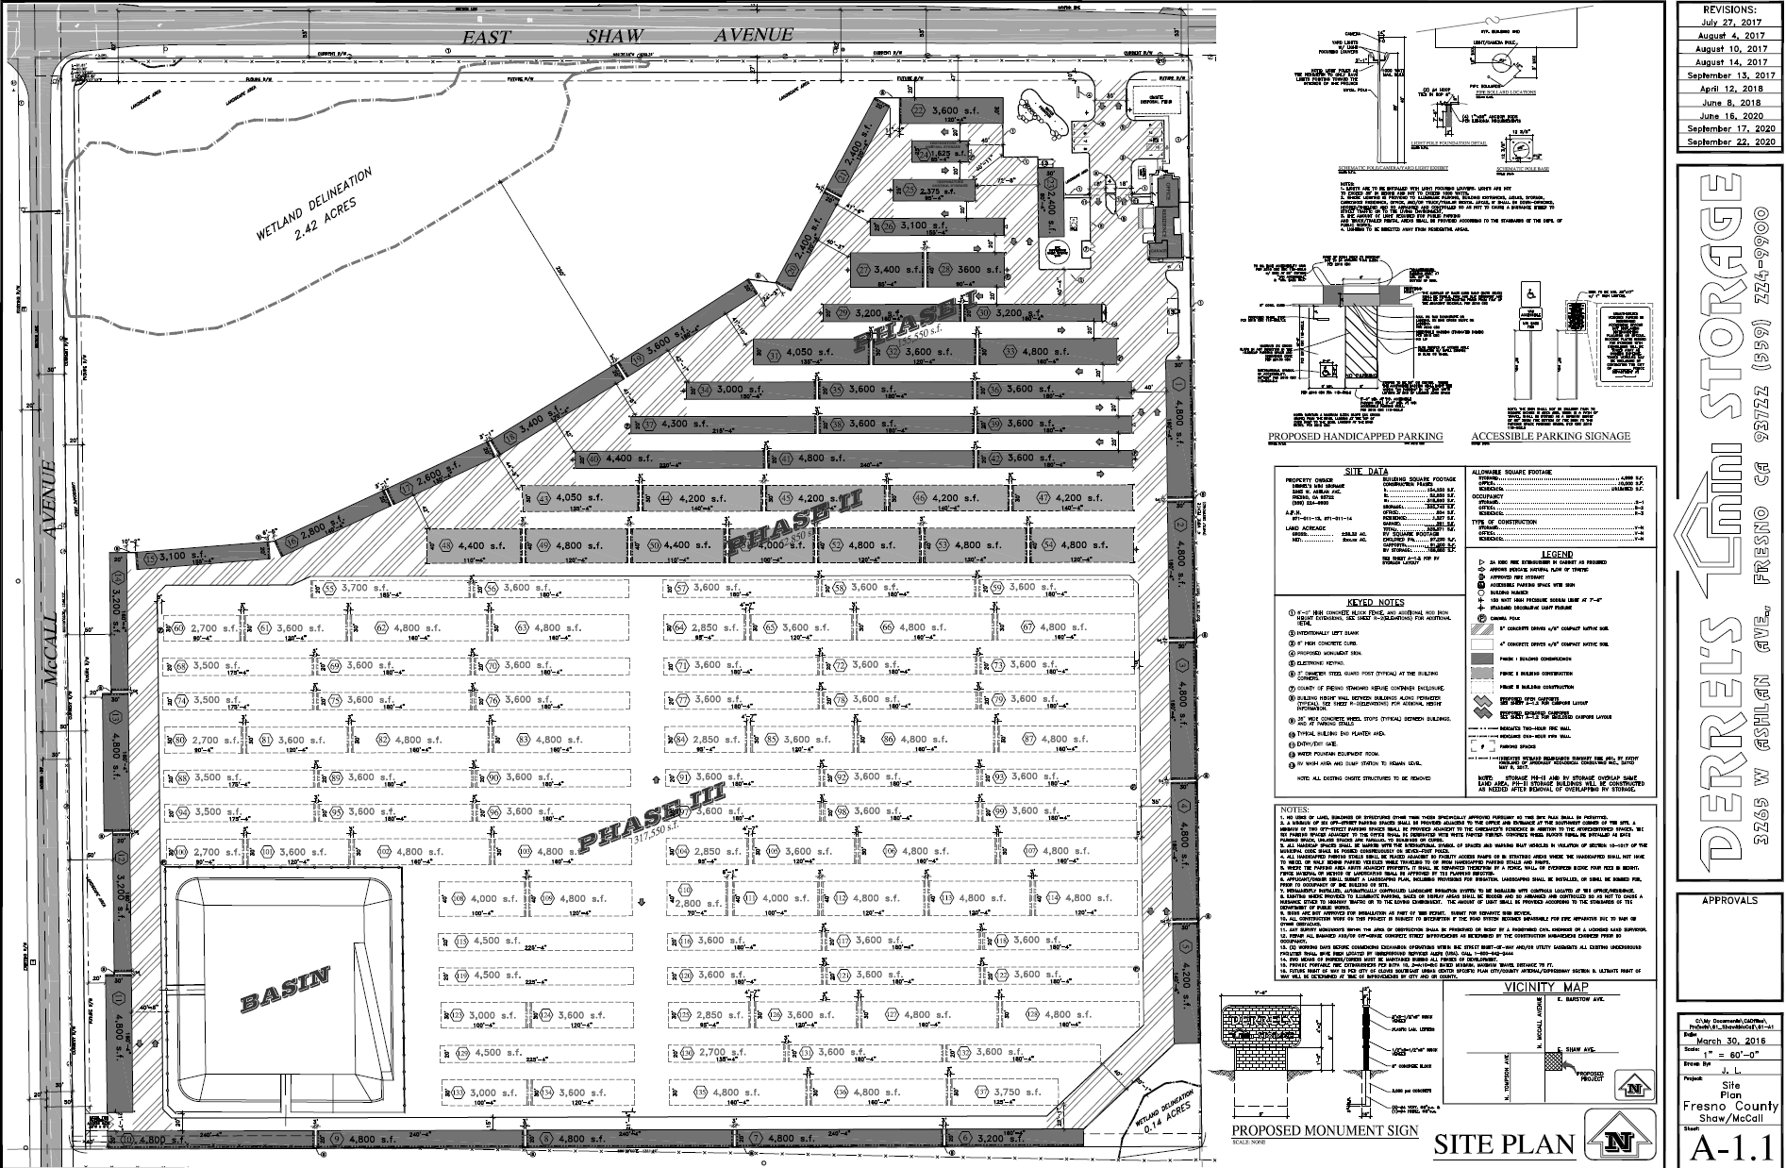

Slide 14
