Slide 1
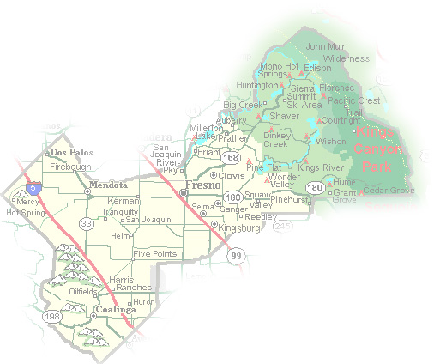
DEPARTMENT of PUBLIC WORKS and PLANNING
DEVELOPMENT SERVICES & CAPITAL PROJECTS DIVISION
VA 4097

Slide 2
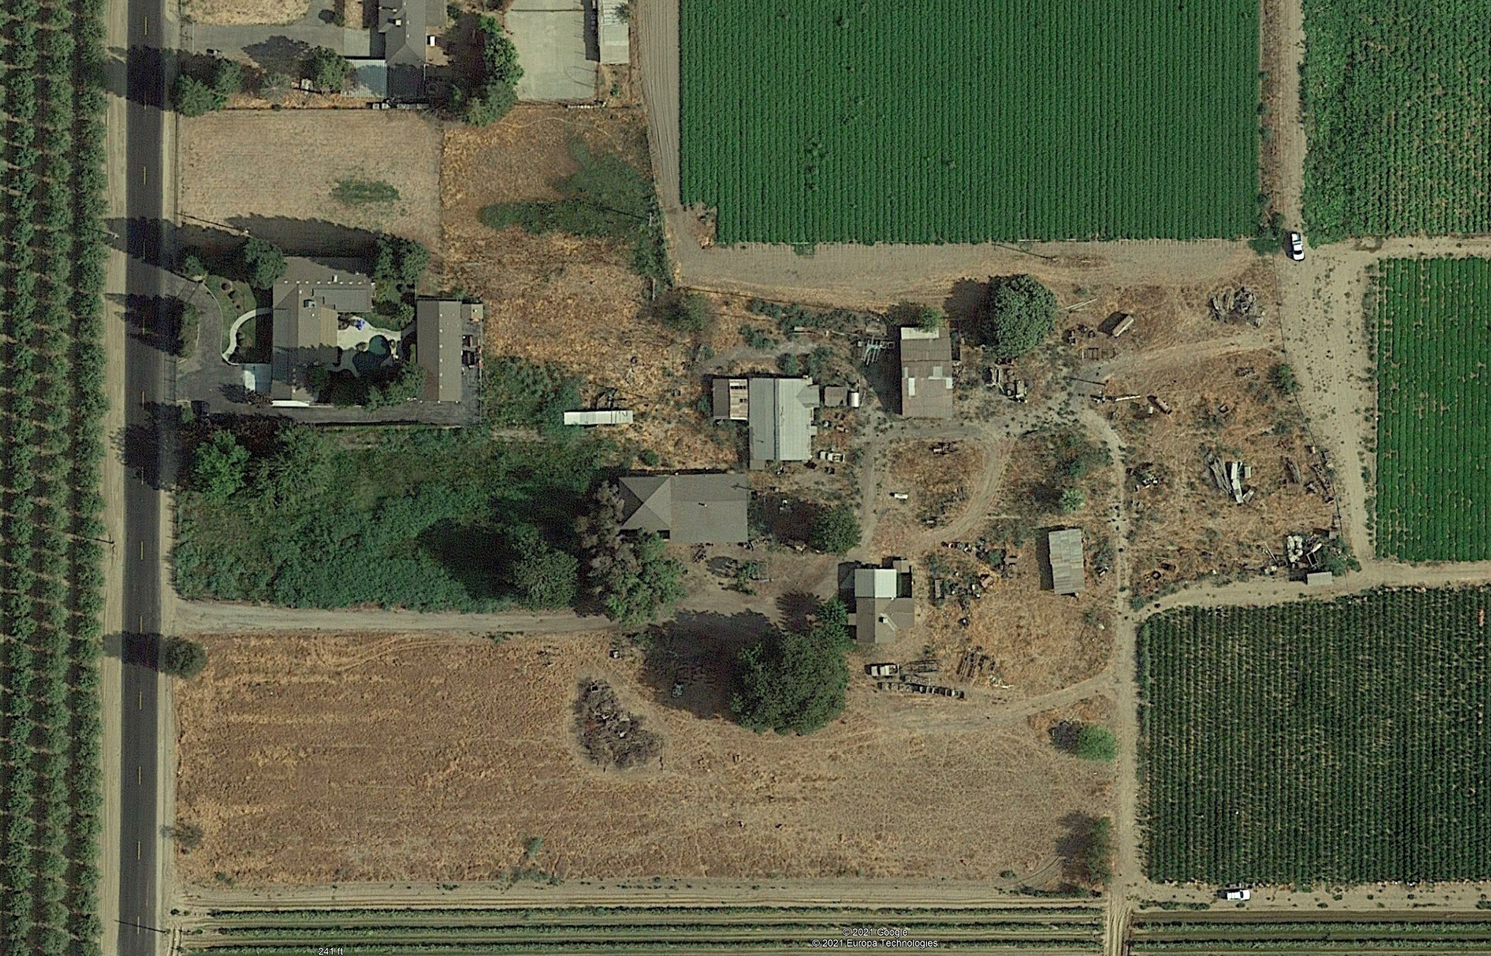
Parcel B
0.94 acre
Parcel A
17.84 acres
Property line encroachment
Garage/Accessory Living Quarters

Slide 3
Parcel B
1.03 acres
Parcel A
17.75 acres
15’ rear yard
setback
Garage/Accessory Living Quarters

Slide 4
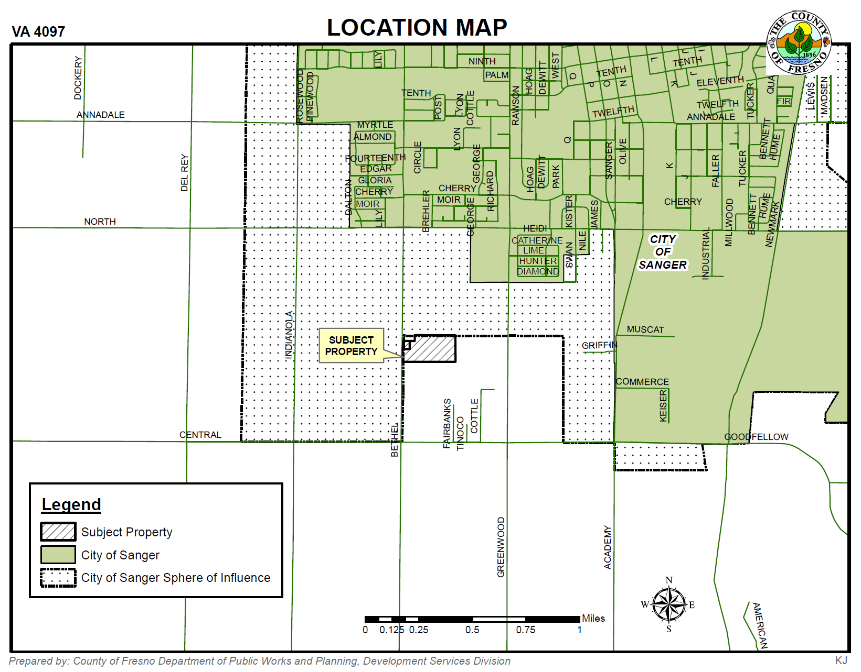

Slide 5
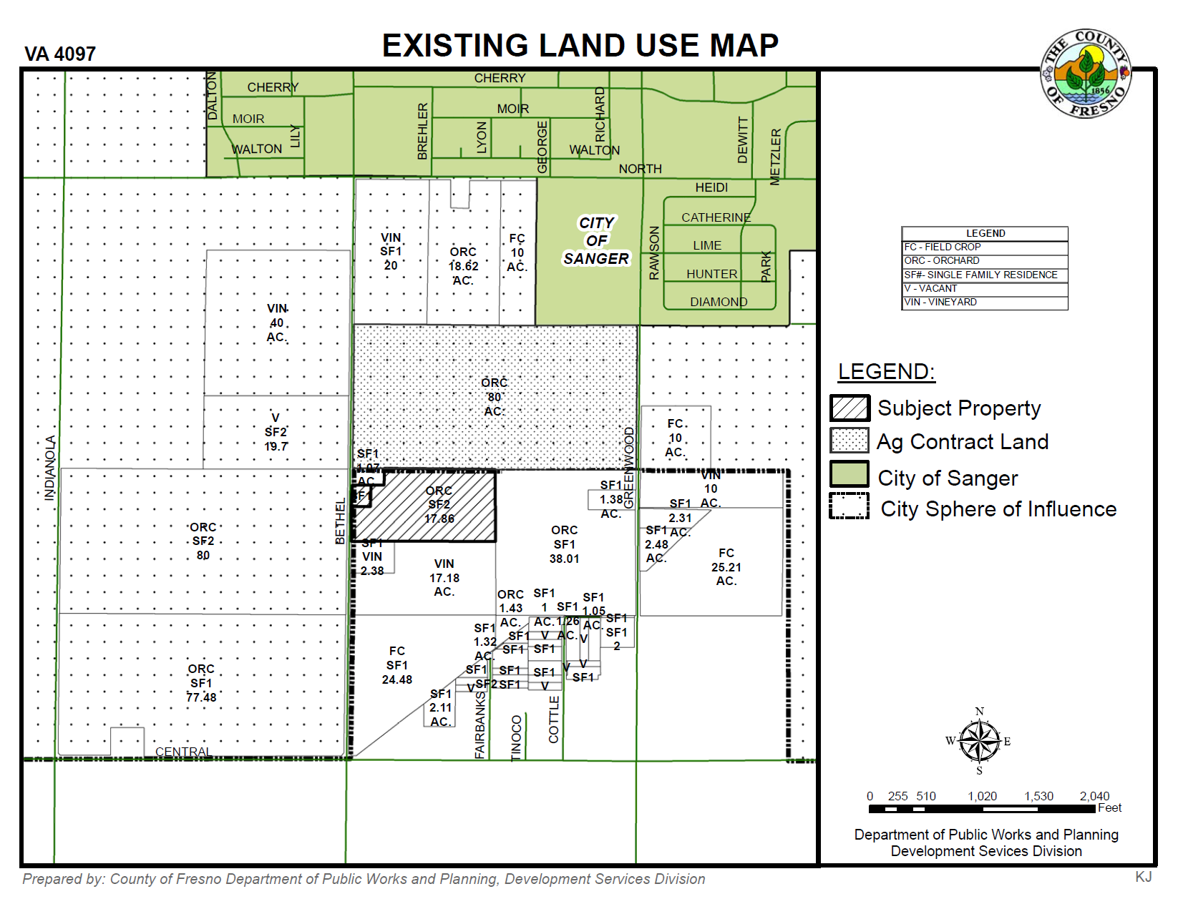

Slide 6
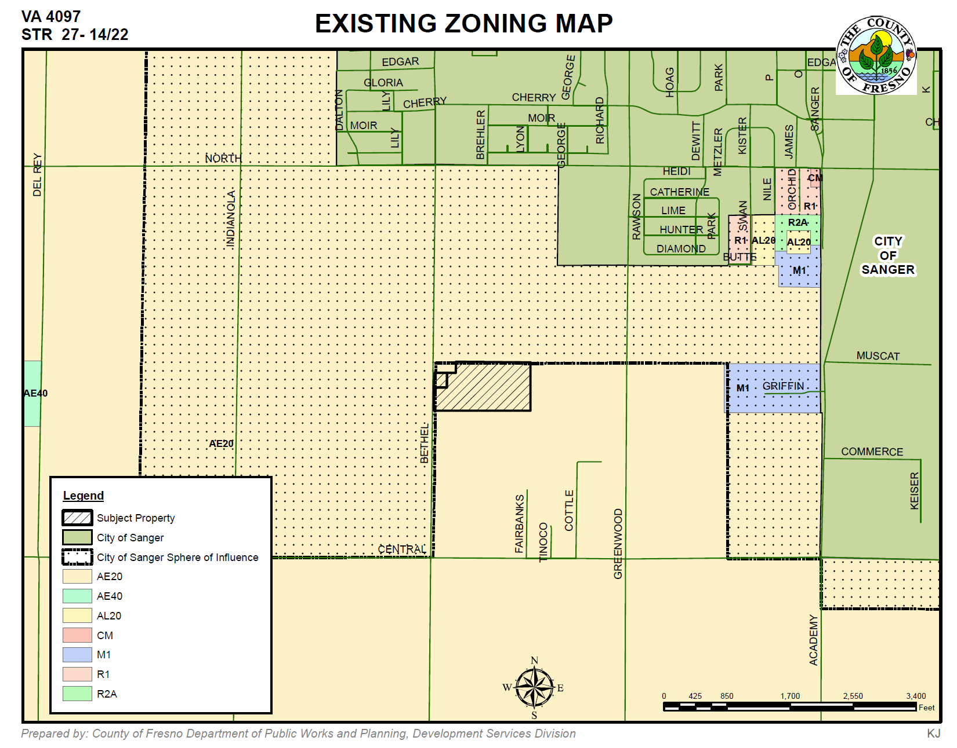

Slide 7
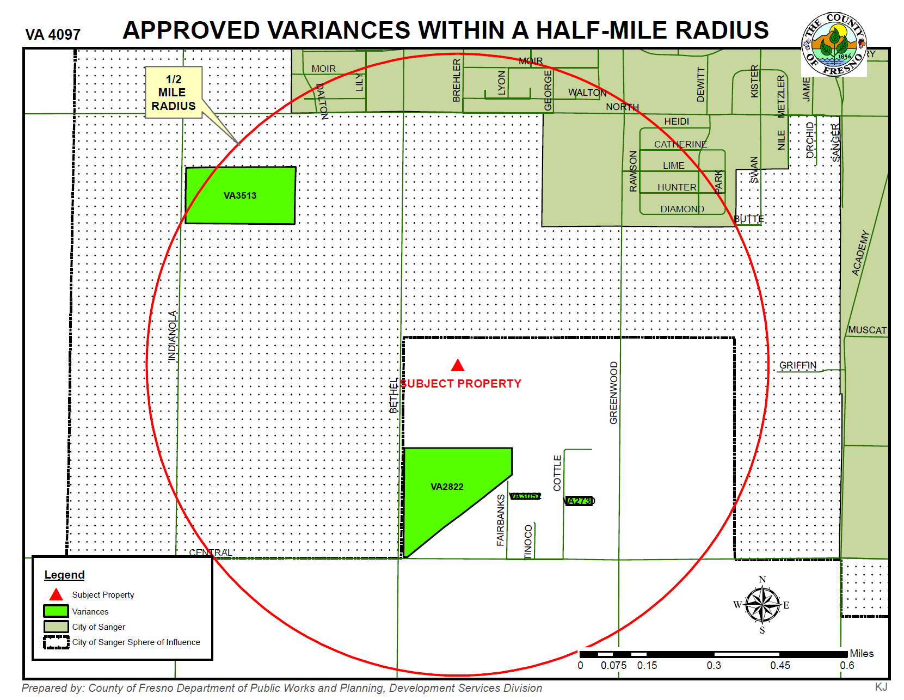

Slide 8
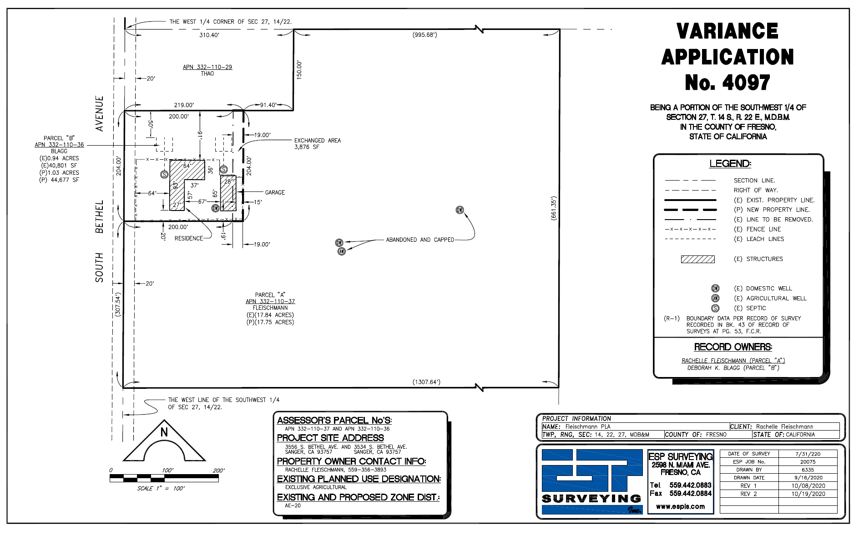
Parcel B
Parcel A

Slide 9
Parcel B
1.03 acres
Parcel A
17.75 acres
15’ rear yard
setback
Garage/Accessory Living Quarters
FINDINGS
There are exceptional or extraordinary circumstances or conditions applicable to the property involved which do not apply generally to other property in the vicinity having the identical zoning classification; and
Such Variance is necessary for the preservation and enjoyment of a substantial property right of the applicant, which right is possessed by other property owners under like conditions in the vicinity having the identical zoning classification.
The granting of a variance will not be materially detrimental to the public welfare or injurious to property and improvement in the vicinity in which the property is located.
The granting of such a variance will not be contrary to the objectives of the General Plan.

Slide 10
DEPARTMENT of PUBLIC WORKS and PLANNING
DEVELOPMENT SERVICES & CAPITAL PROJECTS DIVISION
VA 4097

