Slide 1
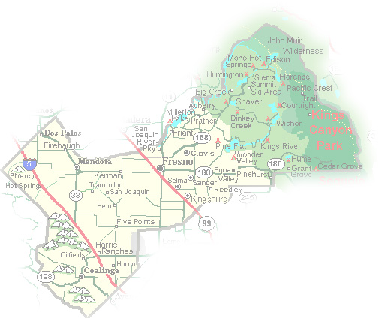
DEPARTMENT of PUBLIC WORKS and PLANNING
DEVELOPMENT SERVICES DIVISION
VA 4098

Slide 2
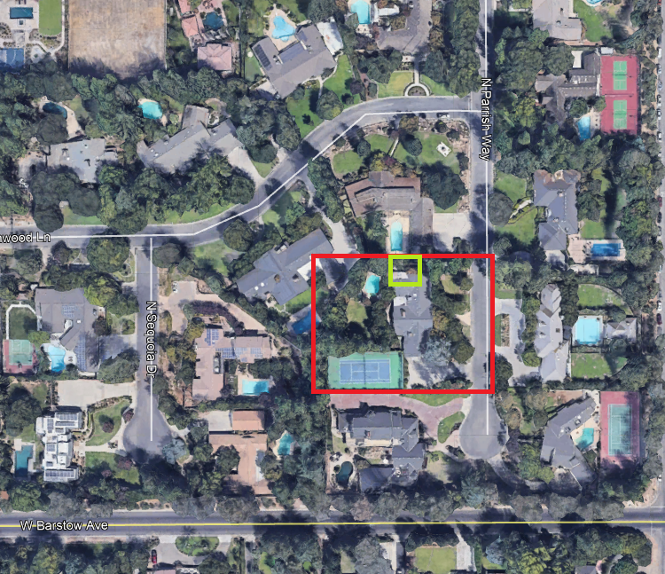
Aerial Image

Slide 3
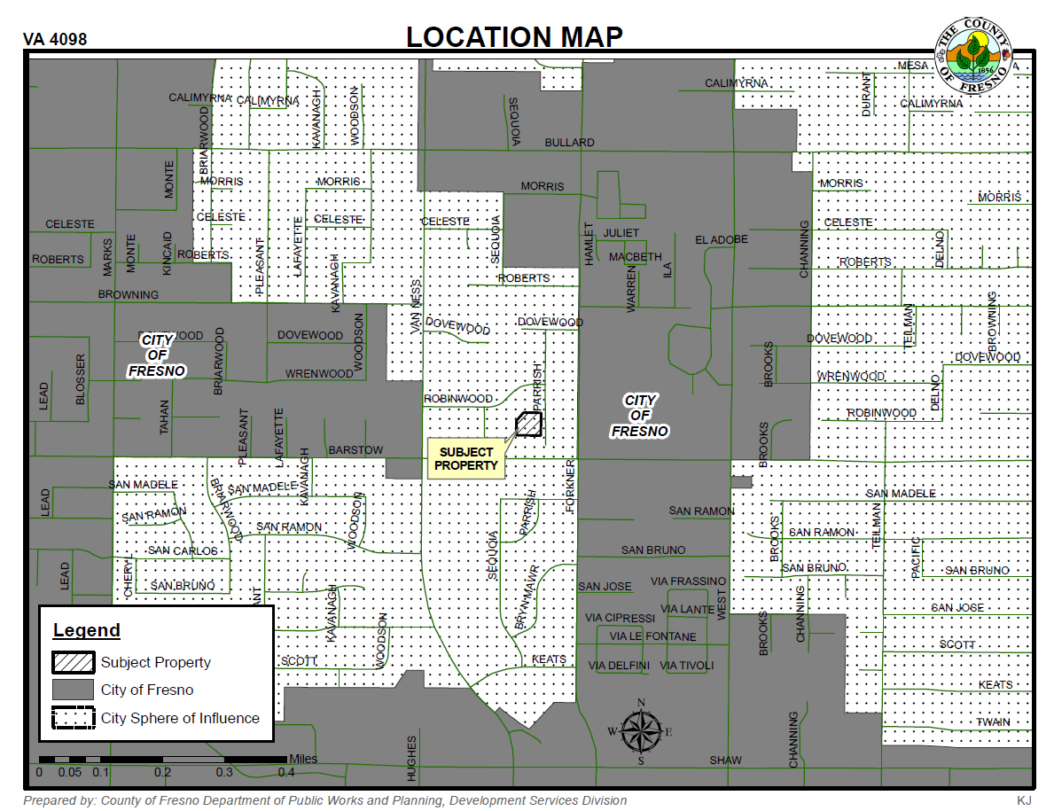

Slide 4
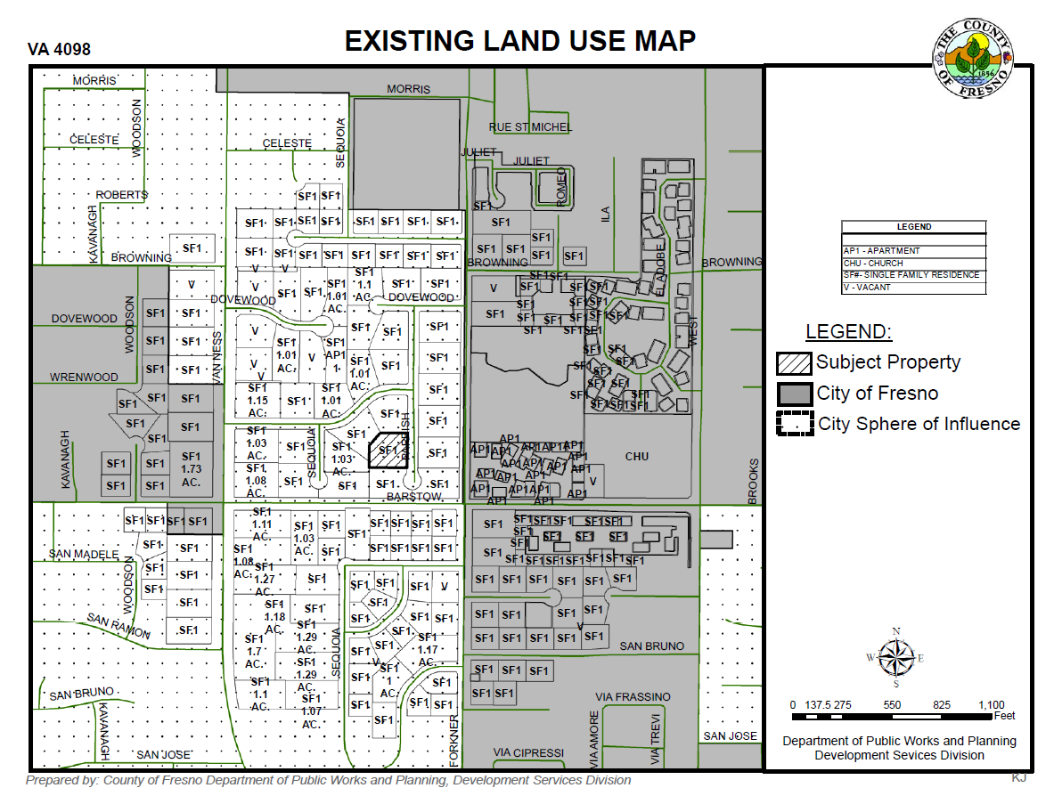

Slide 5
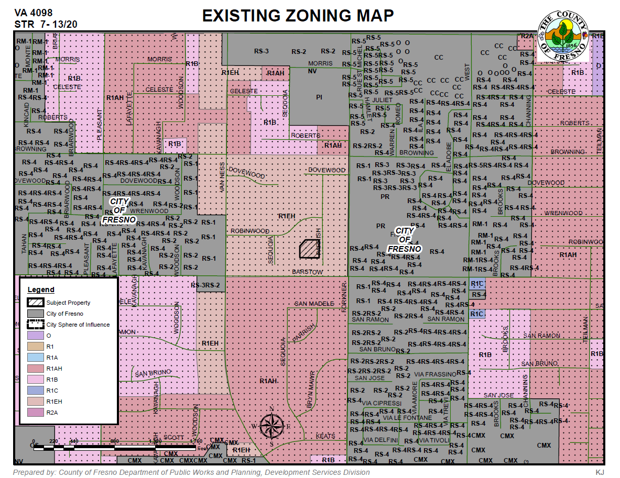

Slide 6
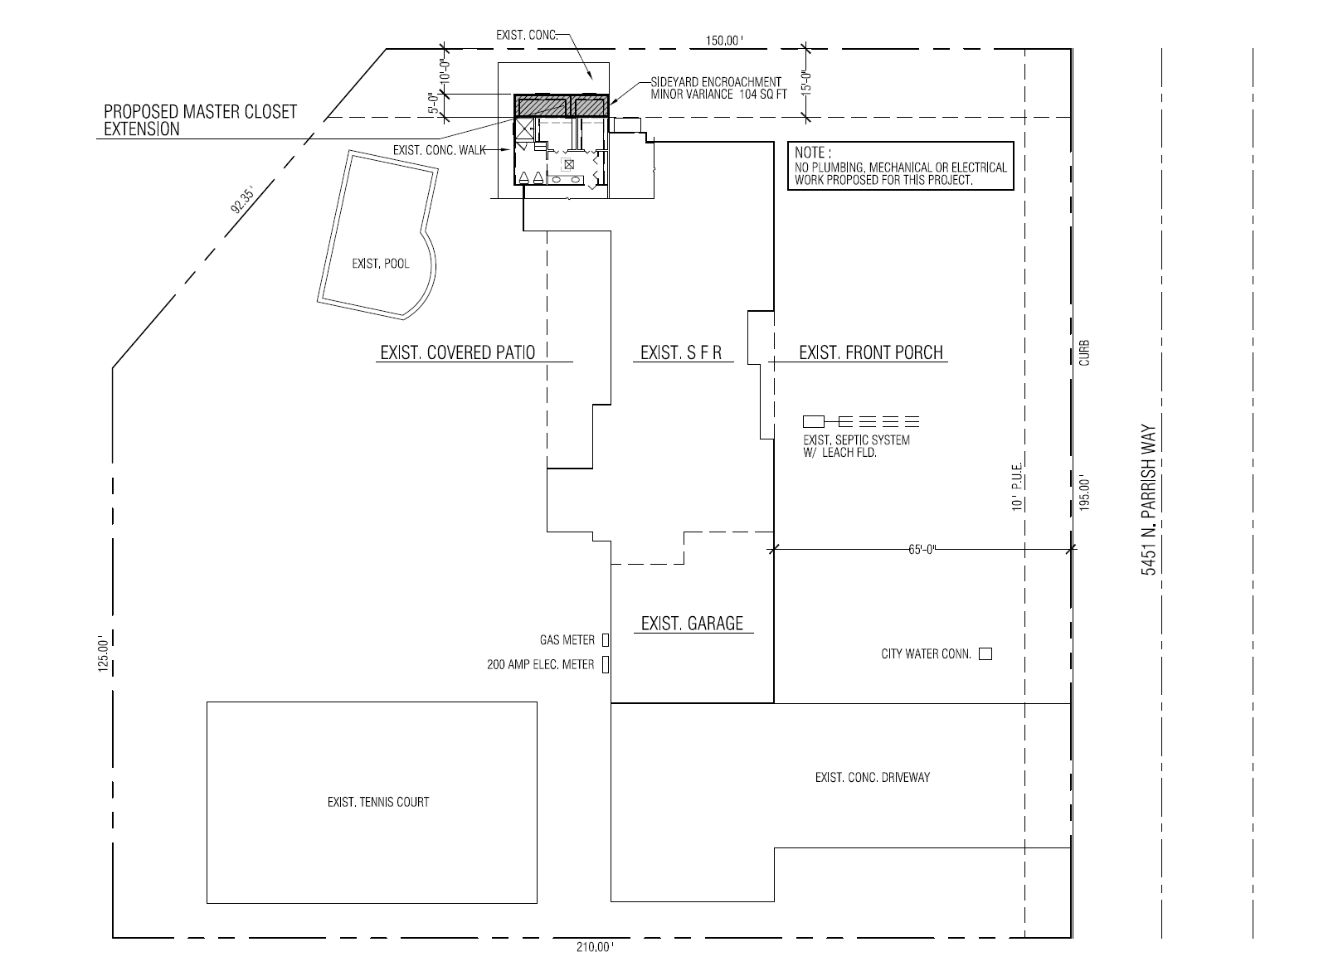

Slide 7
Mandatory Findings
1. There are exceptional or extraordinary circumstances or conditions applicable to the property involved which do not apply generally to other property in the vicinity having the identical zoning classification
2. Such Variance is necessary for the preservation and enjoyment of a substantial property right of the applicant, which right is possessed by other property owners under like conditions in the vicinity having the identical zoning classification.
3. That the proposed use will have no adverse effect on abutting property and surrounding neighborhood or the permitted use thereof
4. That the proposed development is consistent with the General Plan

