Slide 1
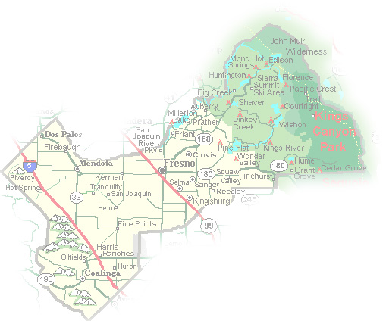
DEPARTMENT of PUBLIC WORKS and PLANNING
DEVELOPMENT SERVICES DIVISION
VA 4104

Slide 2
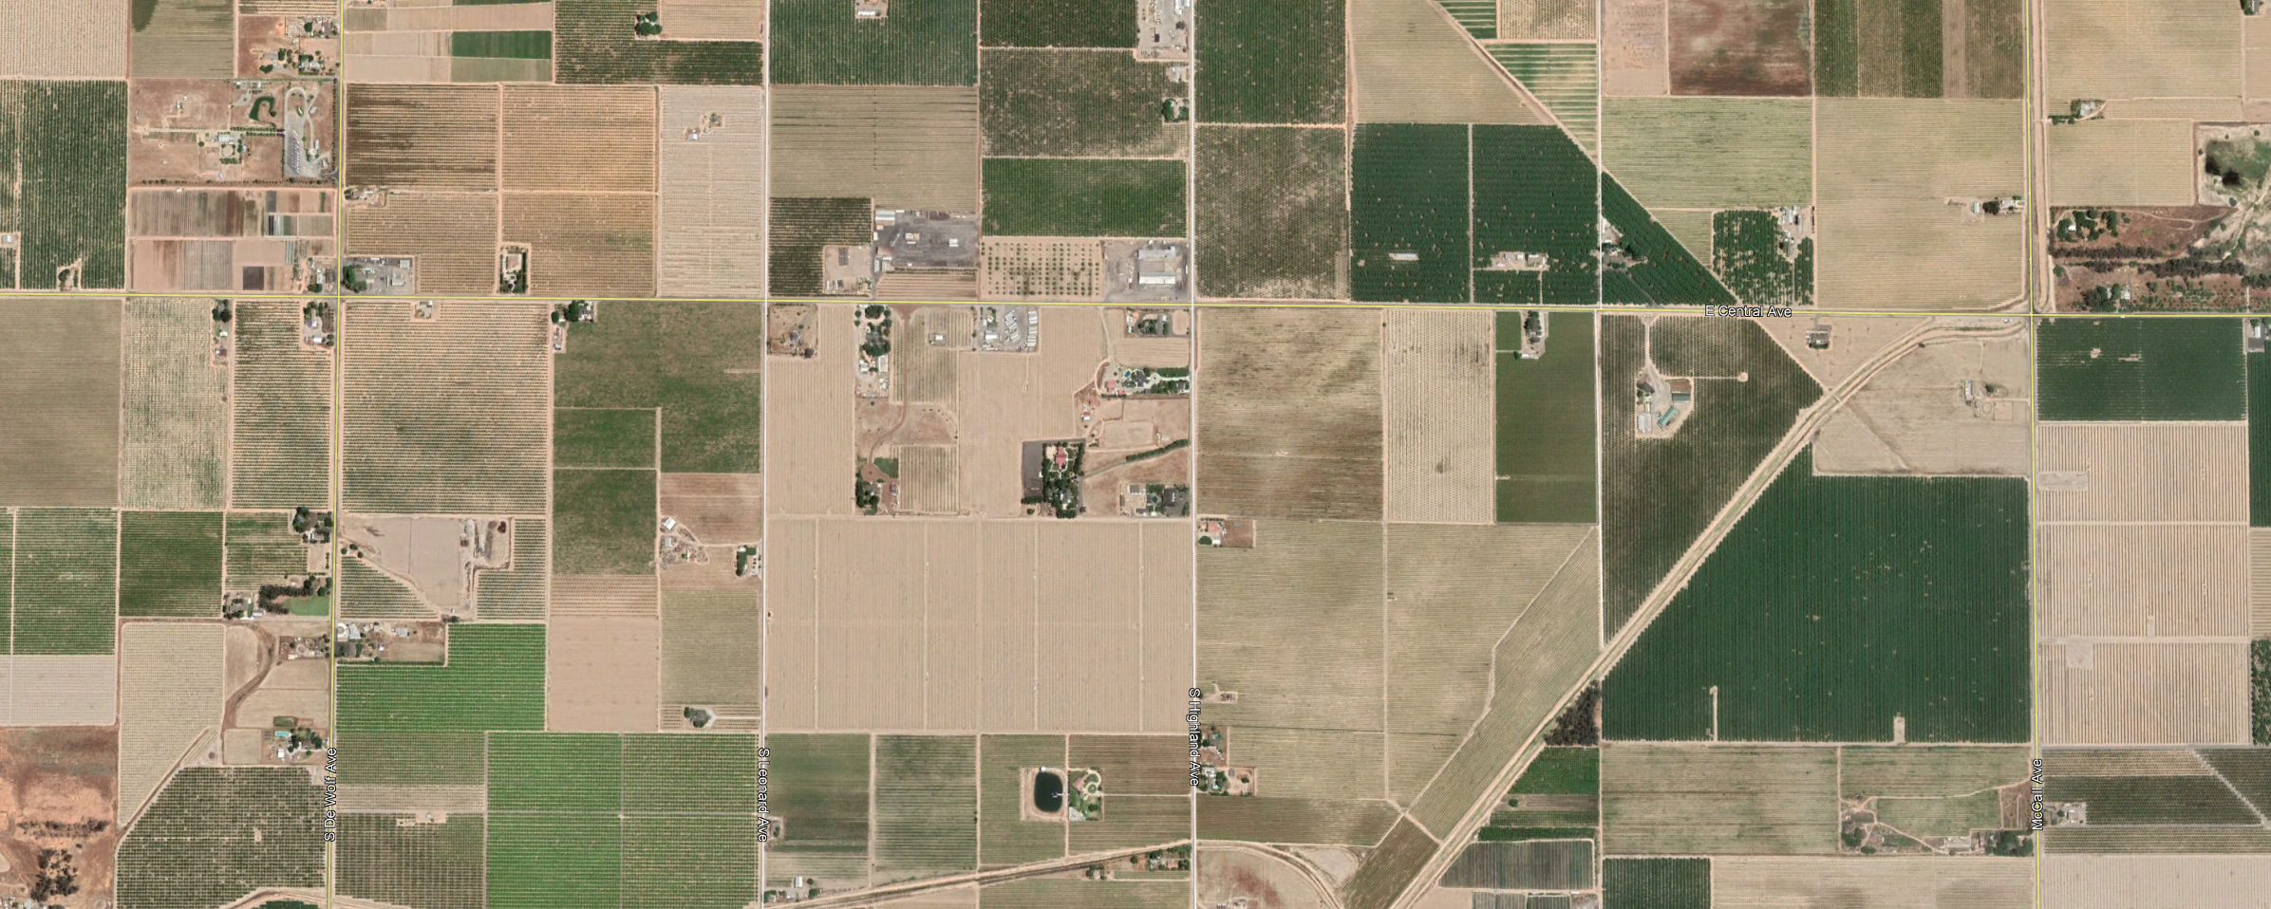
16.92 acres

Slide 3
11.55 acres
5.37 acres

Slide 4
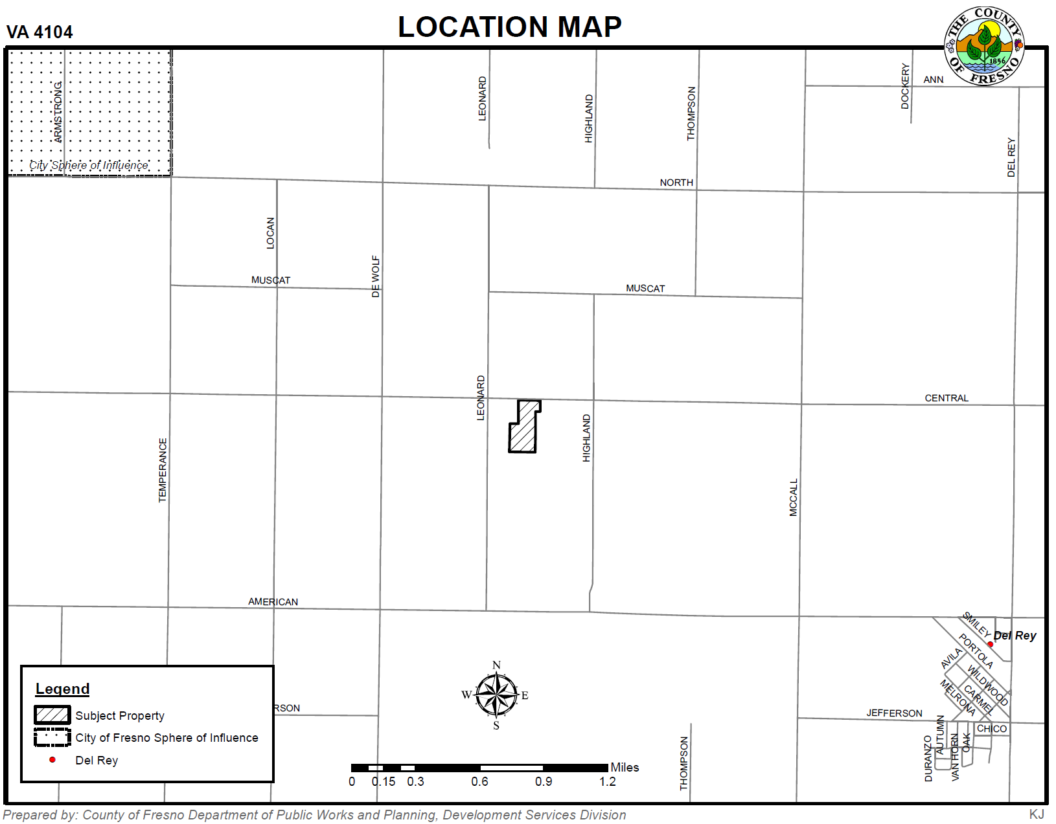

Slide 5
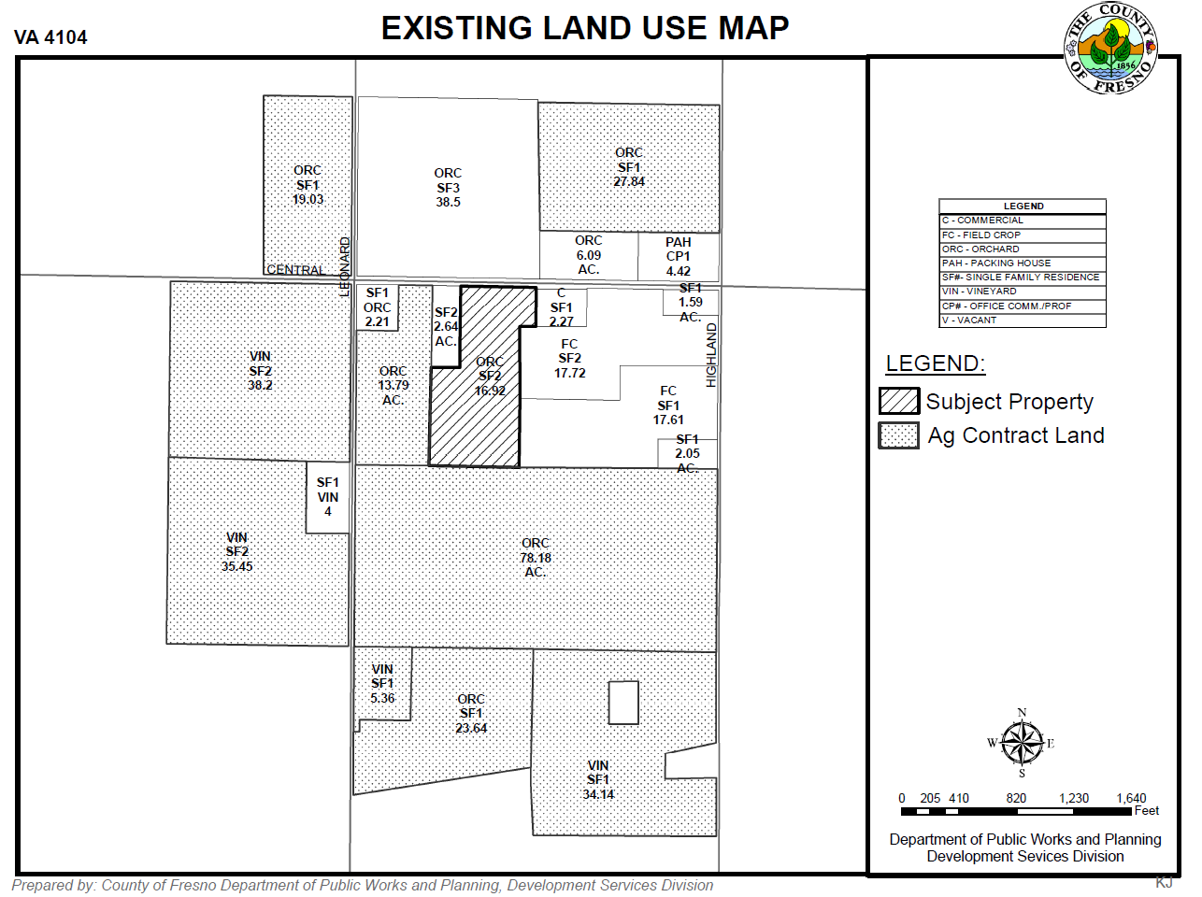

Slide 6
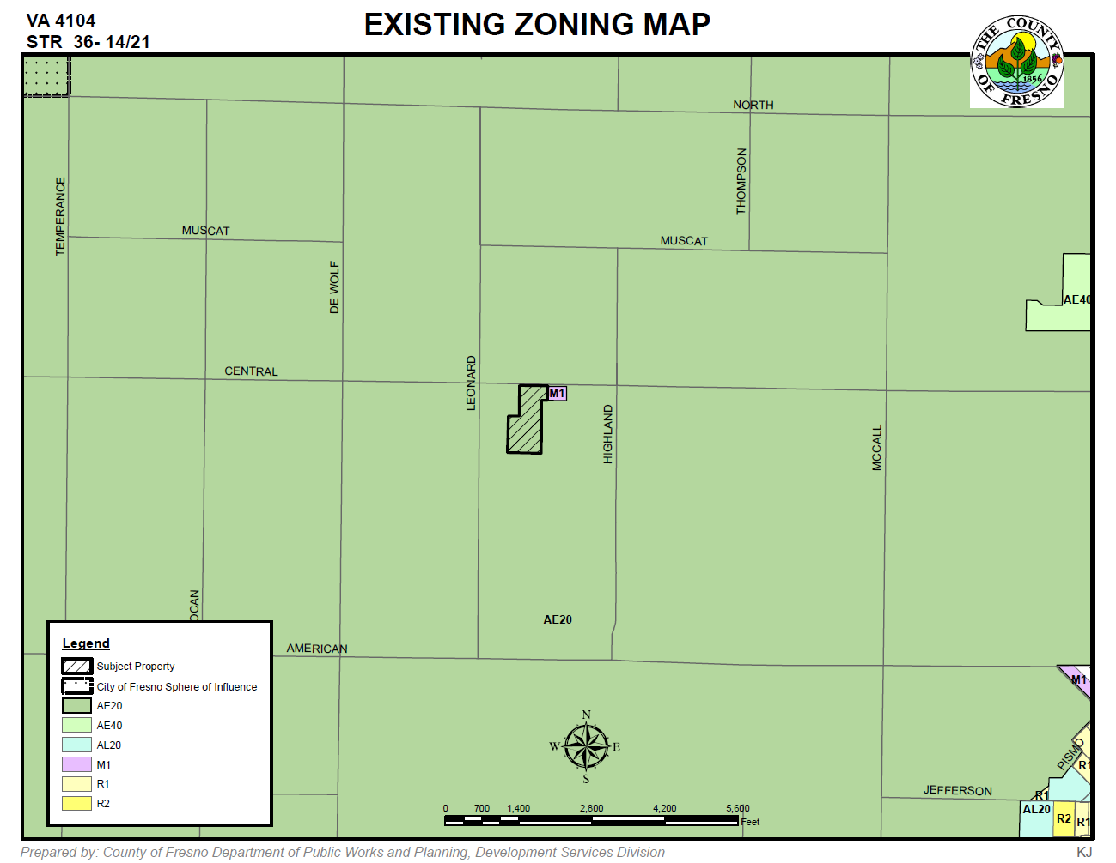

Slide 7
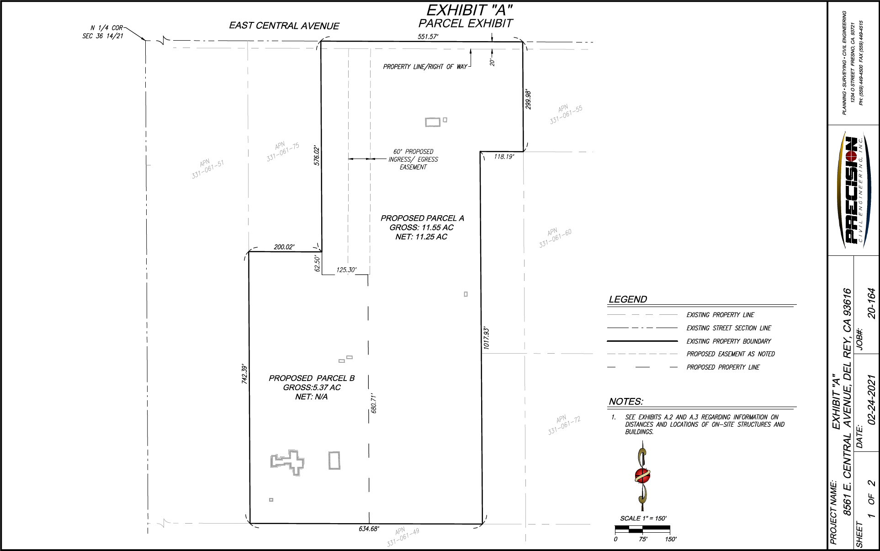

Slide 8
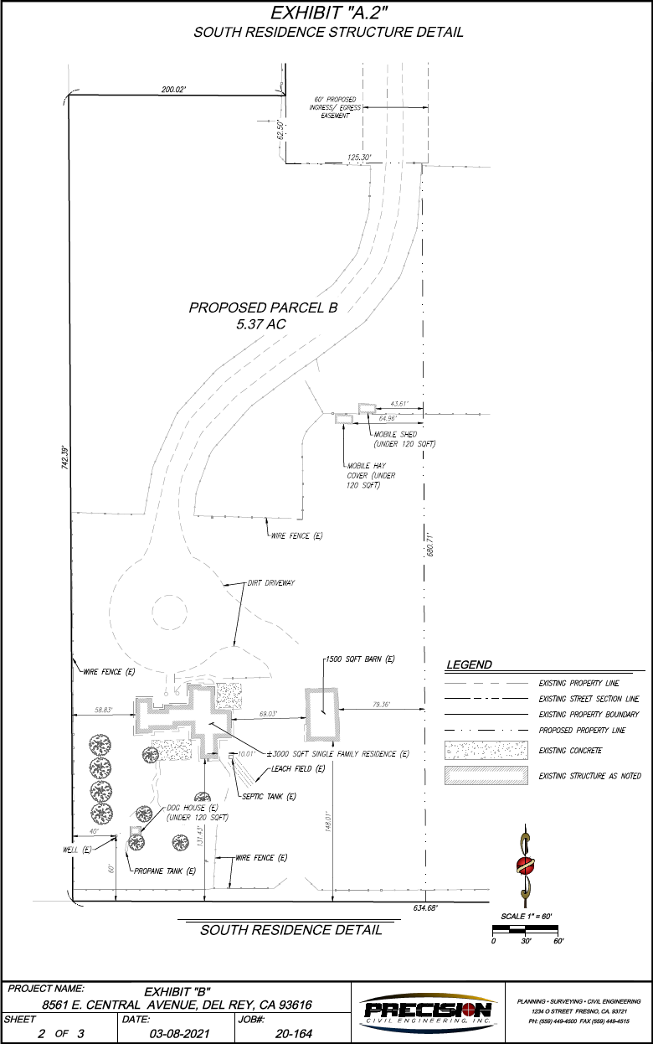

Slide 9
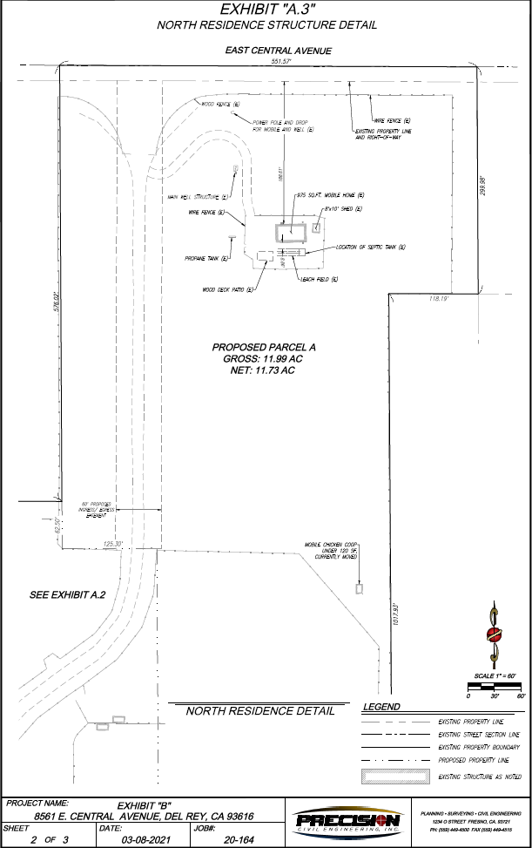

Slide 10
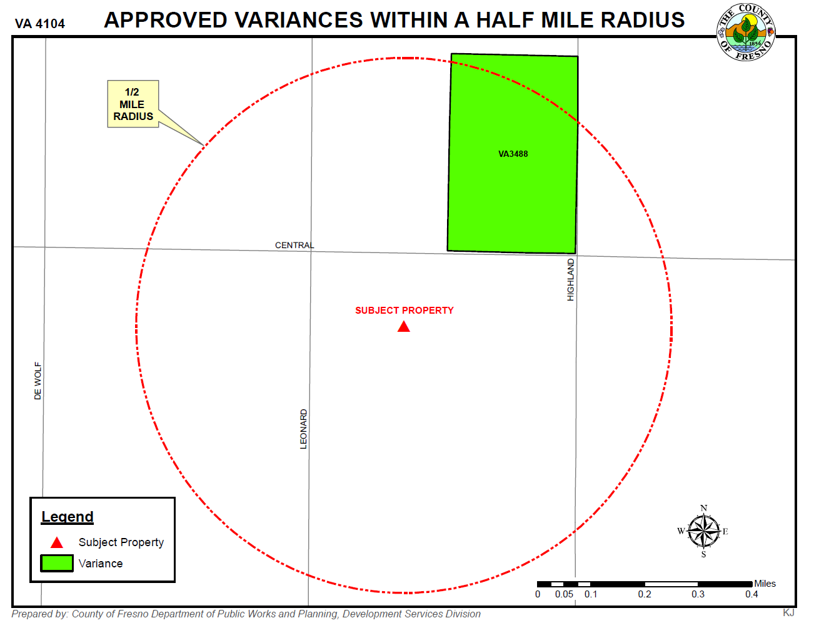

Slide 11
Variance Findings
There are exceptional or extraordinary circumstances or conditions applicable to the property involved which do not apply generally to other properties in the vicinity having the identical zoning classification.
Such variance is necessary for the preservation and enjoyment of a substantial property right of the applicant, which right is possessed by other property owners under like conditions in the vicinity having the identical zoning classification.
The granting of the variance will not be materially detrimental to the public welfare or injurious to property and improvement in the vicinity having the identical zoning classification.
The granting of such a variance will not be contrary to the objectives of the General Plan.

Slide 12
DEPARTMENT of PUBLIC WORKS and PLANNING
DEVELOPMENT SERVICES DIVISION
VA 4104

Slide 13
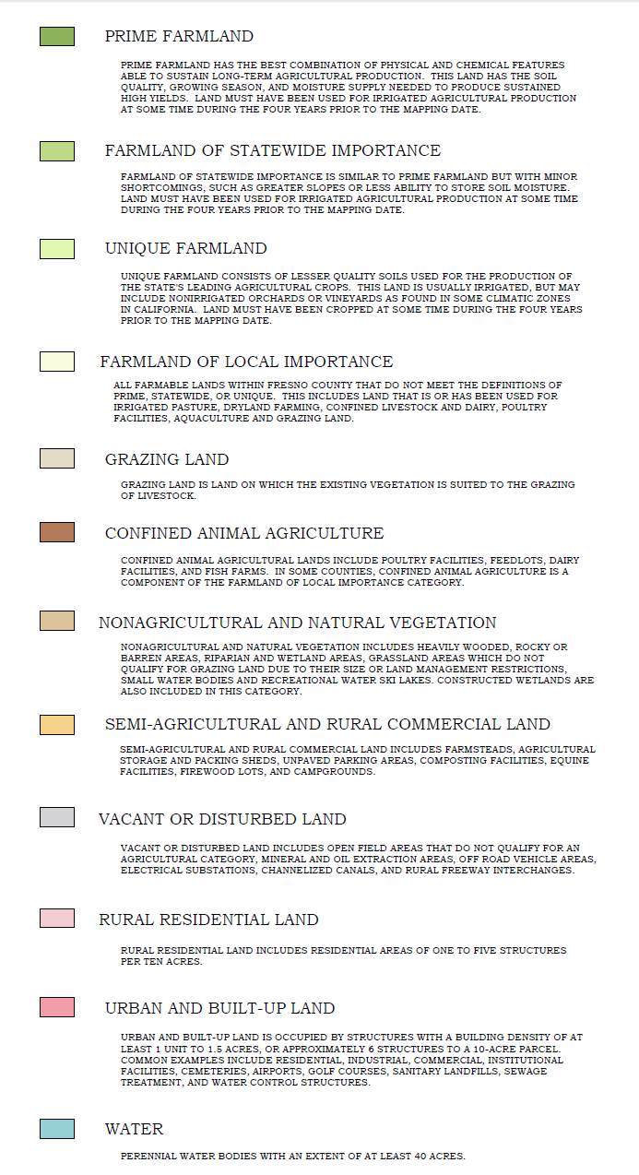
L
U
Approximate area of
physical depression
S
P

Slide 14
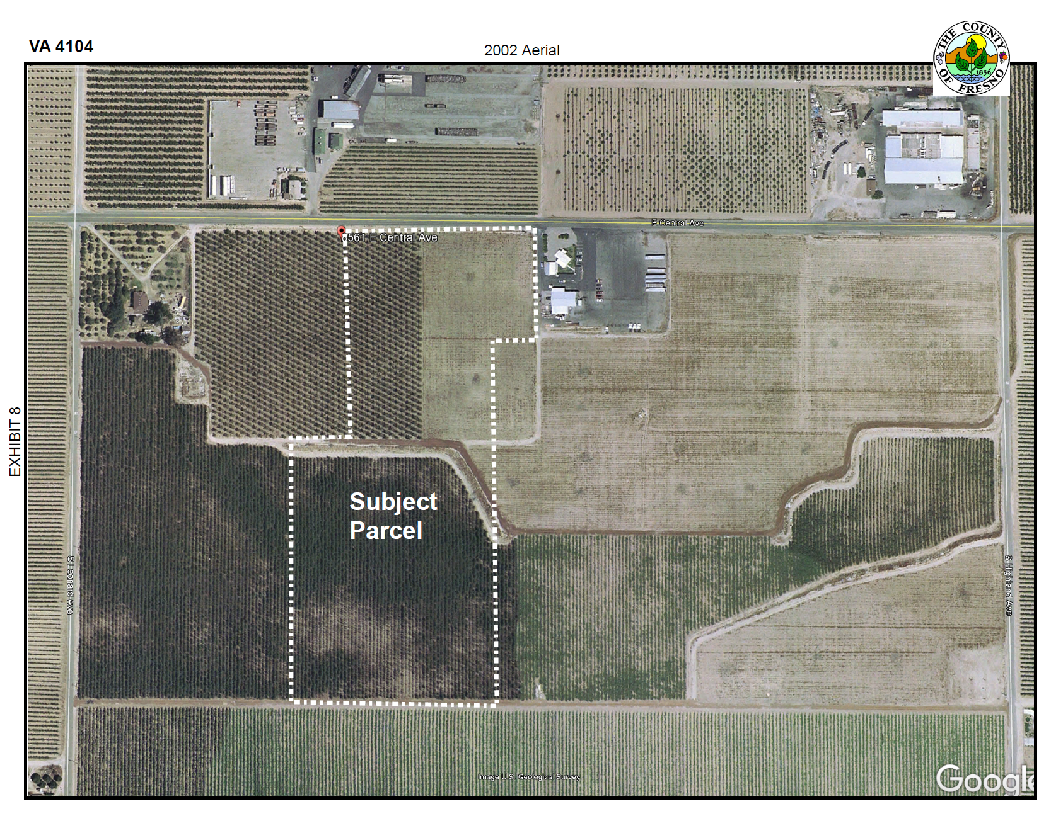

Slide 15
