Slide 1

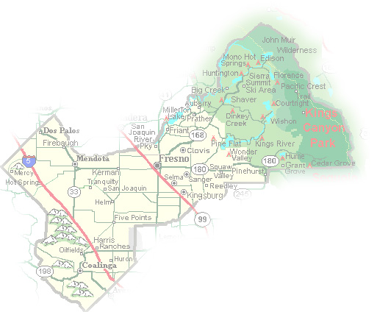
DEPARTMENT of PUBLIC WORKS and PLANNING
DEVELOPMENT SERVICES DIVISION
VA 4100

Slide 7
