Slide 1
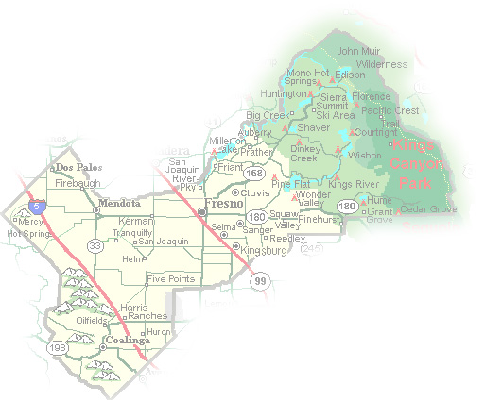
DEPARTMENT of PUBLIC WORKS and PLANNING
DEVELOPMENT SERVICES DIVISION
CUP 3656

Slide 2
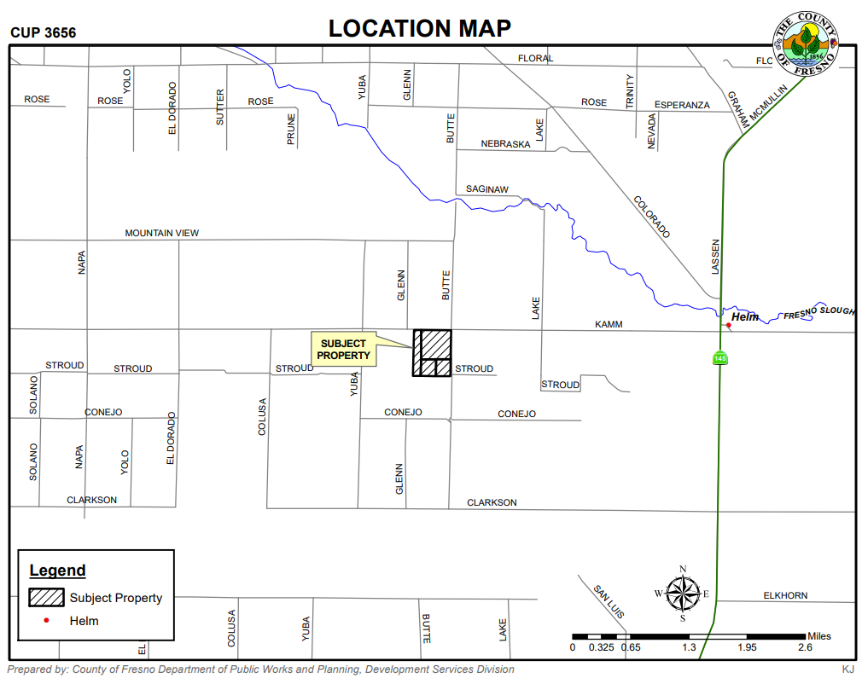

Slide 3
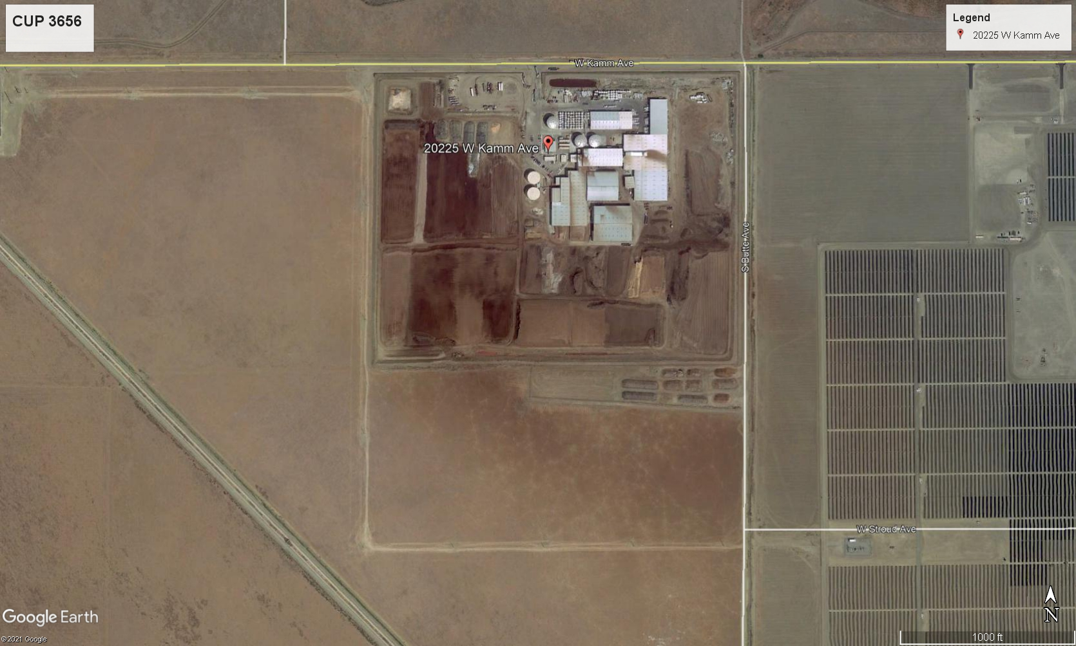
Kamm Avenue
Helm – Three Miles to the East
PROJECT SITE
Butte Avenue

Slide 4
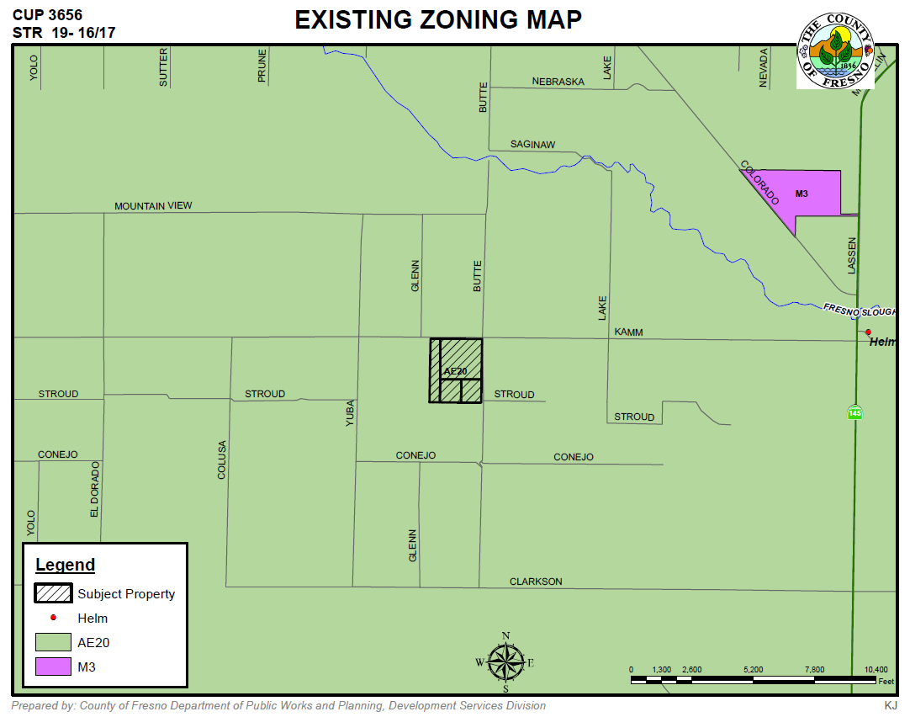

Slide 5
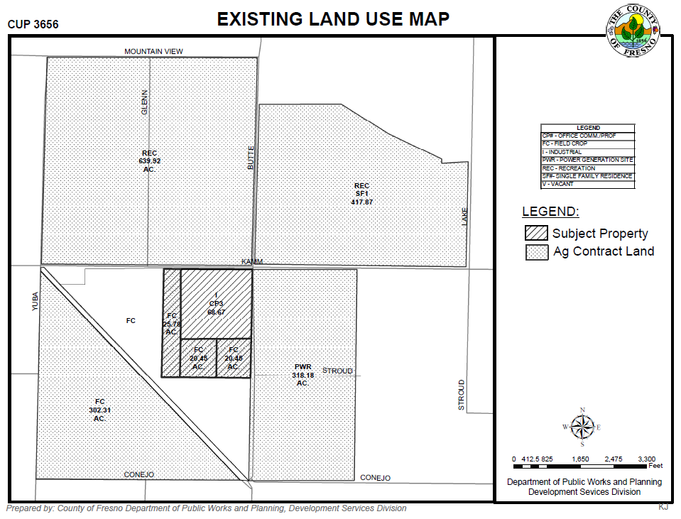

Slide 6
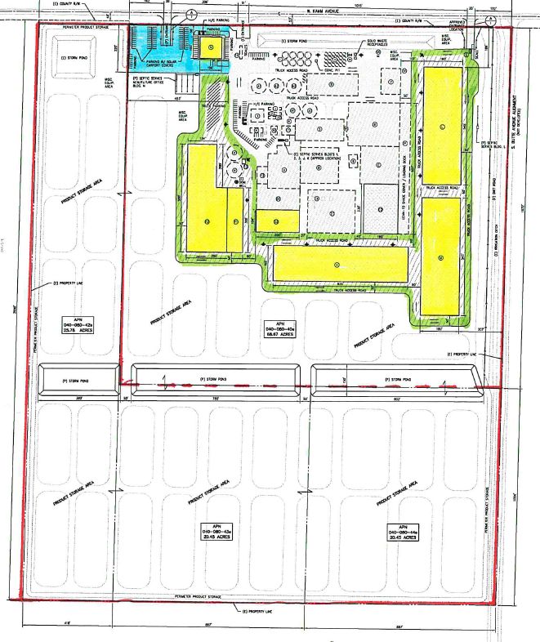
Parking (P)
Buildings (P)
Product Storage Areas (P)
Truck Access Road (P)
68.67 Acres Site (E)
Storm Pond (P)
Product Storage Areas (P)
66.68 Acres Site (Proposed Expansion)

Slide 7
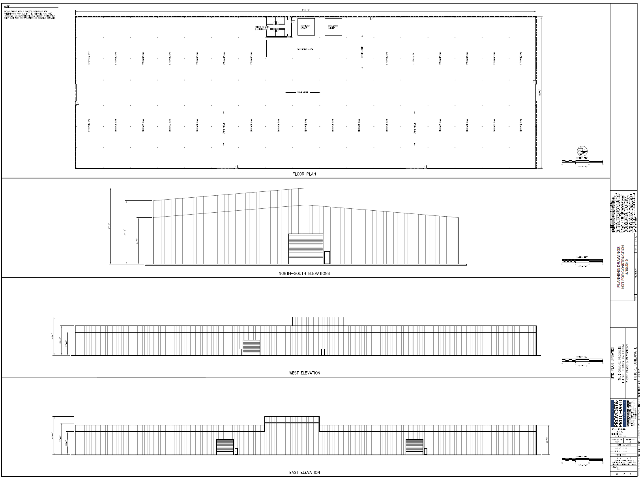

Slide 8
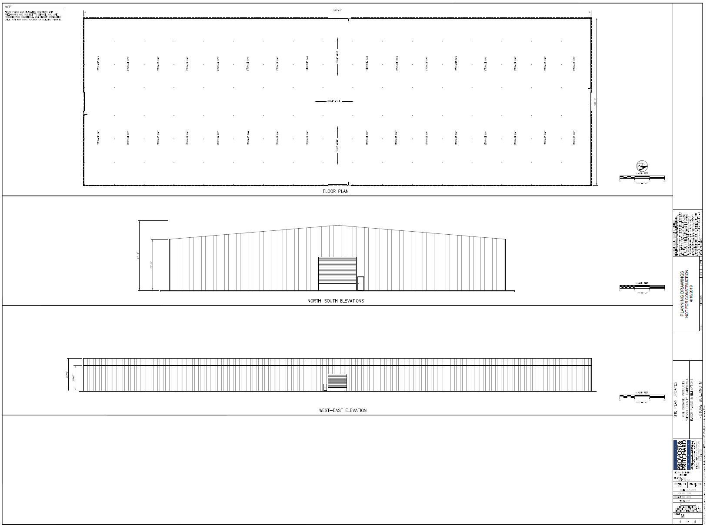

Slide 9
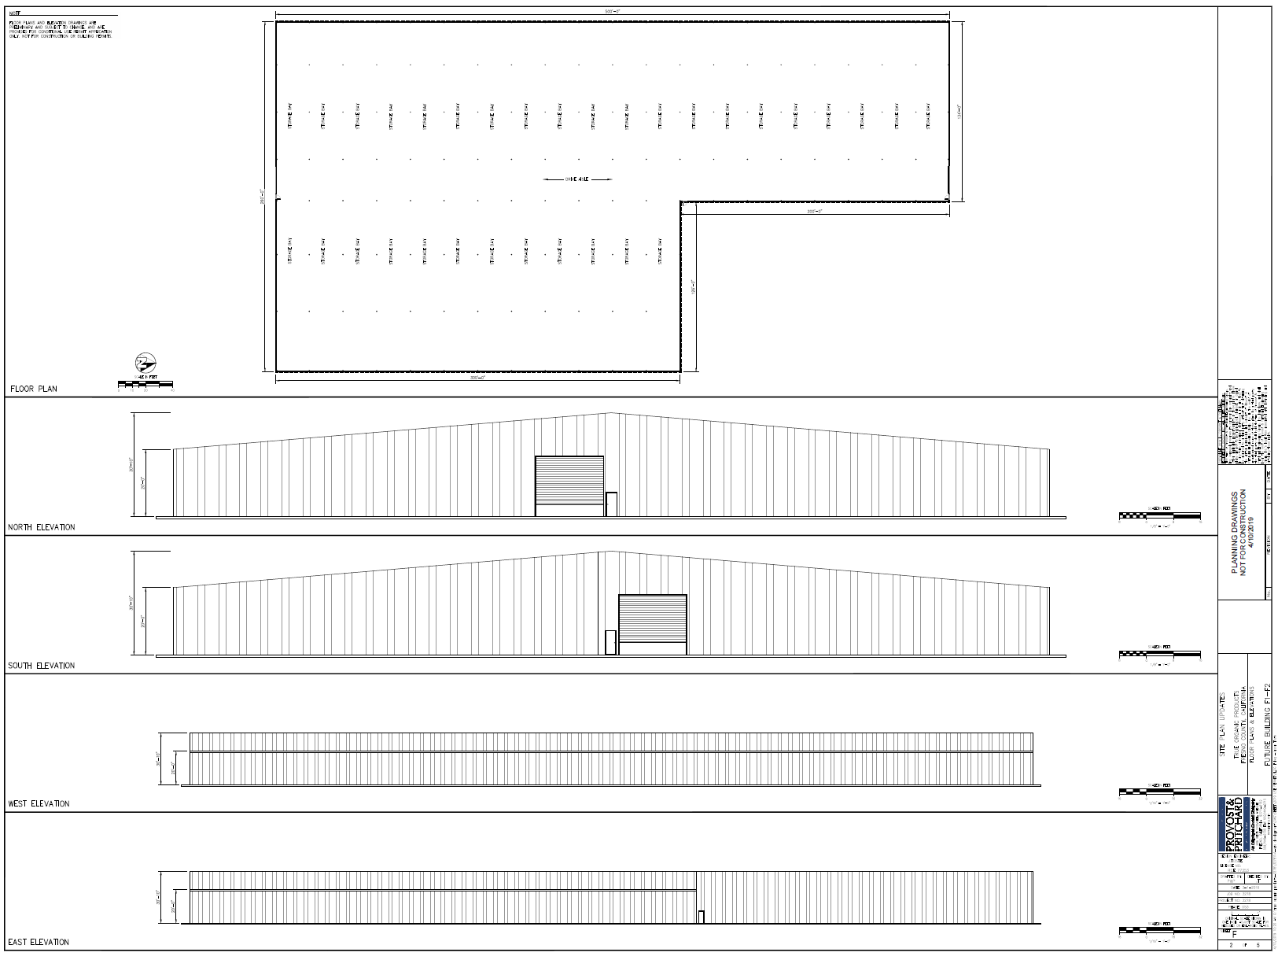

Slide 10
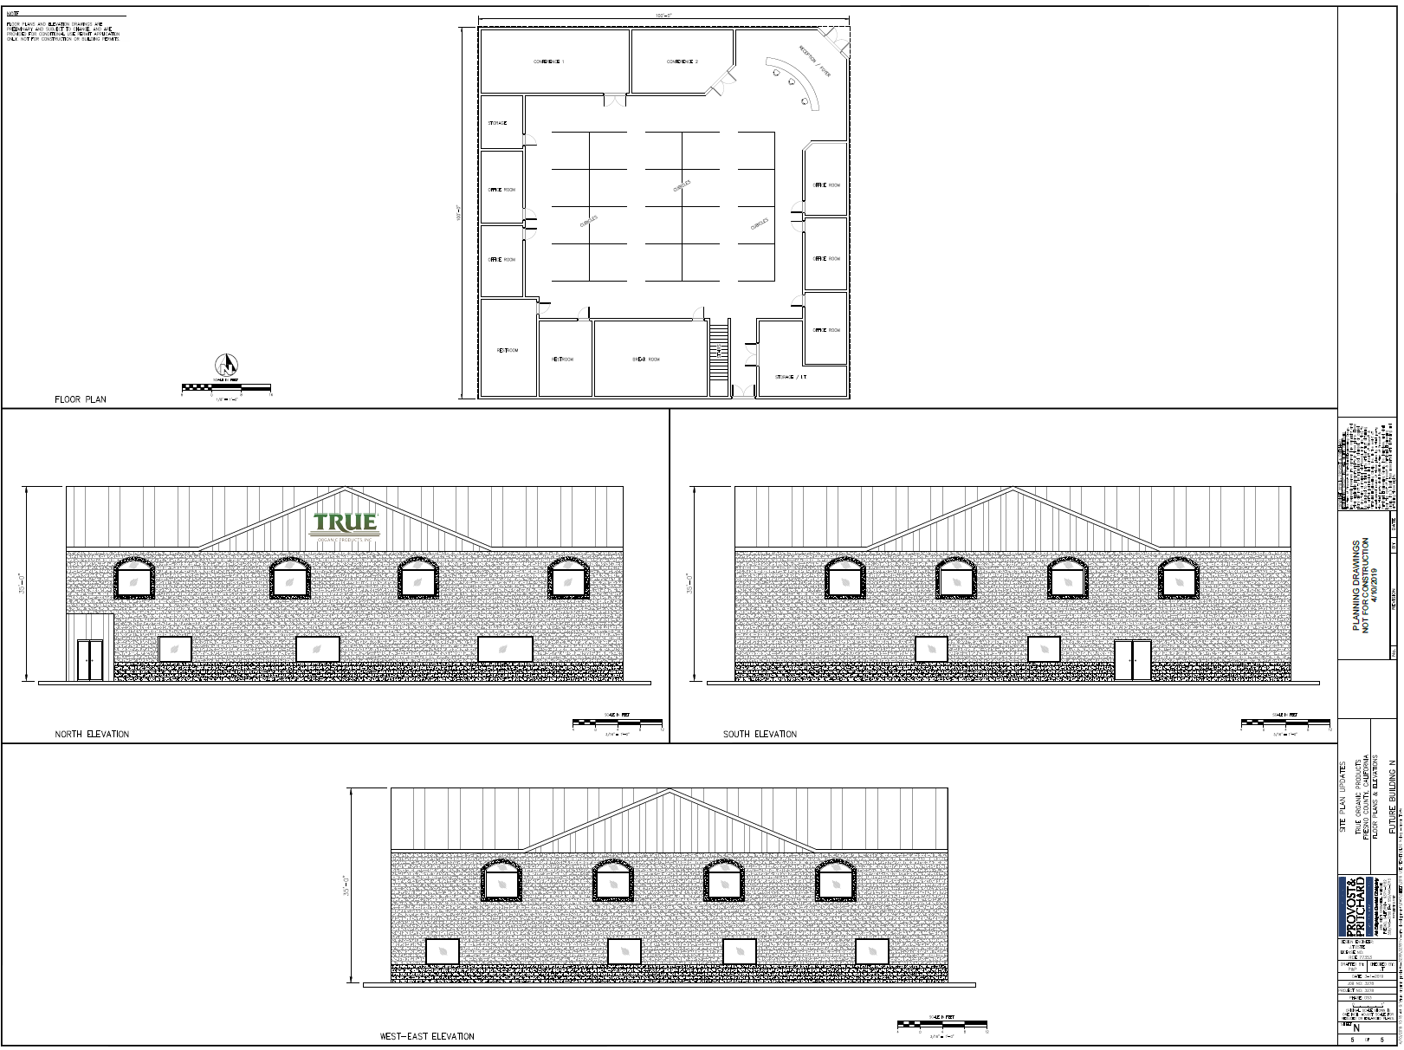

Slide 11
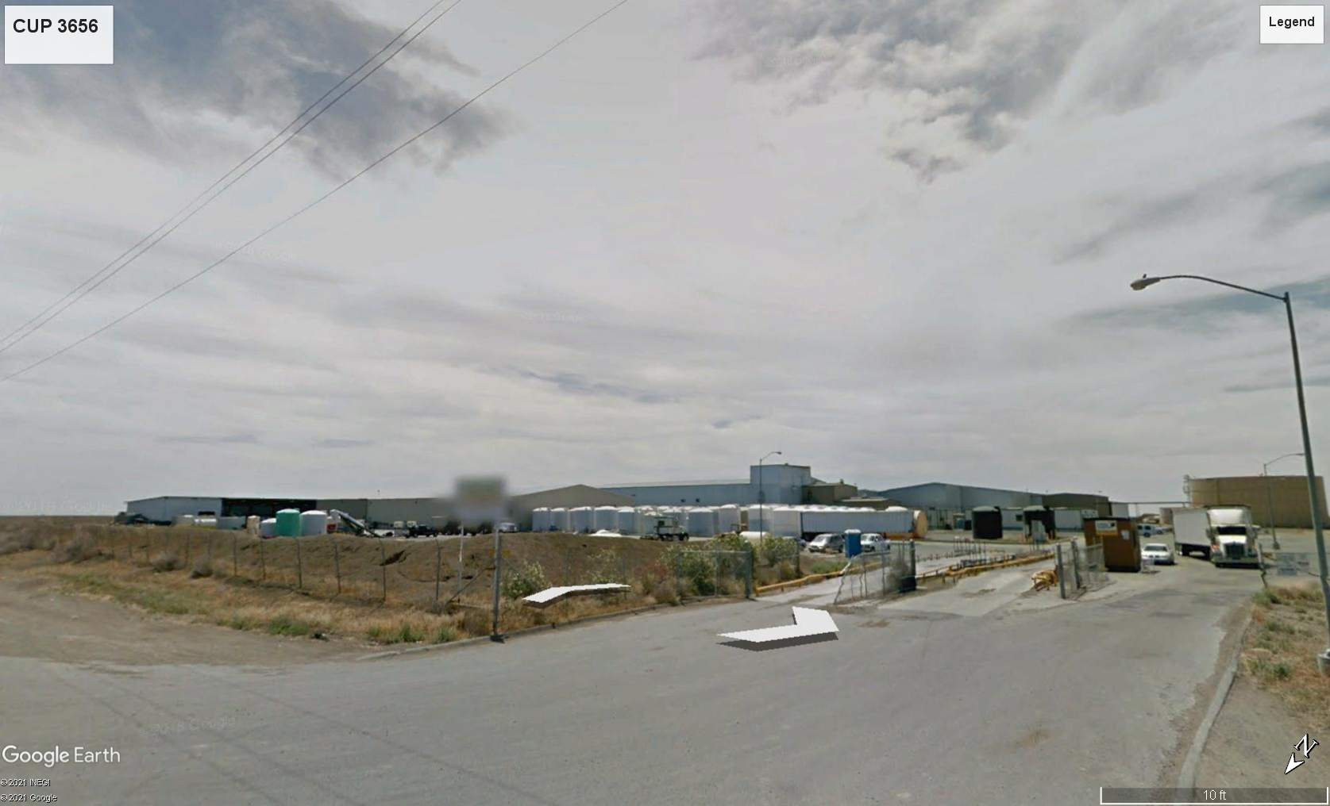
Looking Southeast From Kamm Avenue

Slide 12
PROJECT SITE
FINDINGS
Adequacy of the Project Site
Adequacy of the Streets
No Adverse Effects on the Surrounding Properties
General Plan Consistency

Slide 13
DEPARTMENT of PUBLIC WORKS and PLANNING
DEVELOPMENT SERVICES DIVISION
CUP 3656

Slide 14
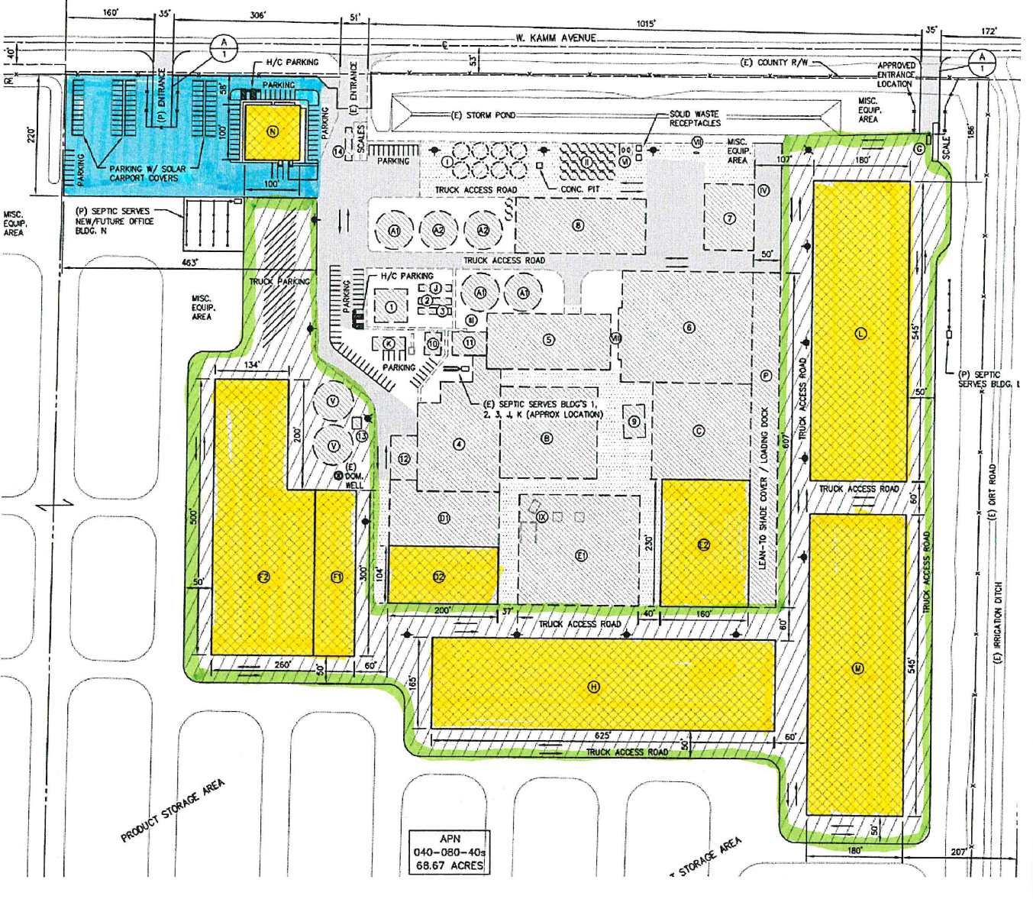

Slide 15
