Slide 1
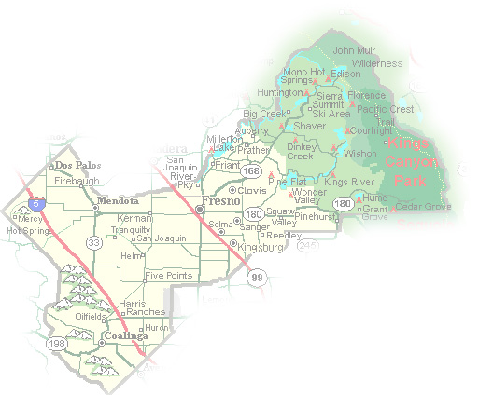
DEPARTMENT of PUBLIC WORKS and PLANNING
DEVELOPMENT SERVICES DIVISION
CUP 3691

Slide 2
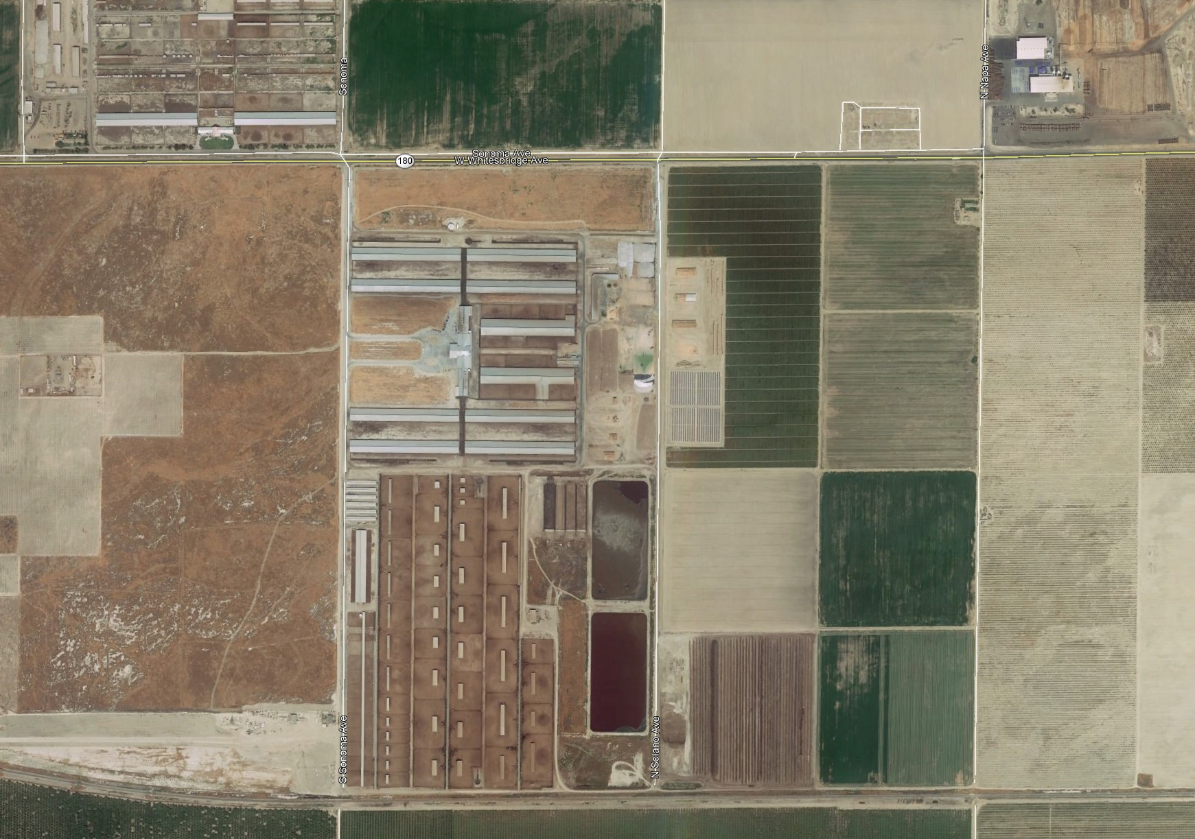
Approximate Location of Project Site

Slide 3
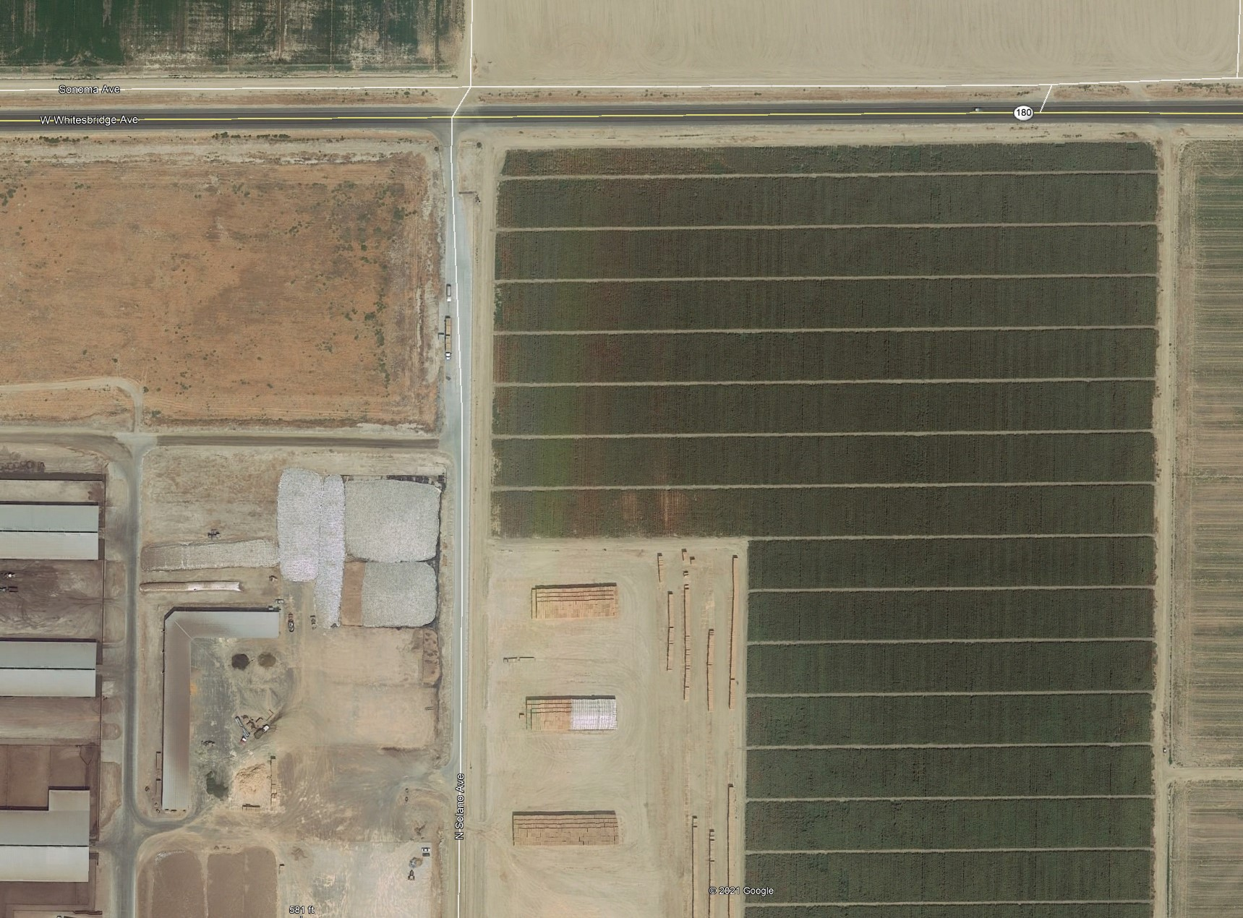
Approximate Location of Project Site

Slide 8
Five Findings for a Conditional Use Permit
The site for the proposed use is adequate in size and shape to accommodate said use and all yards, spaces, walls, and fences, parking, loading, landscaping, and other features required by this Division, to adjust said use with land and uses in the neighborhood.
The site for the proposed use relates to streets and highways adequate in width and pavement type to carry the quantity and kind of traffic generated by the proposed use.
The proposed use will have no adverse impact on abutting property and surrounding neighborhood or permitted use.
The proposed development is consistent with the General Plan.
That the conditions stated in the resolution are deemed necessary to protect the public health, safety, and general welfare

Slide 9
DEPARTMENT of PUBLIC WORKS and PLANNING
DEVELOPMENT SERVICES DIVISION
CUP 3691

