Slide 1
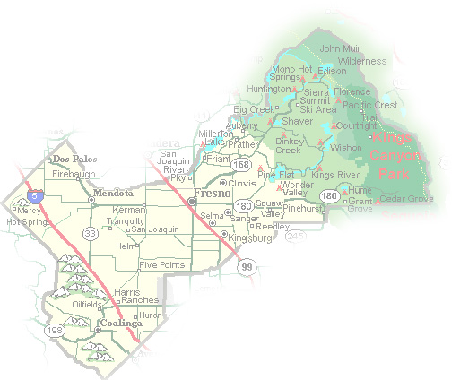
DEPARTMENT of PUBLIC WORKS and PLANNING
DEVELOPMENT SERVICES DIVISION
GPA 564/CUP 3693

Slide 2
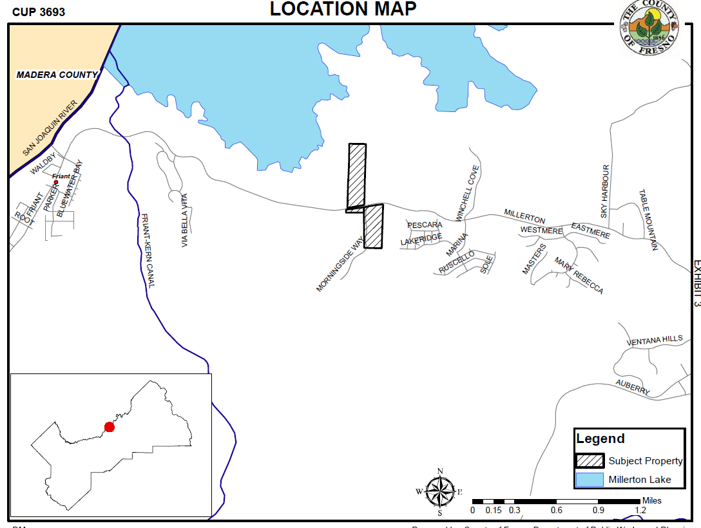

Slide 3
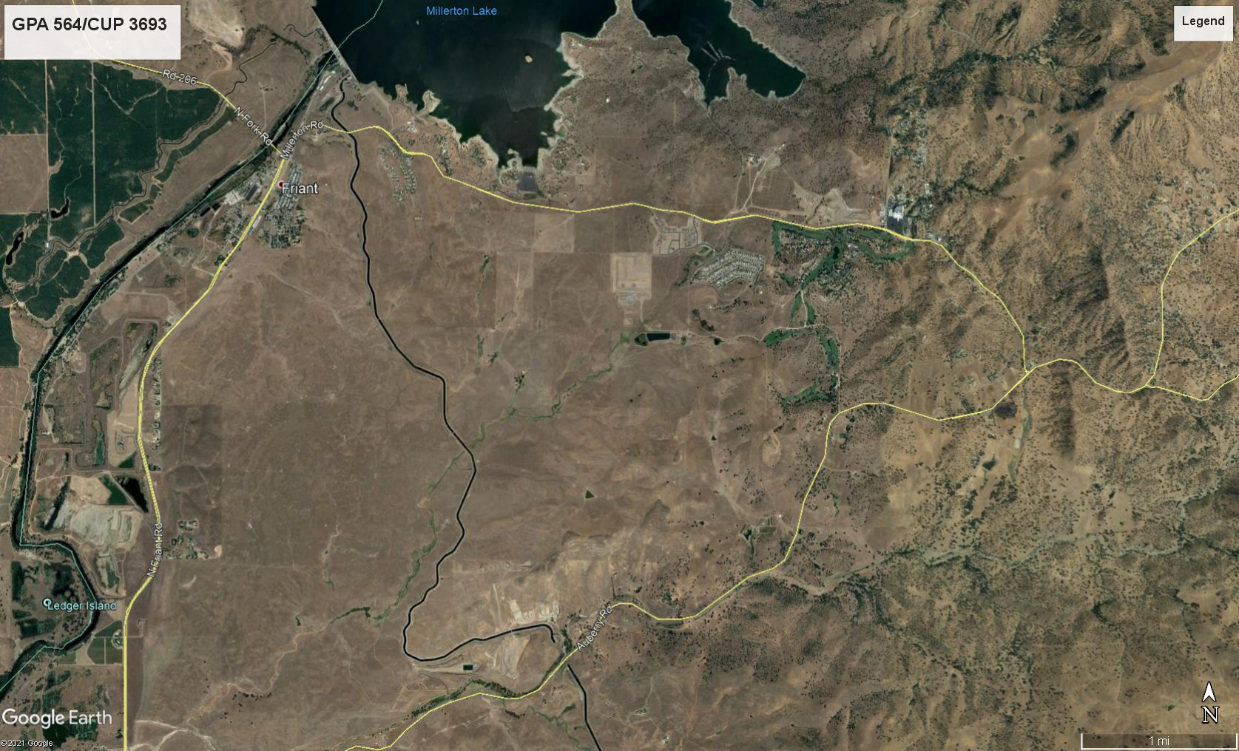
Project Site
Millerton
Specific Plan
Boundary

Slide 4
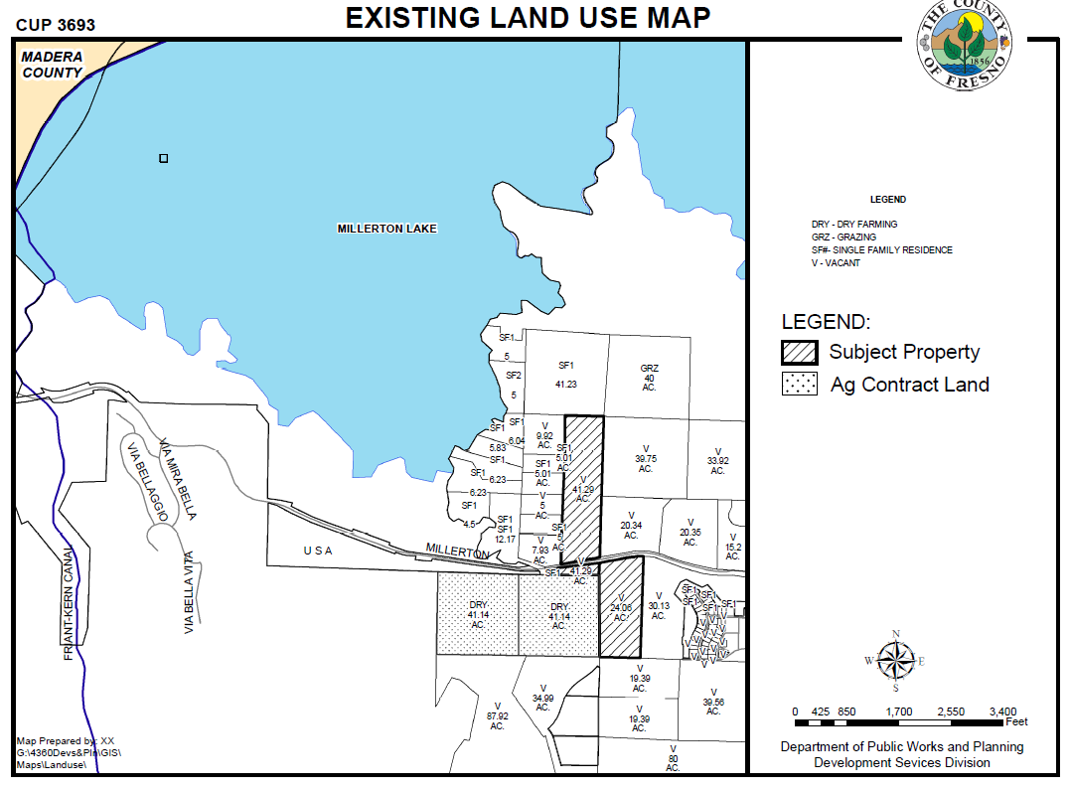

Slide 5
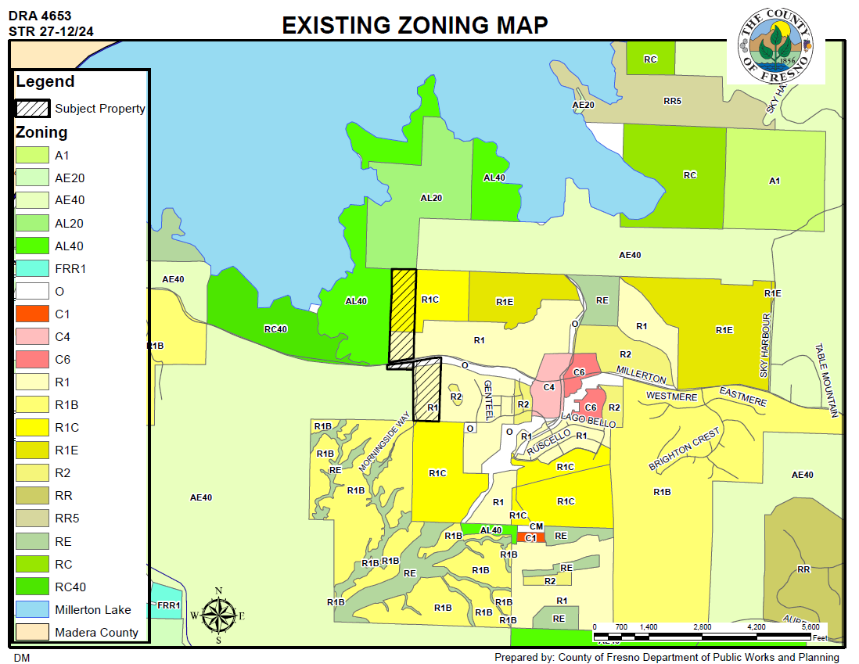

Slide 6
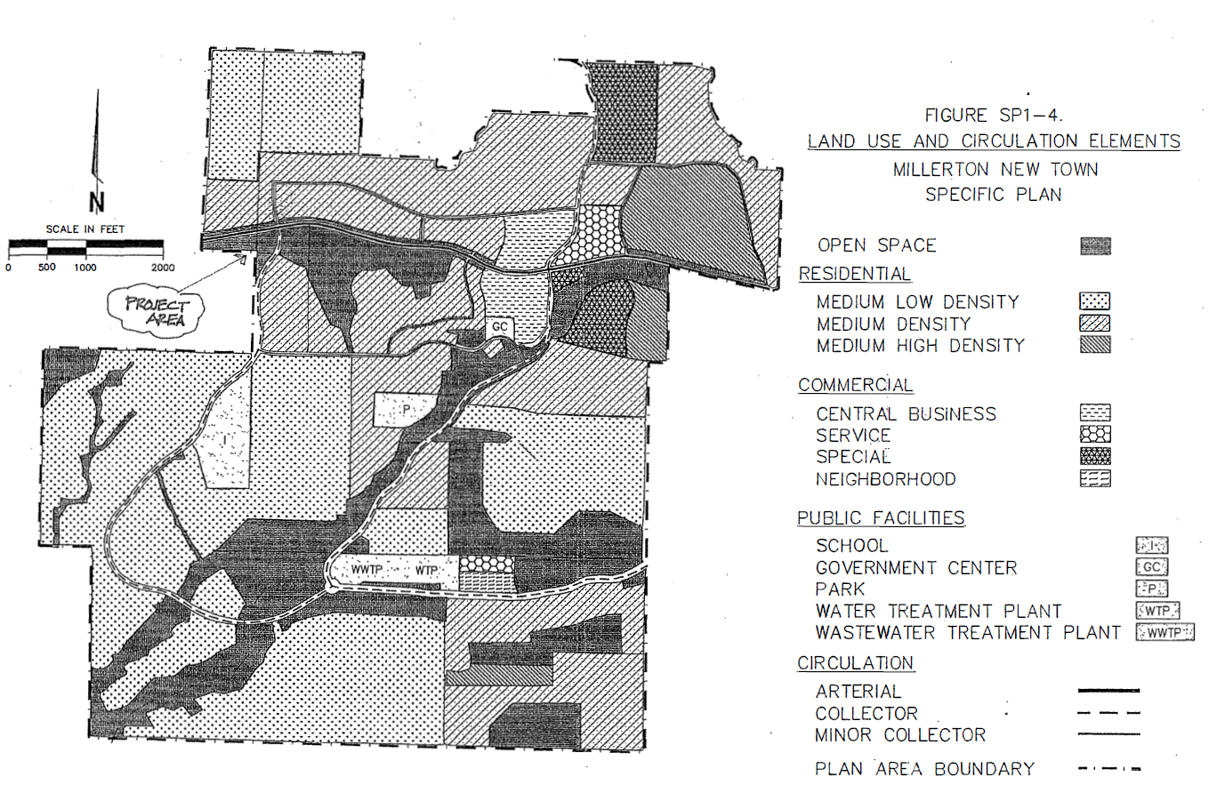

Slide 7
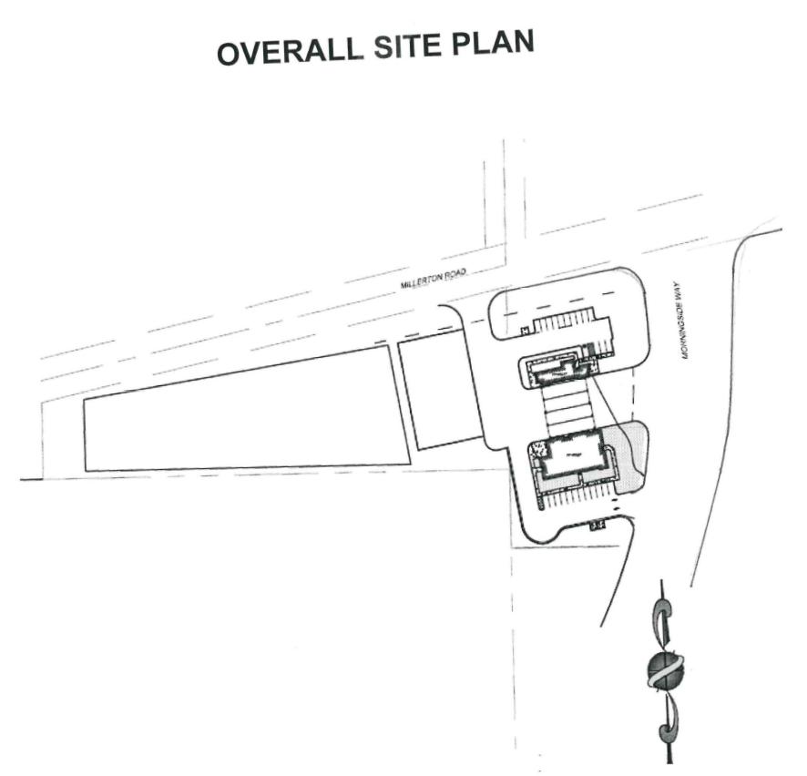
Fire Station Building

Slide 8
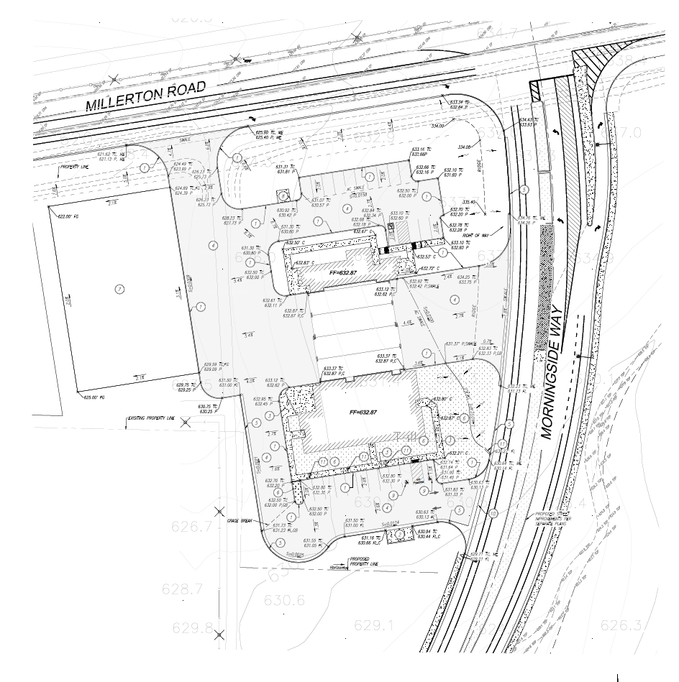

Slide 9
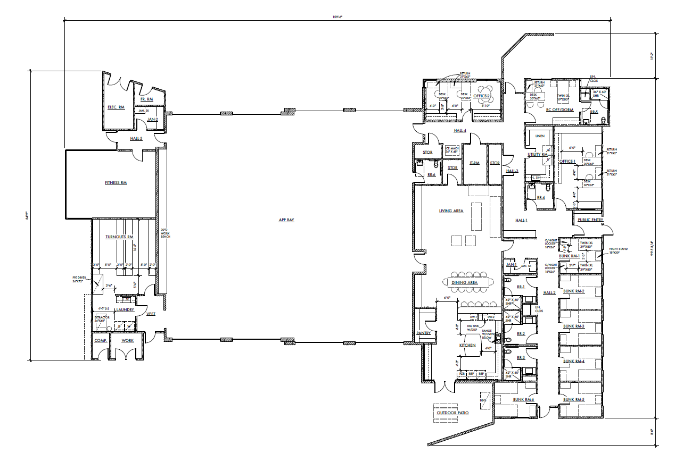

Slide 10
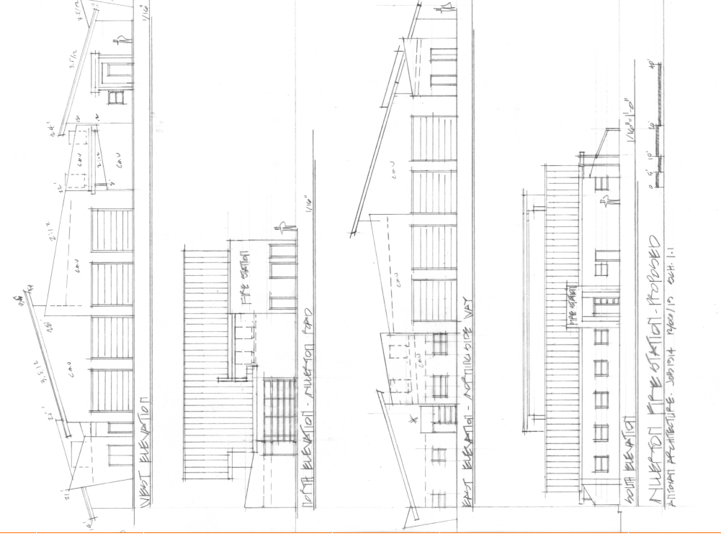

Slide 11
Project Site
Millerton
Boundary

Slide 12
DEPARTMENT of PUBLIC WORKS and PLANNING
DEVELOPMENT SERVICES DIVISION
GPA 564/CUP 3693

Slide 13
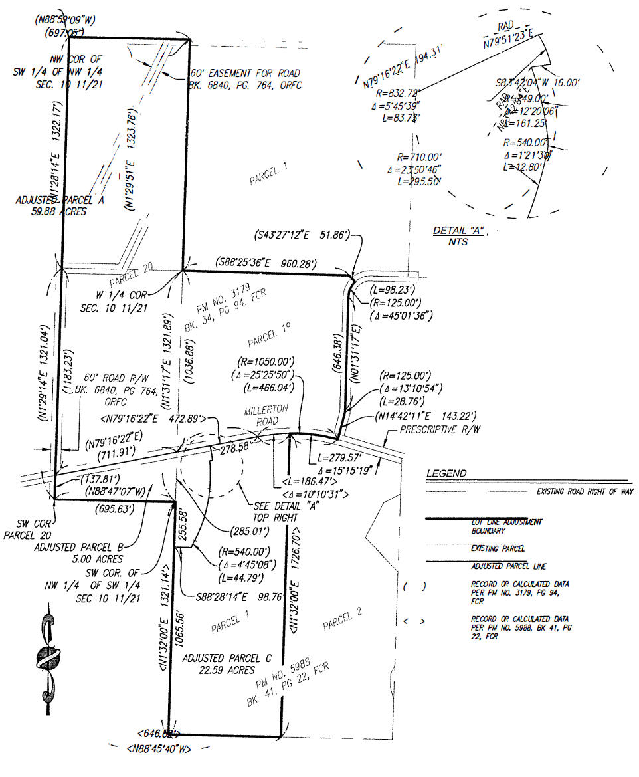

Slide 14
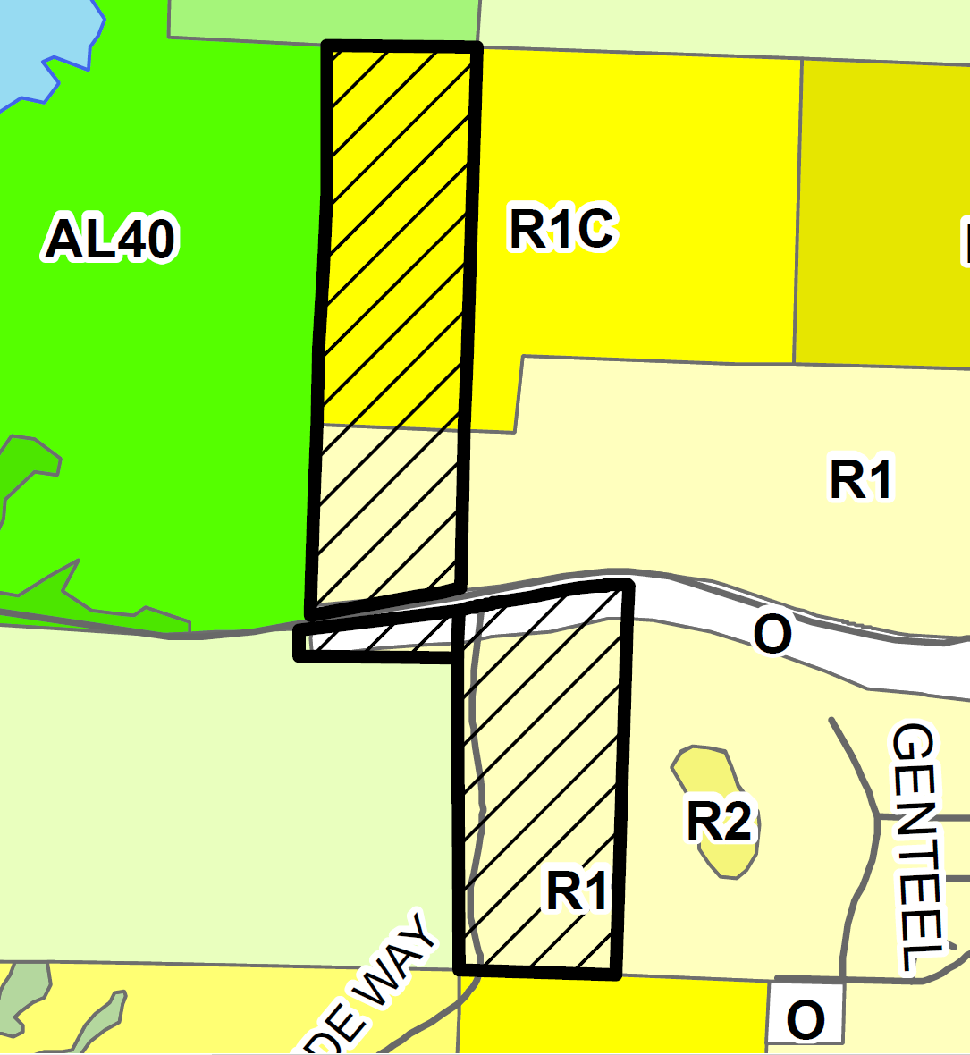
PROJECT SITE

Slide 15
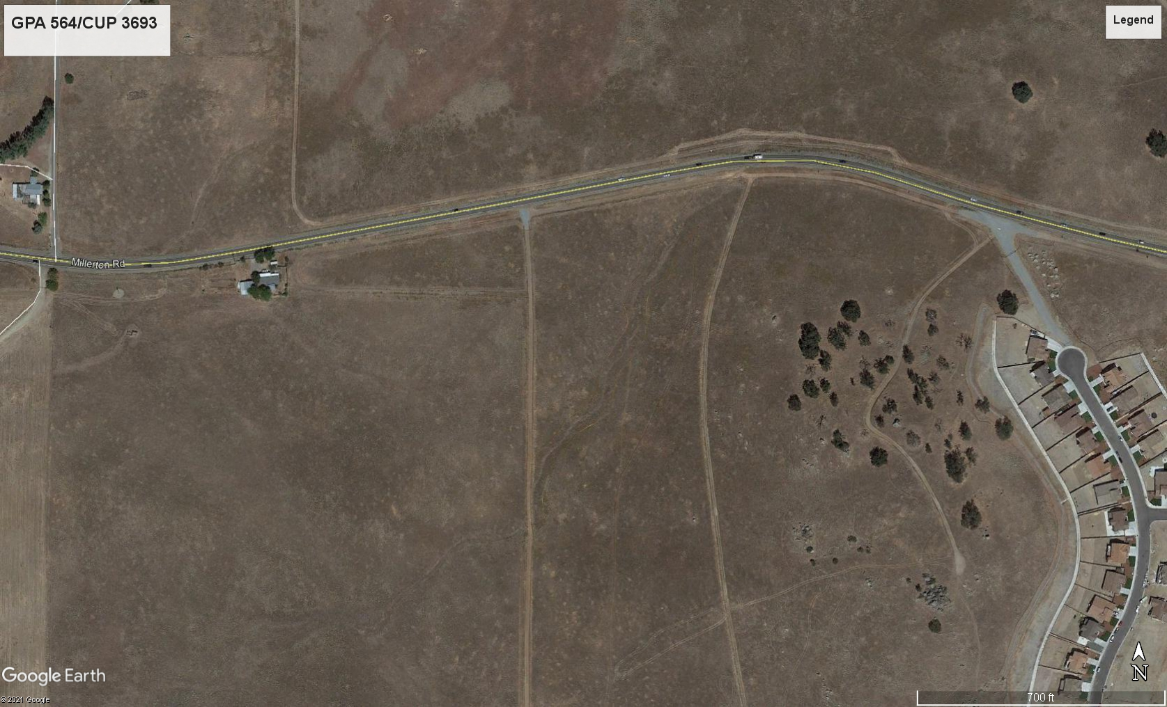
PROJECT
SITE

