Slide 1
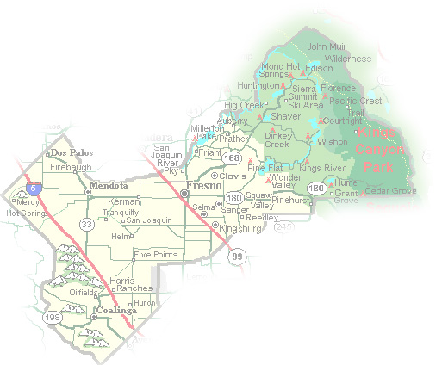
DEPARTMENT of PUBLIC WORKS and PLANNING
DEVELOPMENT SERVICES DIVISION
VA 4103

Slide 2
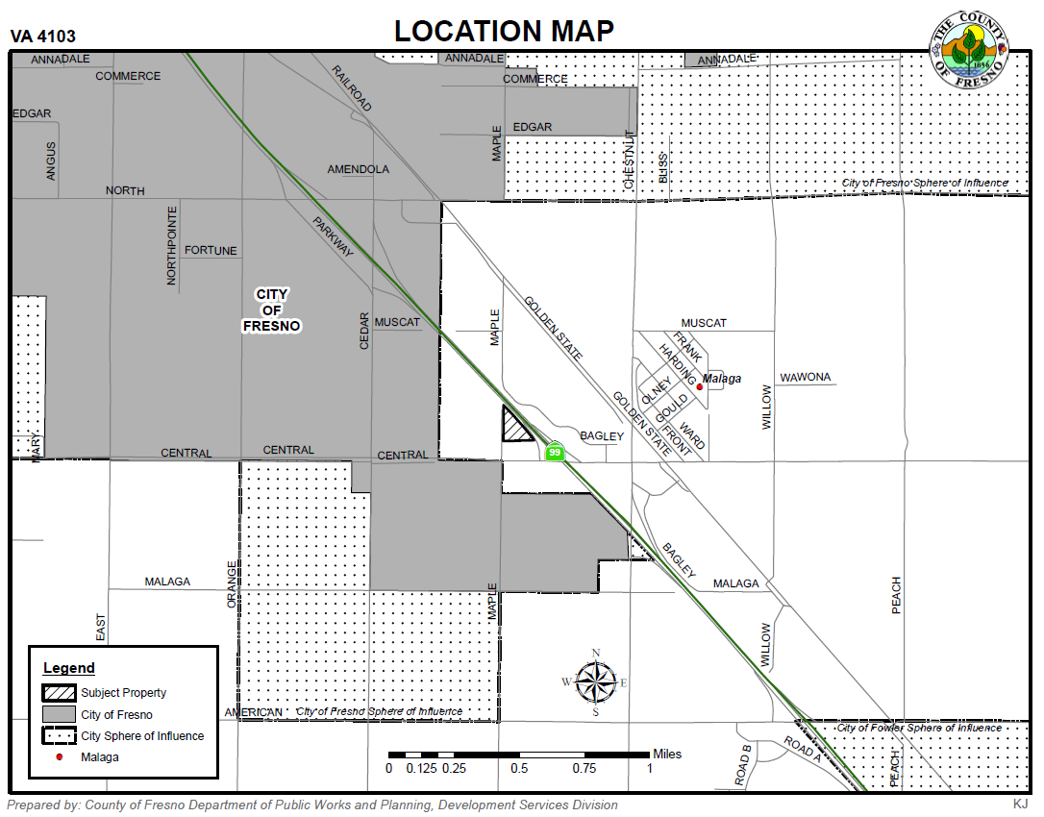

Slide 3
Flagpole

Slide 4
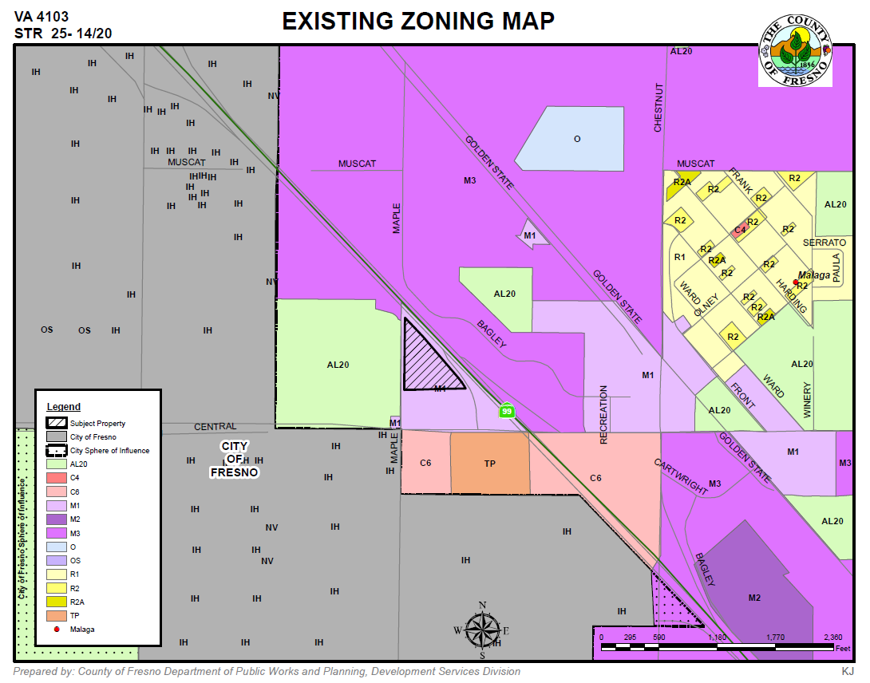

Slide 5
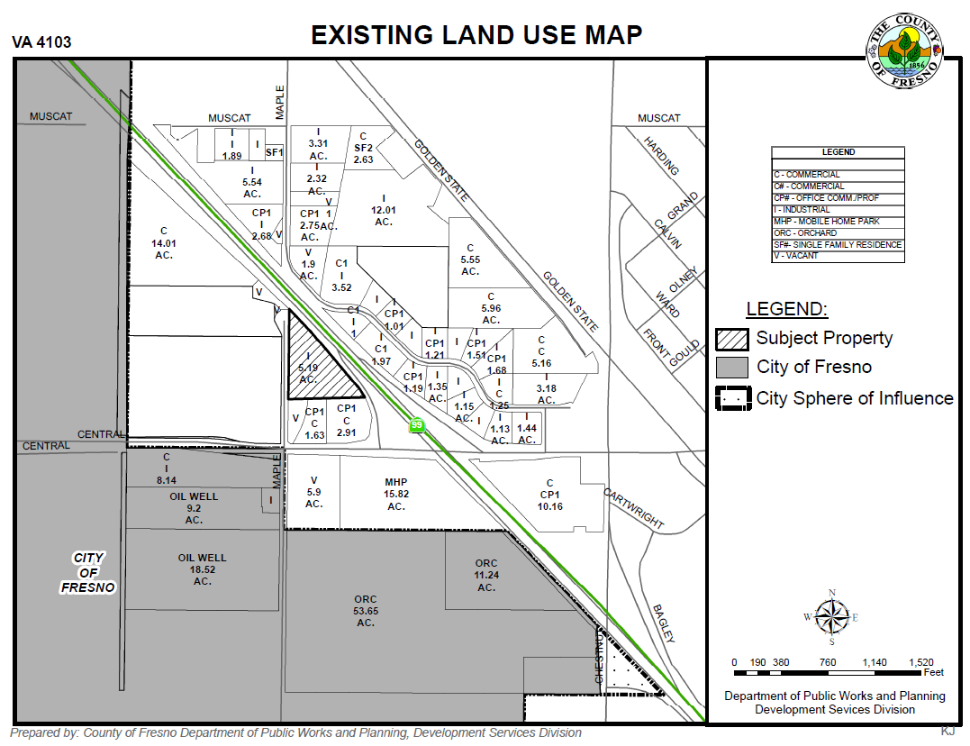

Slide 6
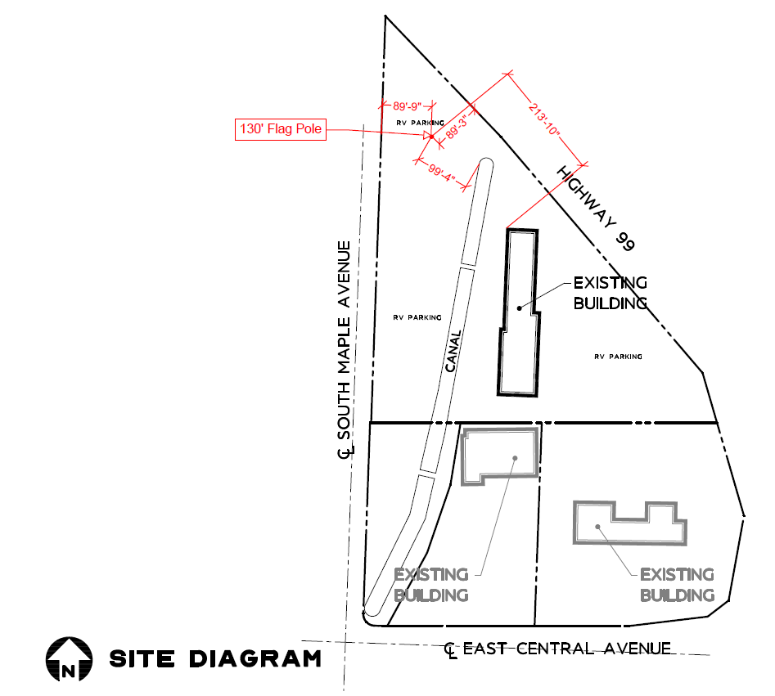

Slide 7
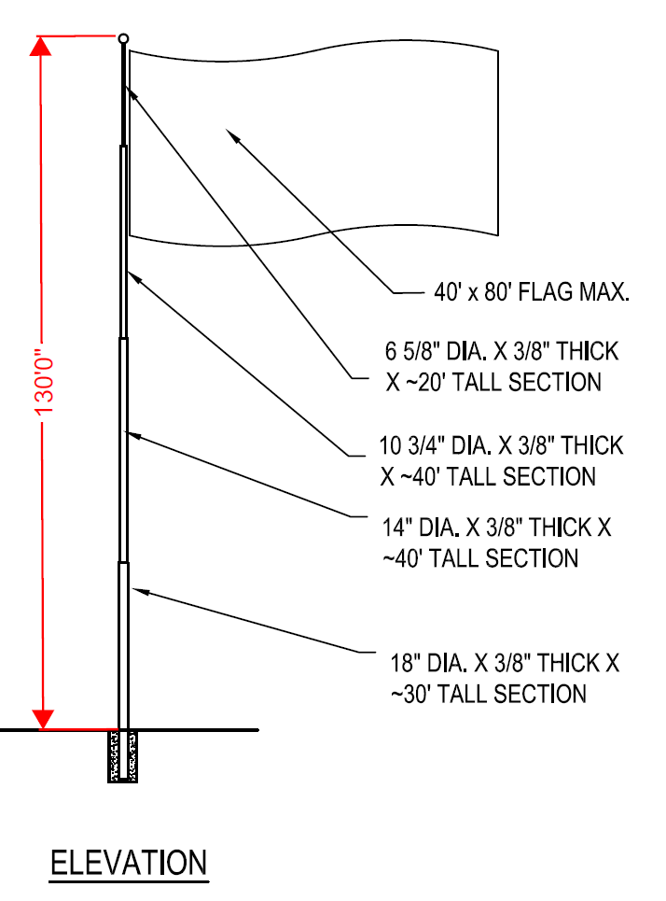

Slide 8
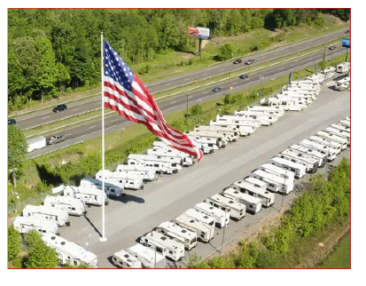

Slide 9
DEPARTMENT of PUBLIC WORKS and PLANNING
DEVELOPMENT SERVICES DIVISION
VA 4103

Slide 10
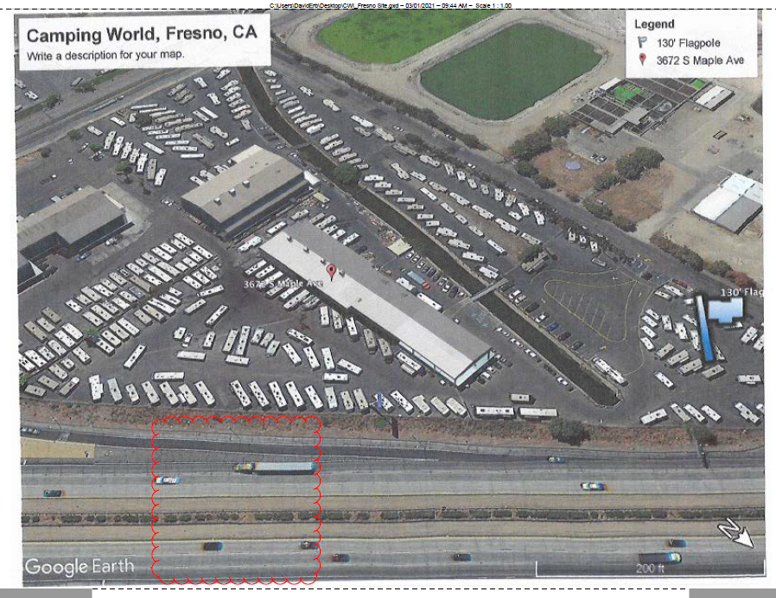
FLAGPOLE

