Slide 1
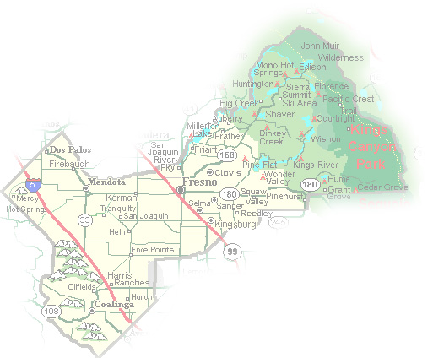
DEPARTMENT of PUBLIC WORKS and PLANNING
DEVELOPMENT SERVICES AND CAPITAL PROJECTS DIVISION
CUP 3478 EXT 4

Slide 2
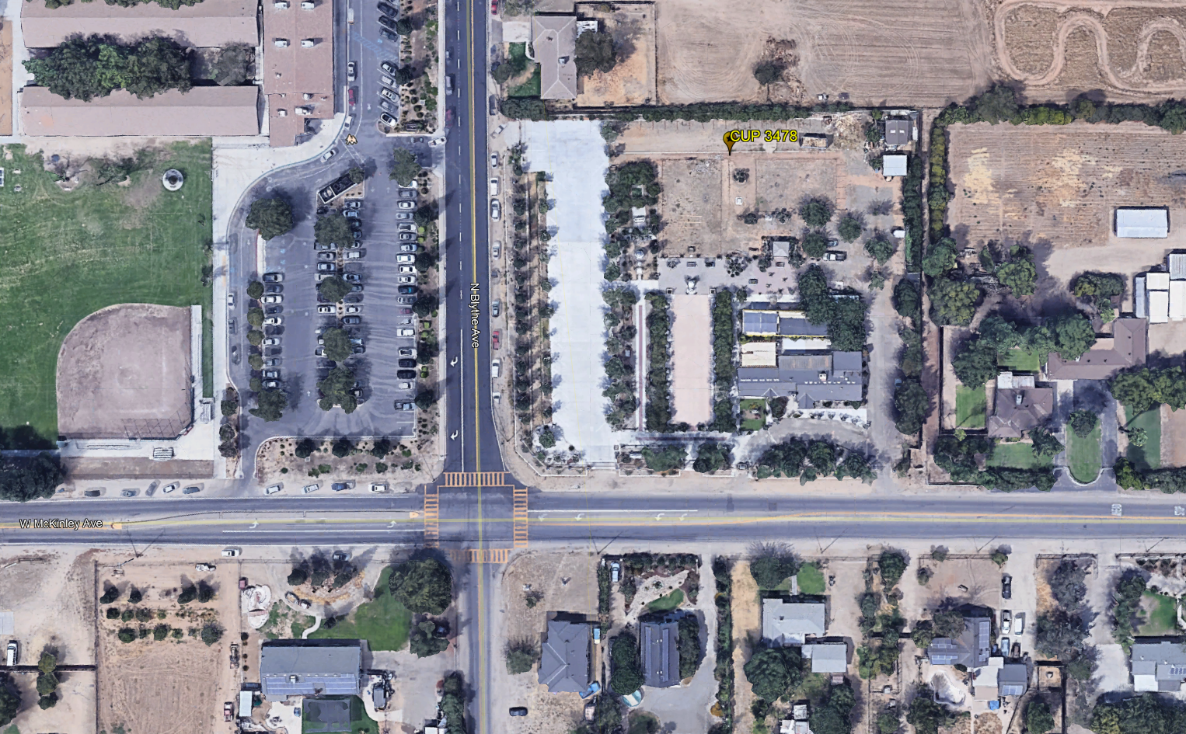

Slide 3
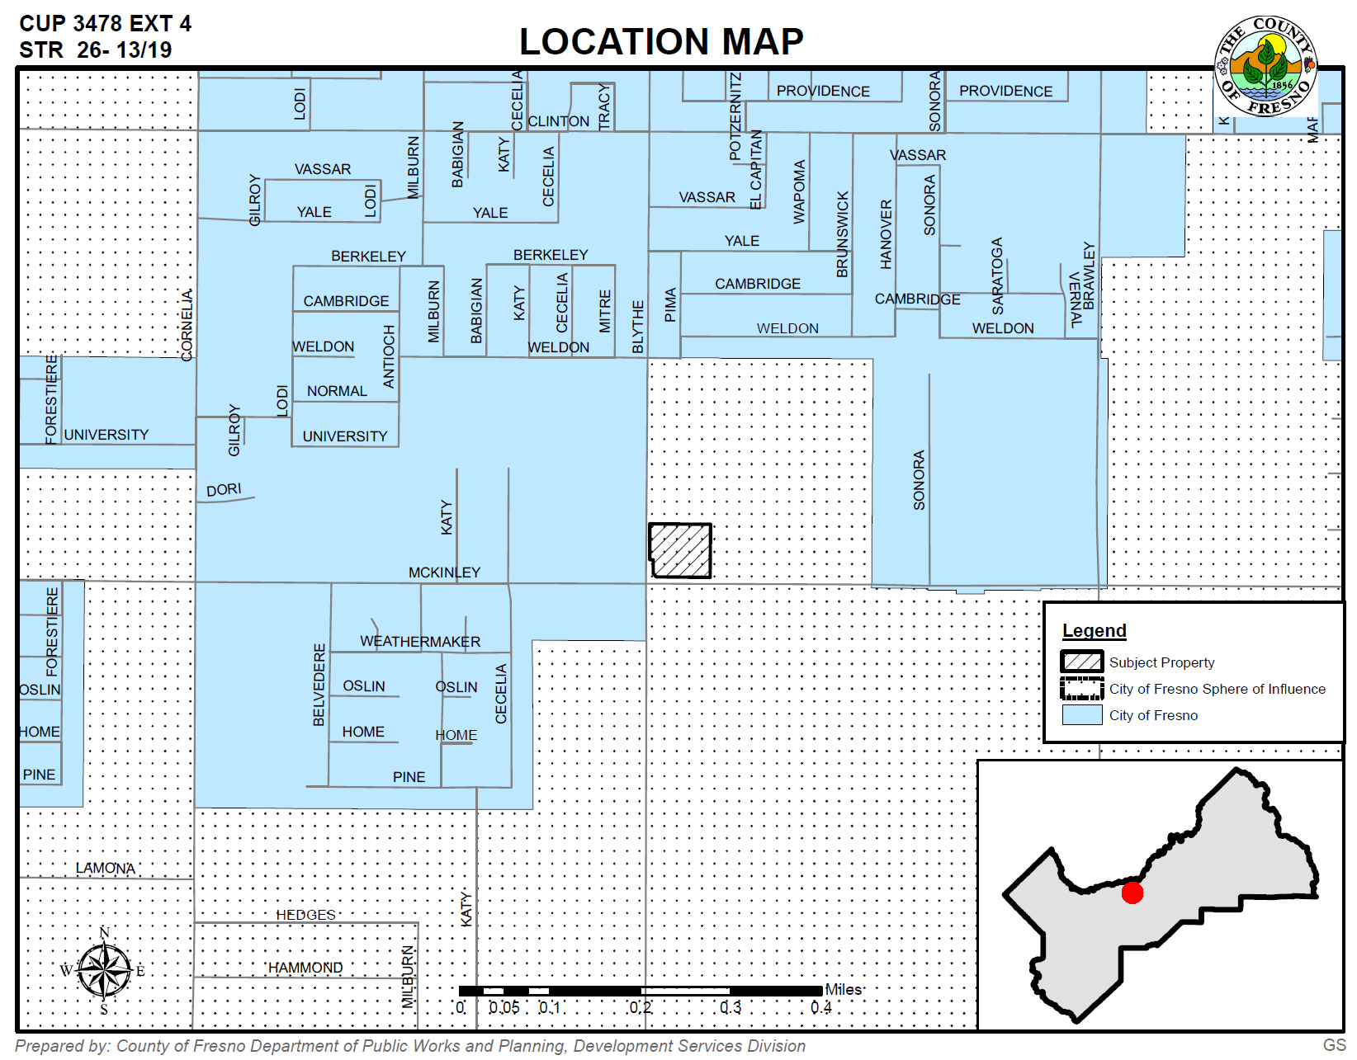

Slide 4
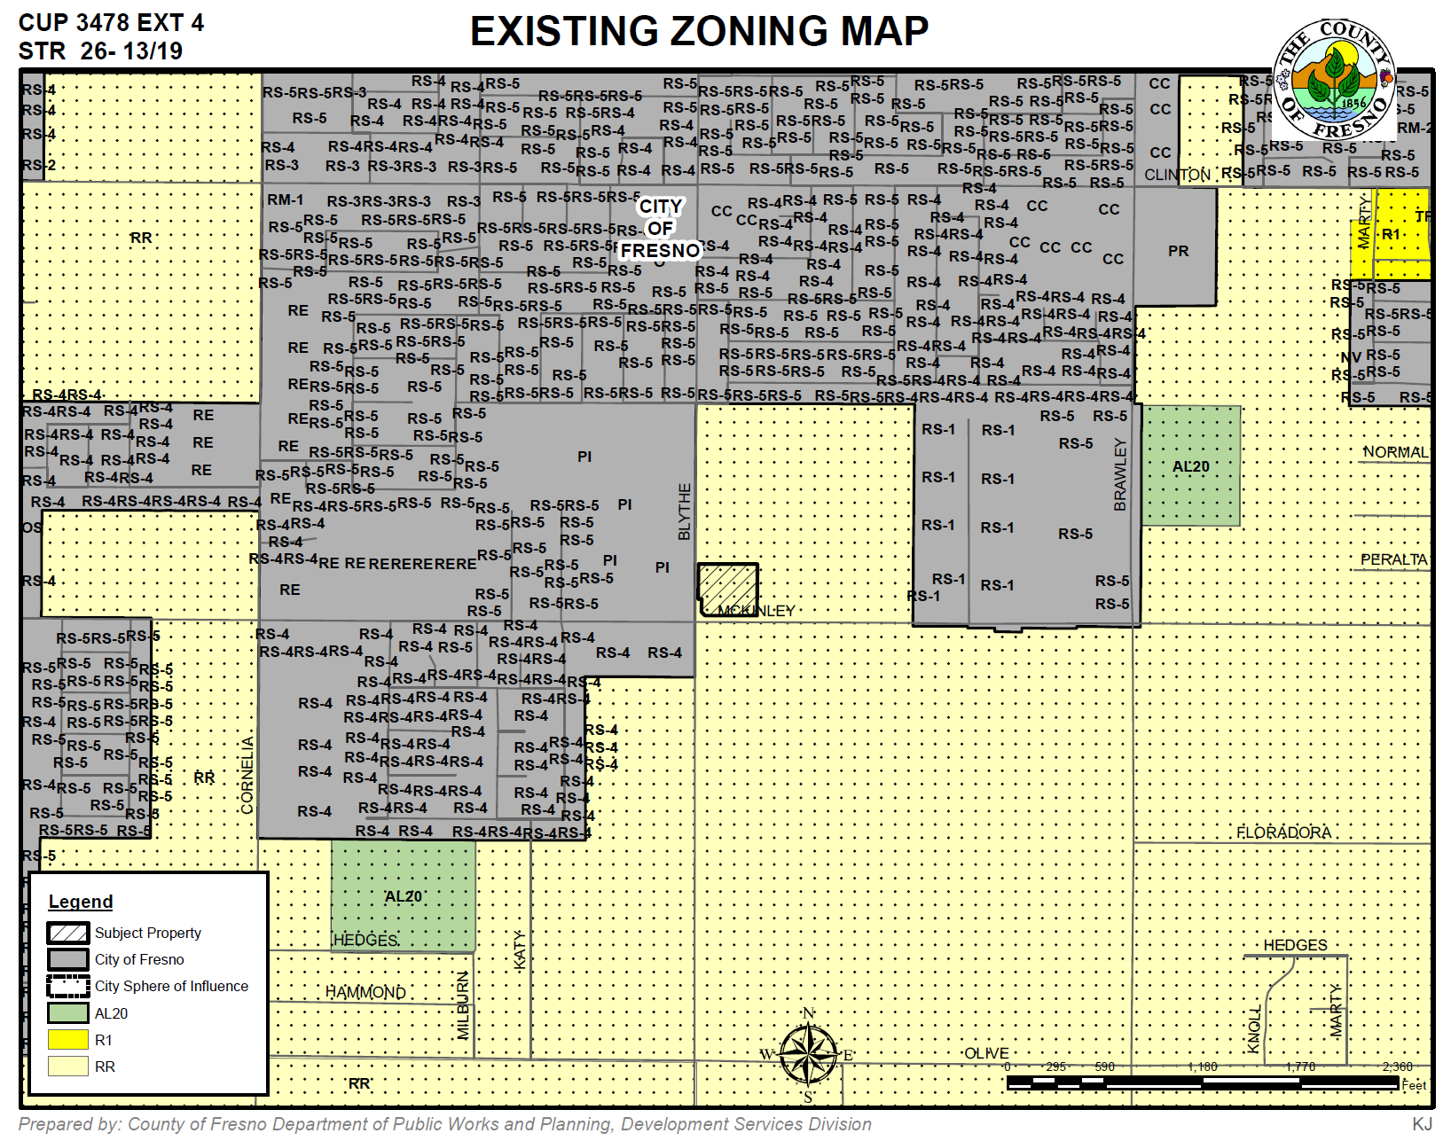

Slide 5
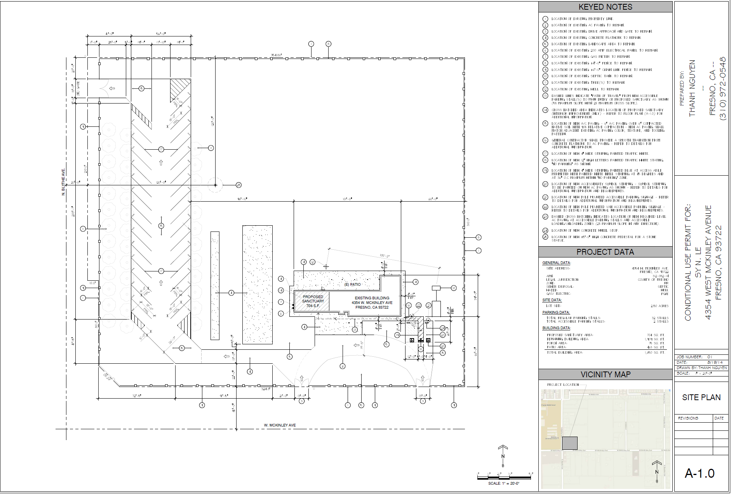

Slide 6
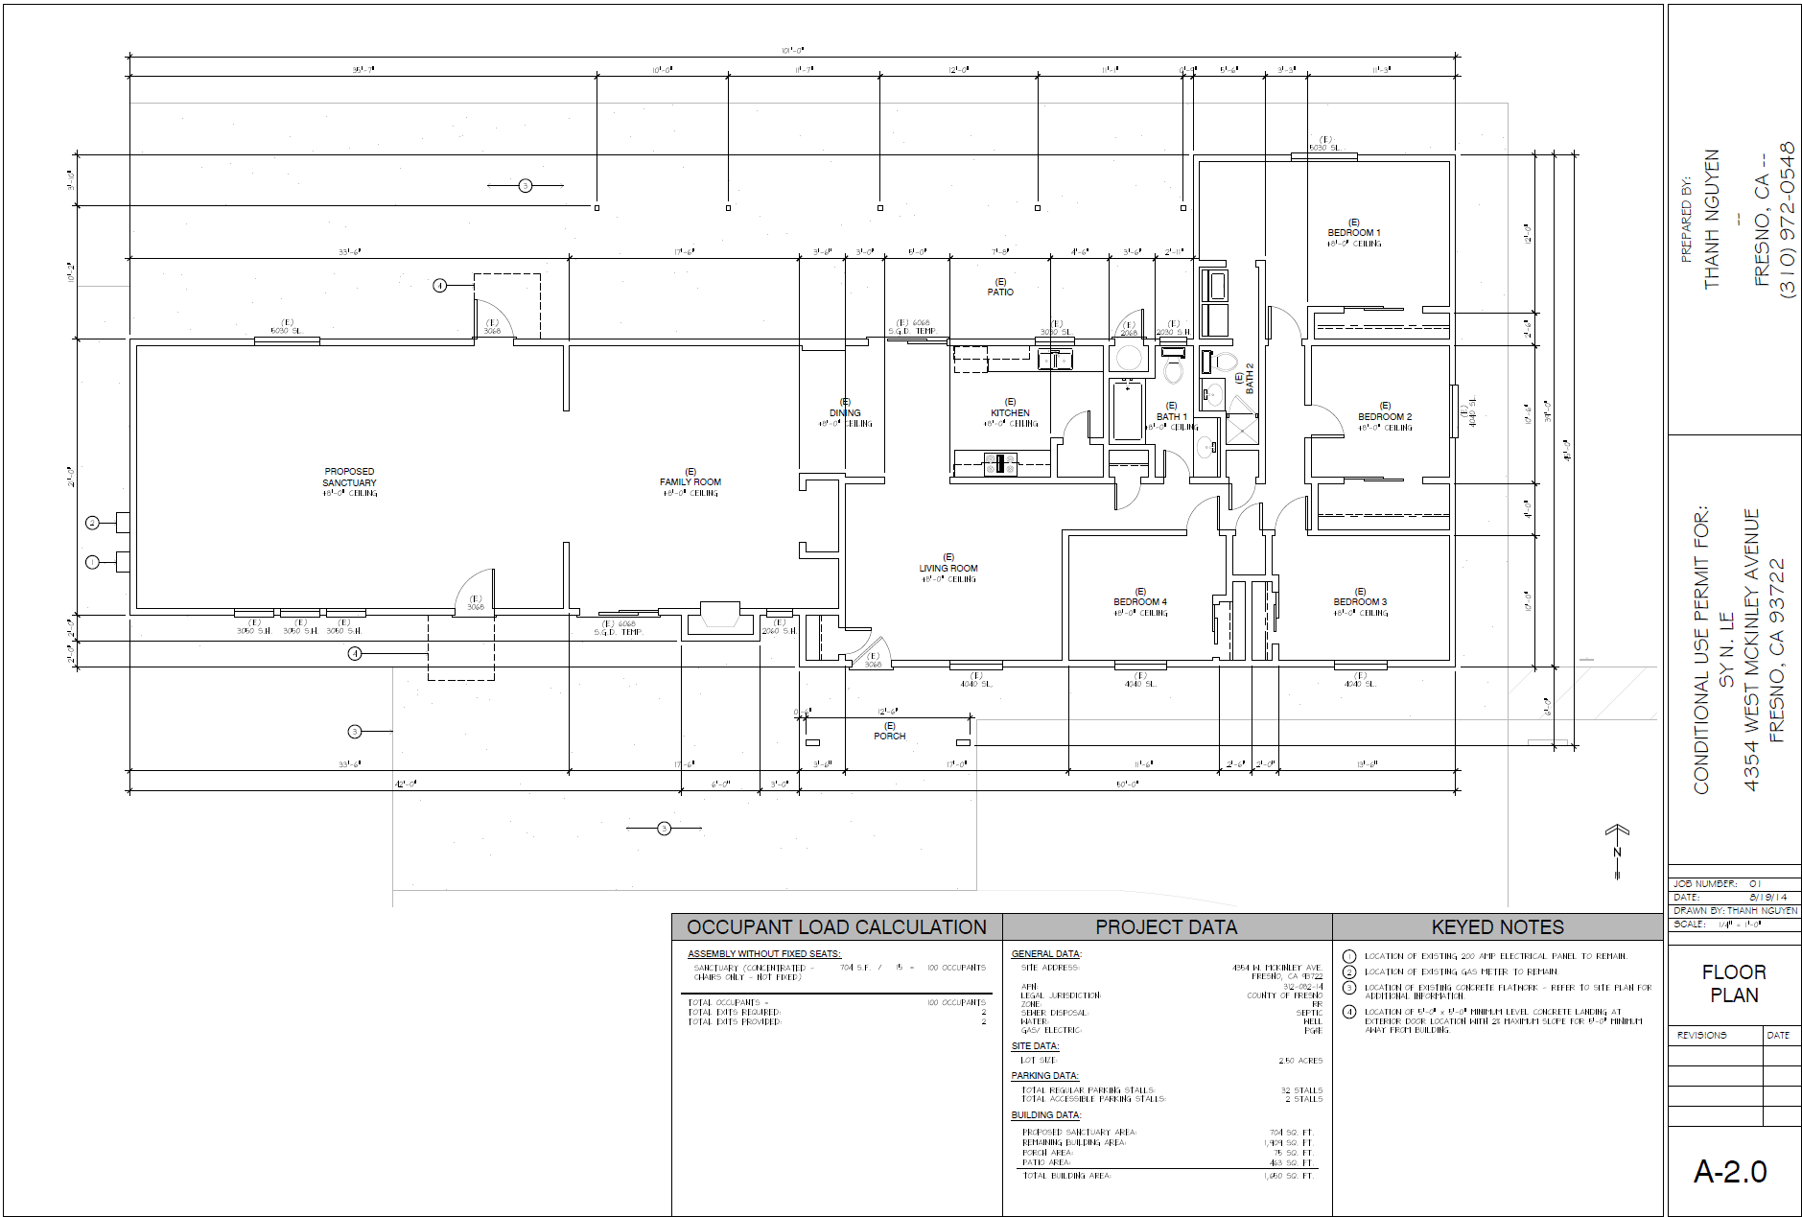

Slide 7
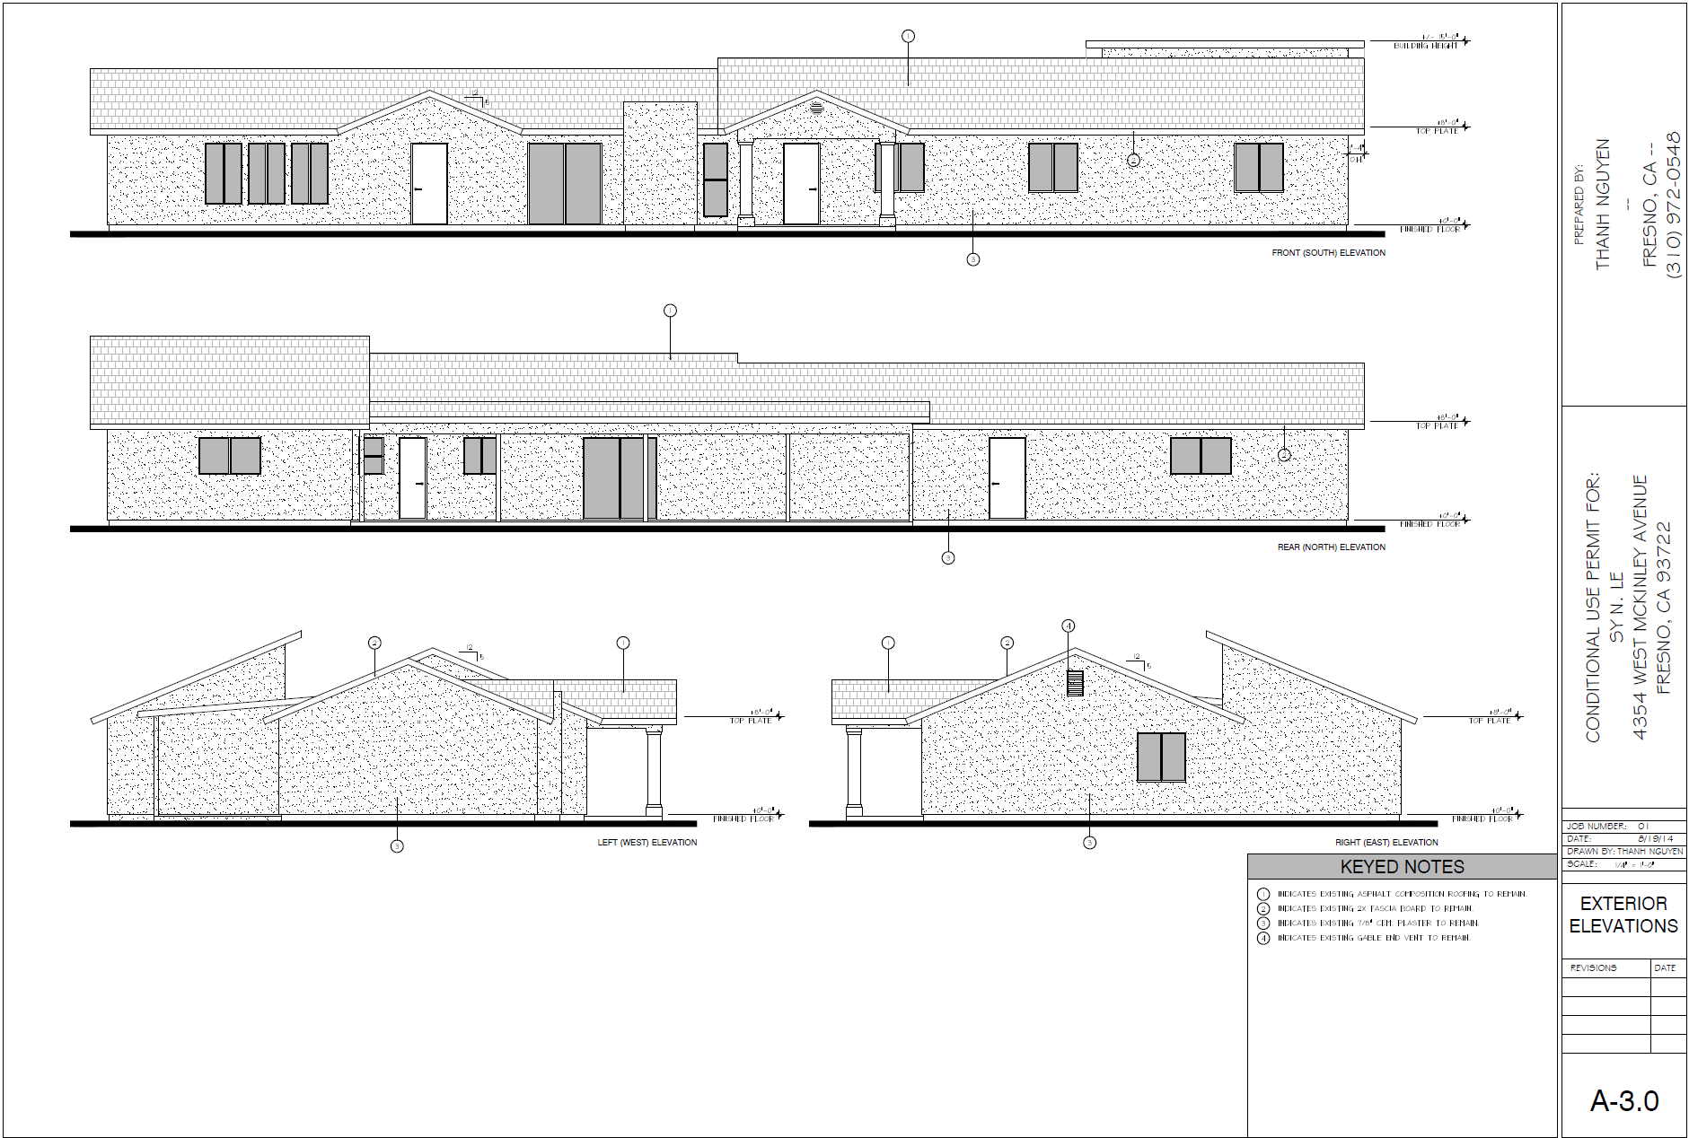

Slide 9
DEPARTMENT of PUBLIC WORKS and PLANNING
DEVELOPMENT SERVICES AND CAPITAL PROJECTS DIVISION
CUP 3478 EXT 4

