Slide 1
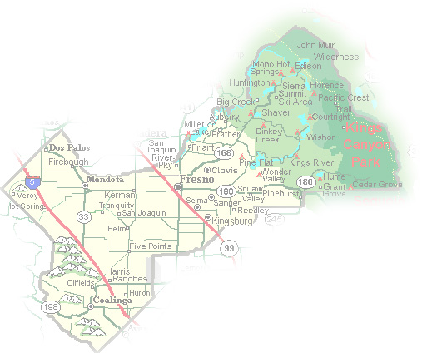
DEPARTMENT of PUBLIC WORKS and PLANNING
DEVELOPMENT SERVICES DIVISION
CUP 3706

Slide 2
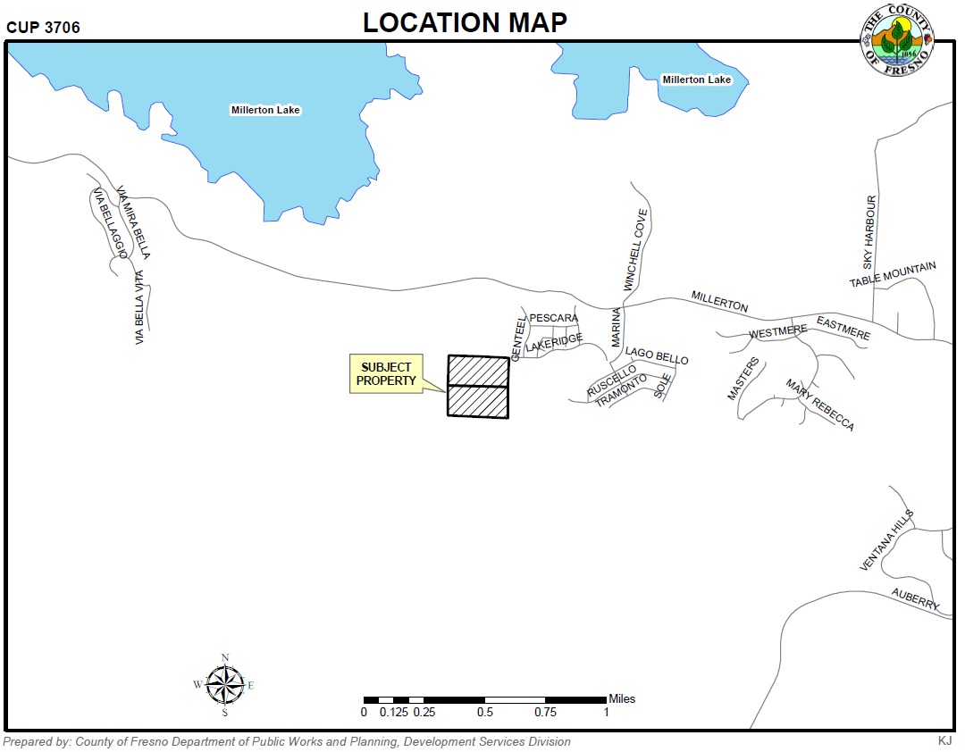

Slide 3
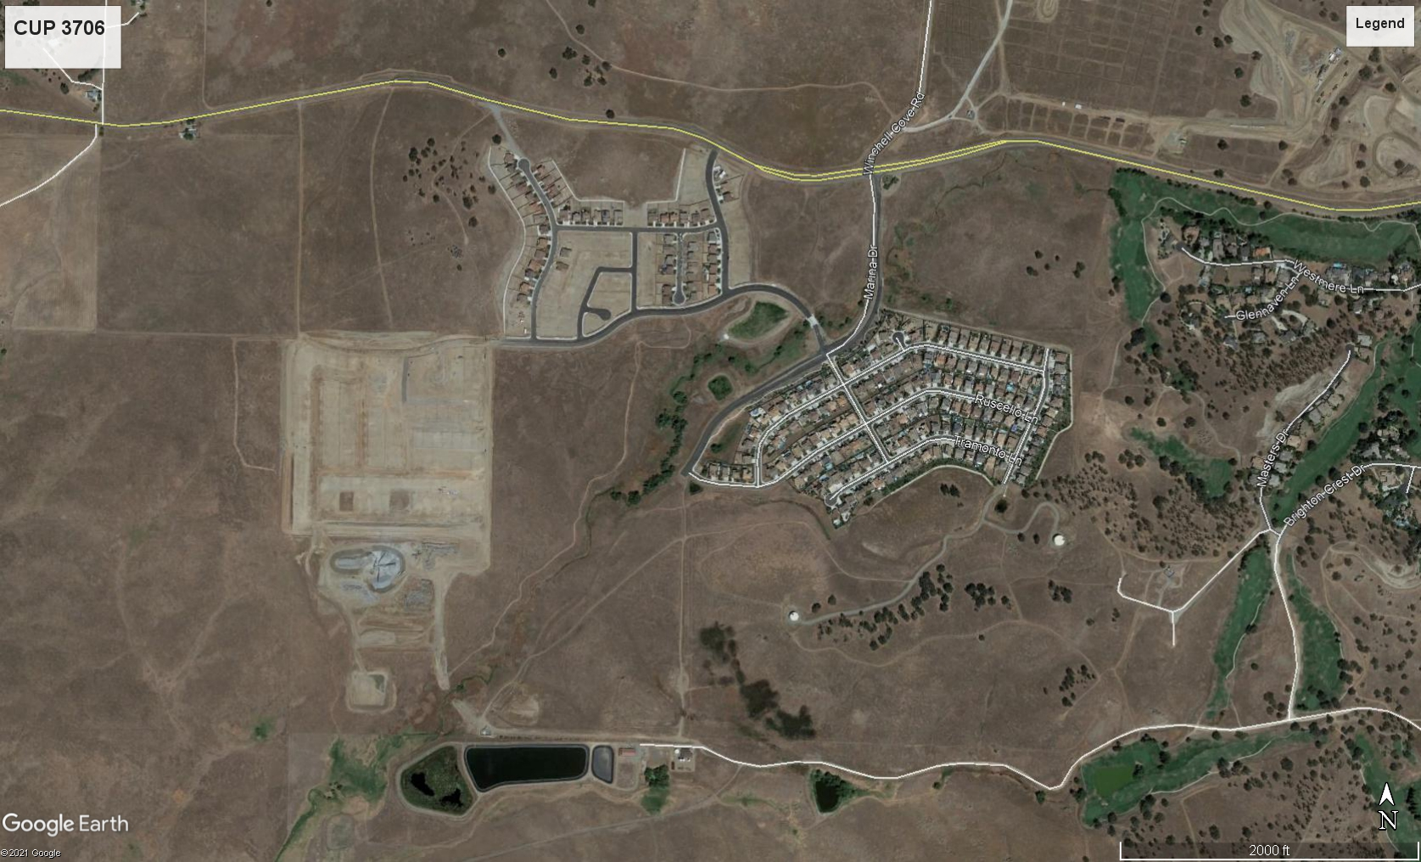
Tract No. 4968
Tract No 6189

Slide 4
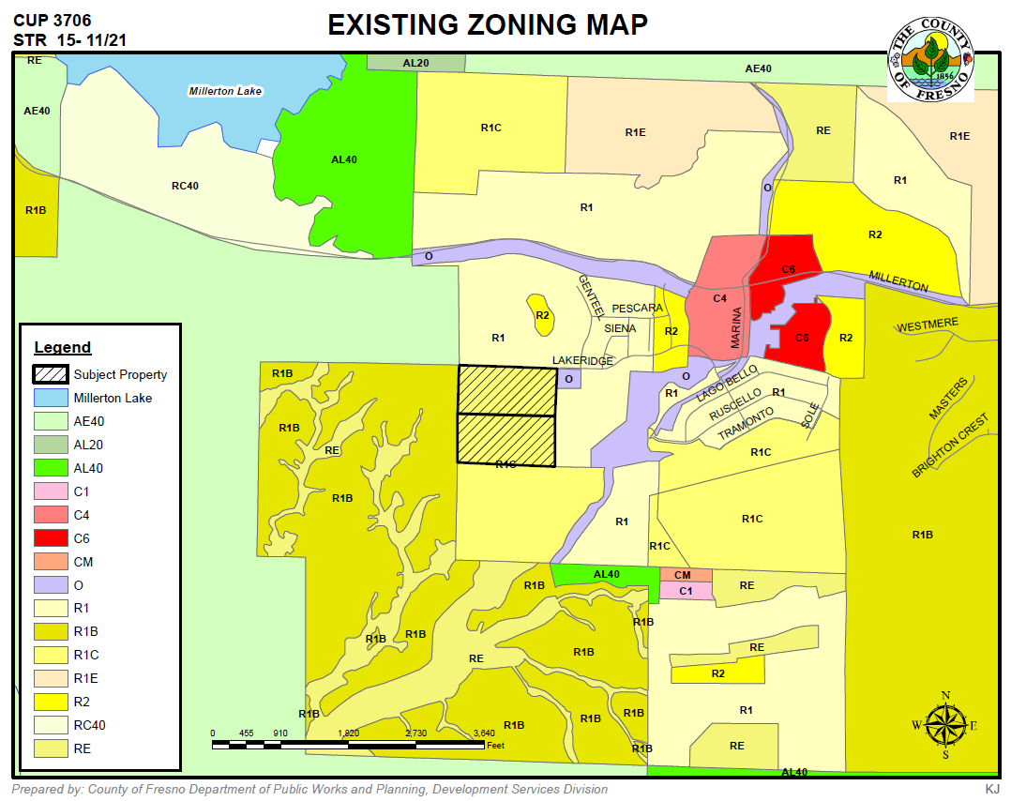

Slide 5
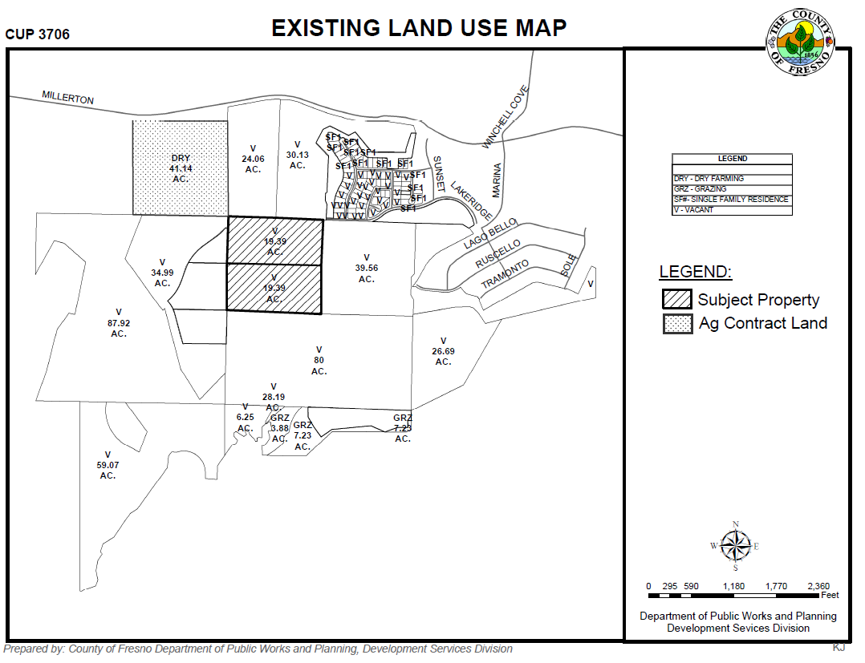

Slide 6
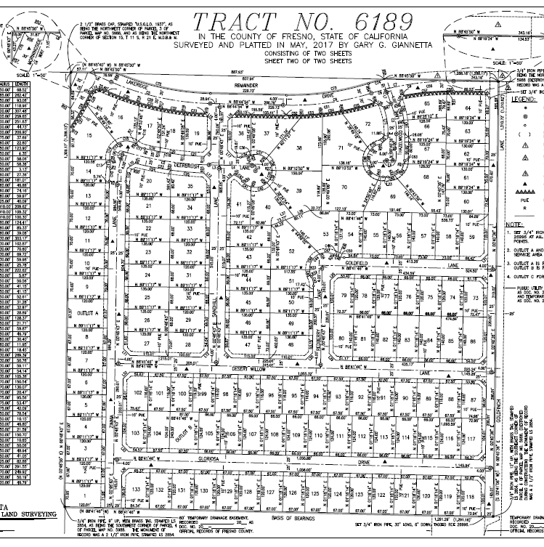
TRACT NO. 6189

Slide 7
DEPARTMENT of PUBLIC WORKS and PLANNING
DEVELOPMENT SERVICES DIVISION
CUP 3706

Slide 8
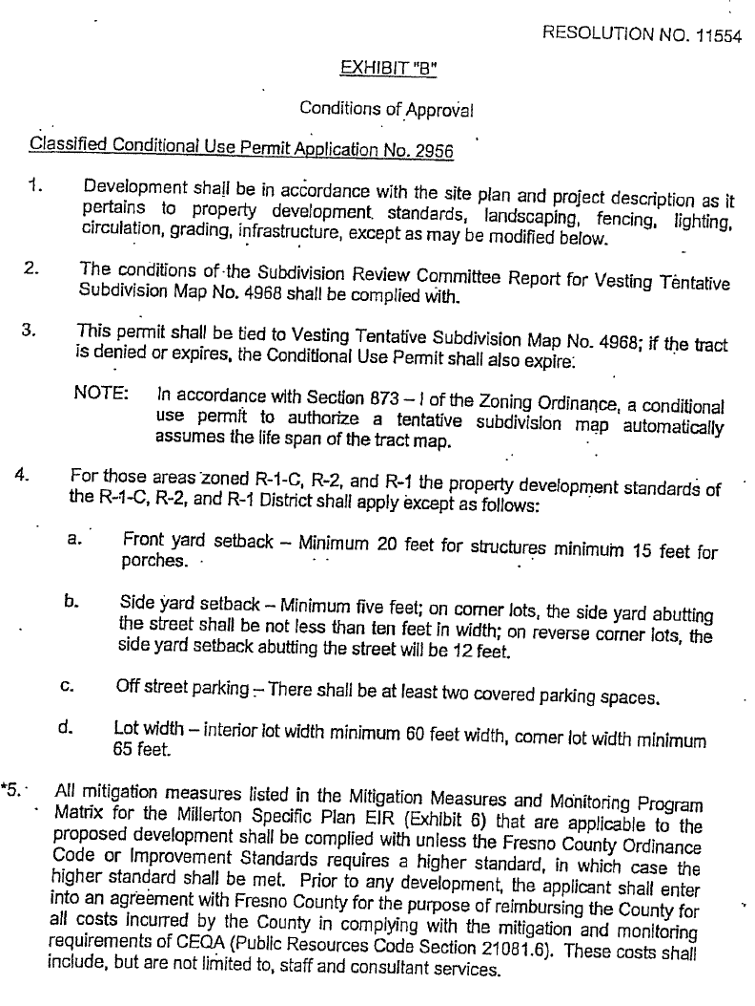

Slide 9
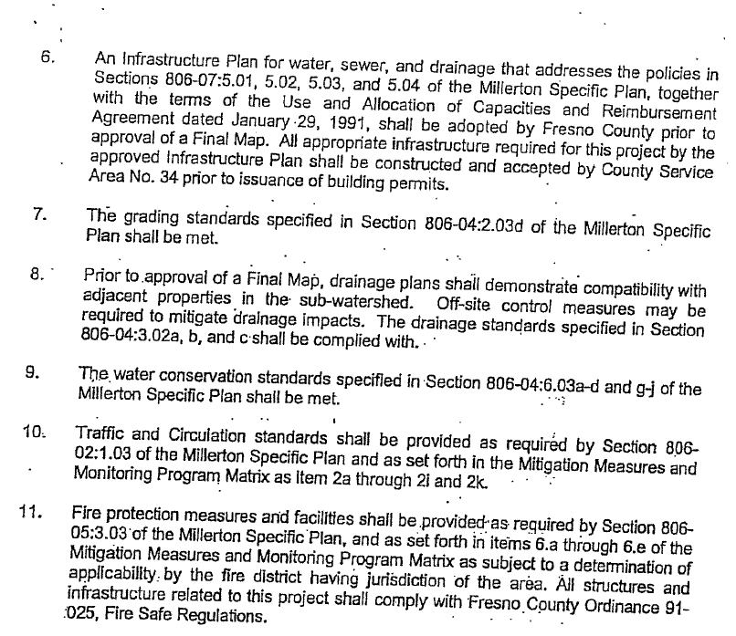

Slide 10
