Slide 1
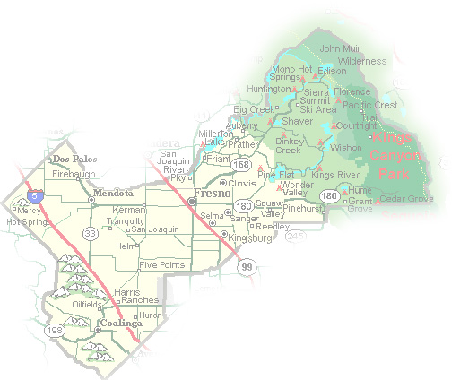
DEPARTMENT of PUBLIC WORKS and PLANNING
DEVELOPMENT SERVICES & CAPITAL PROJECTS DIVISION
TT 5991 EXT 2

Slide 2
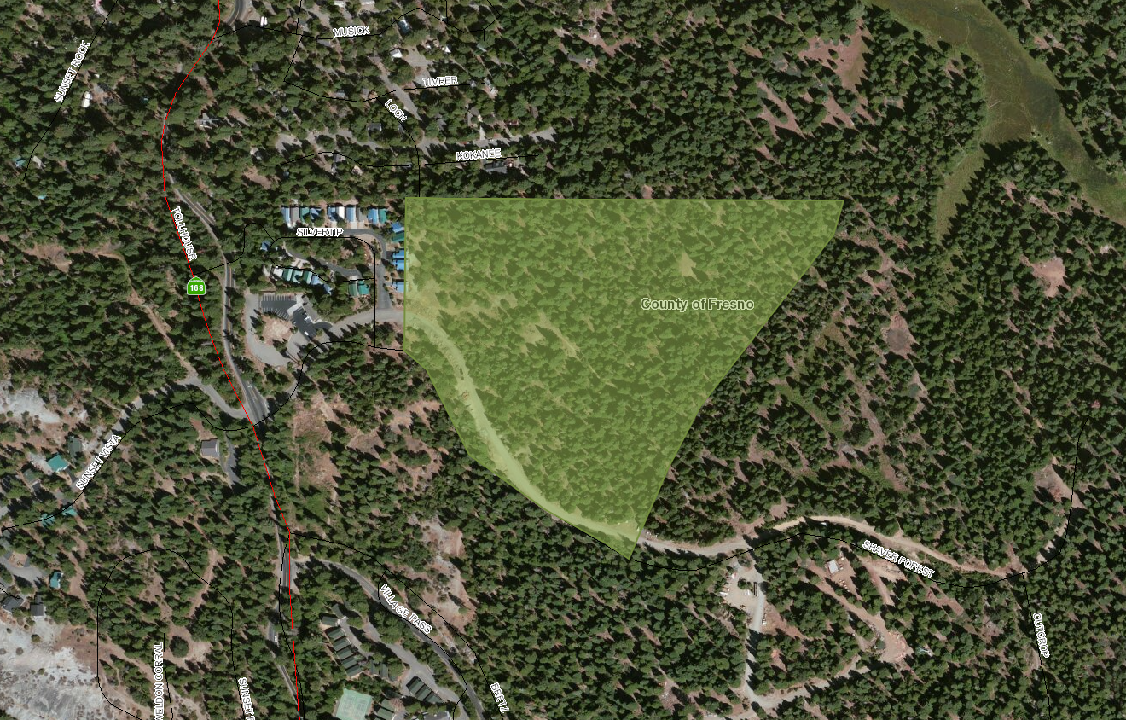
TT 5991

Slide 3
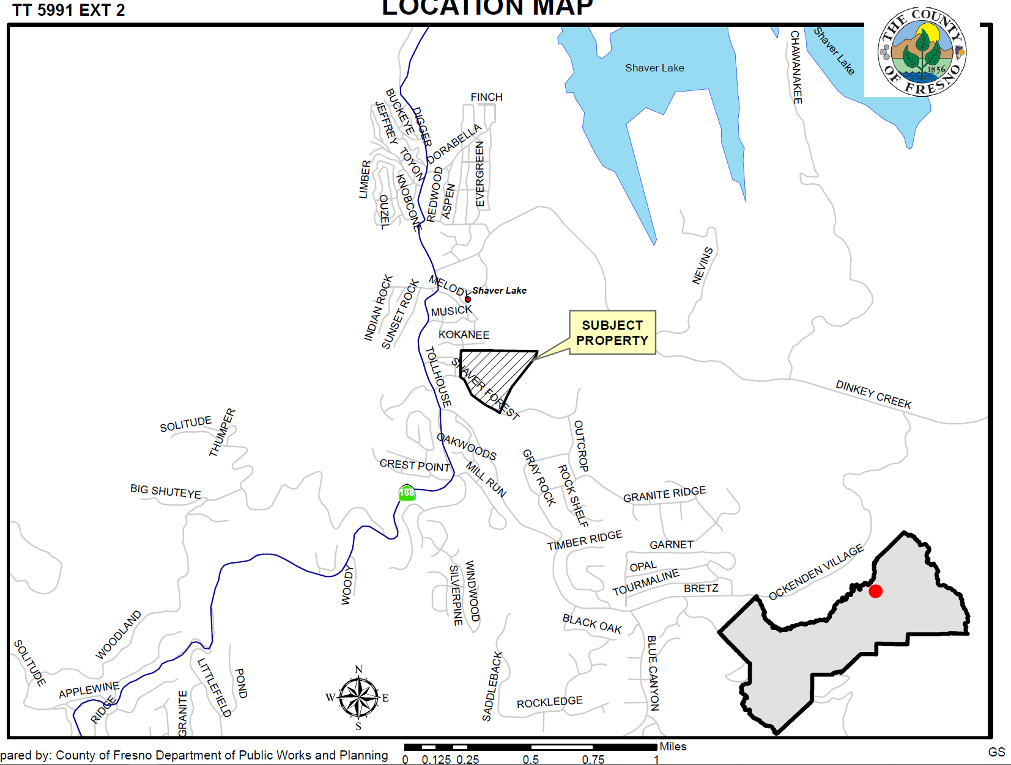

Slide 4
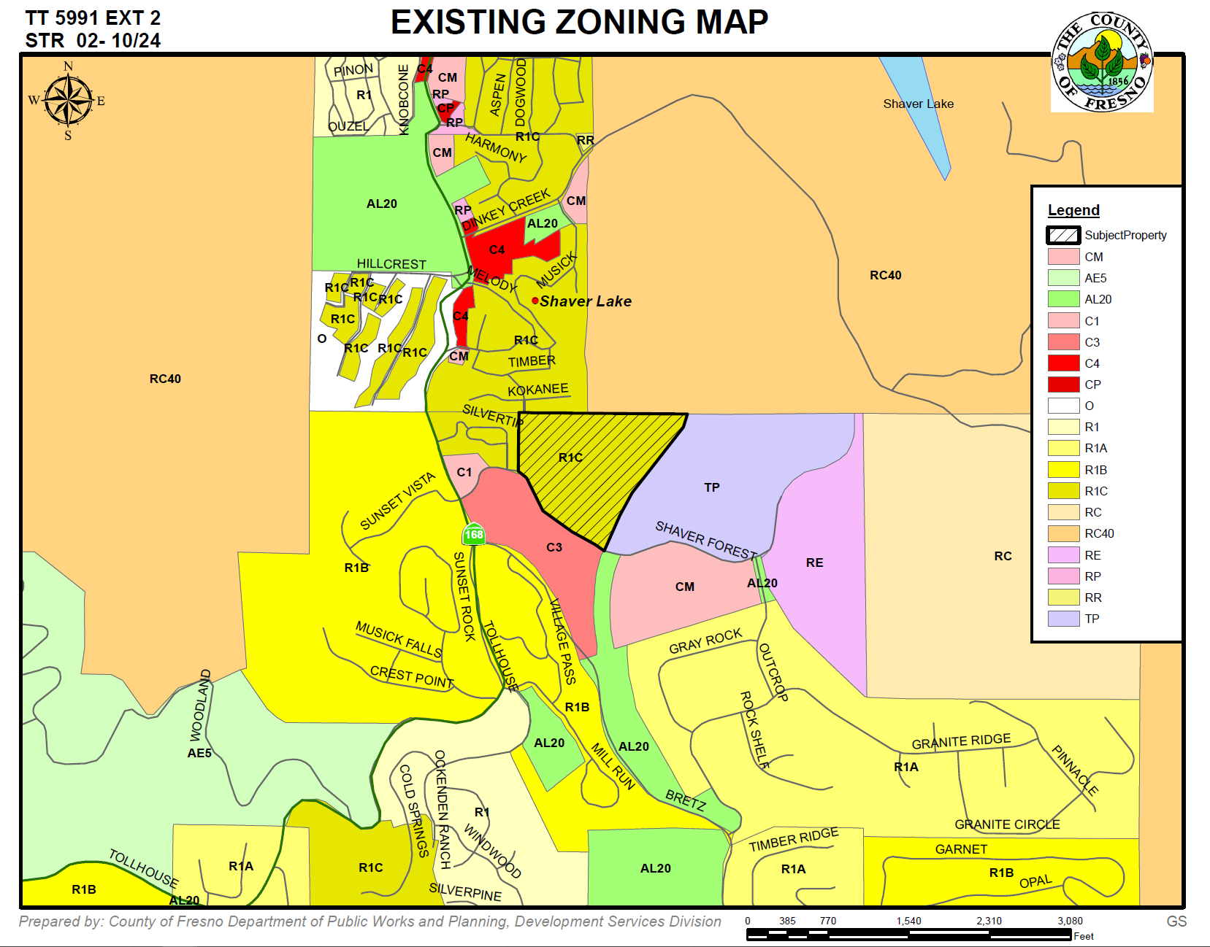

Slide 5
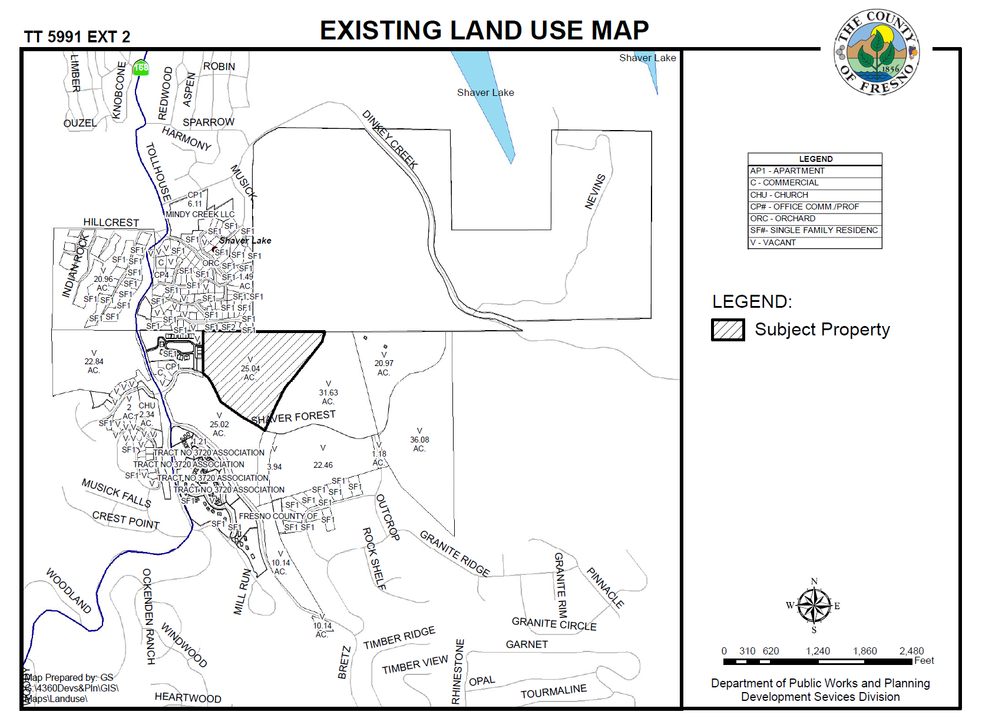

Slide 6
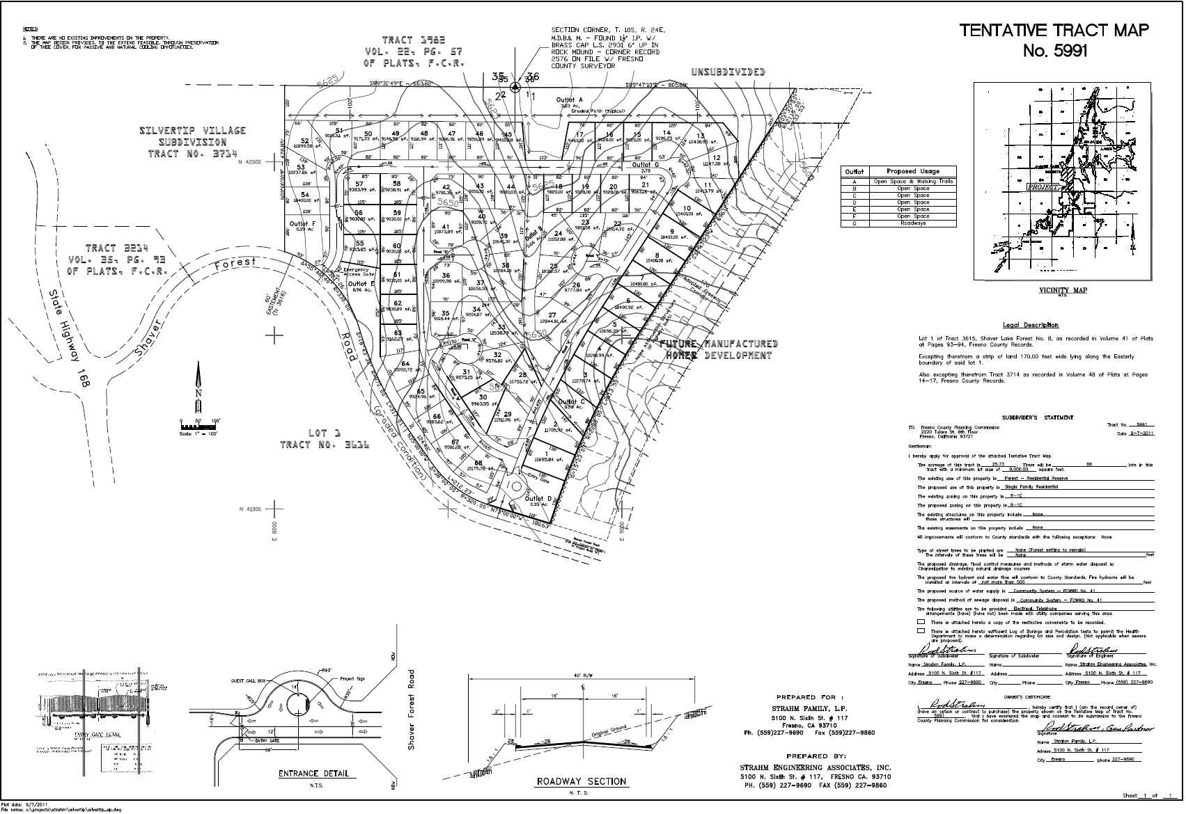

Slide 7
DEPARTMENT of PUBLIC WORKS and PLANNING
DEVELOPMENT SERVICES & CAPITAL PROJECTS DIVISION
TT 5991 EXT 2

