Slide 1
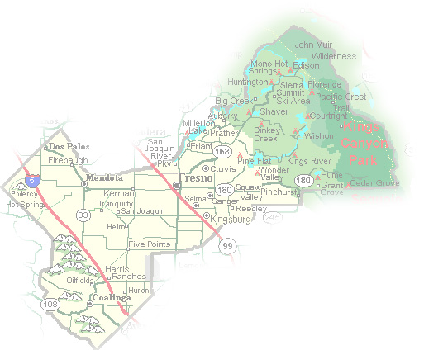
DEPARTMENT of PUBLIC WORKS and PLANNING
DEVELOPMENT SERVICES & CAPITAL PROJECTS DIVISION
TT 6226 EXT 1

Slide 2
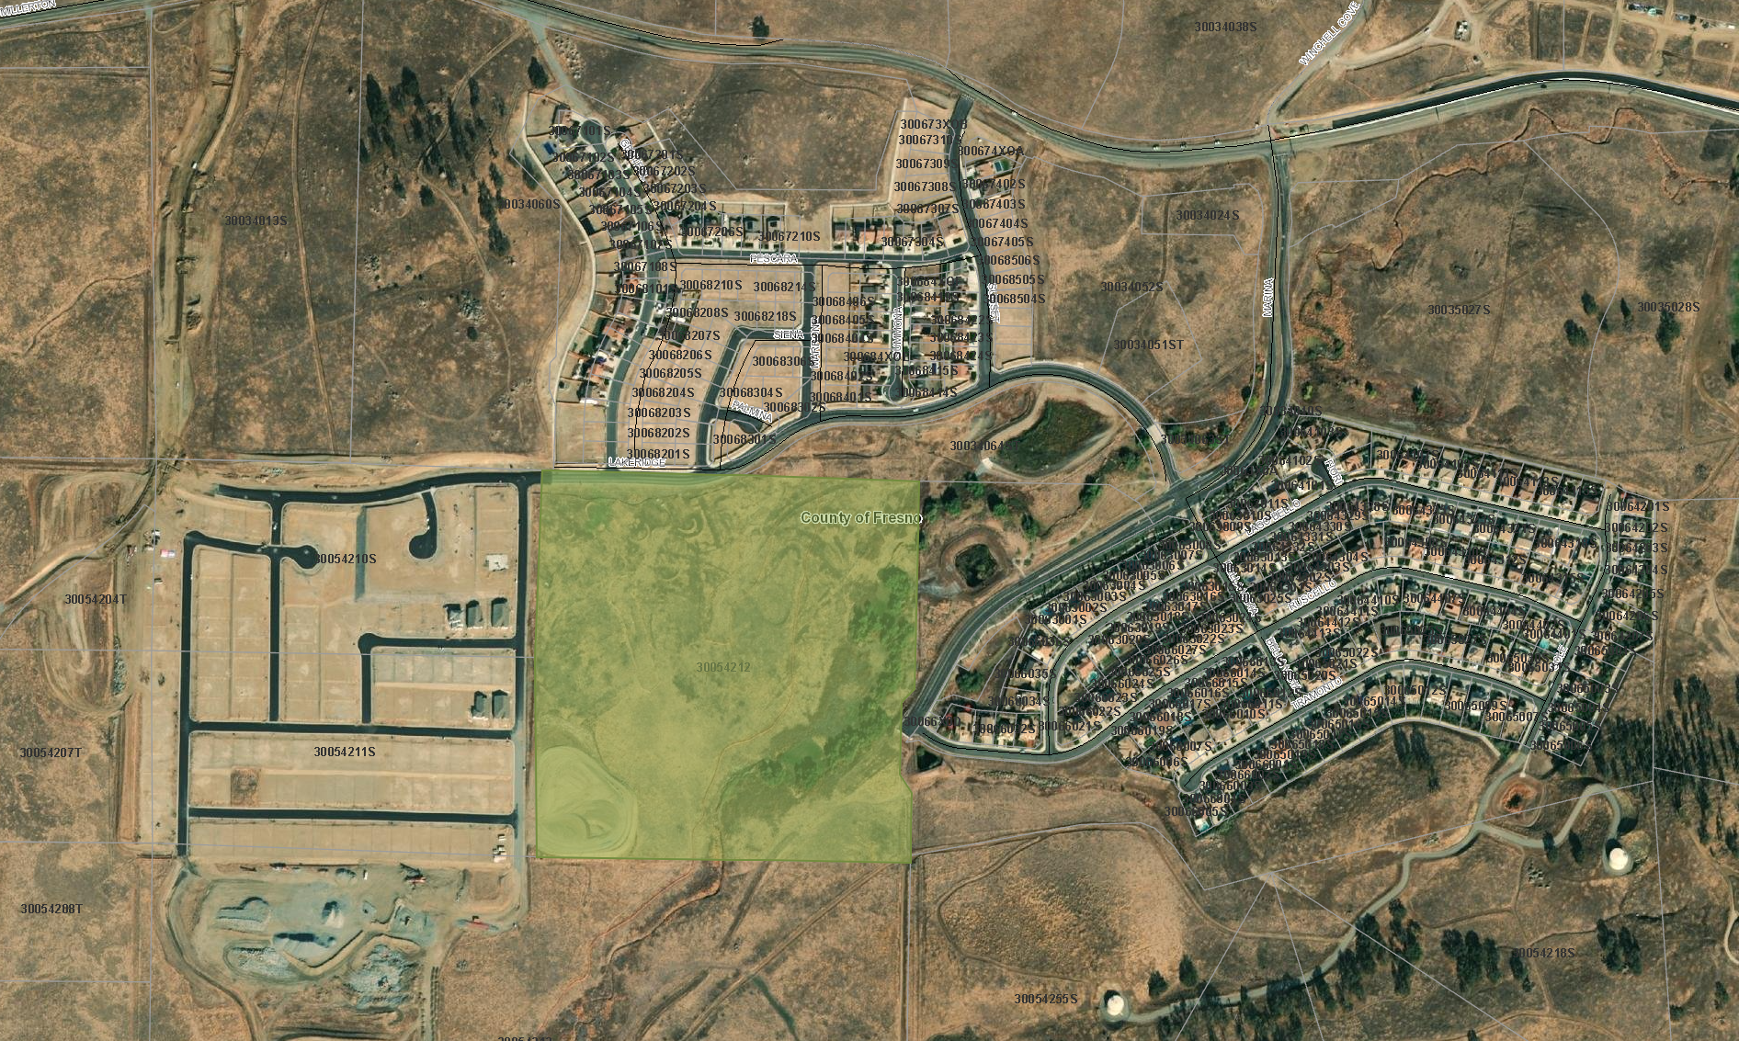
Millerton Road
Marina Drive
TT 4968
TT 4870
TT 4968
TT 6226

Slide 3
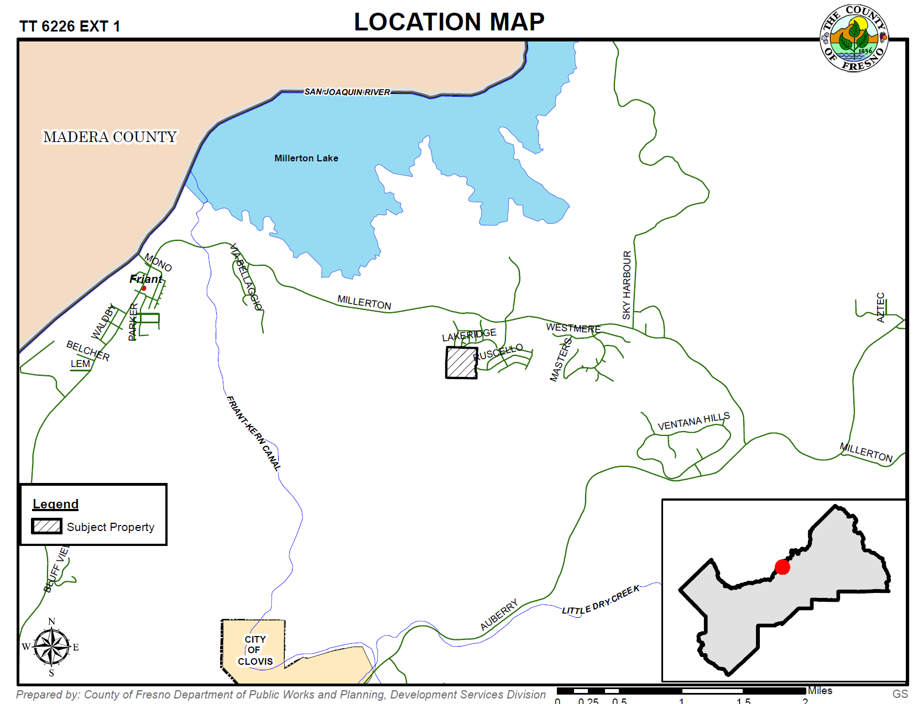

Slide 4
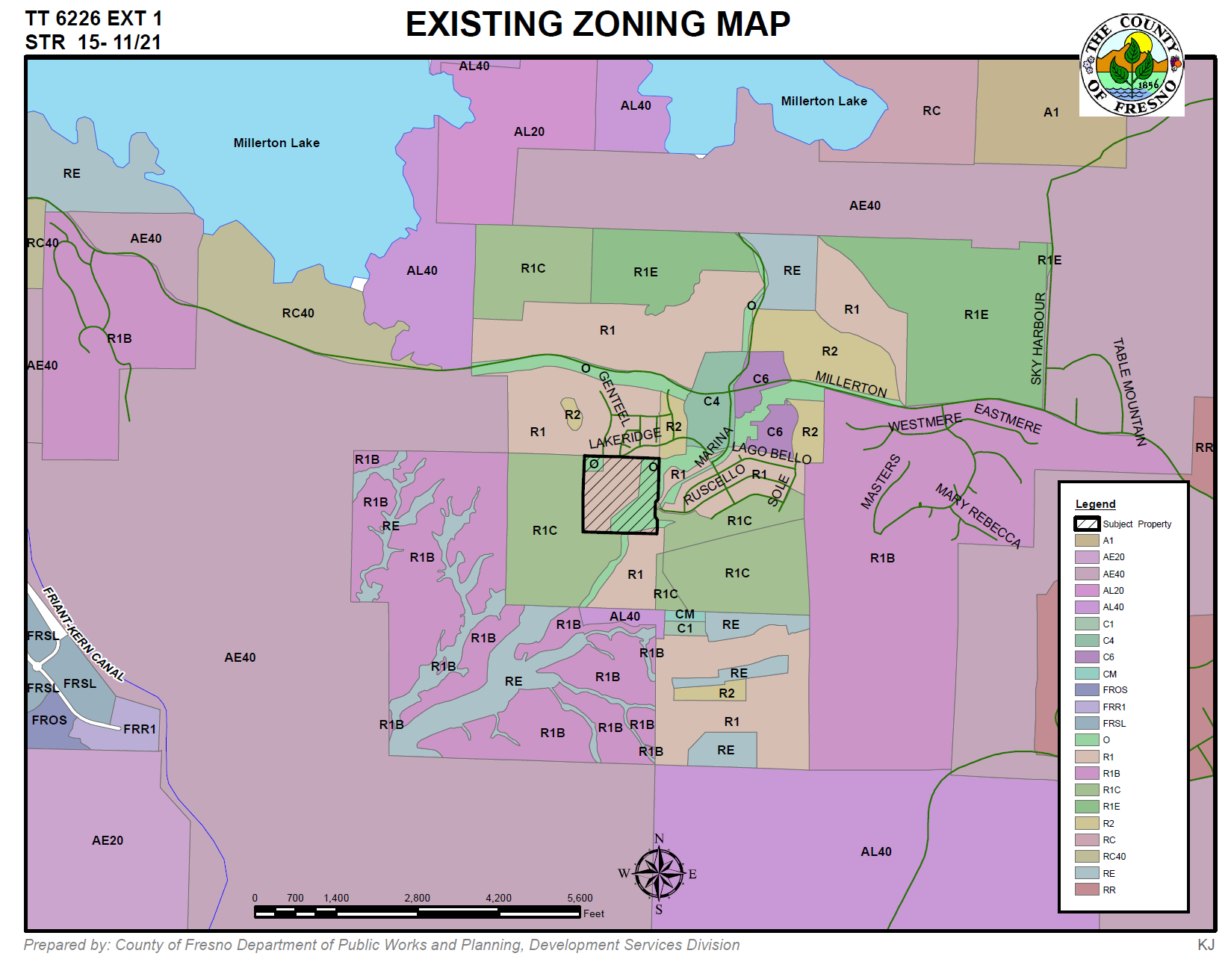

Slide 5
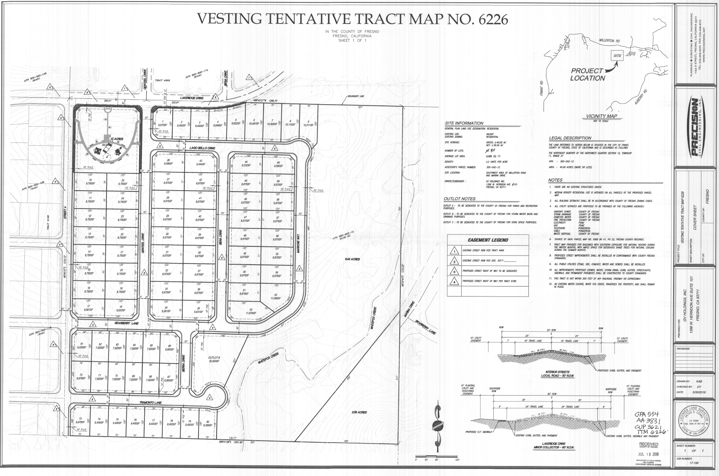

Slide 6
DEPARTMENT of PUBLIC WORKS and PLANNING
DEVELOPMENT SERVICES & CAPITAL PROJECTS DIVISION
TT 6226 EXT 1

