Slide 1
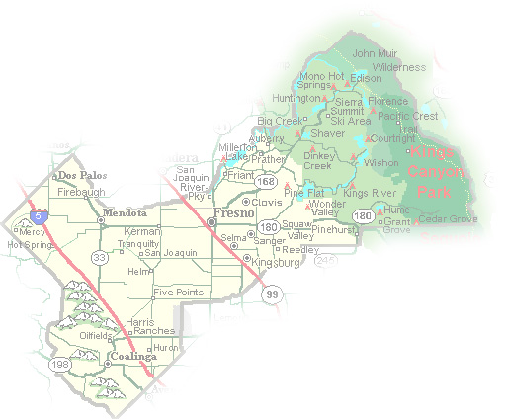
DEPARTMENT of PUBLIC WORKS and PLANNING
DEVELOPMENT SERVICES DIVISION
VA 4107

Slide 2
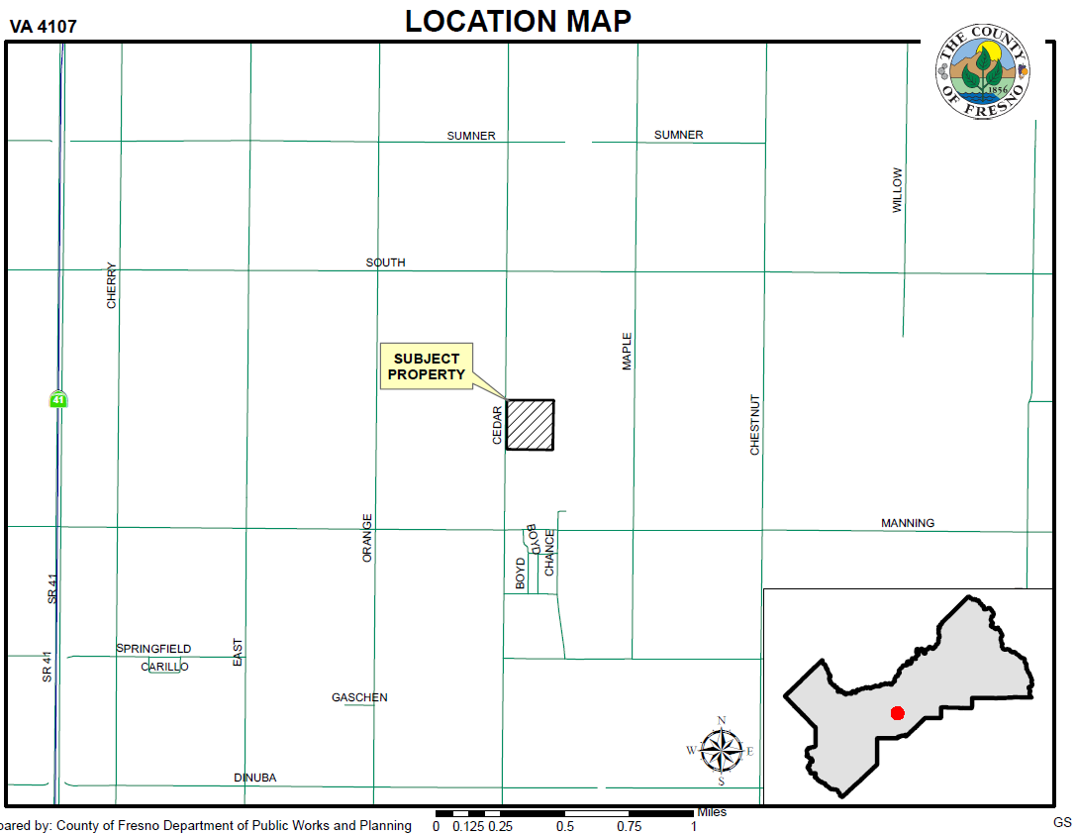

Slide 3
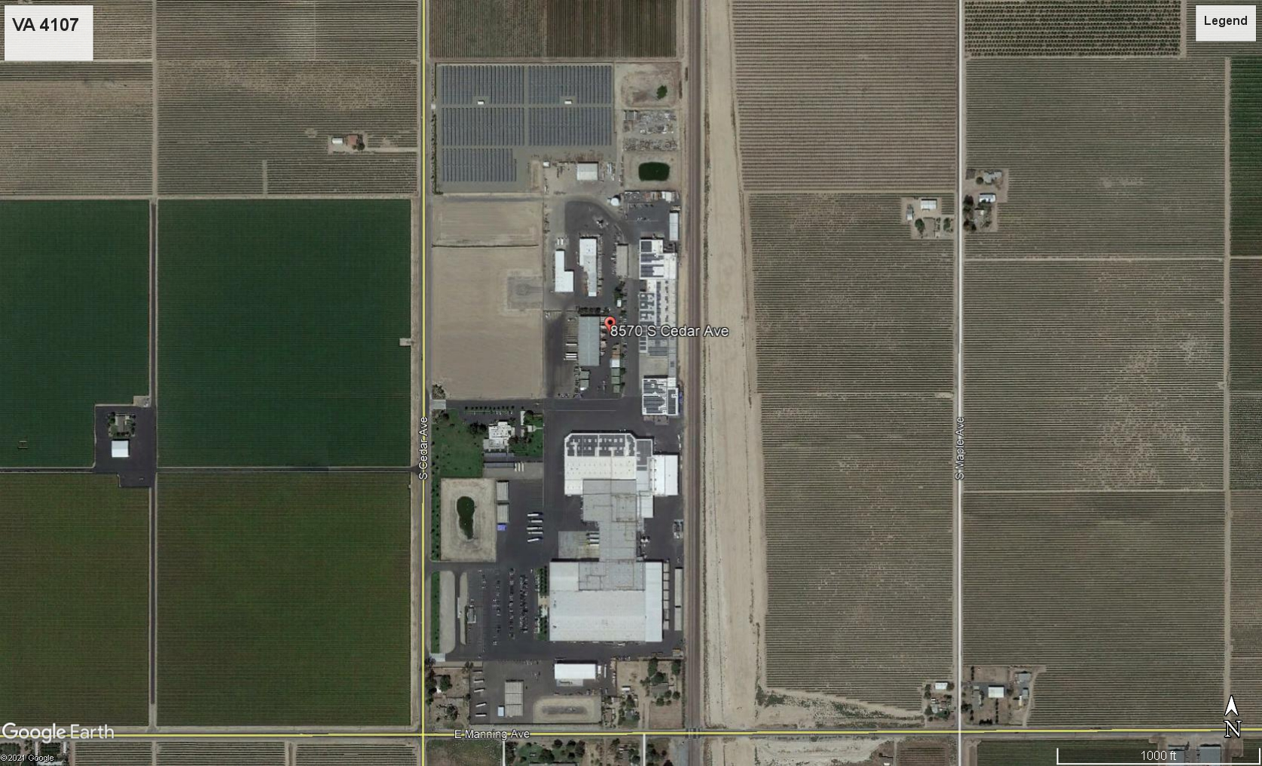
CEDAR AVENUE
PROJECT SITE
Building to be Replaced with the Proposed 40-foot-tall Warehouse
The Existing Fruit Packing facility
MANNING AVENUE

Slide 4
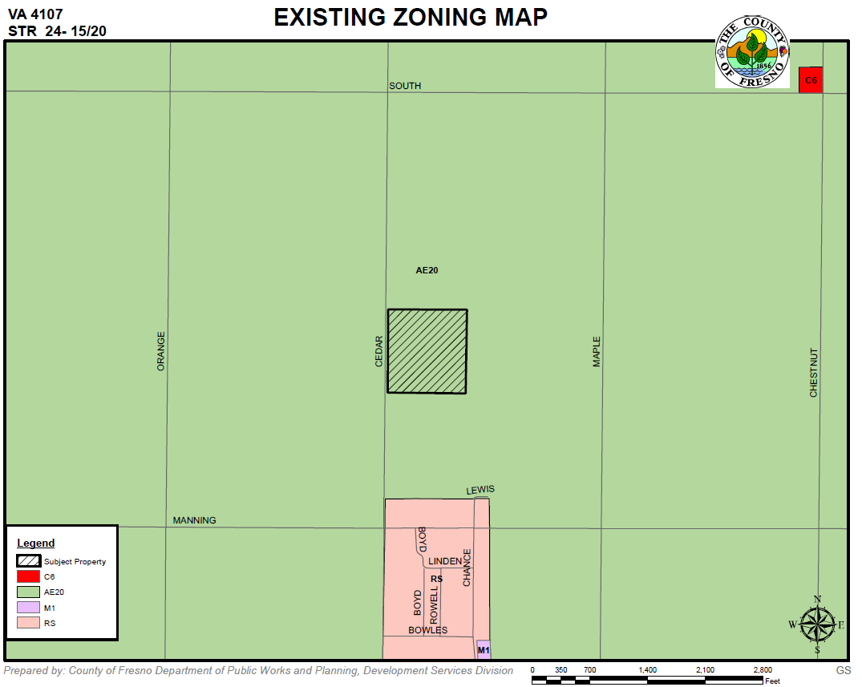

Slide 5
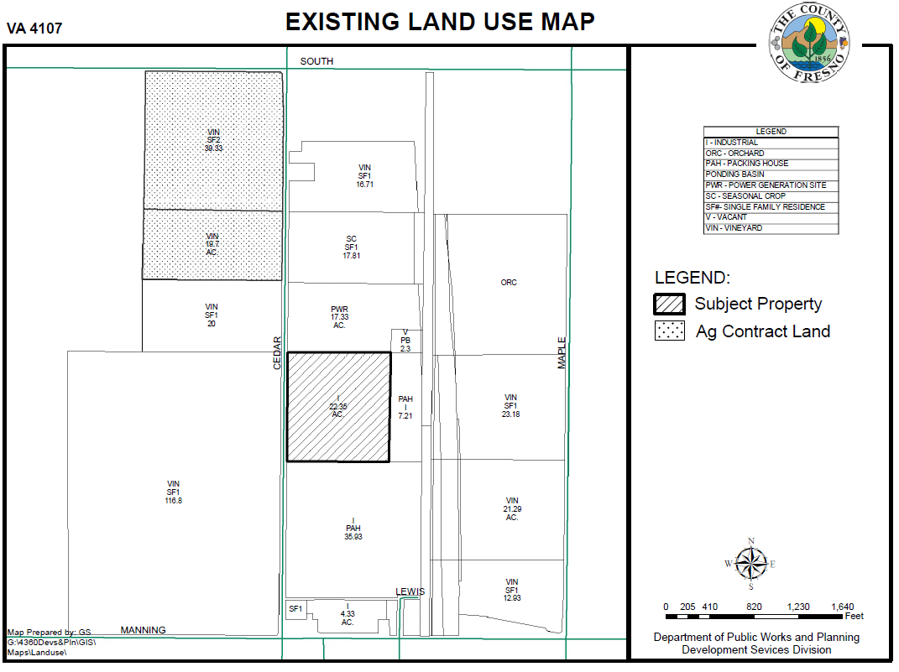

Slide 6
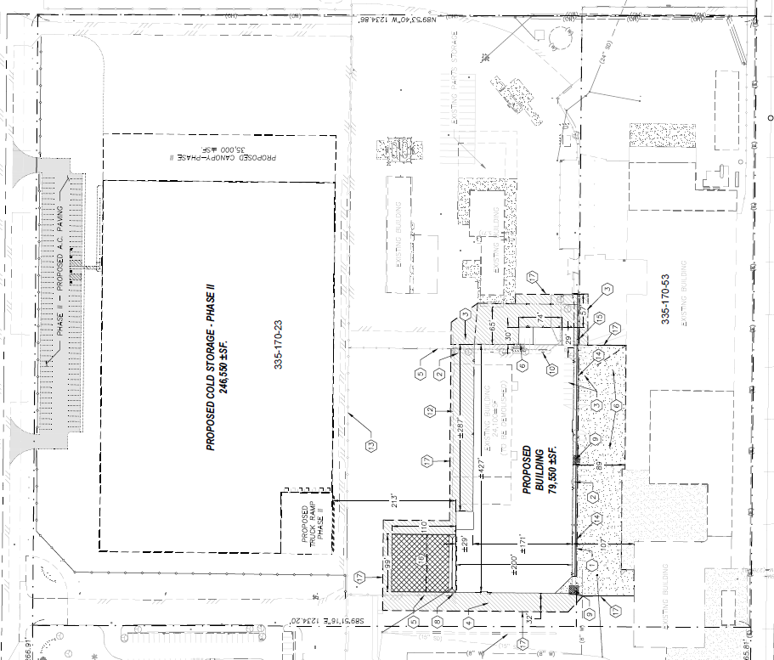

Slide 7
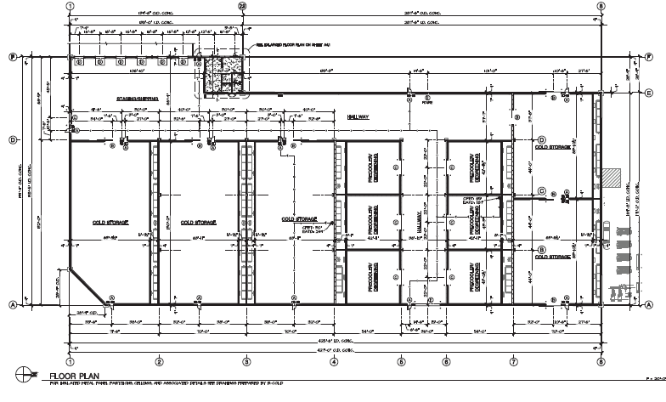

Slide 8
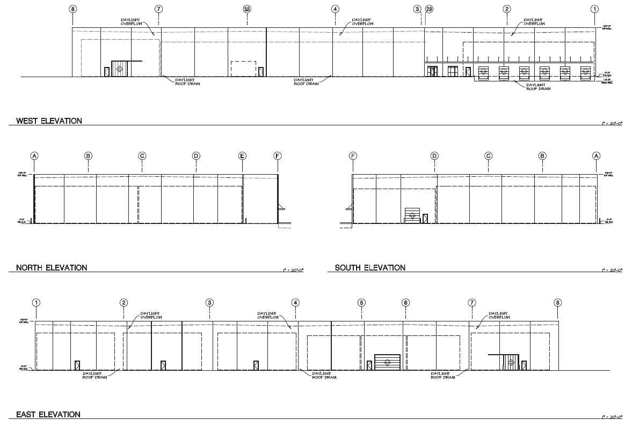

Slide 9
DEPARTMENT of PUBLIC WORKS and PLANNING
DEVELOPMENT SERVICES DIVISION
VA 4107

Slide 10
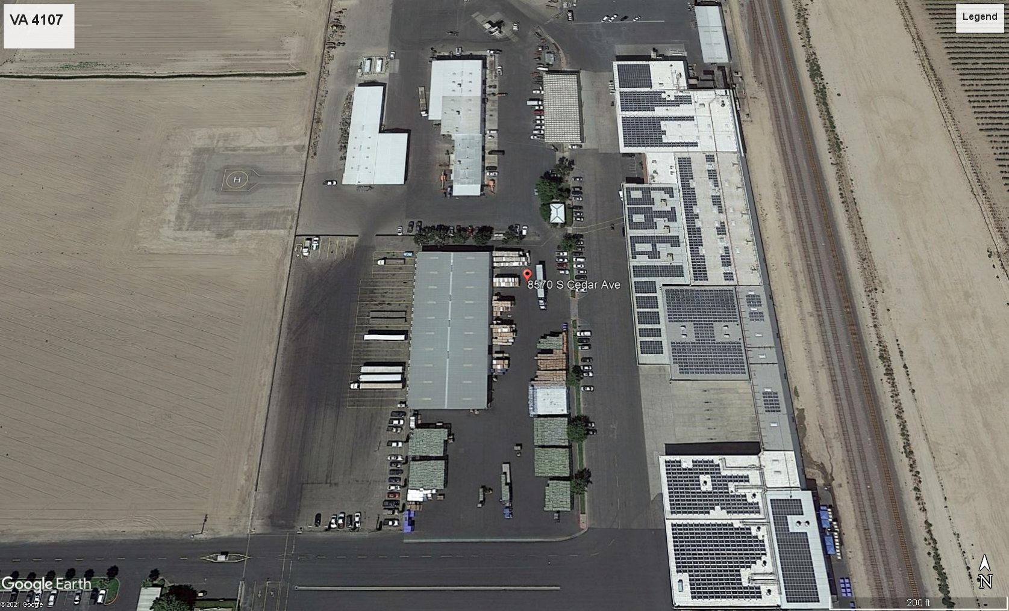

Slide 11
