Slide 1
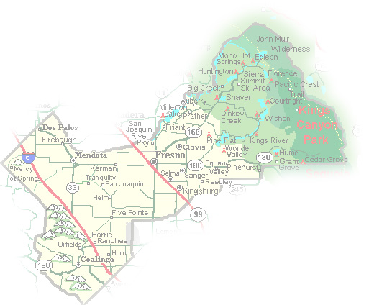
DEPARTMENT of PUBLIC WORKS and PLANNING
DEVELOPMENT SERVICES DIVISION
VA 4105

Slide 2
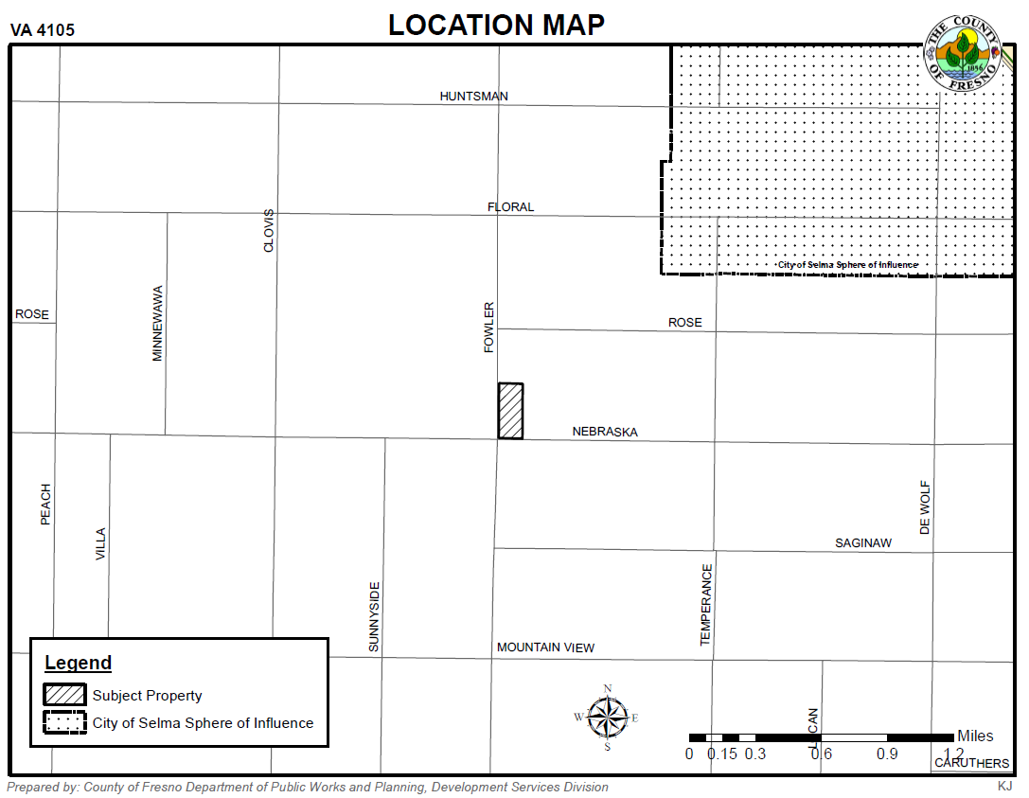

Slide 3
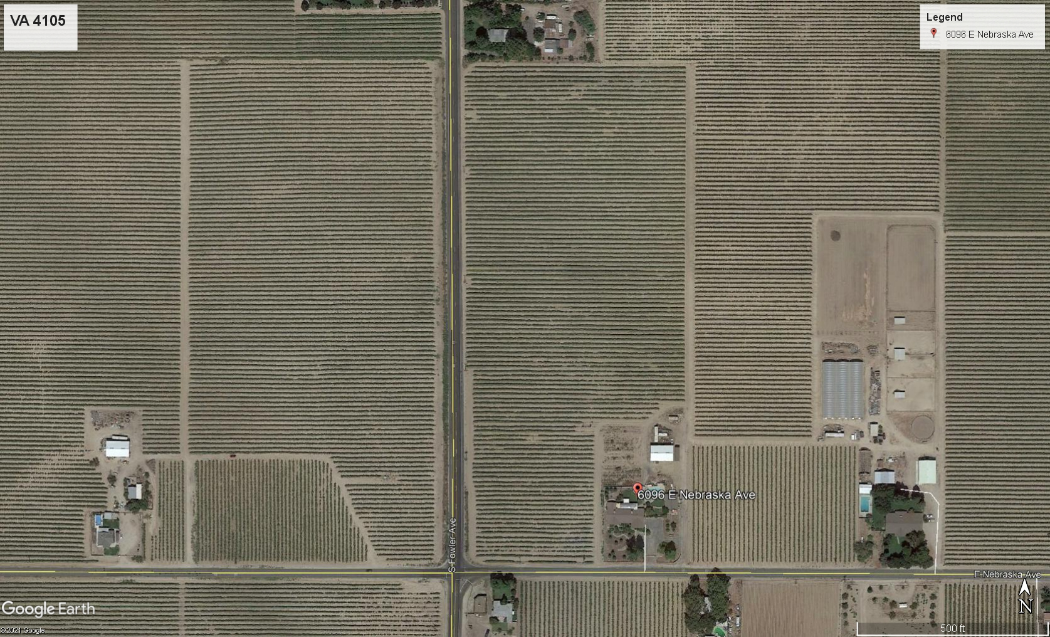
Fowler Ave
PROJECT SITE
PARCEL B
17 ACRES
PARCEL A
2 ACRES
Nebraska Ave

Slide 4
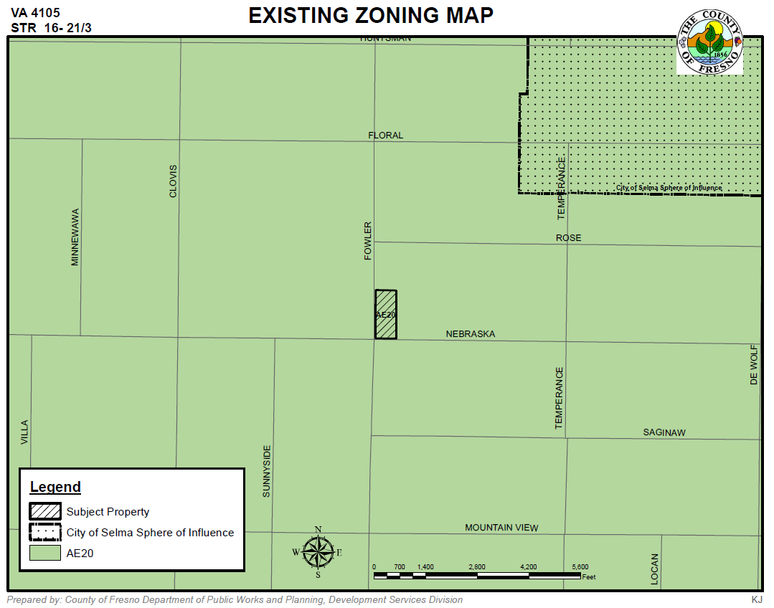

Slide 5
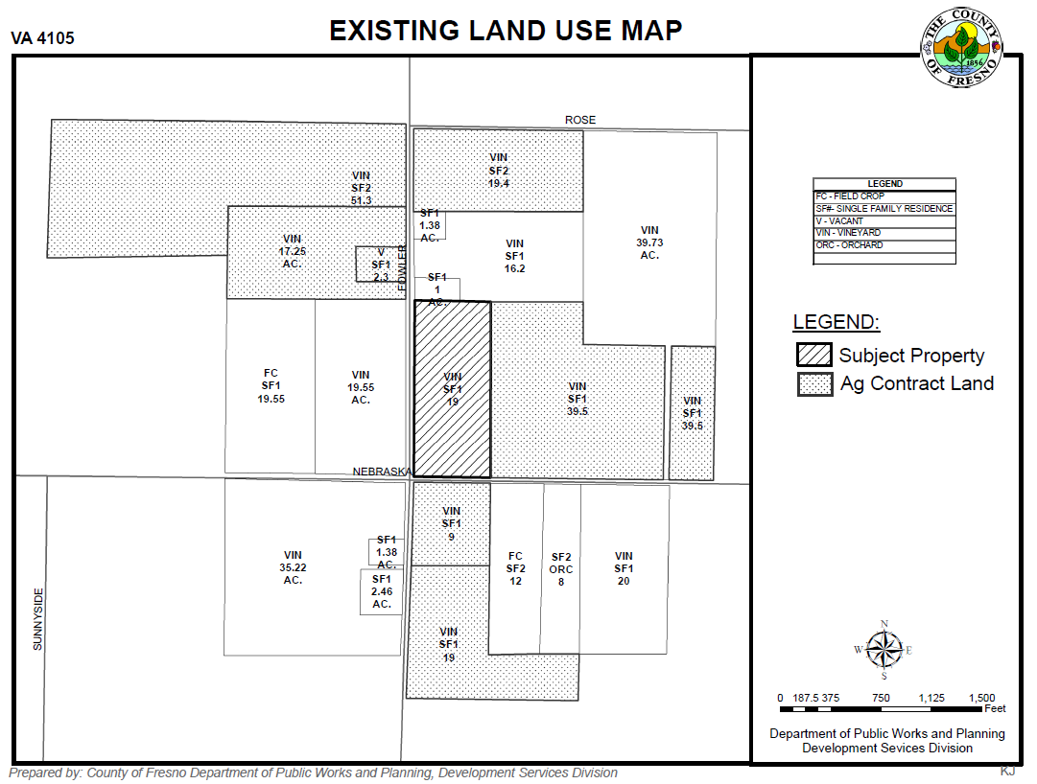

Slide 6
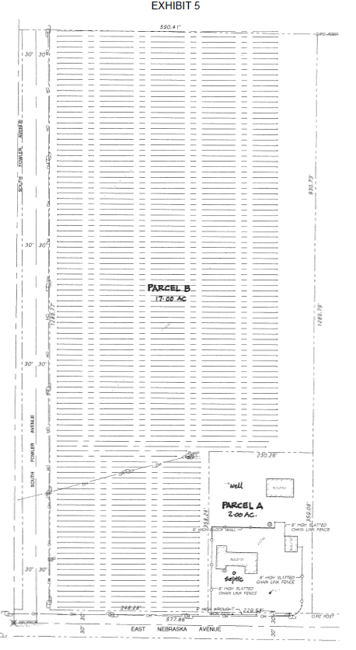

Slide 7
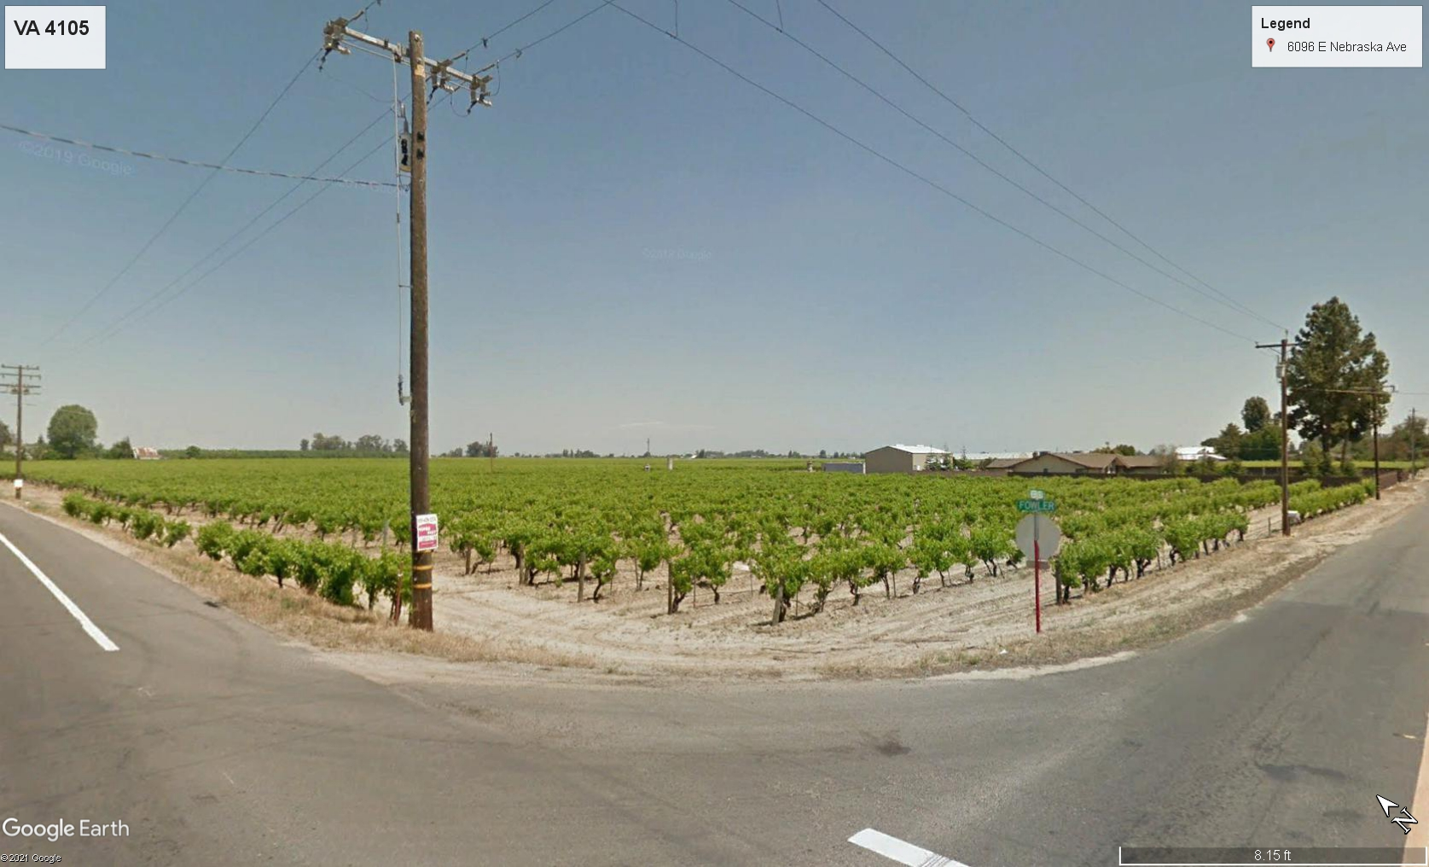
Parcel B
17 Acres
Parcel A
2 Acres
Fowler Ave
Nebraska Ave

Slide 8
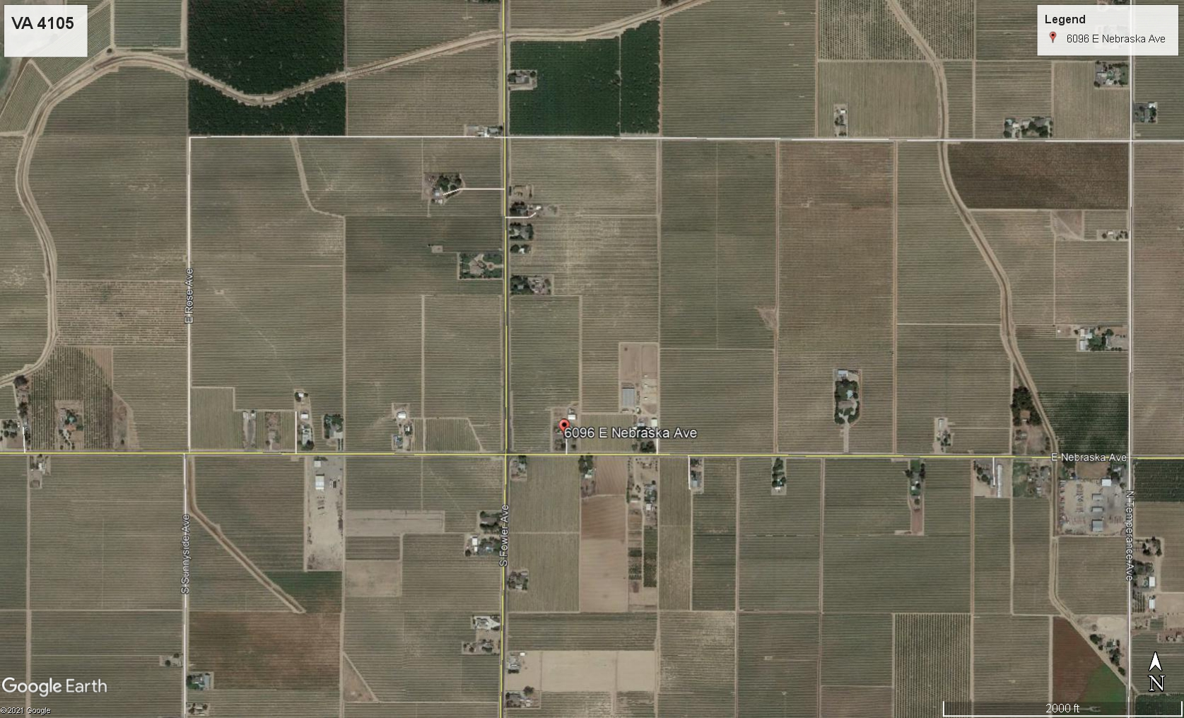
PROJECT SITE
REQUIRED FINDINGS
Exceptional or extraordinary circumstances applicable to the property
Preservation of substantial property rights
Adverse effects on surrounding properties
General Plan consistency

Slide 9
DEPARTMENT of PUBLIC WORKS and PLANNING
DEVELOPMENT SERVICES DIVISION
VA 4107

Slide 10
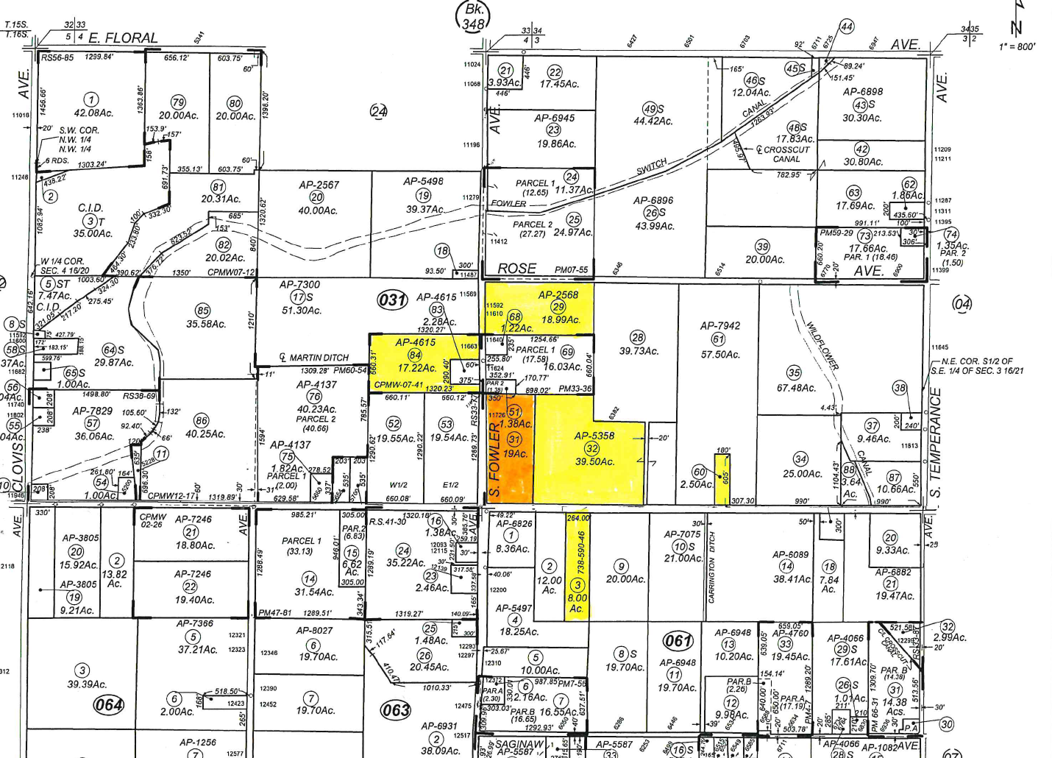
Project Site
NEIGHBORS IN SUPPORT OF THE APPLICATION

Slide 11
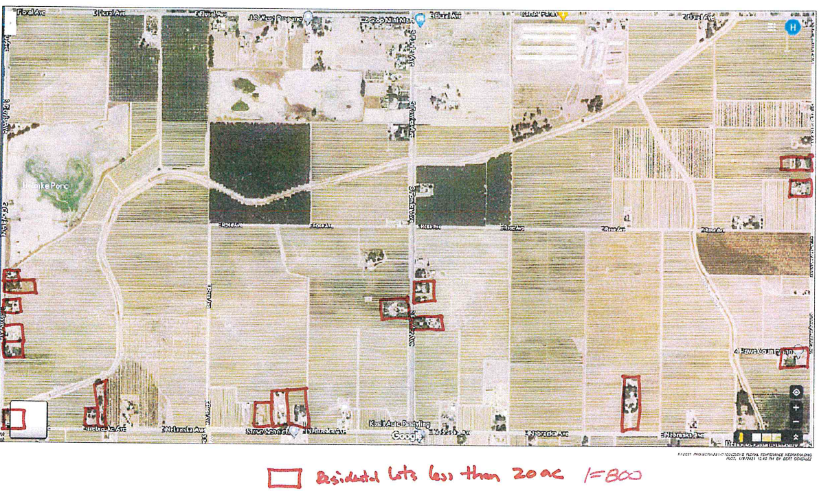

Slide 12
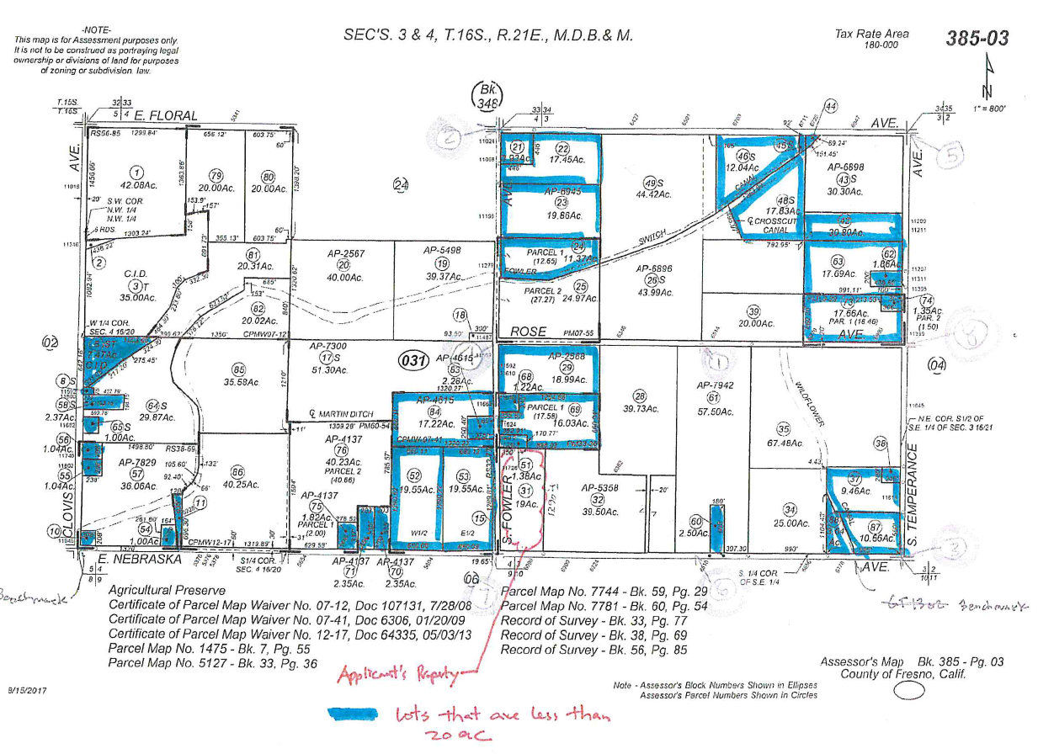

Slide 13
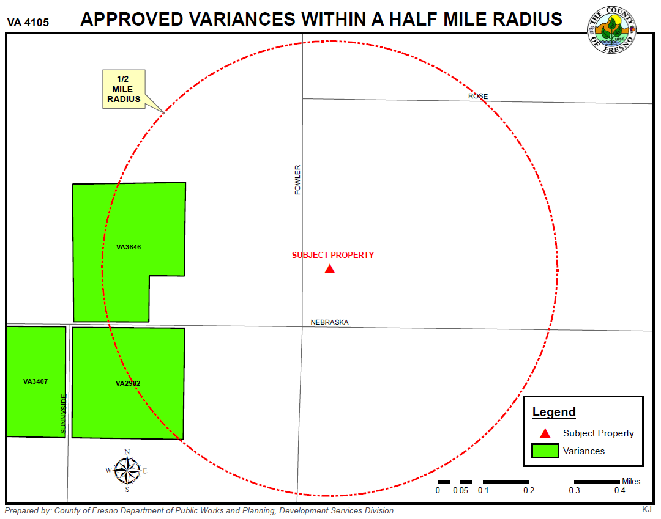

Slide 14
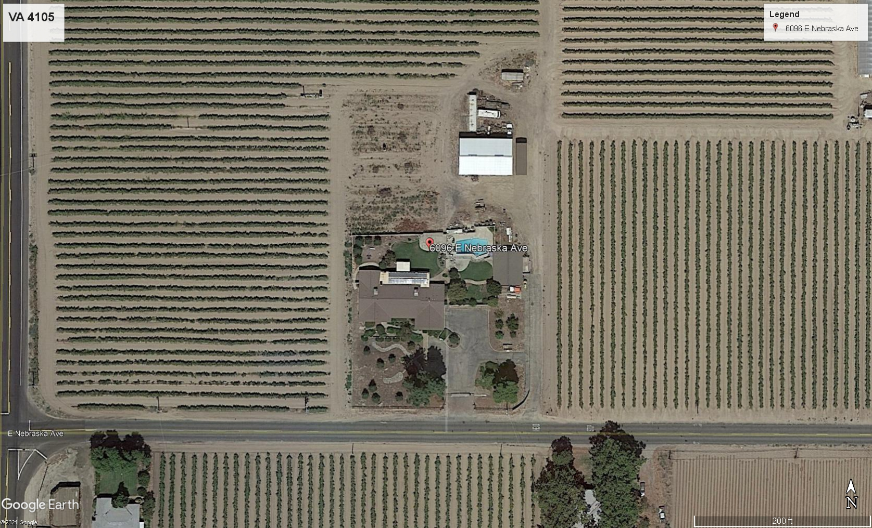

Slide 15
Fowler Ave
PROJECT SITE
PARCEL B
17 ACRES
PARCEL A
2 ACRES
Nebraska Ave

Slide 16
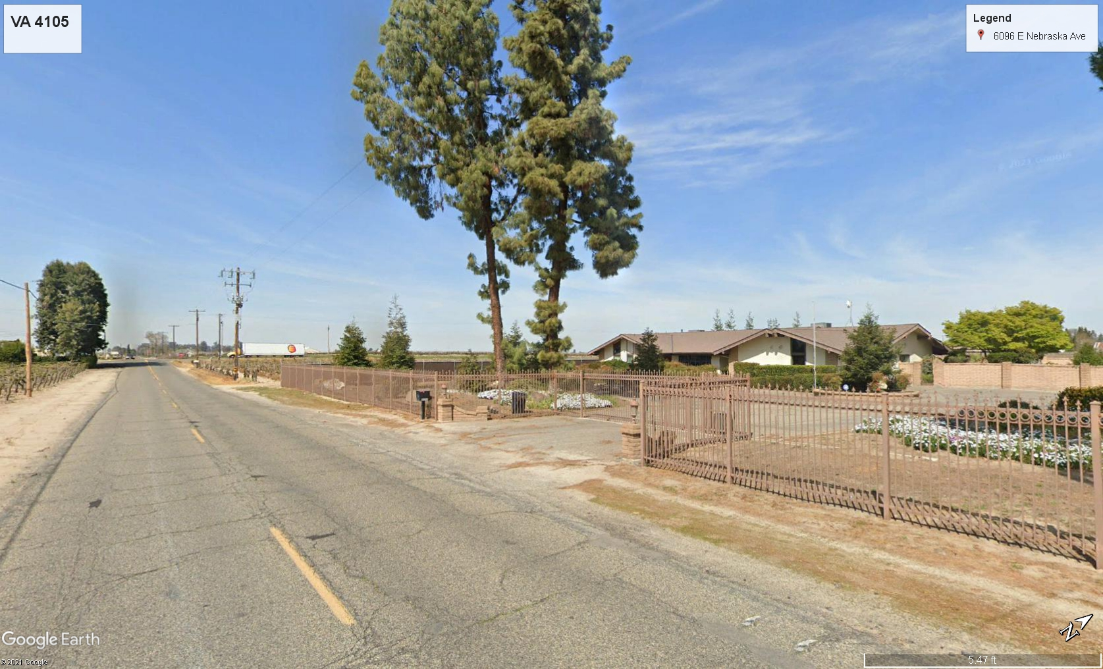
Nebraska Ave

