Slide 1
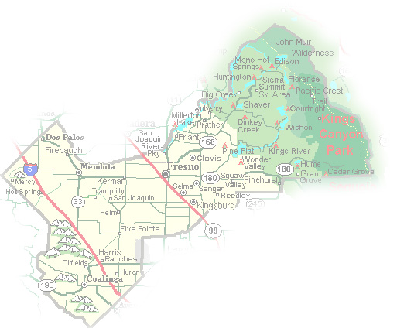
DEPARTMENT of PUBLIC WORKS and PLANNING
DEVELOPMENT SERVICES & CAPITAL PROJECTS DIVISION
CUP 3680

Slide 2
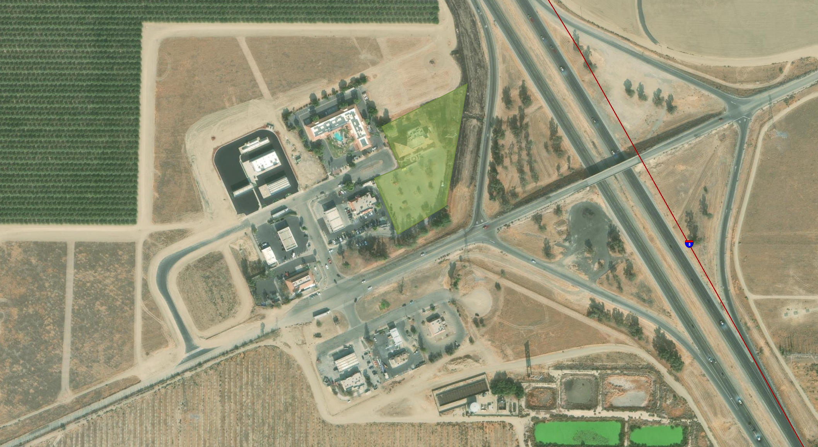
Subject parcel/ 2.62-acres
Panoche Road

Slide 3
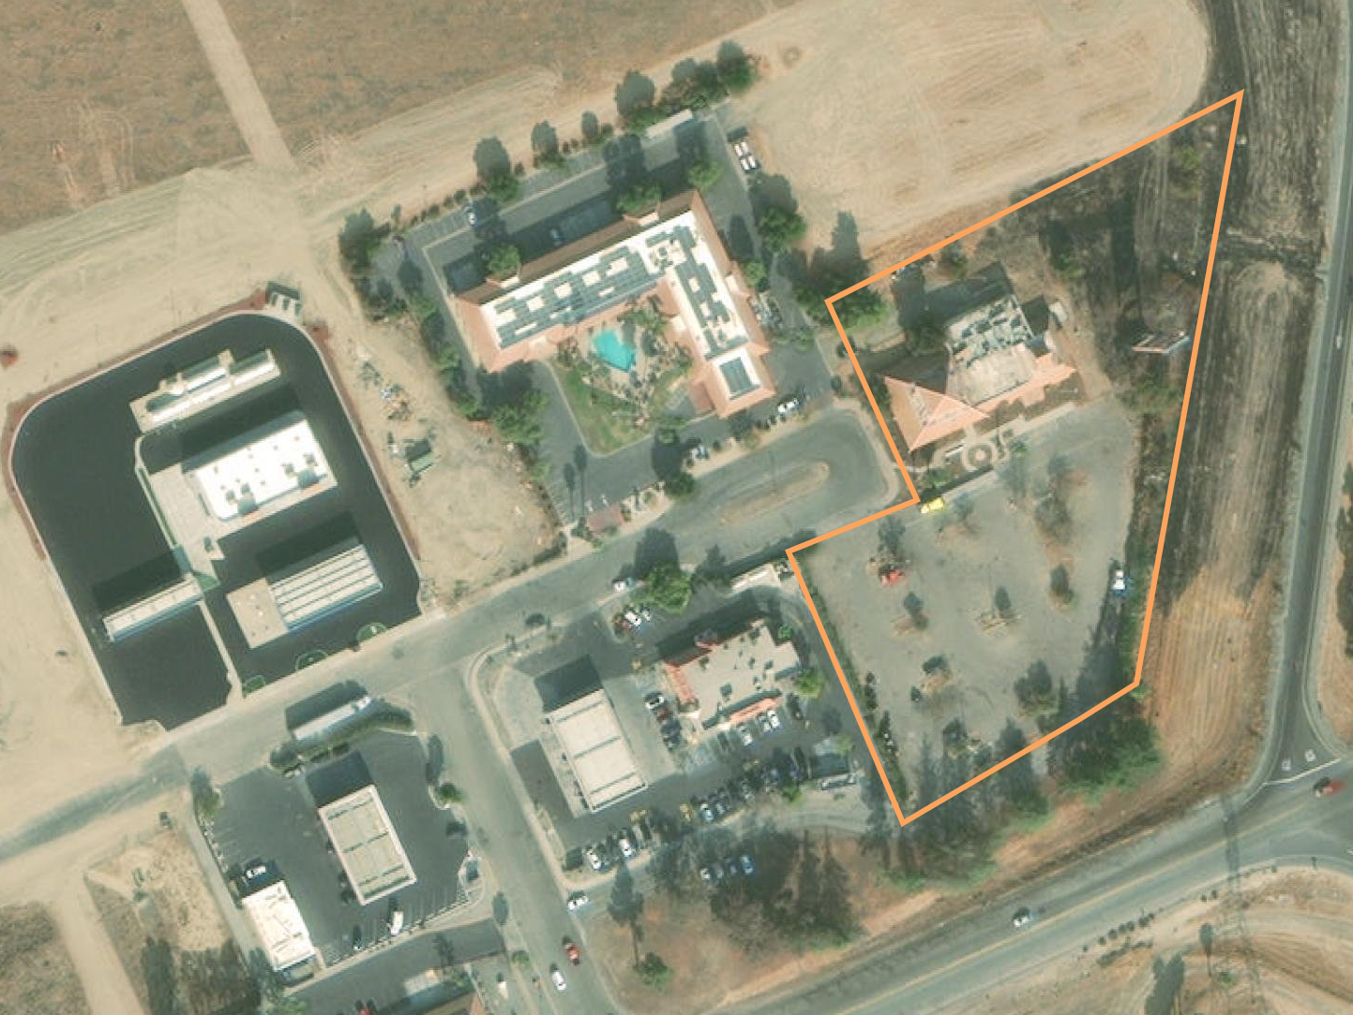
Hotel
Valero Station
Project site/ former Apricot Tree Restaurant
Tesla EV Charging Station
McDonalds/Chevron Station
76 Station/Food Mart
Westside Country Store/ Subway
Taco Bell w/ drive through
Panoche Road

Slide 4
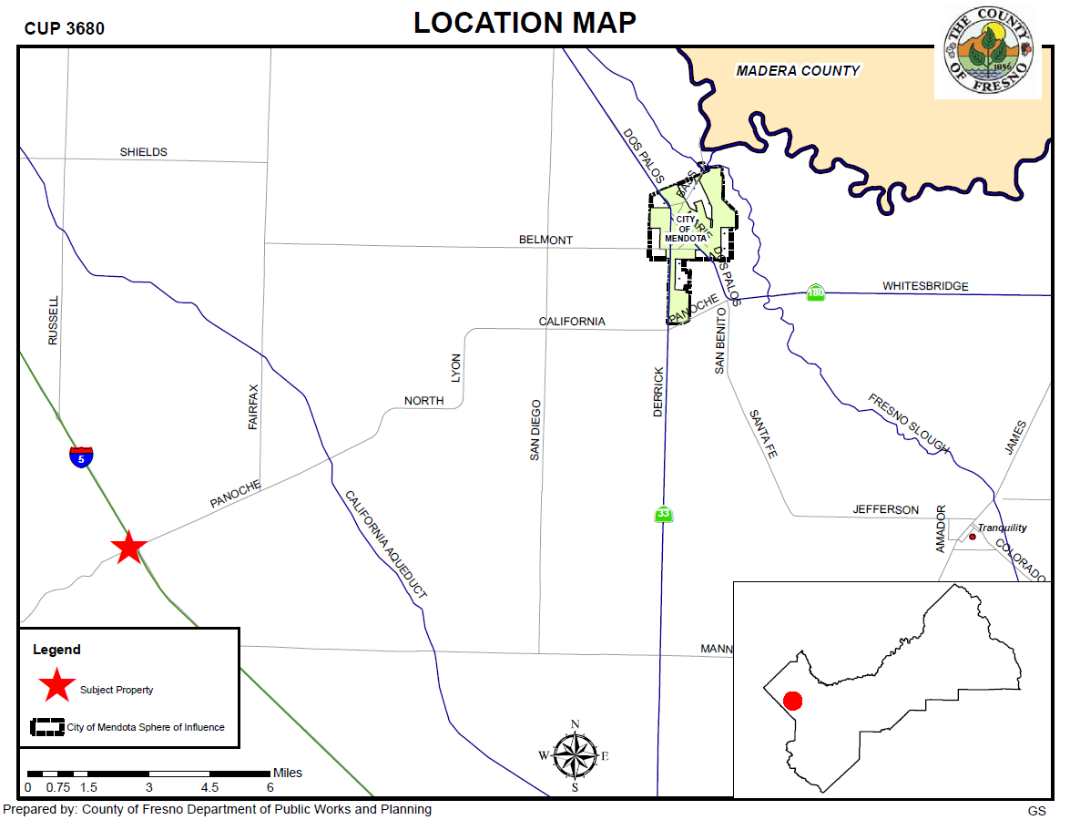

Slide 5
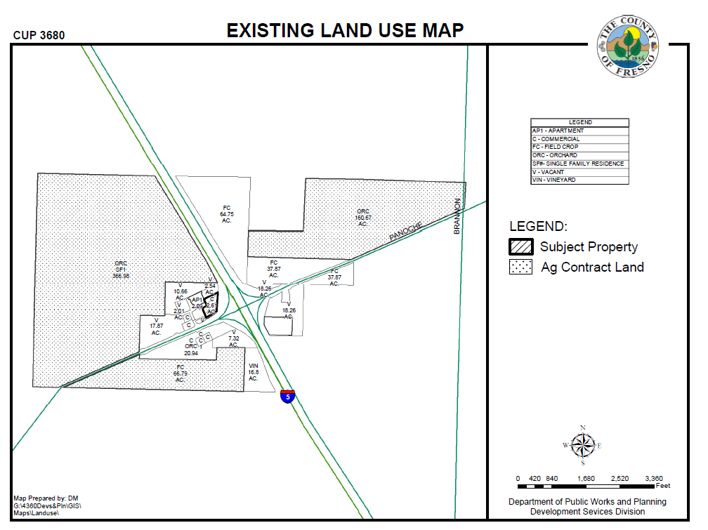

Slide 6
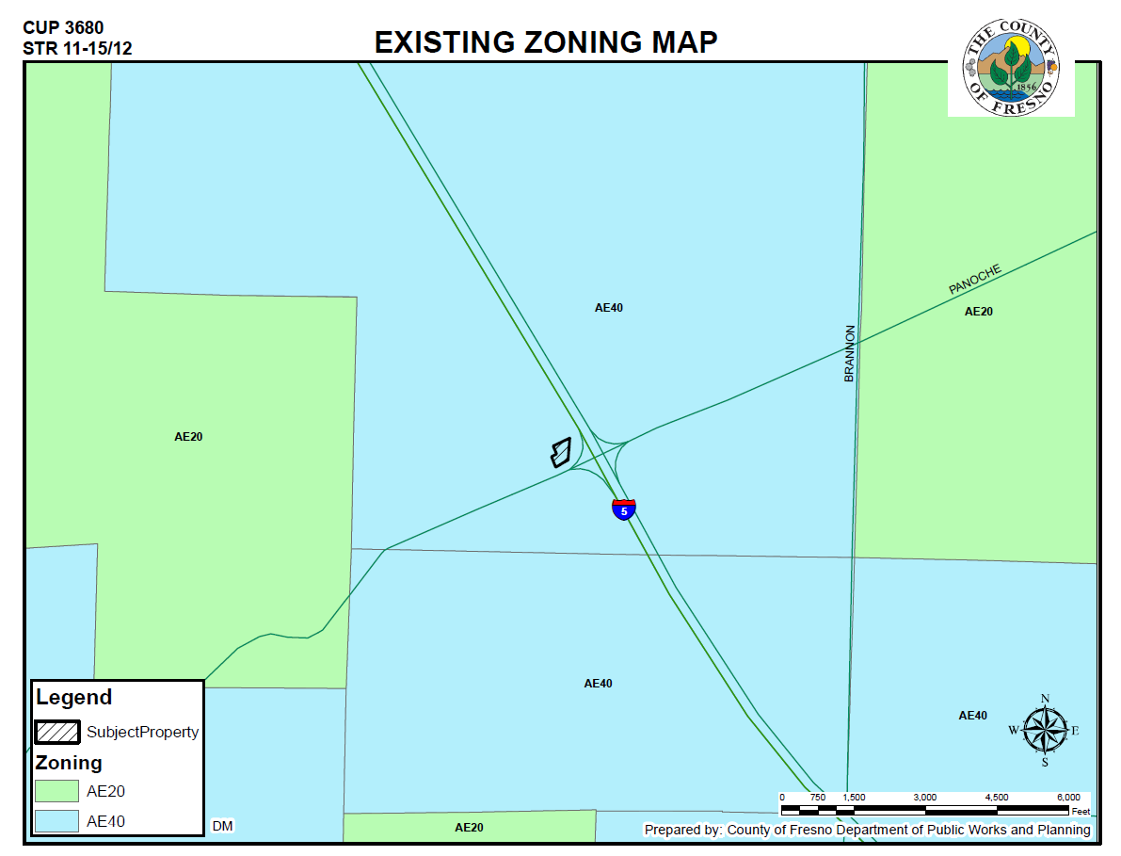

Slide 7
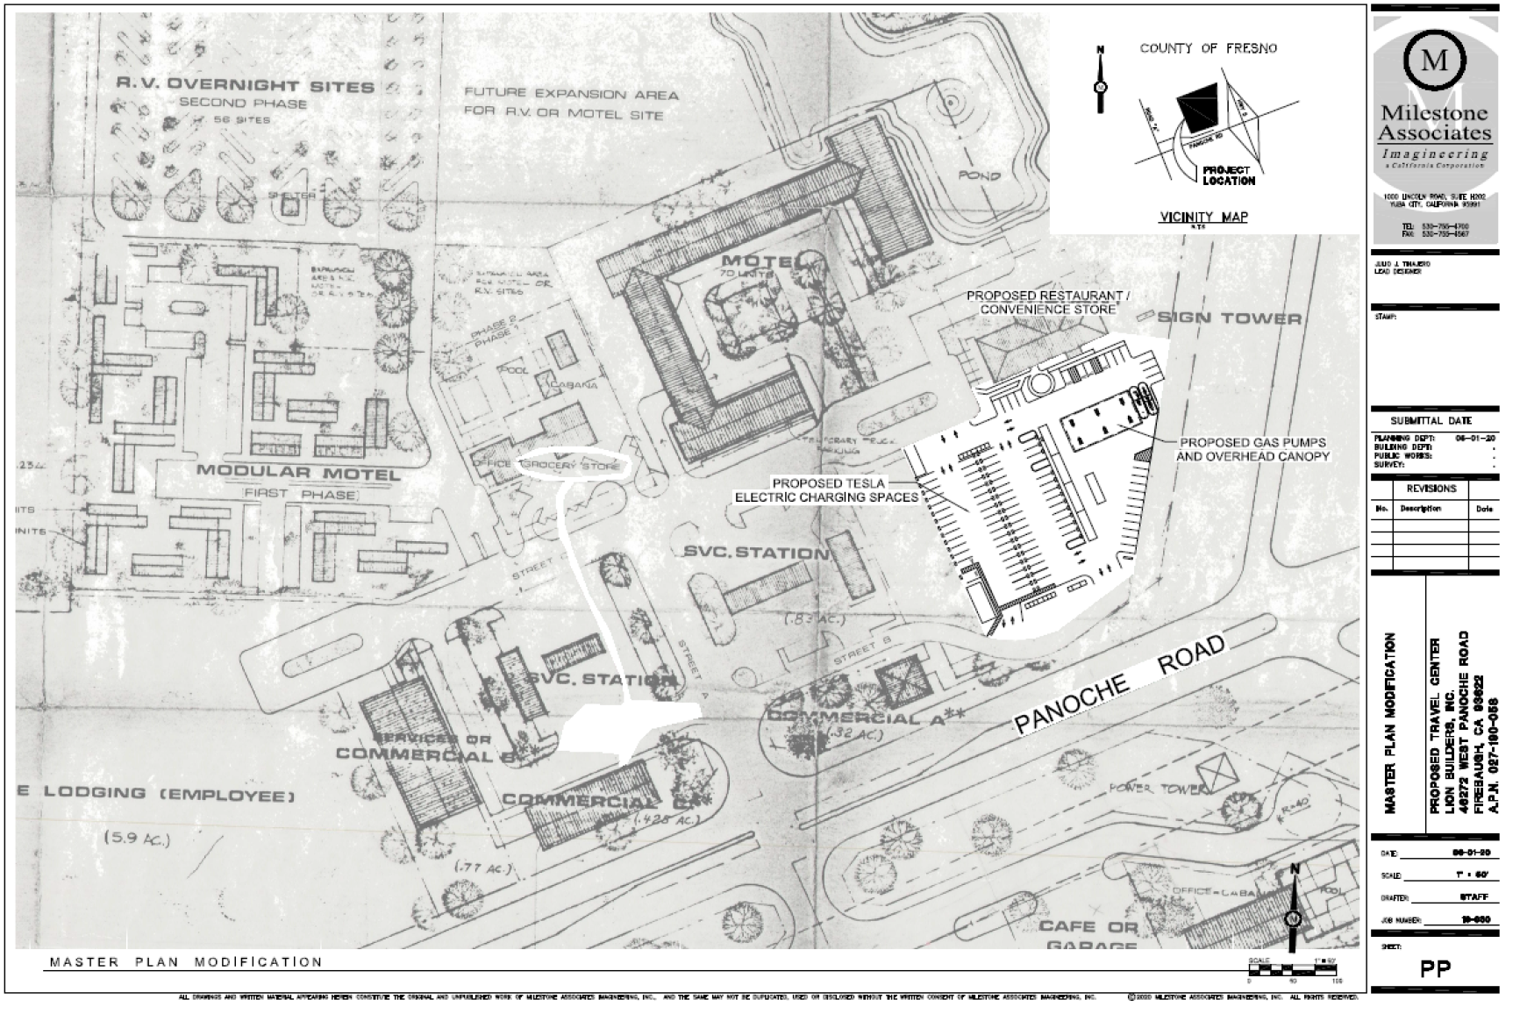

Slide 8
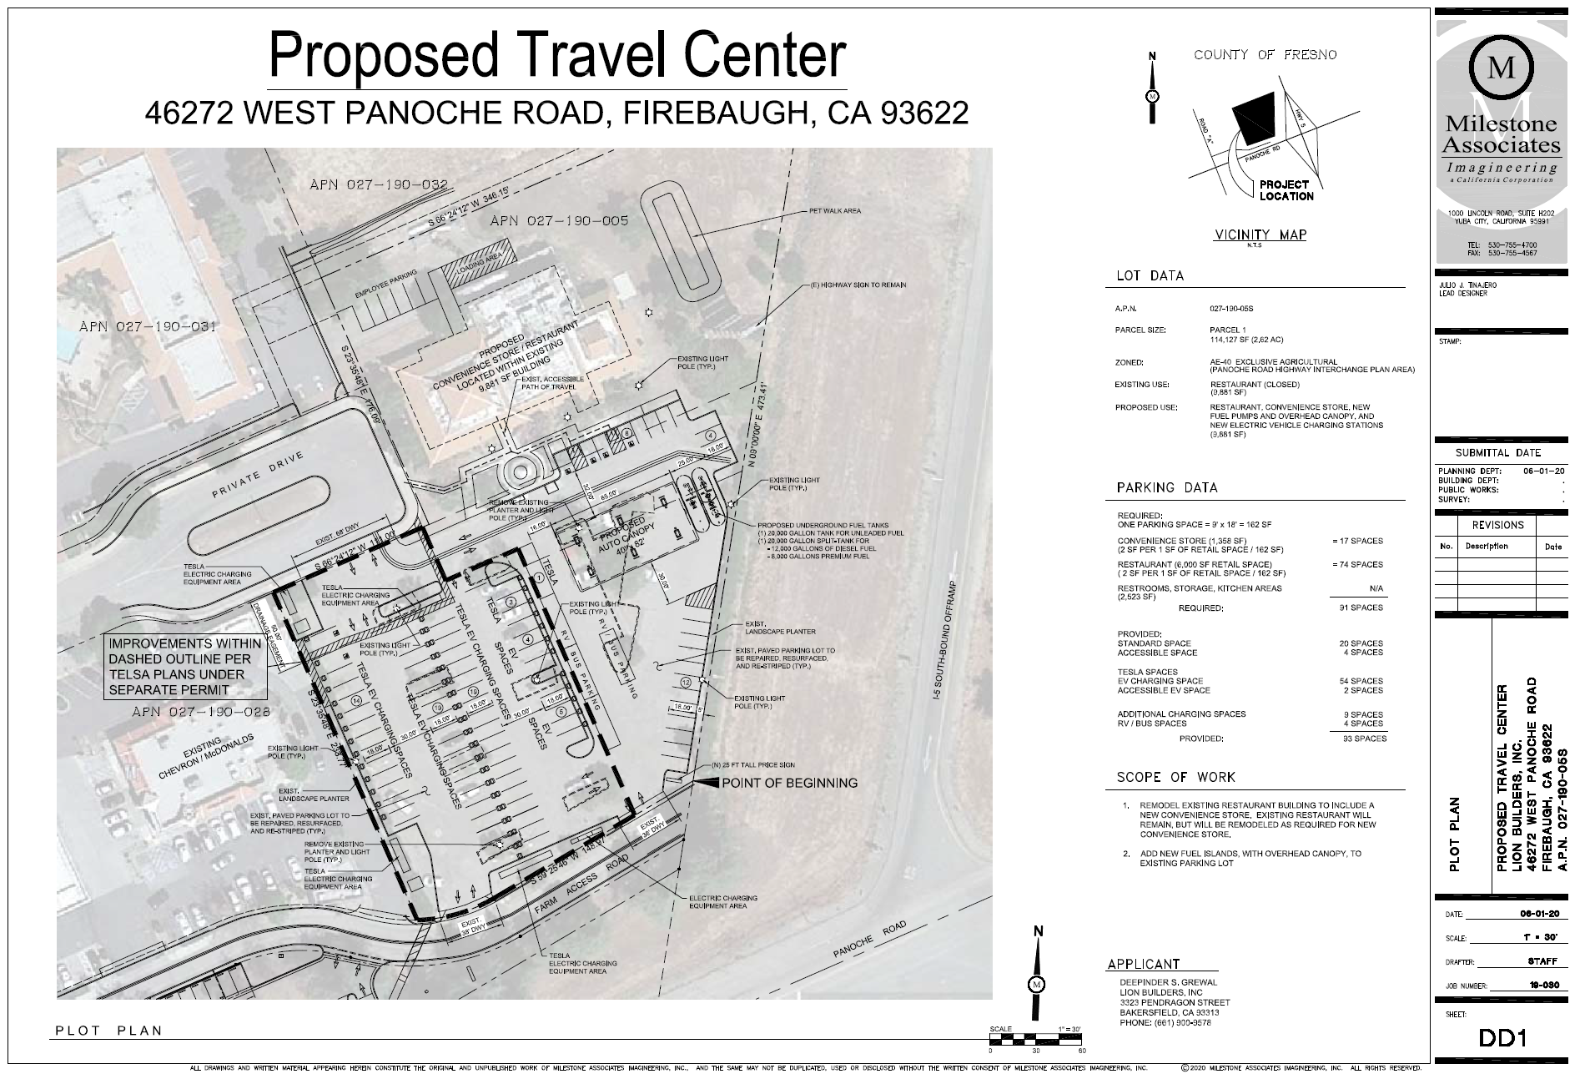

Slide 9
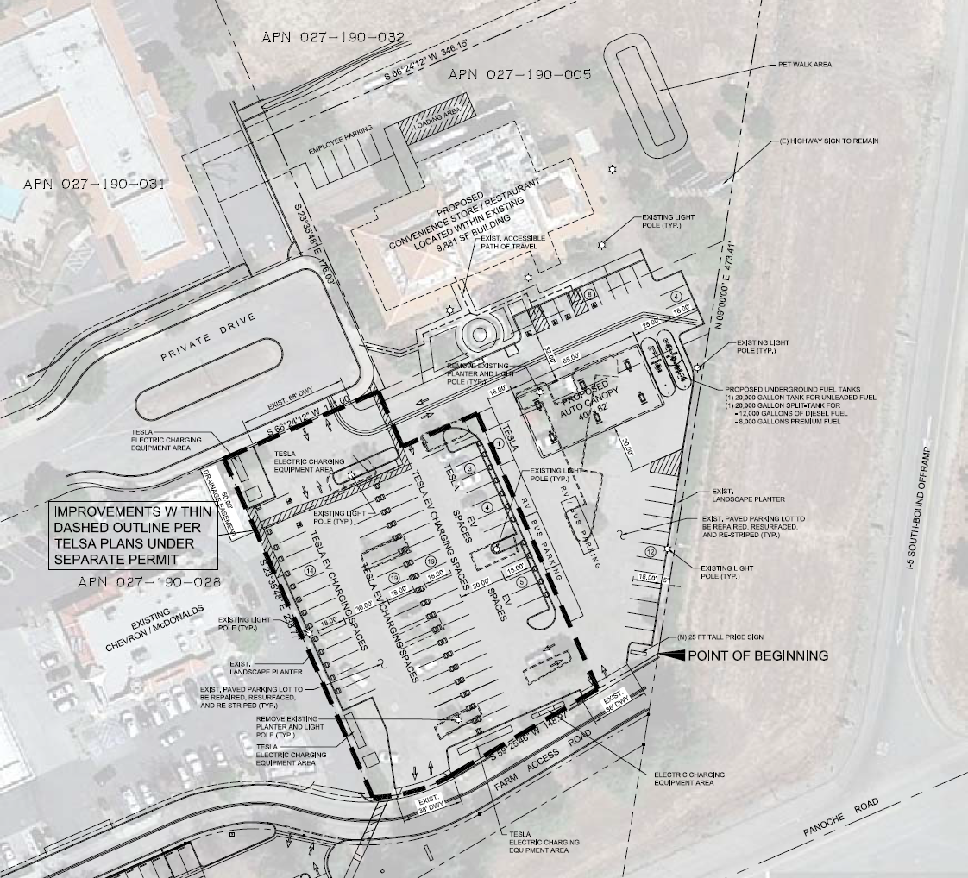
Proposed restaurant & convenience market
Proposed Fuel Canopy
Existing Tesla EV charging station

Slide 10
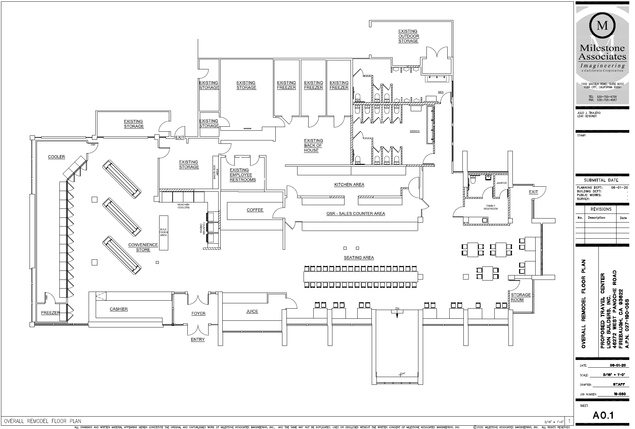

Slide 11
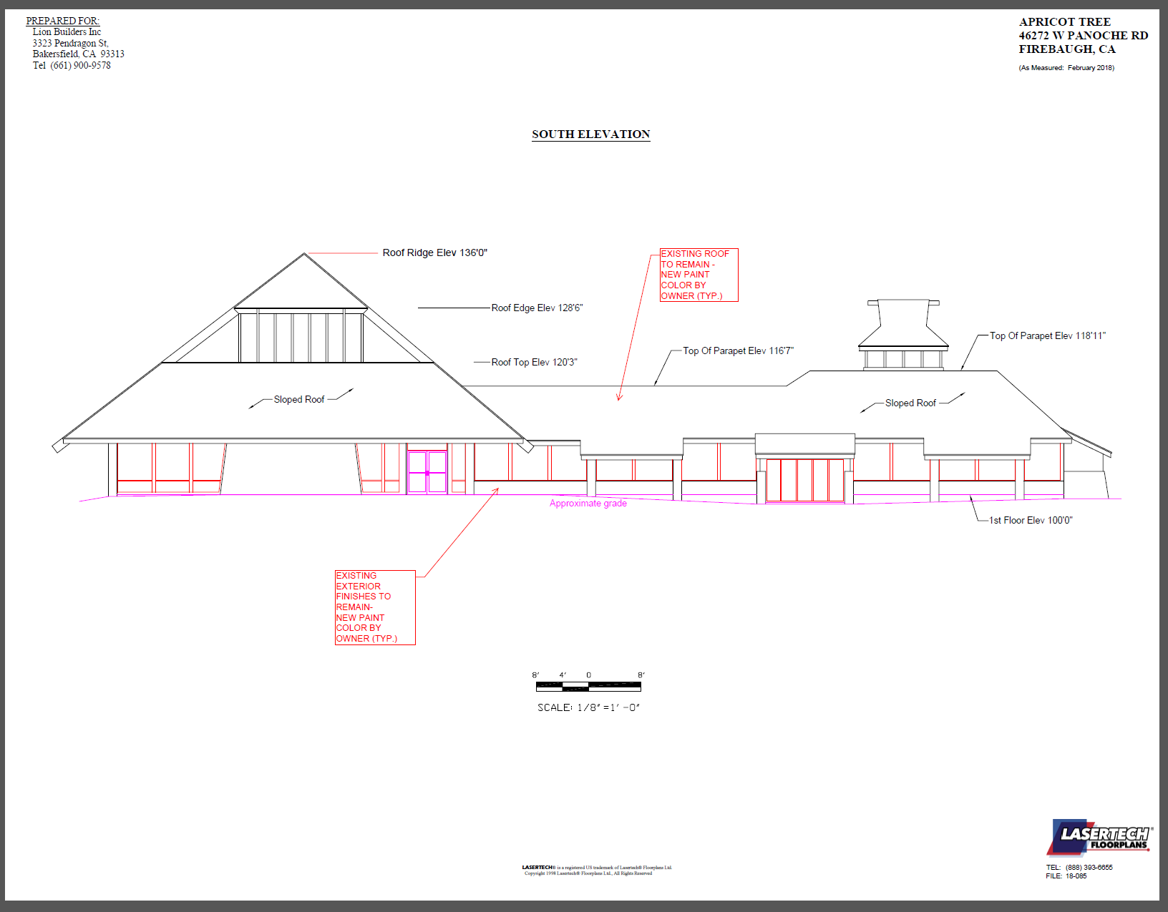

Slide 12
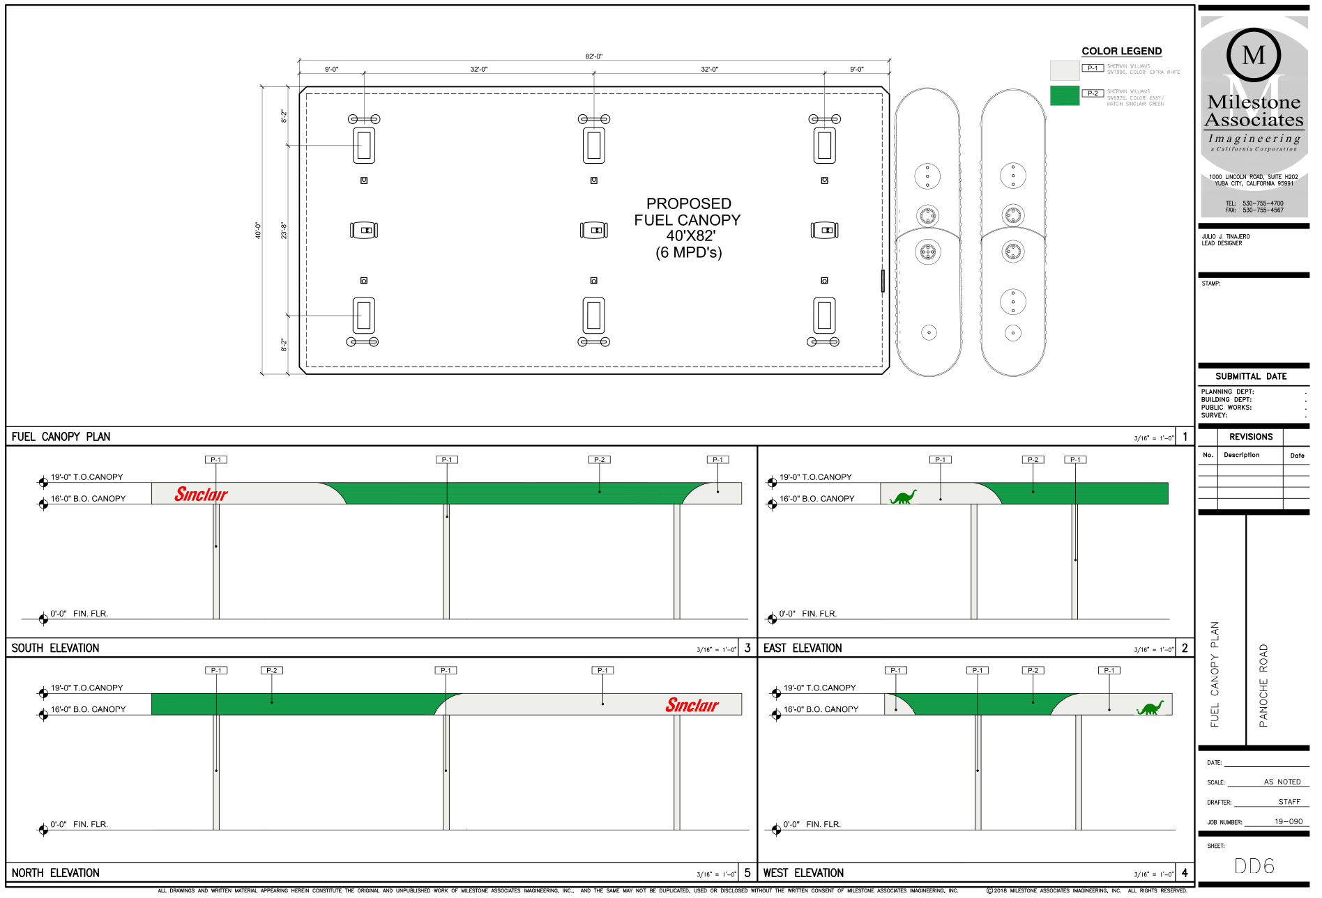

Slide 13
Adequate Size and Shape of the parcel
Adequacy of Streets and Highways serving the parcel
No Adverse Effects Upon surrounding property
Consistency with the General Plan
That the conditions stated in the resolution are deemed necessary to protect the public health, safety and general welfare.

Slide 14
DEPARTMENT of PUBLIC WORKS and PLANNING
DEVELOPMENT SERVICES & CAPITAL PROJECTS DIVISION
CUP 3680

Slide 15
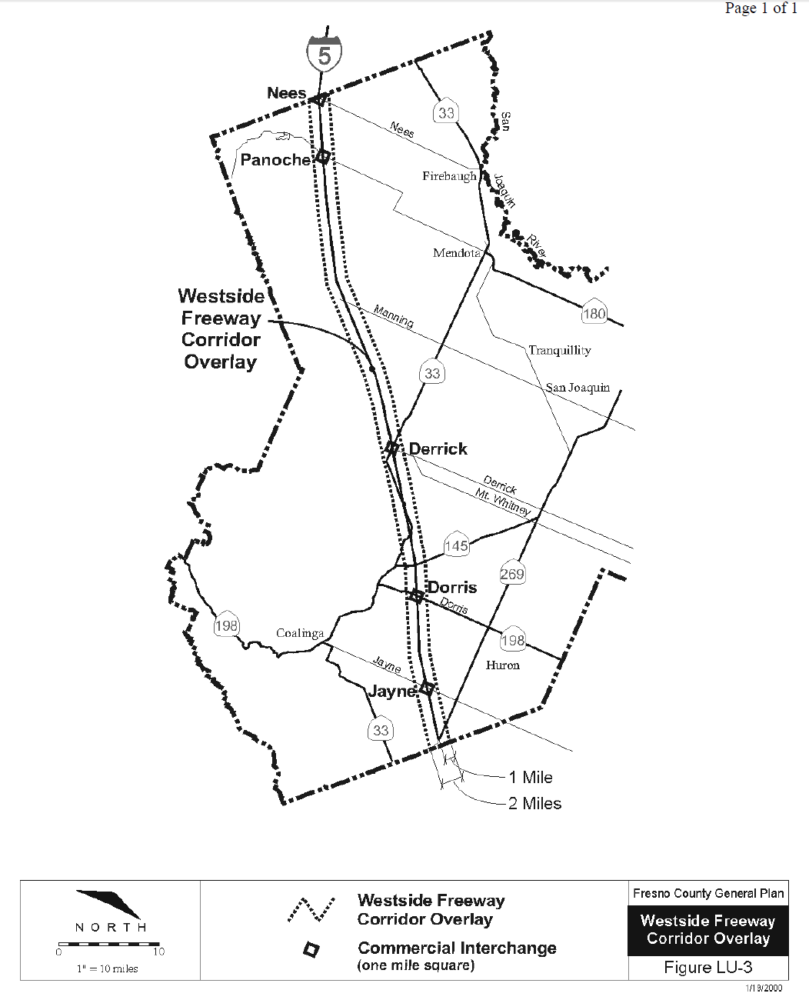
Project Site

Slide 16
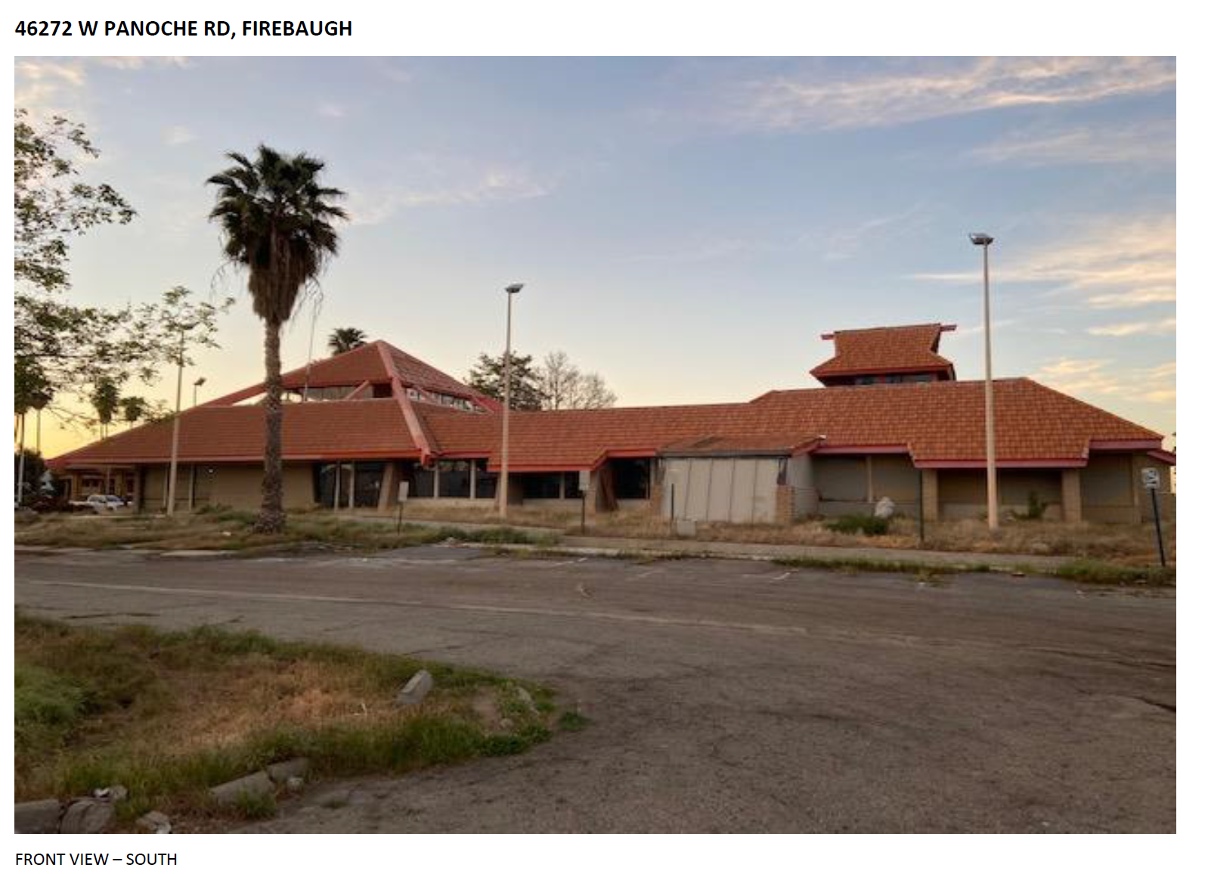

Slide 17
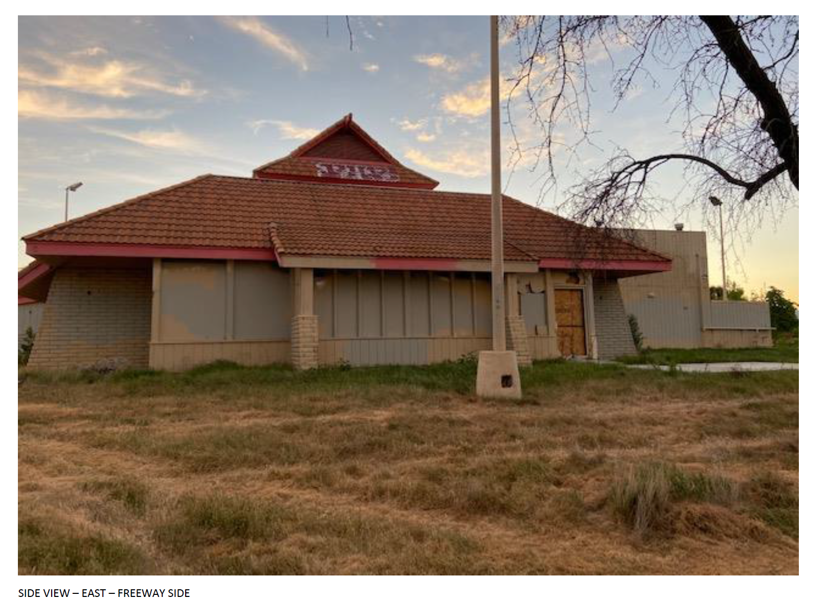

Slide 18
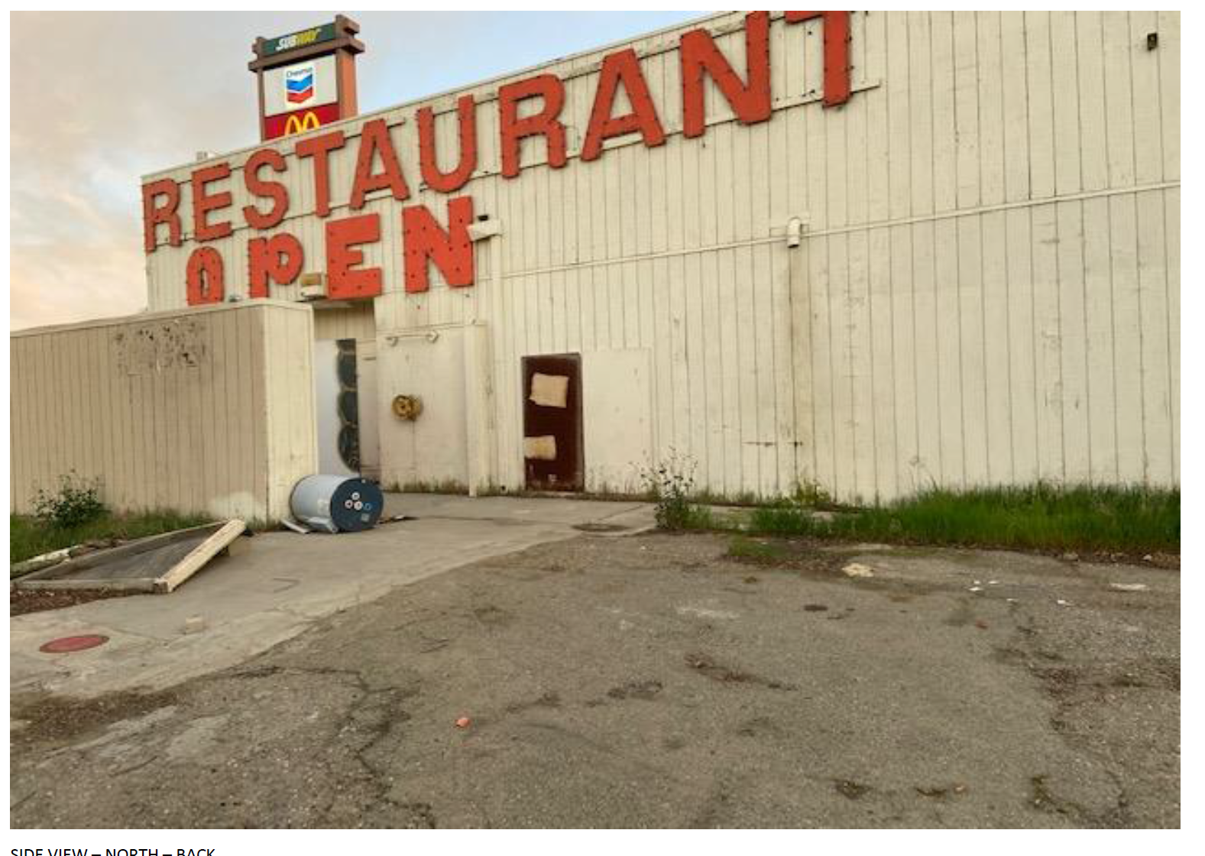

Slide 19
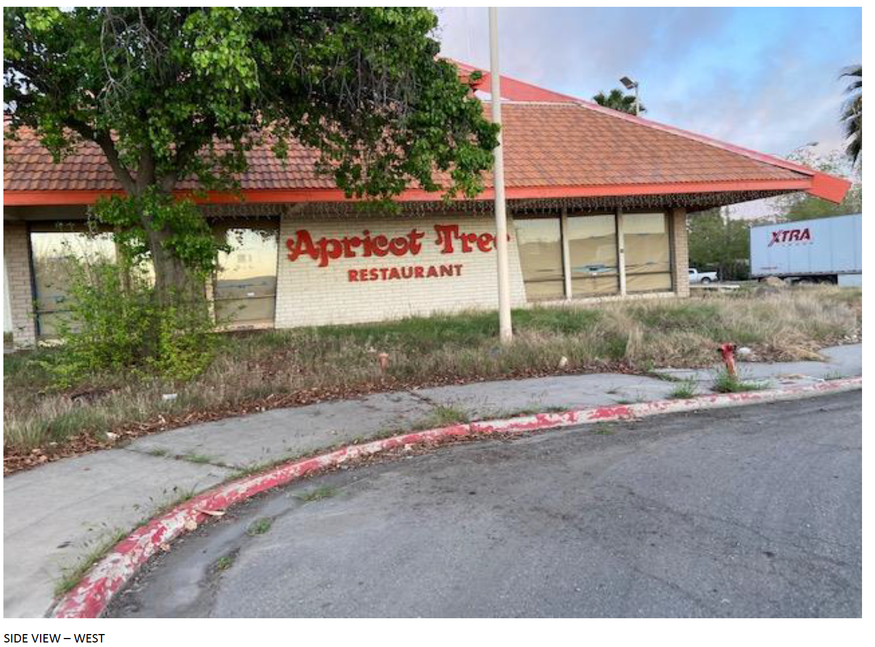

Slide 20
