Slide 1
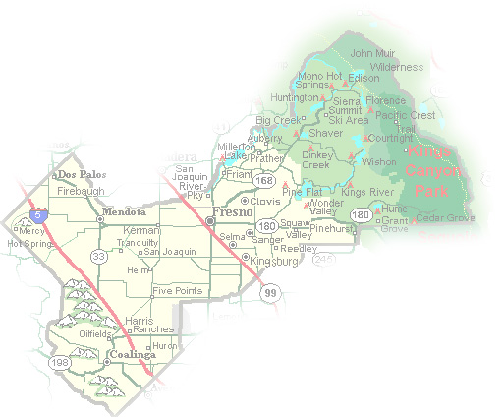
DEPARTMENT of PUBLIC WORKS and PLANNING
DEVELOPMENT SERVICES DIVISION
VA 4106

Slide 2
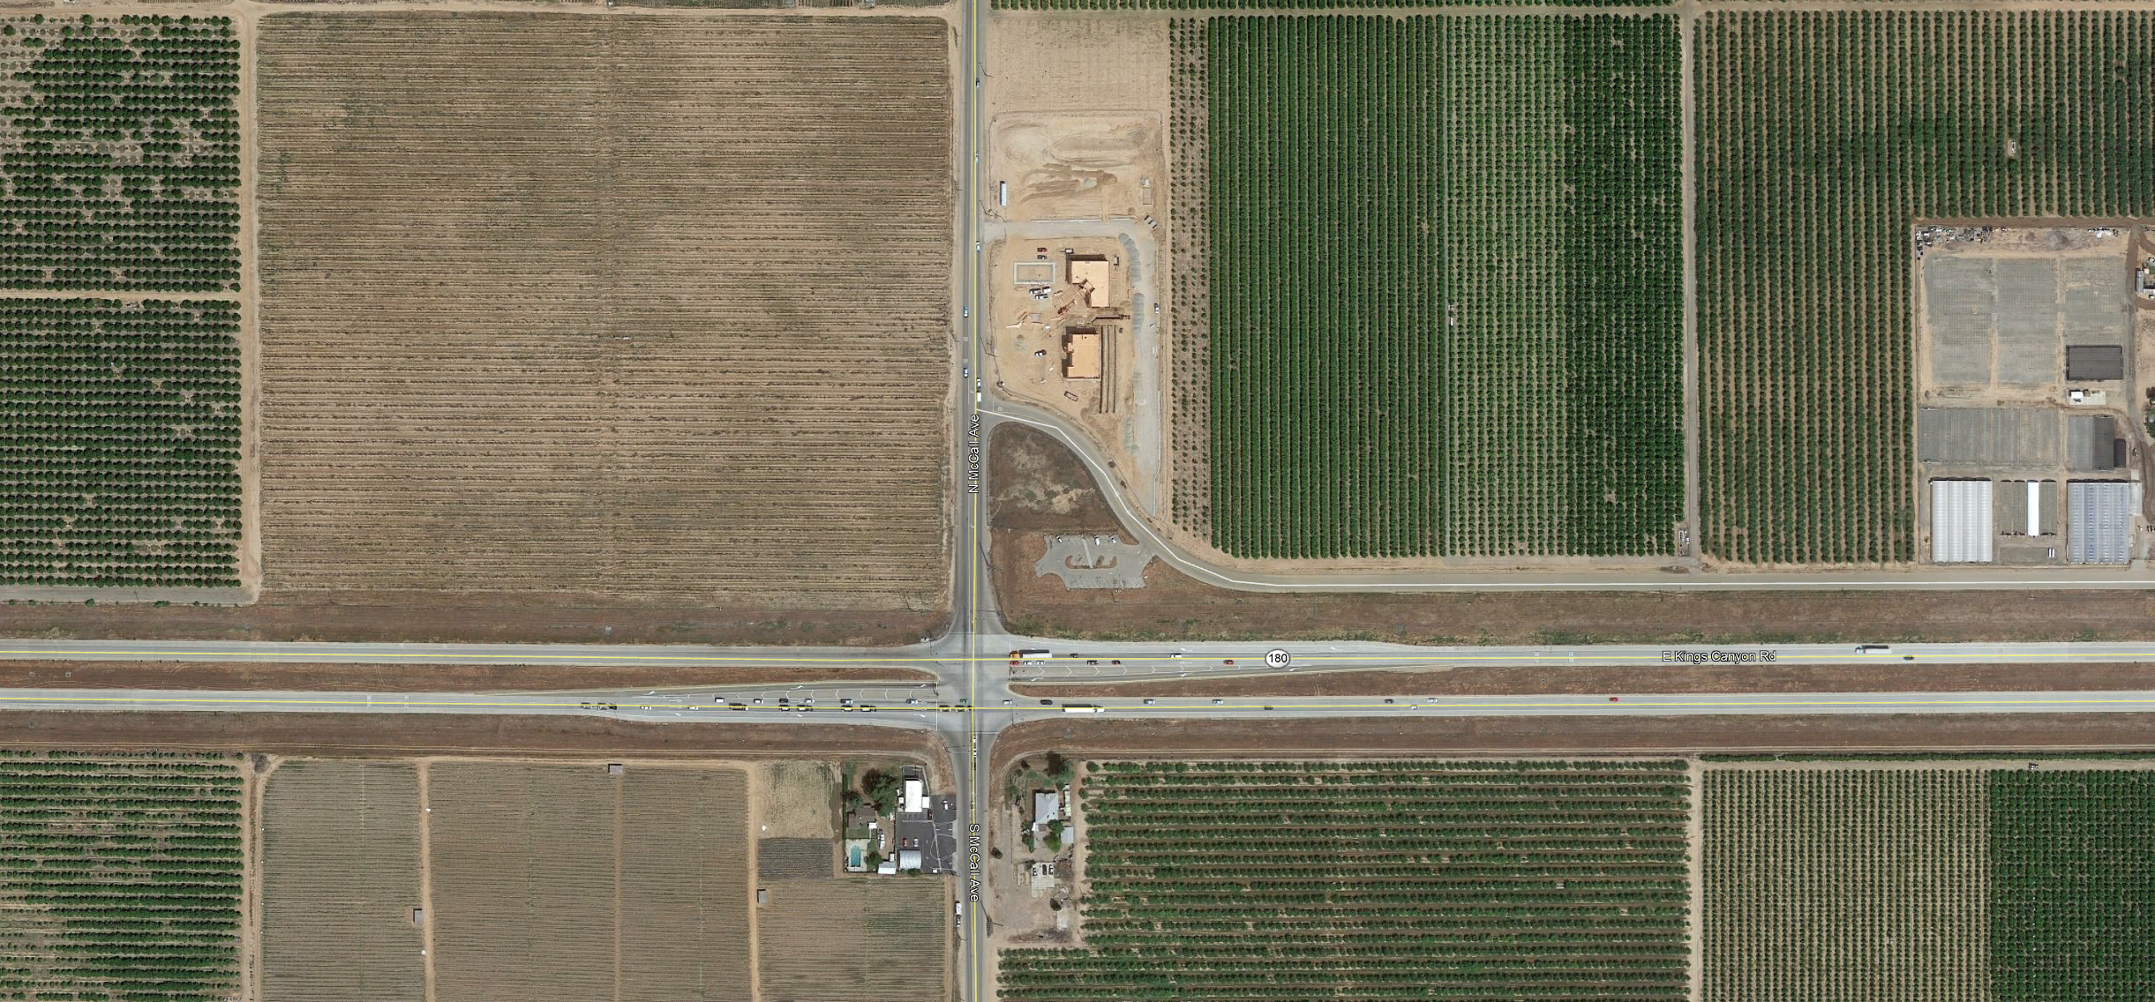
Project Site/
Existing Commercial
Development
Proposed sign location

Slide 3
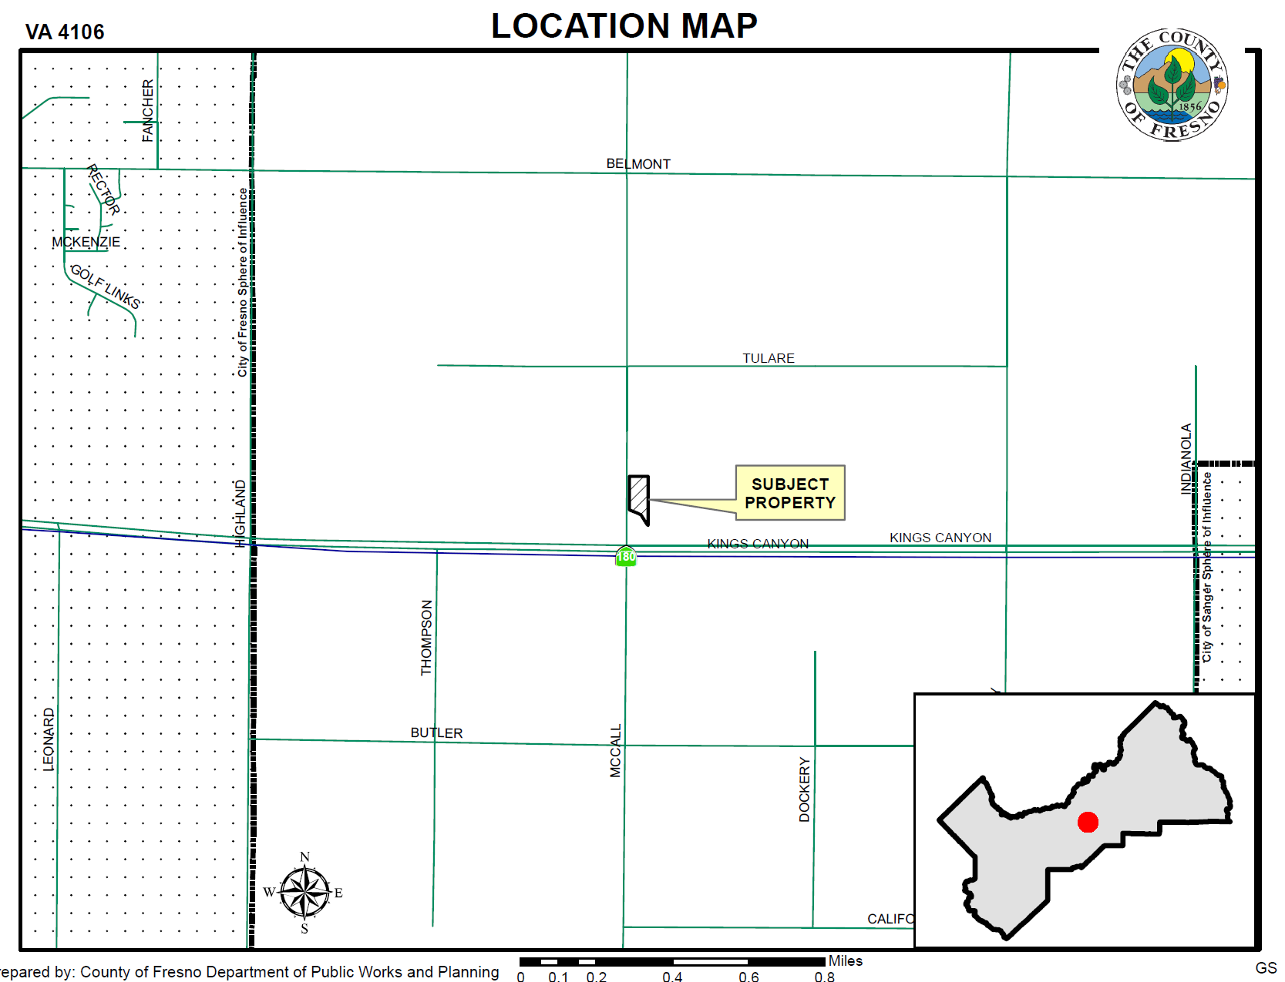

Slide 4
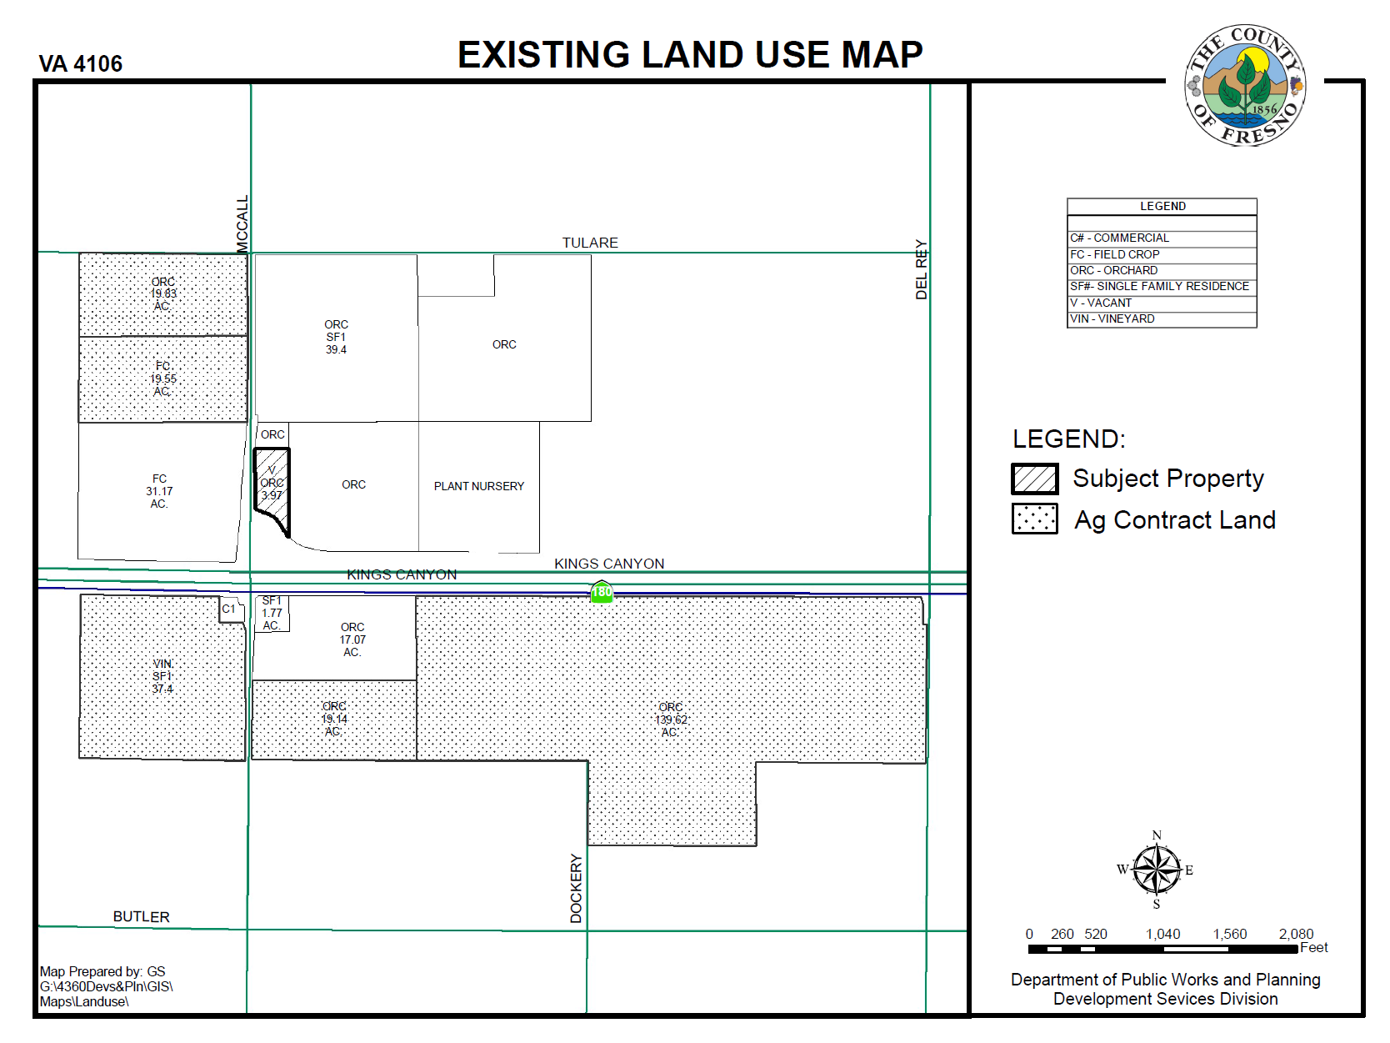

Slide 5
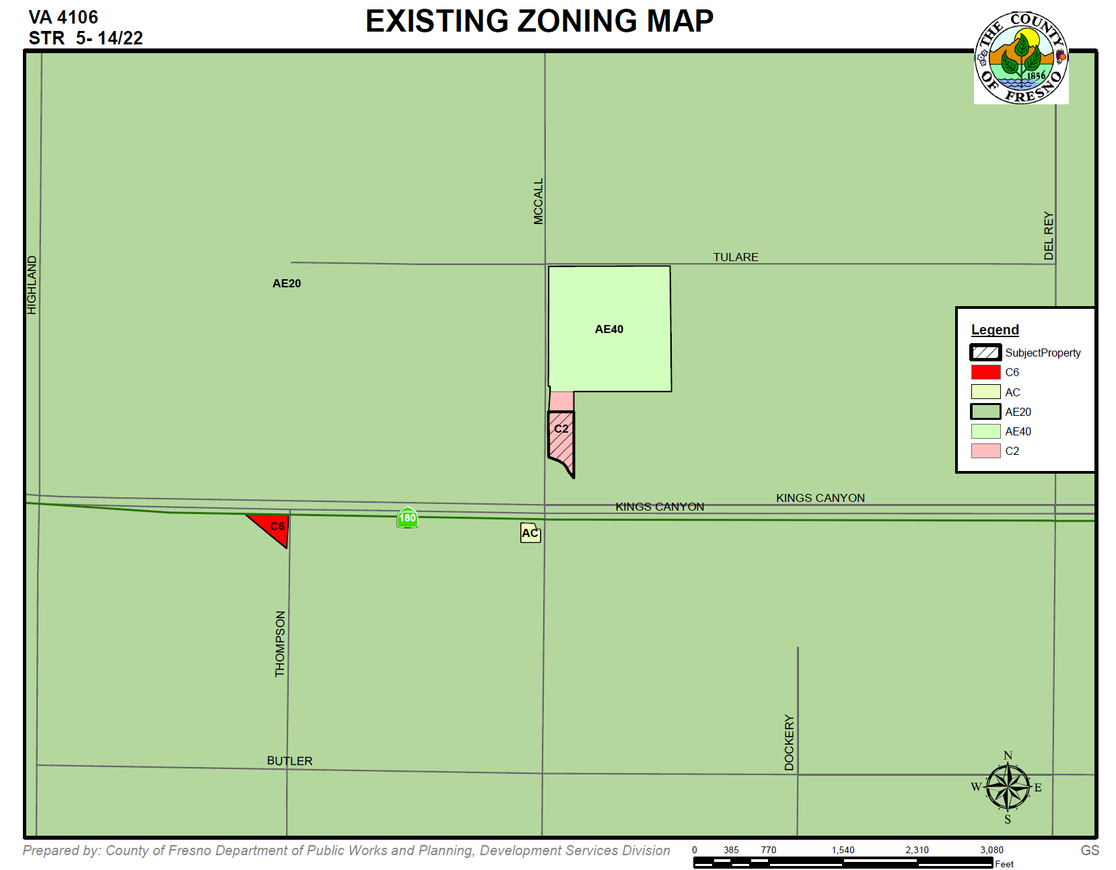

Slide 6
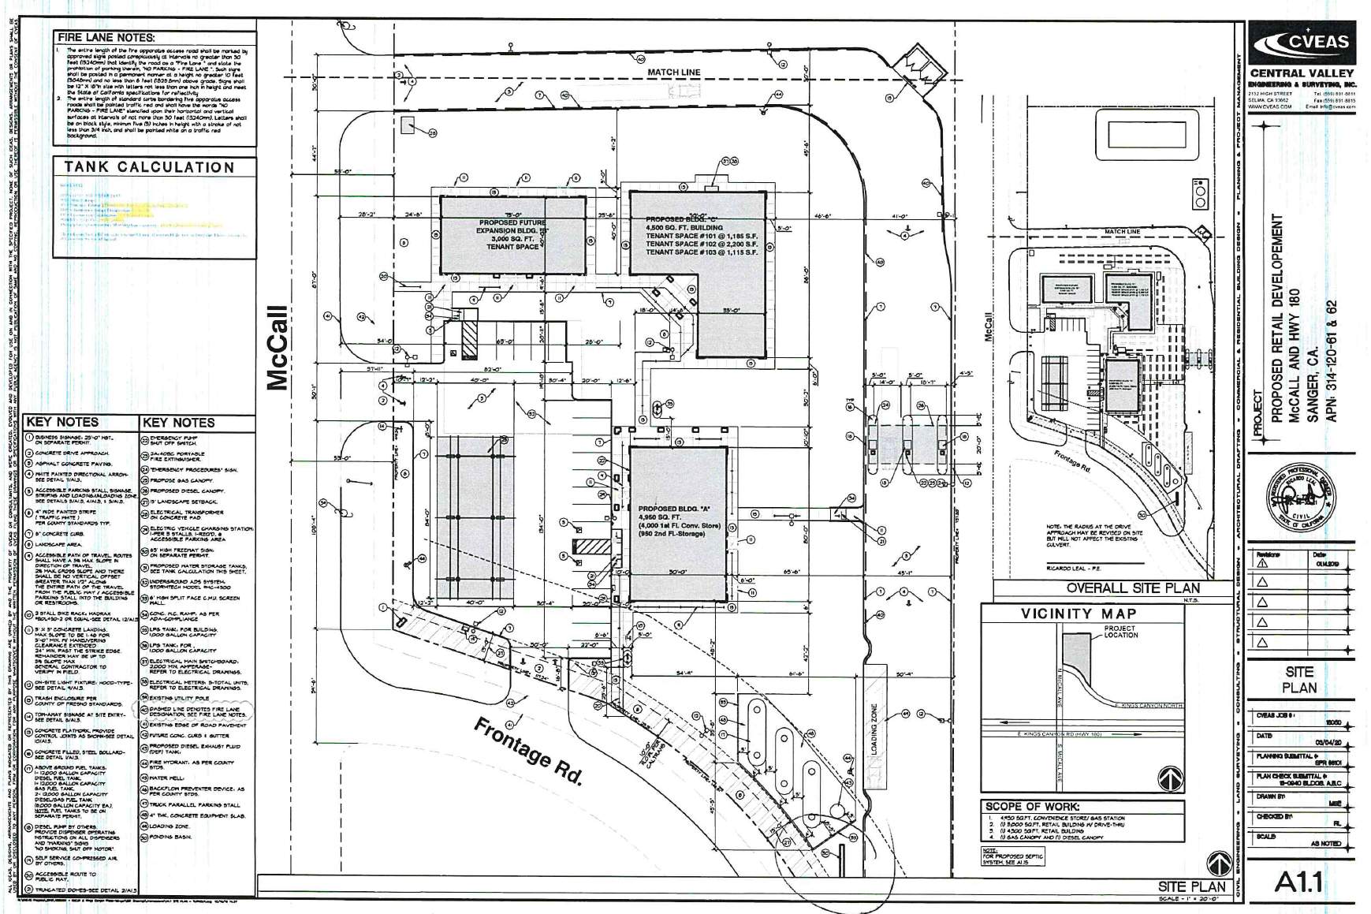
Bldg. B
Bldg. C
Fuel Pumps
Bldg. A.
Proposed sign location

Slide 7
Proposed Sign Elevation drawings

Slide 8
Project Site/
Existing Commercial
Development
Proposed sign location
Variance Findings
There are exceptional or extraordinary circumstances or conditions applicable to the property involved which do not apply generally to other properties in the vicinity having the identical zoning classification.
Such variance is necessary for the preservation and enjoyment of a substantial property right of the applicant, which right is possessed by other property owners under like conditions in the vicinity having the identical zoning classification.
The granting of the variance will not be materially detrimental to the public welfare or injurious to property and improvement in the vicinity having the identical zoning classification.
The granting of such a variance will not be contrary to the objectives of the General Plan.

Slide 9
DEPARTMENT of PUBLIC WORKS and PLANNING
DEVELOPMENT SERVICES DIVISION
VA 4106

Slide 11
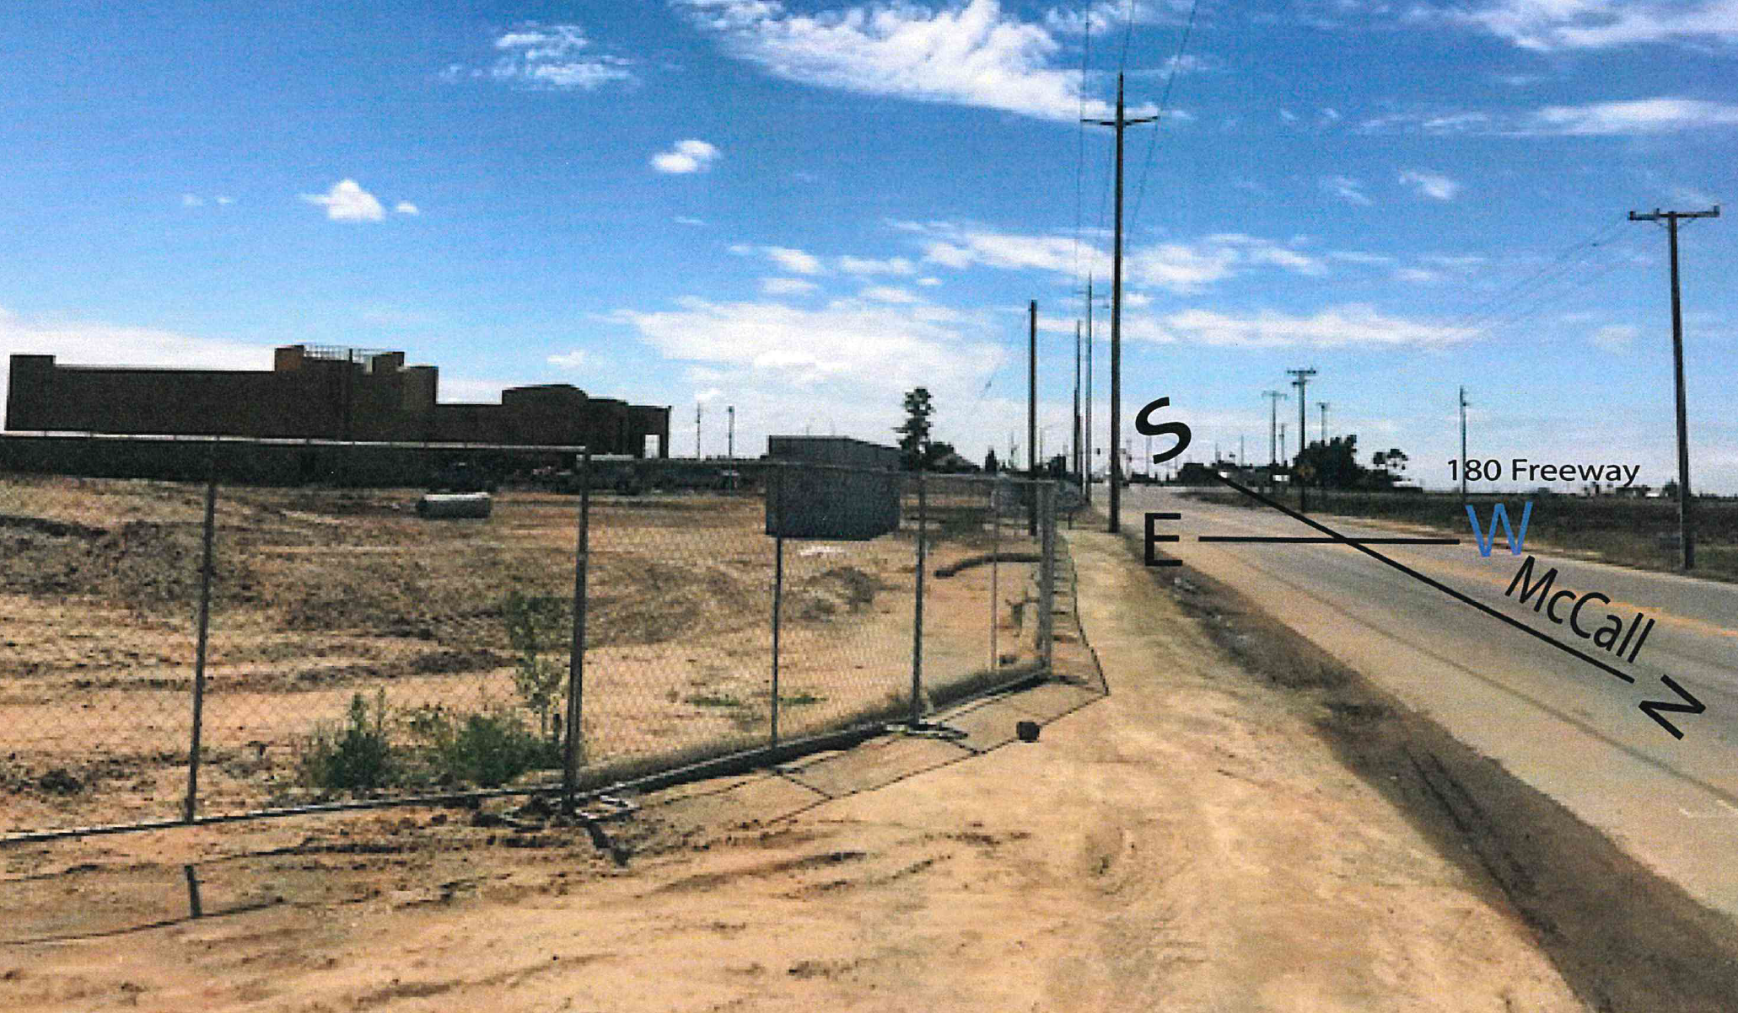

Slide 12
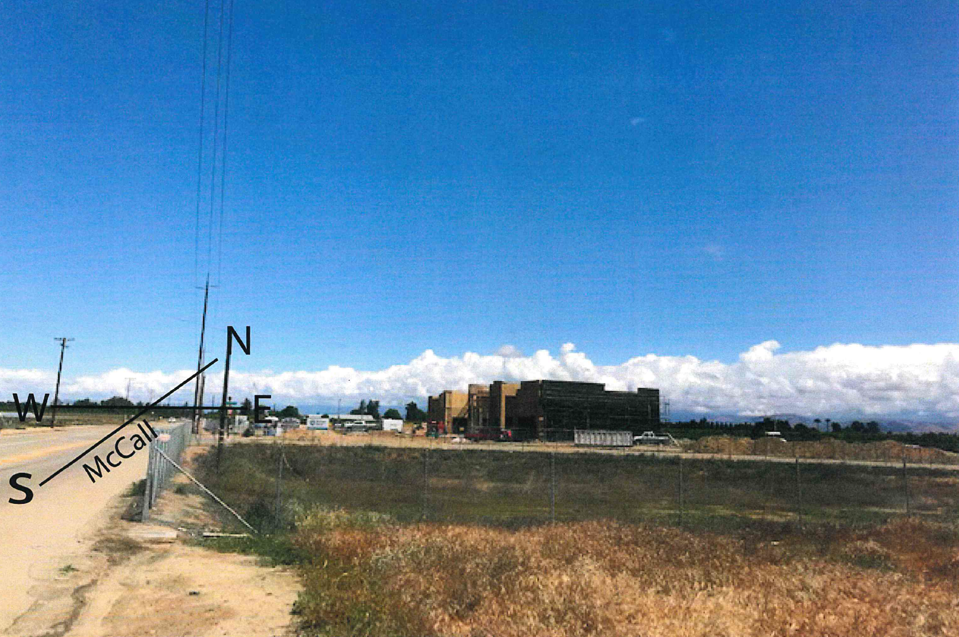

Slide 13
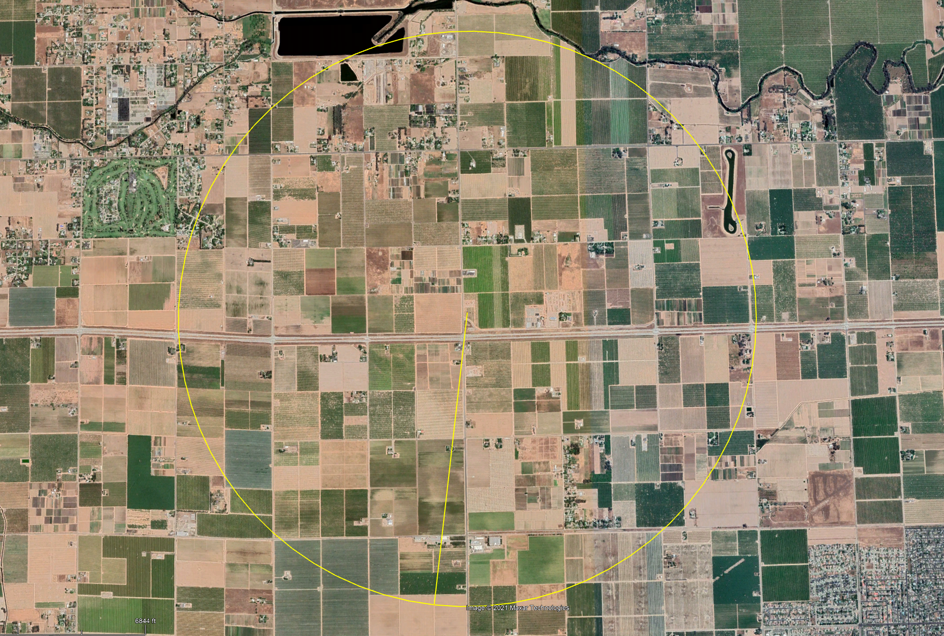
Project Site
Radius 1.5 Miles

Slide 14
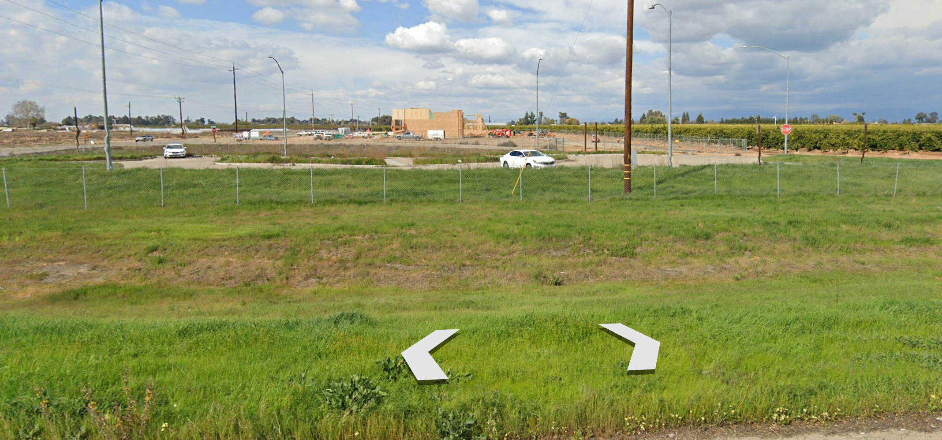

Slide 15
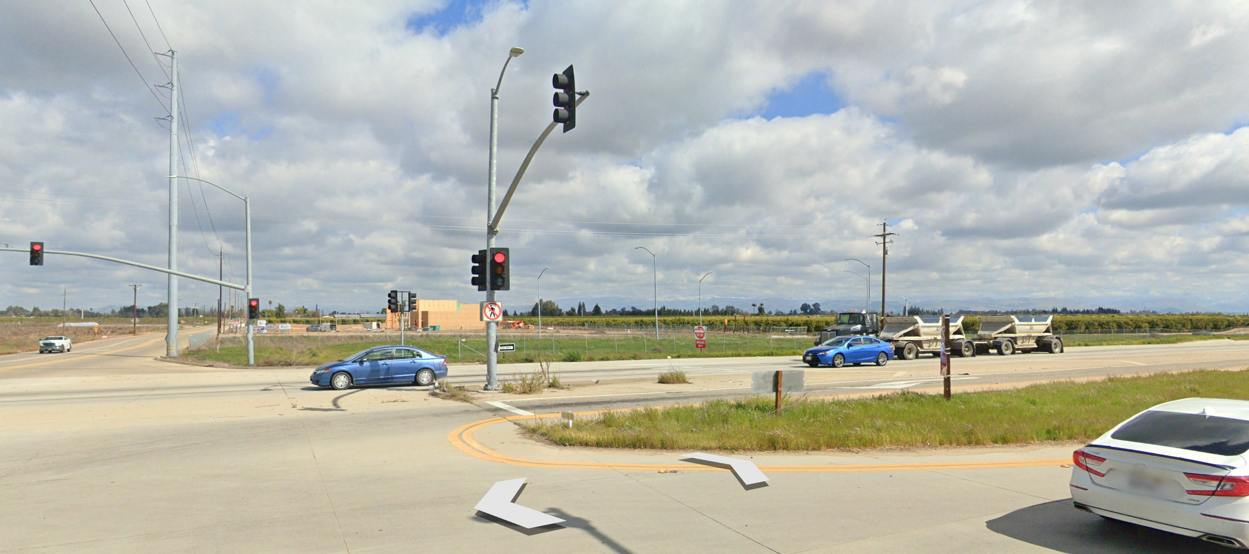

Slide 16
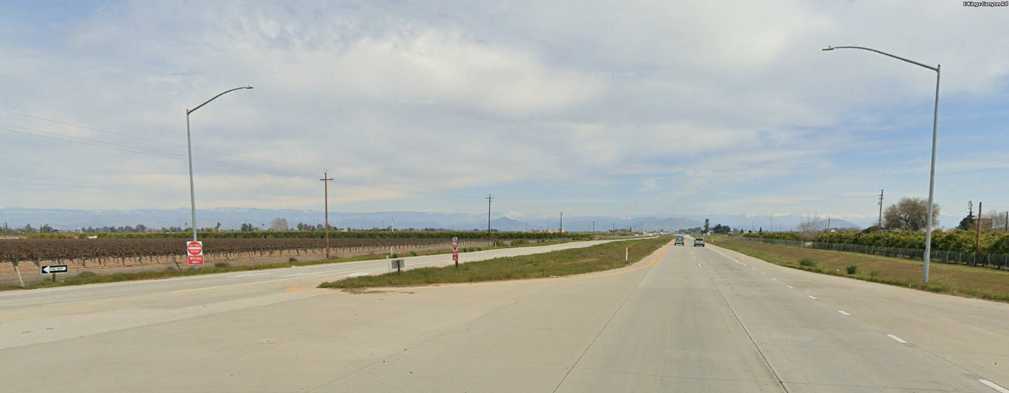
Project site
View from approximately one-half mile west of the project site;
eastbound lanes of Kings Canyon Road

