Slide 1
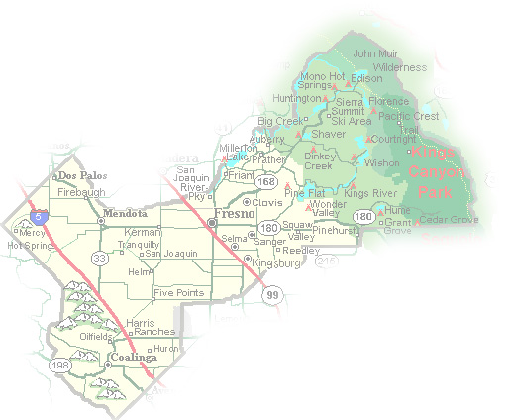
DEPARTMENT of PUBLIC WORKS and PLANNING
DEVELOPMENT SERVICES DIVISION
AA 3815

Slide 2
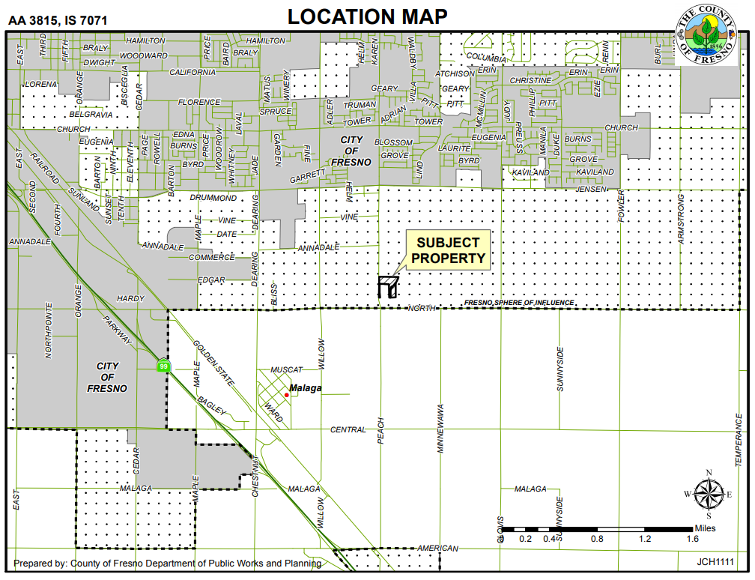
North Ave.
Peach Ave.

Slide 3
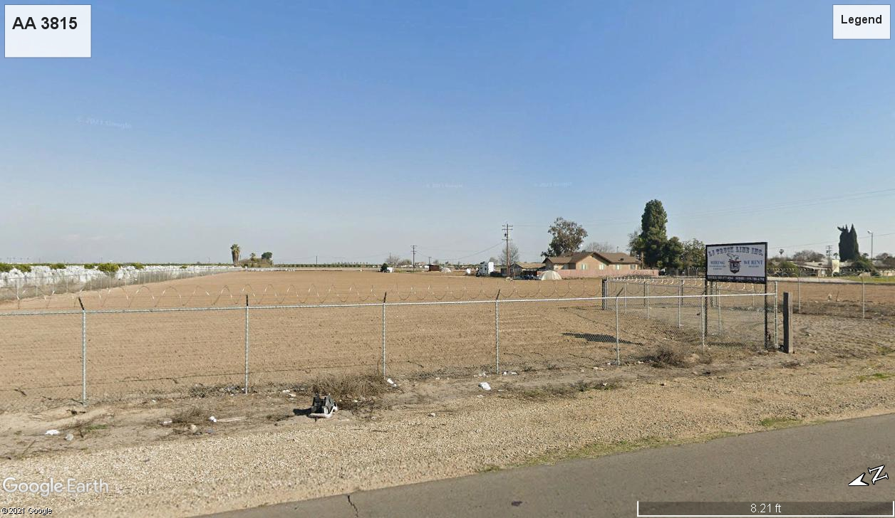

Slide 4
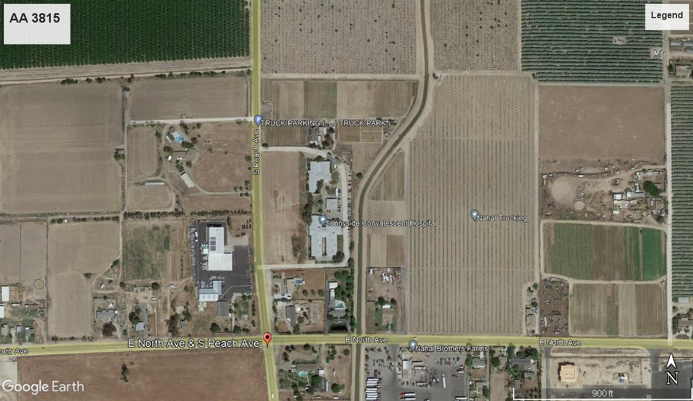
Project Site

Slide 5
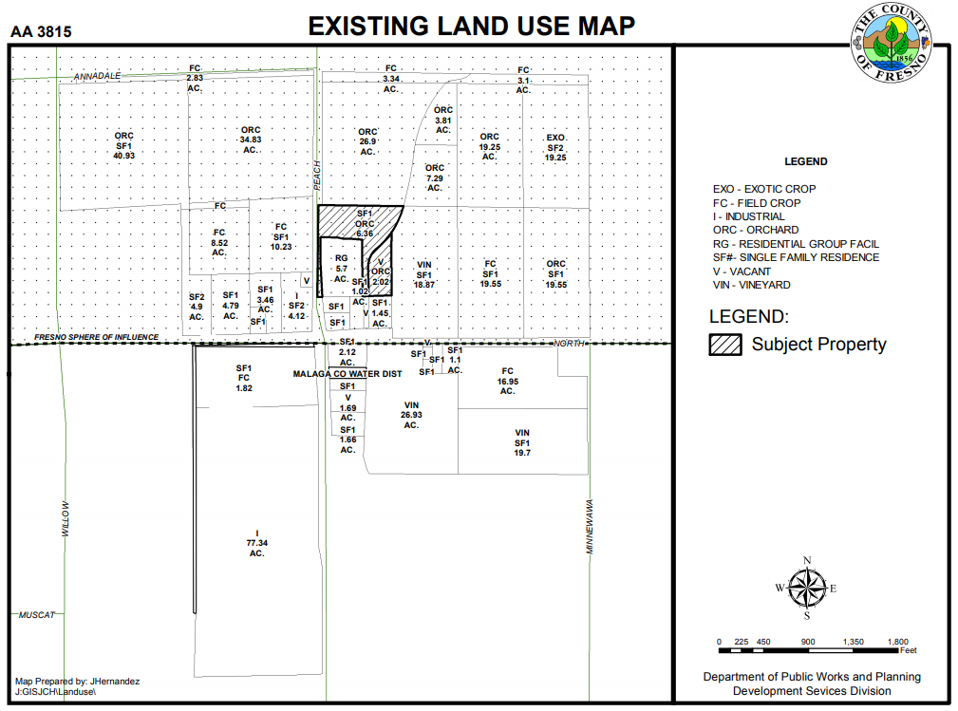

Slide 6
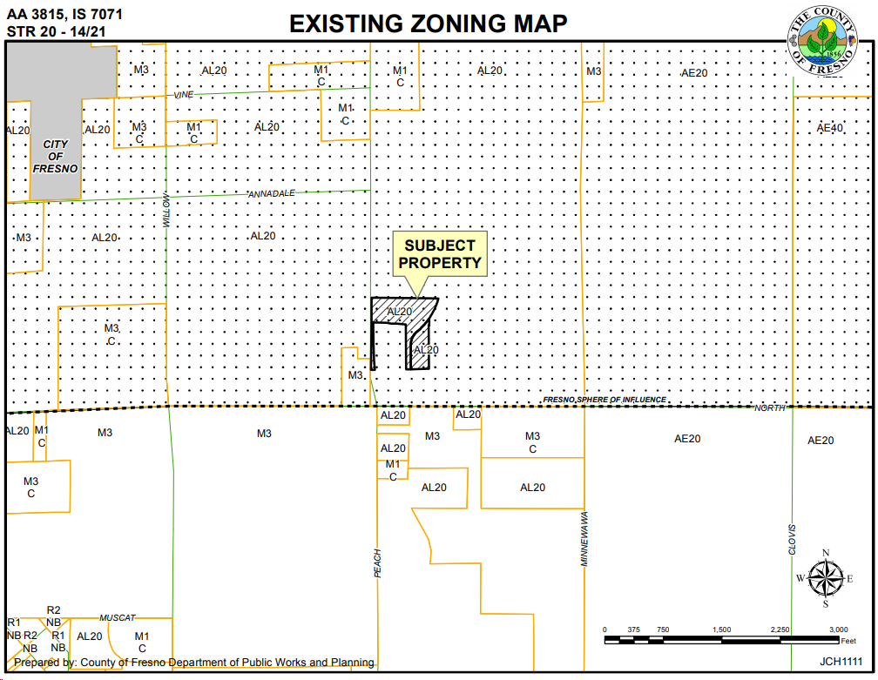
North Ave.
Peach Ave.

Slide 7
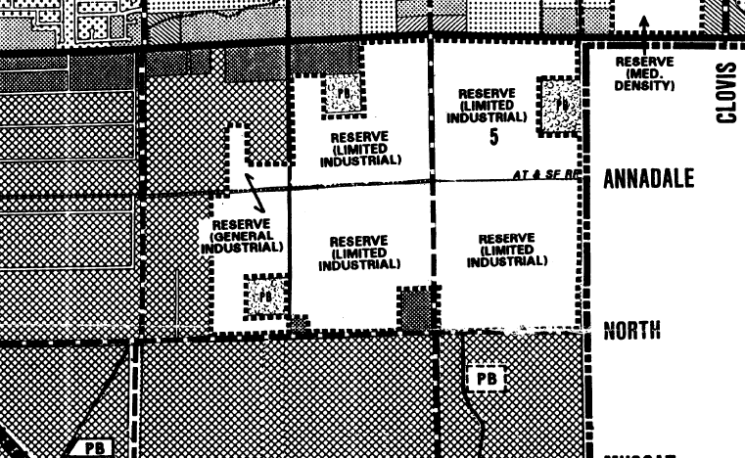
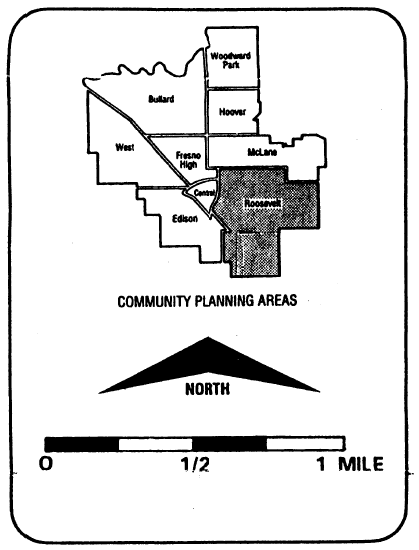
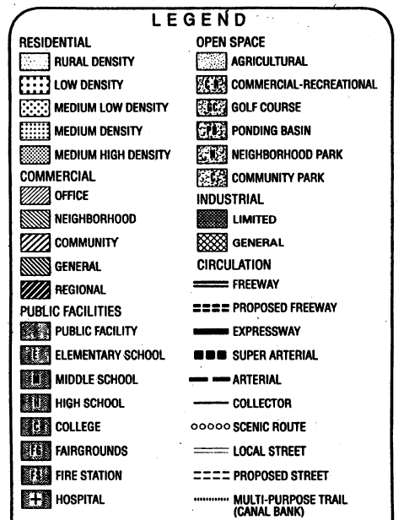
Peach Ave

Slide 8
Animal hospitals and shelters
Automobile repairs
Automobile service stations
Caretaker's residence
Incidental industrial uses.
Equipment rental or sale
Farm equipment sales and service
Ice and cold storage plants
Mechanical car, truck, motor & equipment wash, including self-service
Offices: Administrative, Business, General, Medical, Professional
New and used recreational vehicle sales and service
Signs, subject to the provisions of Section
Machinery and shop (no punch presses over twenty (20) tons or drophammers)
Cabinet or carpenter shops
Fruit and vegetables (packing only)
Honey extraction plant
Stone monument works
Contractors' storage yard
Machinery rental storage yard
Motion picture studio storage yard
Transit storage
Blueprinting and photocopying
Laundries
Assembly of small electric and electronic equipment
Assembly of plastic items made from finished plastic
Communication equipment buildings
See Exhibit 8

Slide 9
Recommended Motion (Approval Action)
Recommend adoption of the Mitigated Negative Declaration prepared based on Initial Study No. 7071; and
Recommend that the Board of Supervisors determine that the proposed rezone to the M1(c) (Light Manufacturing, Conditional) Zone District is consistent with the General Plan and the County-adopted Roosevelt Community Plan and approve Amendment Application No. 3815, subject to the recommended Mitigation Measures, and Conditions of Approval; and
Direct the Secretary to prepare a Resolution documenting the Commission’s action.
Alternative Motion (Denial Action)
Determine that the M-1(c) (Light Manufacturing, Conditional) zoning is not appropriate for the property based on (state basis for denial), and deny Amendment Application No. 3815; and
Direct the Secretary to prepare a Resolution documenting the Commission’s action

Slide 10
DEPARTMENT of PUBLIC WORKS and PLANNING
DEVELOPMENT SERVICES DIVISION
AA 3815

Slide 11
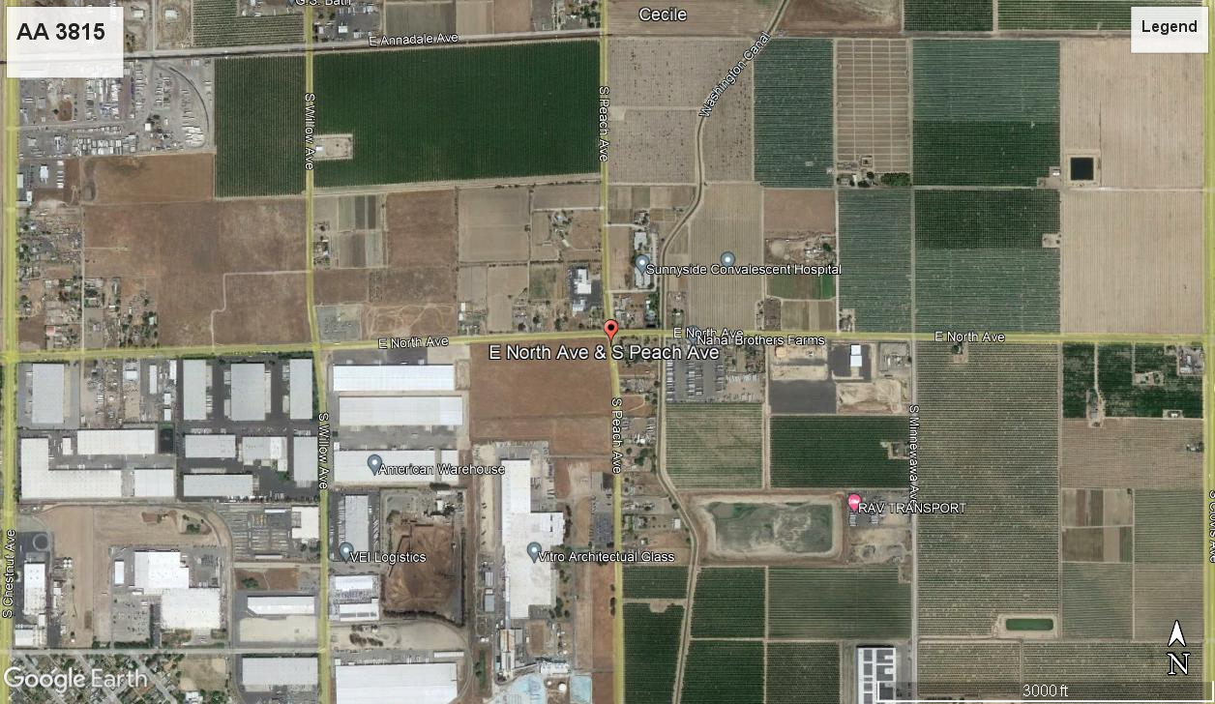
Project Site

Slide 12
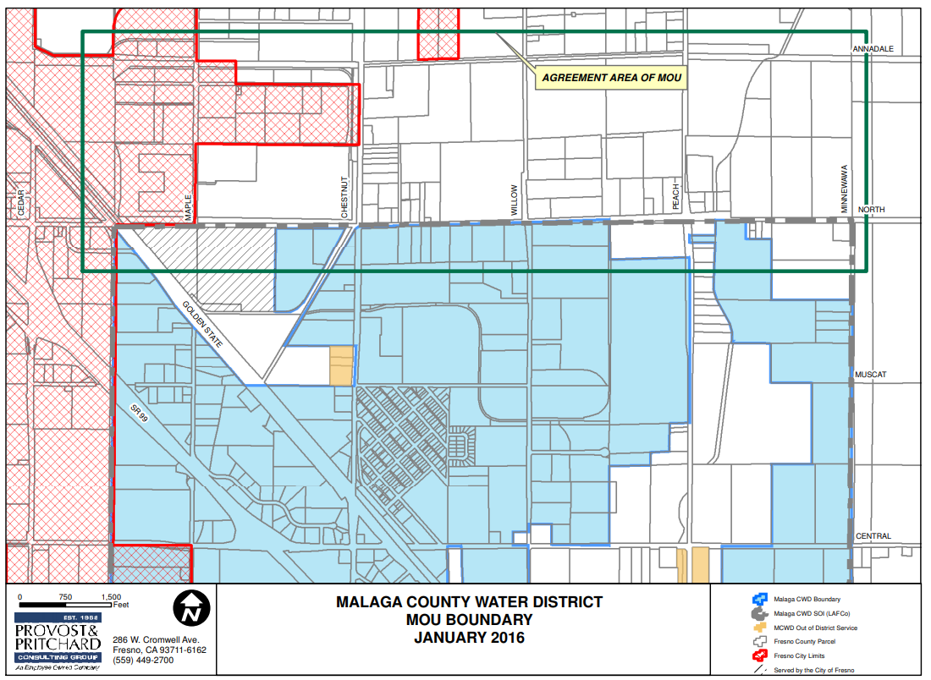

Slide 13
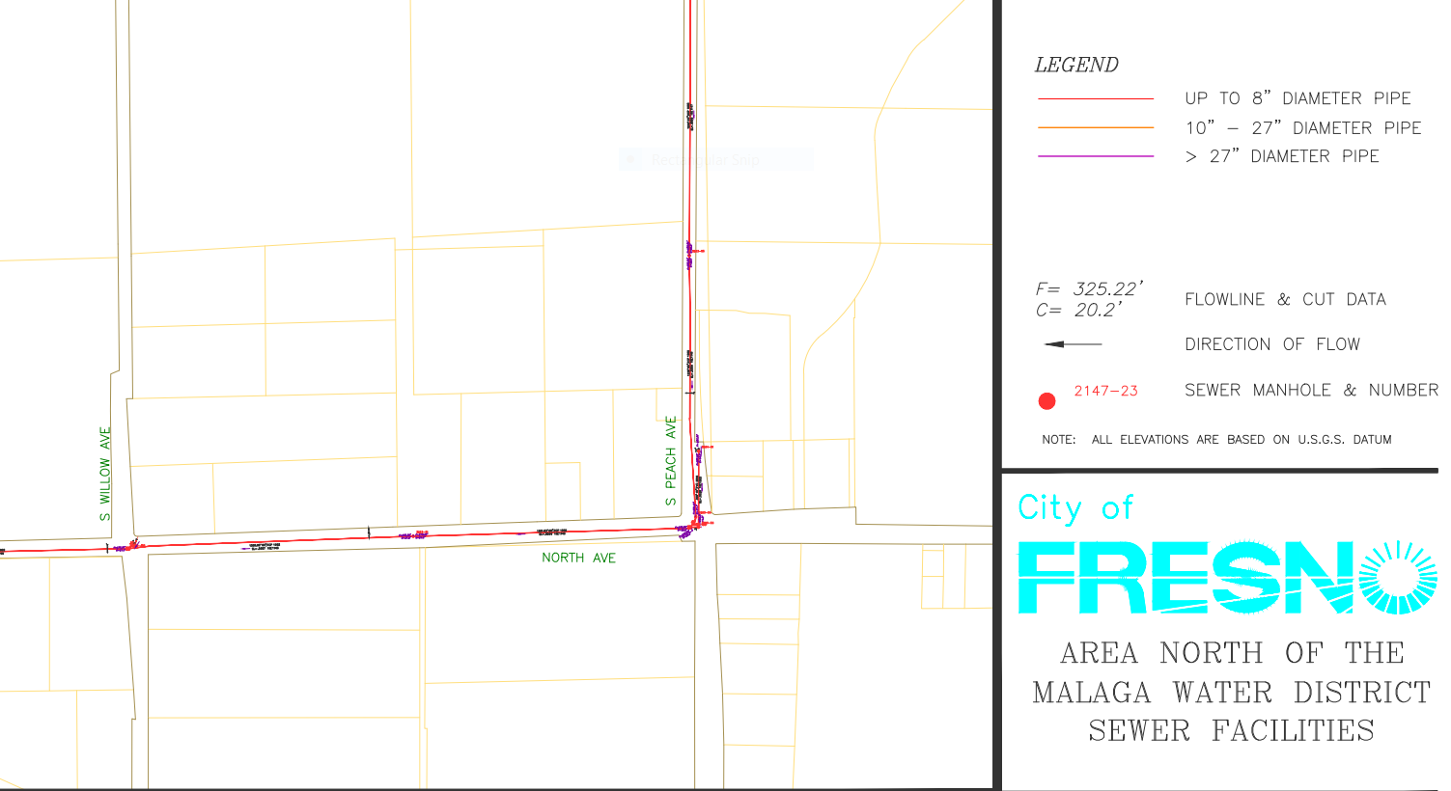

Slide 14
