Slide 1
CUP 3607 Initial One-Year Time Extension

Slide 2
Background Information
ACTION | RESULT
PC Approved CUP 3607 July 18th, 2019 | Finalized August 6th, 2019
Applicant submitted time extension July 1, 2021 | Would extend date August 6th, 2022

Slide 4
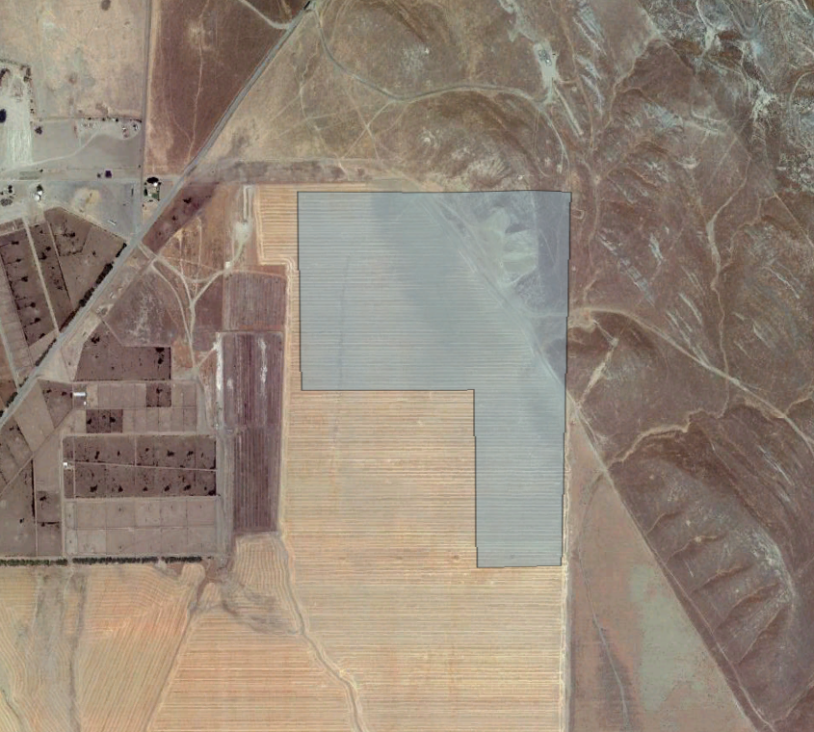
Location
Shell Road
Parcel Boundary
Project Site
N

Slide 7
Justification
CUP 3607 was previously reviewed and approved by the County
There is no change to the design and use of the approved project
No building due to Covid-19 restrictions
A first one-year CUP permit extension is needed

Slide 8
Conclusion & Planning Commission Motions
Staff recommends that the first one-year Time Extension for Unclassified Conditional Use Permit No. 3607 should be approved based on factors by the applicant regarding Covid-19. Approval of this Time Extension will extend the expiration date July 18th, 2022.
Recommended Motion (Approval Action)
  Move to approve the first one-year Time Extension for Unclassified Conditional Use Permit No. 3607
  Direct the Secretary to prepare a Resolution documenting the Commission’s action.
Alternative Motion (Denial Action)
  Move to deny the first one-year Time Extension request for Unclassified Conditional Use Permit No. 3607 based on (state reason for denial).
  Direct the Secretary to prepare a Resolution documenting the Commission’s action.

Slide 9
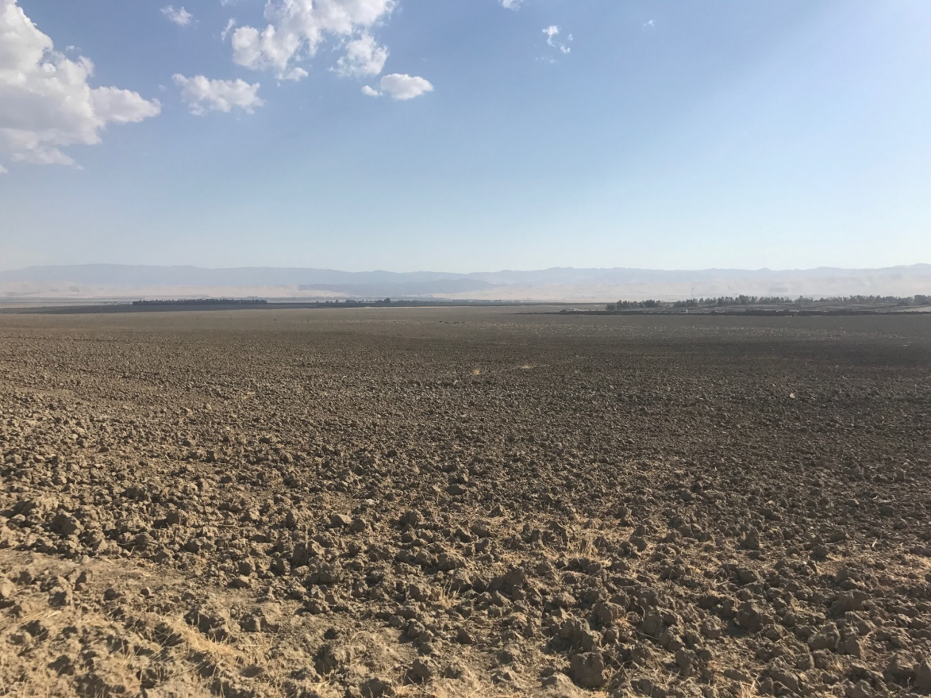
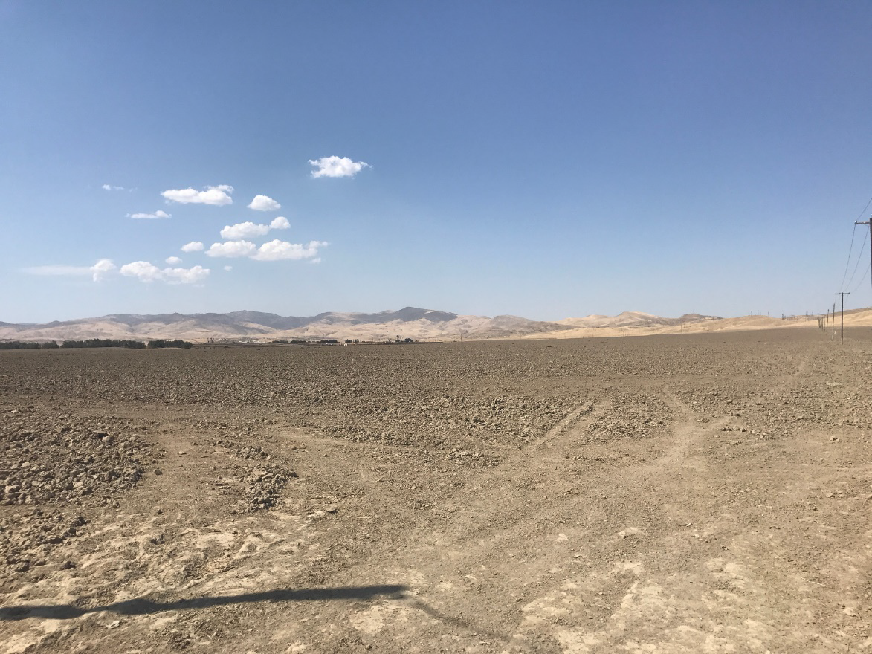
Site Photos
Looking southwest from northeast corner
Looking northwest from southeast corner

Slide 10
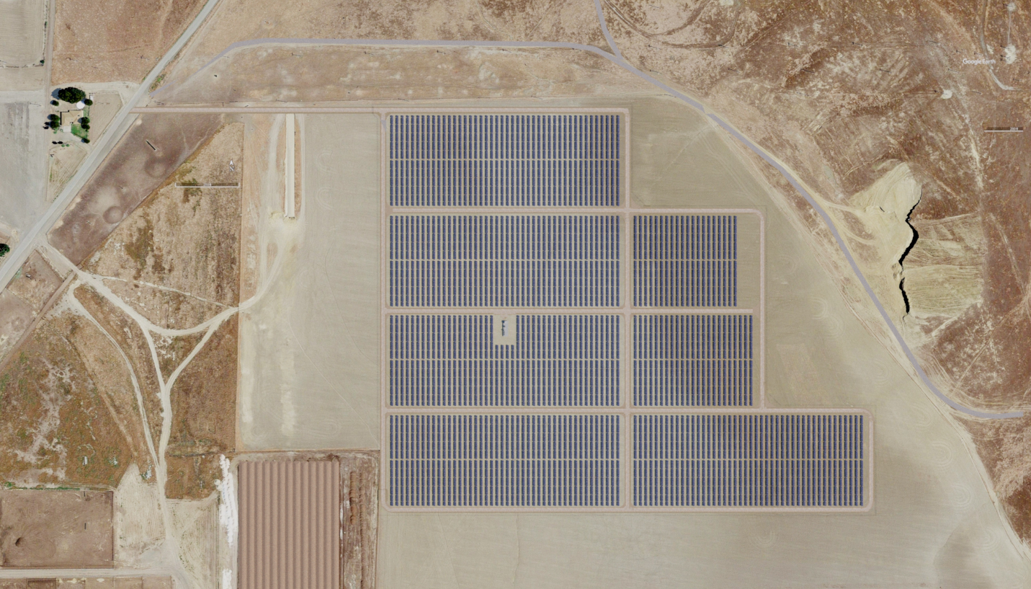
Site Plan
Shell Road
Parcel Boundary
Project Summary
5 MW Solar
47 acres on a 88-acre site
Local area highly disturbed by oil production
Community Solar Program
  Reduction in utility bills for subscribers
  Small-scale
N

Slide 11
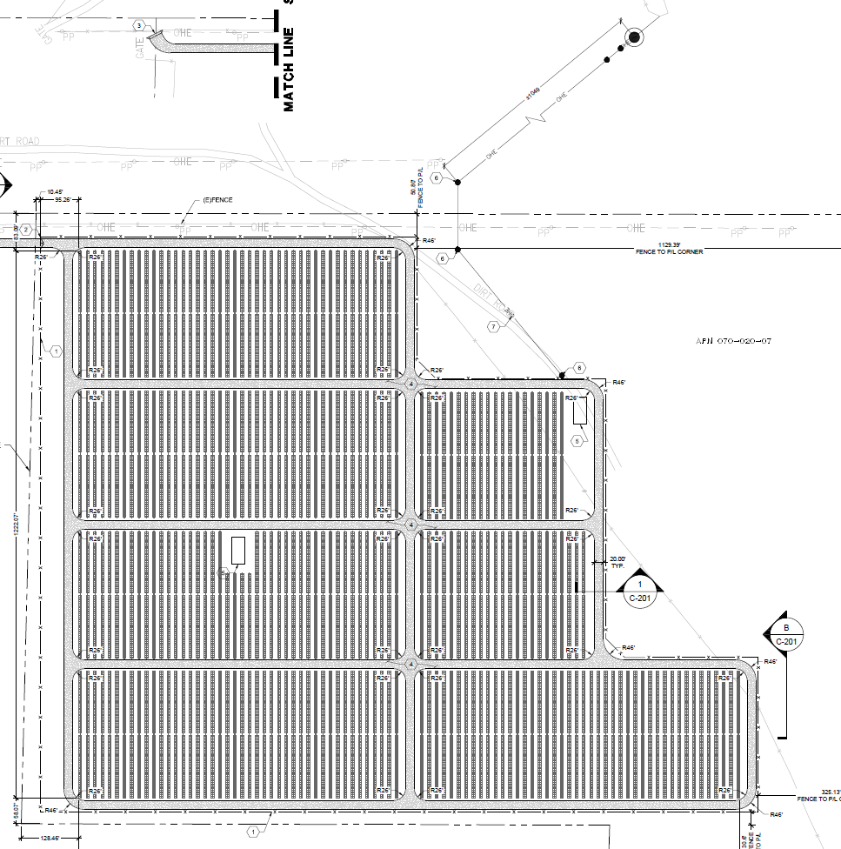
Site Plan
POINT OF INTERCONNECTION
1050 FEET
20-FOOT WIDE ACCESS ROADS
PV SOLAR ARRAY
N

Slide 12
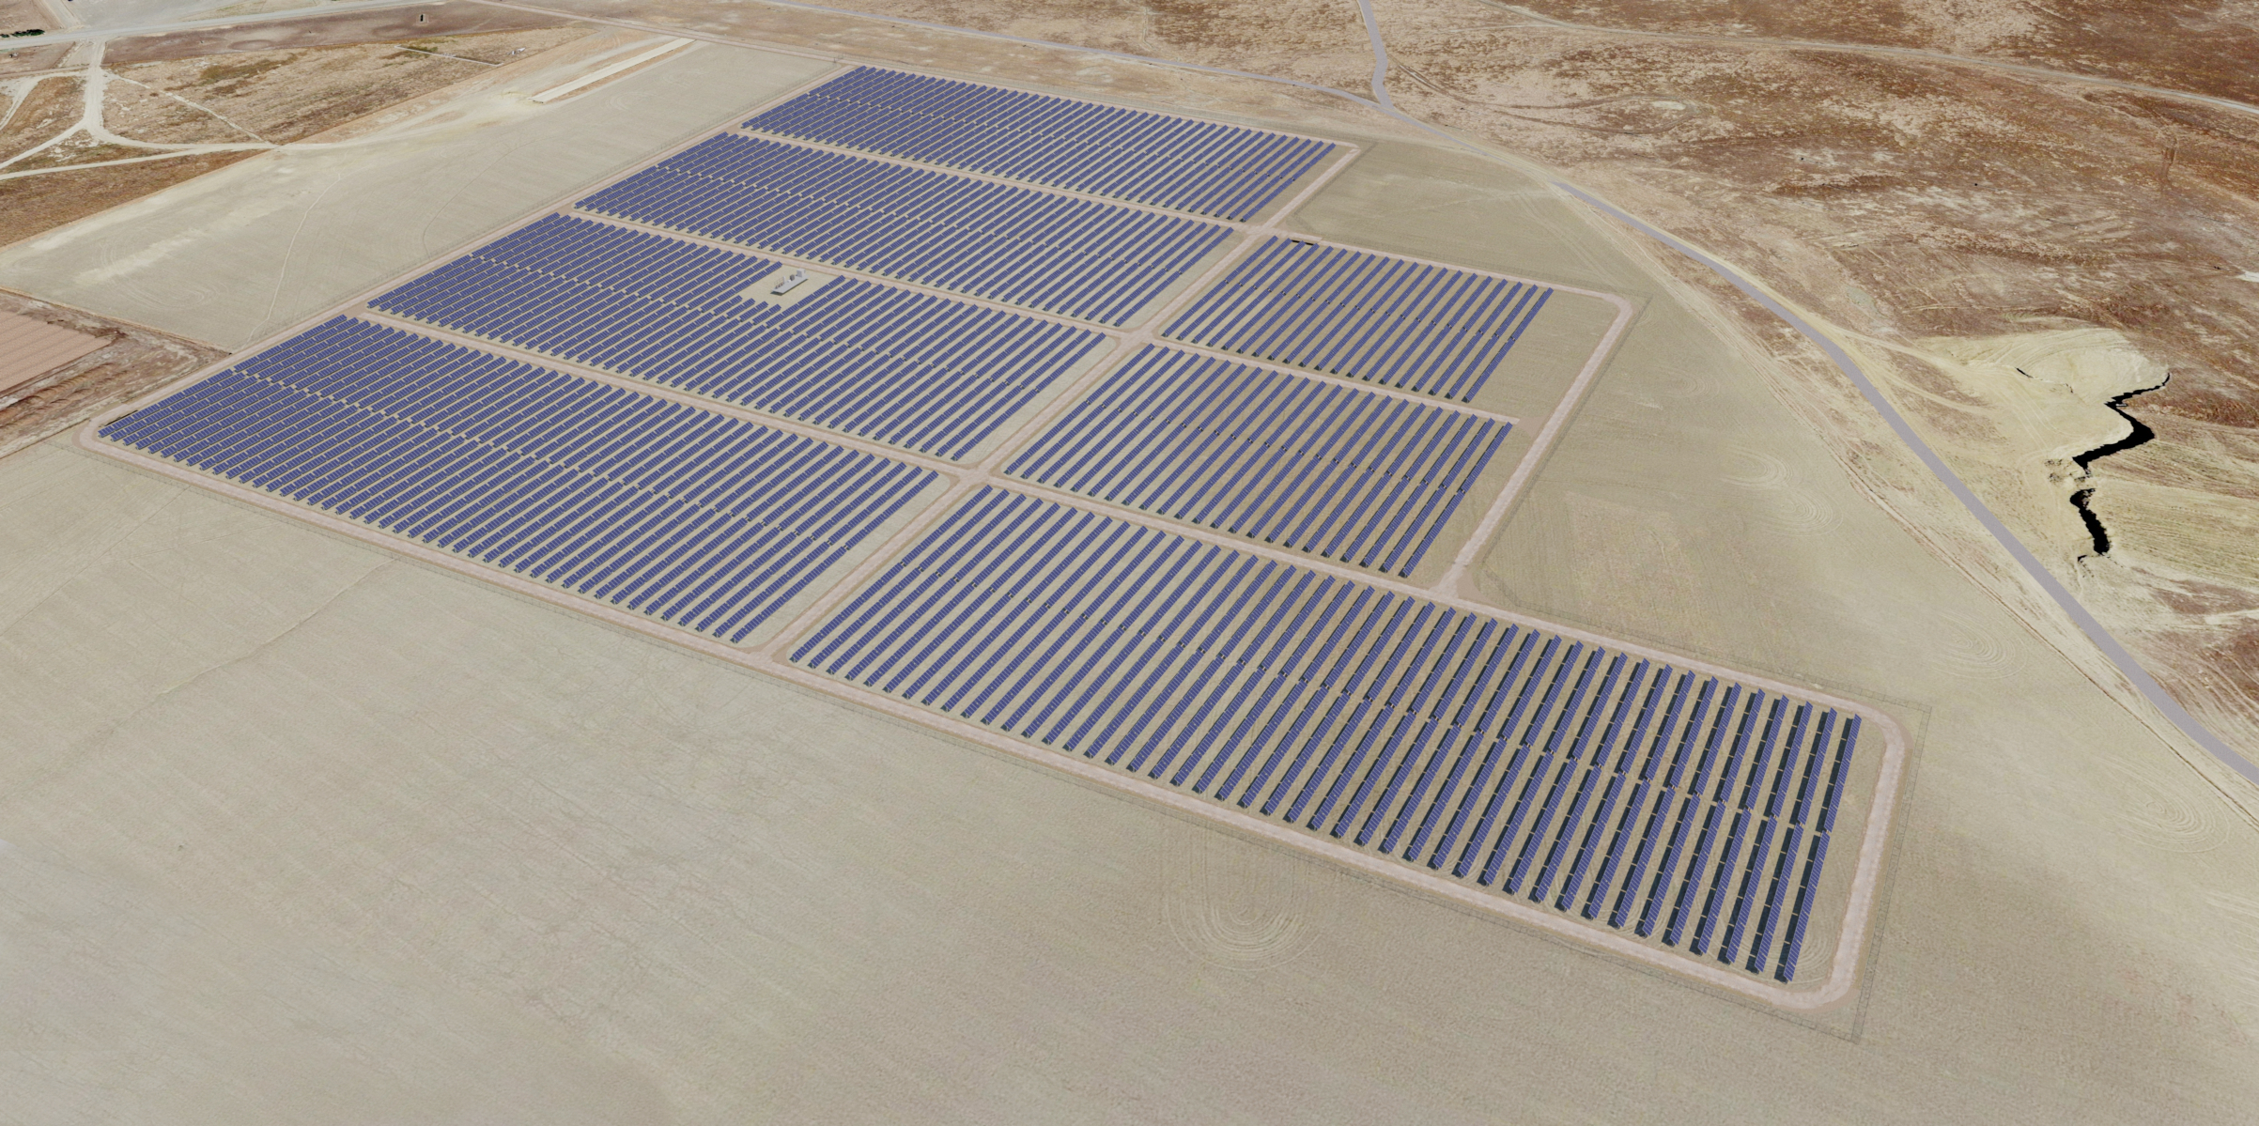
Rendering
N
N

Slide 13
Compatibility with Adjacent Land Uses
Local land uses are predominantly oil production and grazing.
Grazing lands to the south have the same property owner.
No compatibility issues with either use are anticipated.

Slide 14
Beneficial Temporary Use
The solar facility is planned and permitted for 25 years, after which it will be removed per the CUP requirements
During the solar facility’s lifespan, it will produce clean energy for use in the area and local subscribers will benefit by receiving a discount on their electric bills

Slide 15
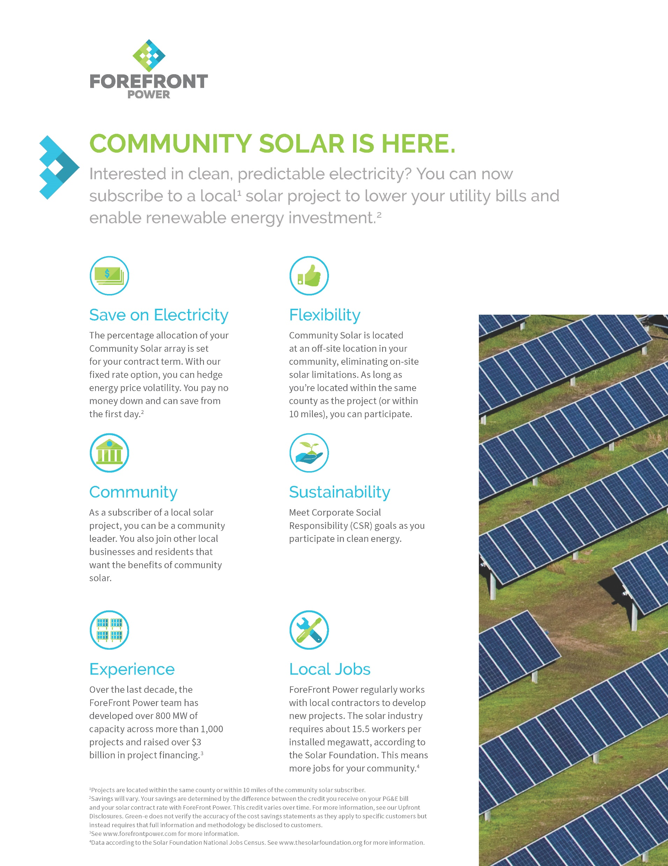
http://info.forefrontpower.com/ca-communitysolar

