Slide 1

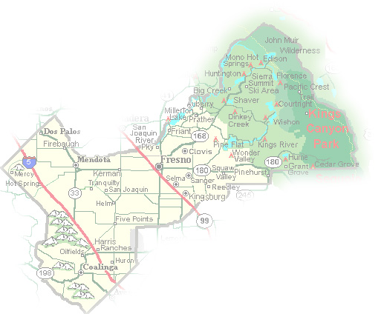
DEPARTMENT of PUBLIC WORKS and PLANNING
DEVELOPMENT SERVICES DIVISION
CUP 3609
Second One-Year Time Extension

Slide 2
Background Information
ACTION | RESULT
PC Approved CUP 3609 October 25, 2018 | Finalized November 10, 2018, to extend to November 10, 2020
Applicant submitted first 1-year time extension October 7, 2020 | Approved December 10, 2020 Would extend date November 10, 2021
Applicant submitted second 1-year time extension July 1, 2021 | Would extend date November 10, 2022

Slide 5
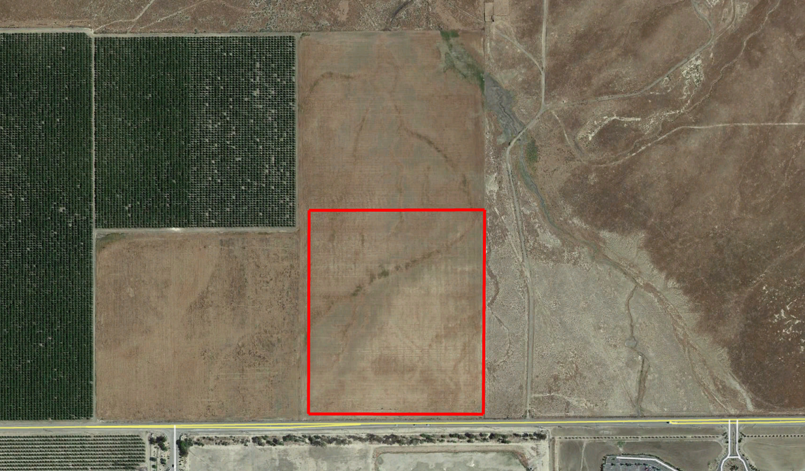
79.7-acre parcel
Abandoned Oil Well
Seasonal Stream
39-acre Solar Facility
Solar Facility Access
W. Jayne Avenue
Point of Interconnection
Pleasant Valley State Prison

Slide 7
Justification for Second One Year Time Extension
CUP 3609 was previously reviewed and approved by the County
There is no change to the design and use of the approved project
No building due to Covid-19 restrictions
A second one-year CUP permit extension is needed

Slide 8
Conclusion & Planning Commission Motions
Staff recommends that the second one-year Time Extension for Unclassified Conditional Use Permit No. 3609 should be approved based on factors by the applicant regarding Covid-19. Approval of this Time Extension will extend the expiration date to November 10, 2022.
Recommended Motion (Approval Action)
  Move to approve the second one-year Time Extension for Unclassified Conditional Use Permit No. 3609
  Direct the Secretary to prepare a Resolution documenting the Commission’s action
Alternative Motion (Denial Action)
  Move to deny the second one-year Time Extension request for Unclassified Conditional Use Permit No. 3607 based on (state reason for denial)
  Direct the Secretary to prepare a Resolution documenting the Commission’s action

