Slide 1

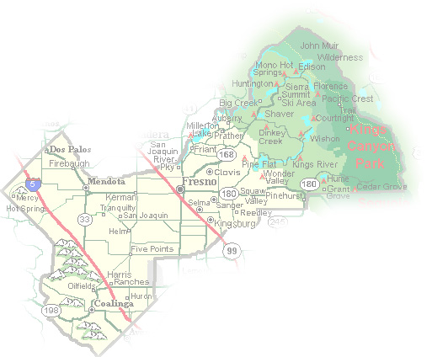
DEPARTMENT of PUBLIC WORKS and PLANNING
DEVELOPMENT SERVICES DIVISION
CUP 3714

Slide 5
SITE PLAN

Slide 6
12 Foot Proposed Lattice Tower Extension

Slide 7
Tower
Footings

Slide 14
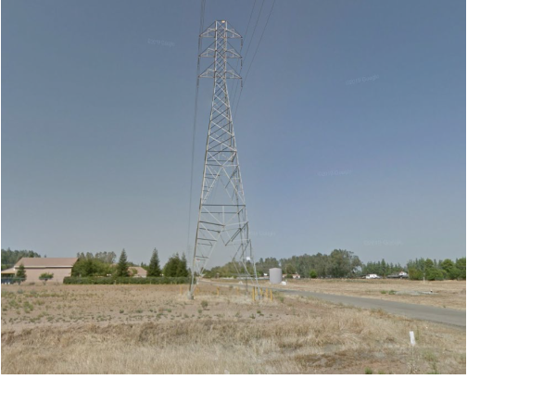
Most Ideal Location
Least intrusive means to fill significant gap of coverage
Provide AT&T’s ability to improve service in this portion of the County

Slide 15
Findings | Description | Findings Met
1 | Parcel’s size and shape adequate | YES
2 | Site can accommodate negligible traffic increase | YES
3 | No adverse effect on surrounding neighborhood | YES
4 | Consistent with General Plan | YES
5 | Condition necessary for public health, safety, and general welfare | YES

Slide 16
Recommended Motion (Approval Action)
Move to determine the required Findings can be made as recommended by the Staff Report and move to approve Conditional Use Permit No. 3714, subject to the Conditions of Approval and Project Notes listed in Exhibit 1; and
Direct the Secretary to prepare a Resolution documenting the Commission’s action
Alternative Motion (Denial Action)
Move to determine that the required Findings cannot be made (state basis for not making the Findings) and move to deny Conditional Use Permit No. 3714; and
Direct the Secretary to prepare a Resolution documenting the Commission’s action.

