Slide 1

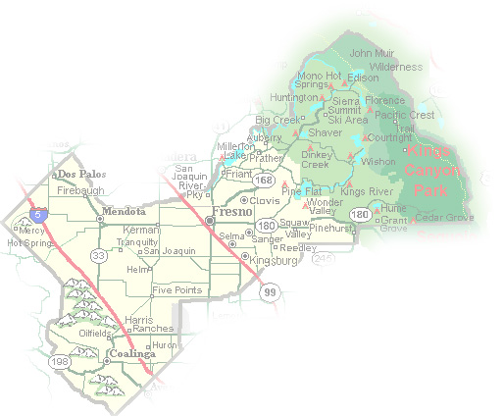
DEPARTMENT of PUBLIC WORKS and PLANNING
DEVELOPMENT SERVICES DIVISION
CUP 3712

Slide 2
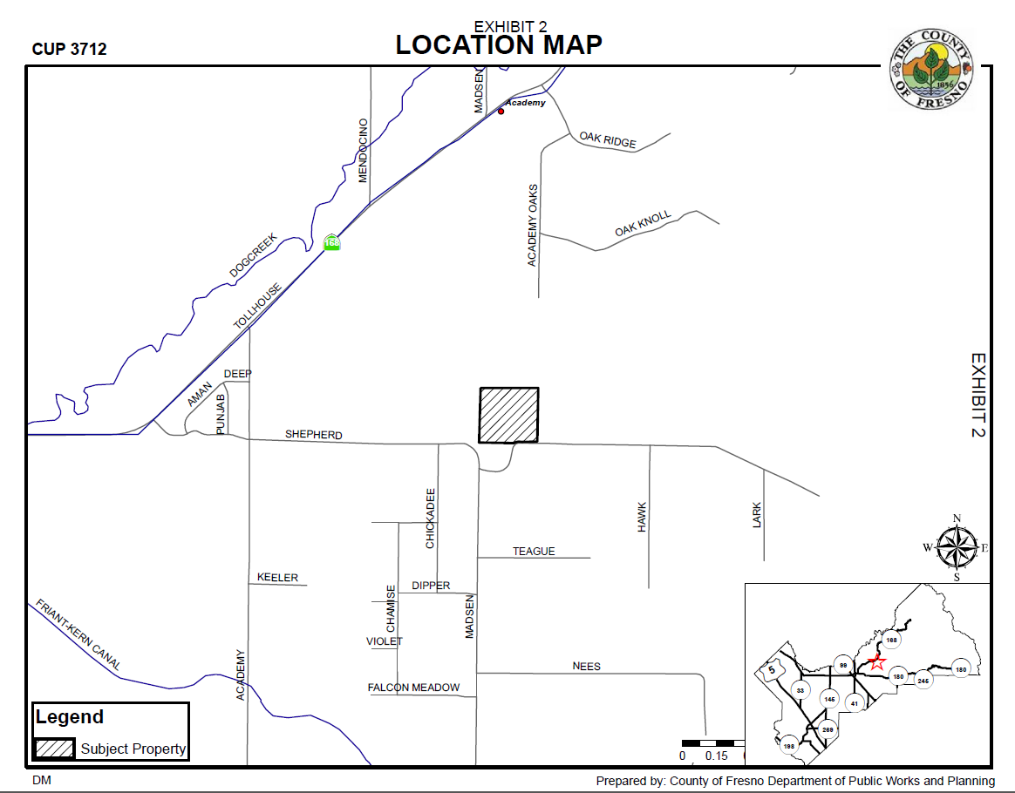

Slide 3
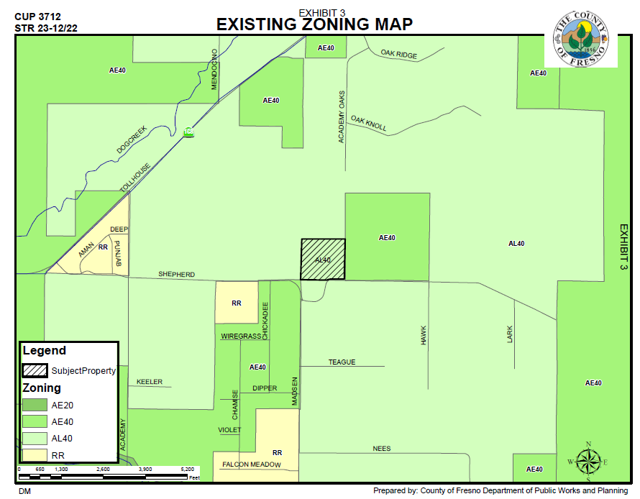

Slide 4
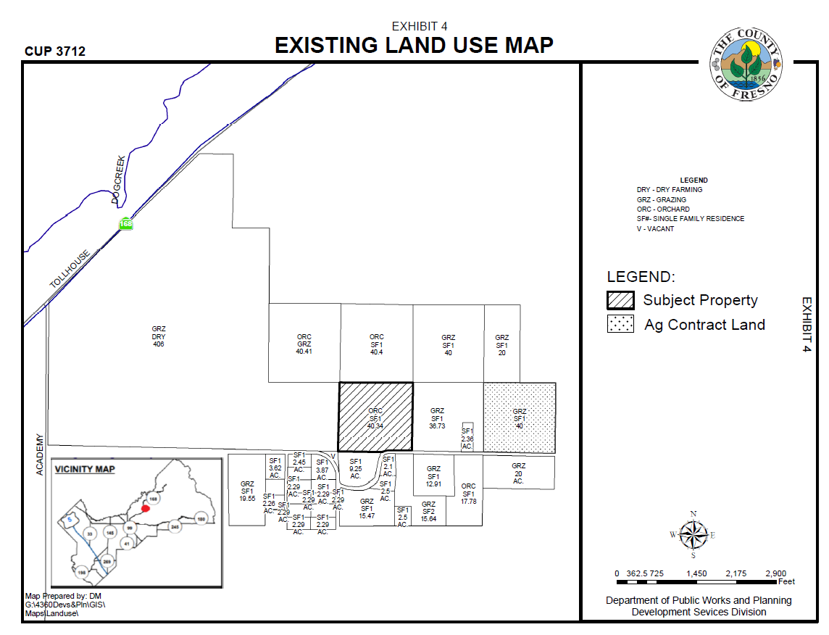

Slide 5
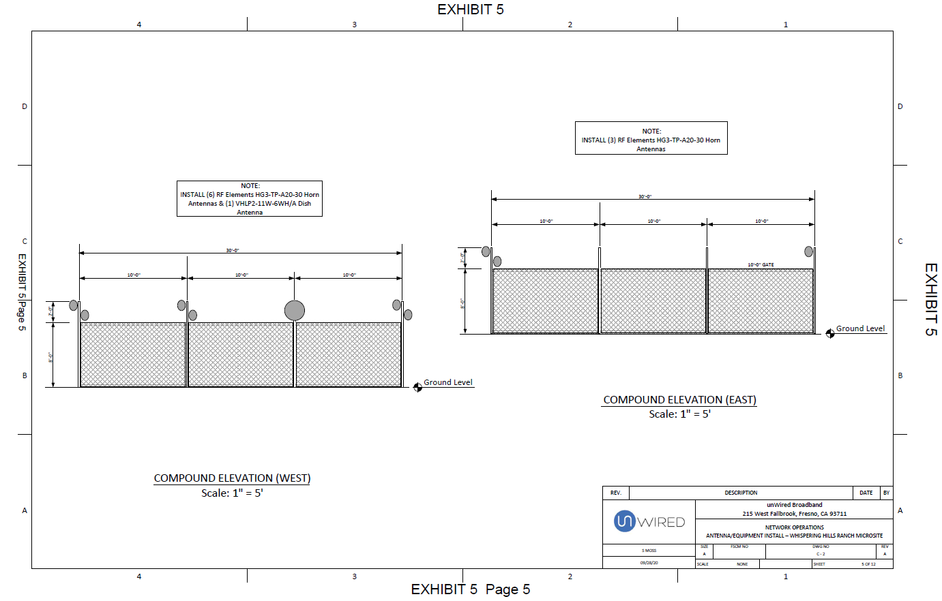

Slide 6
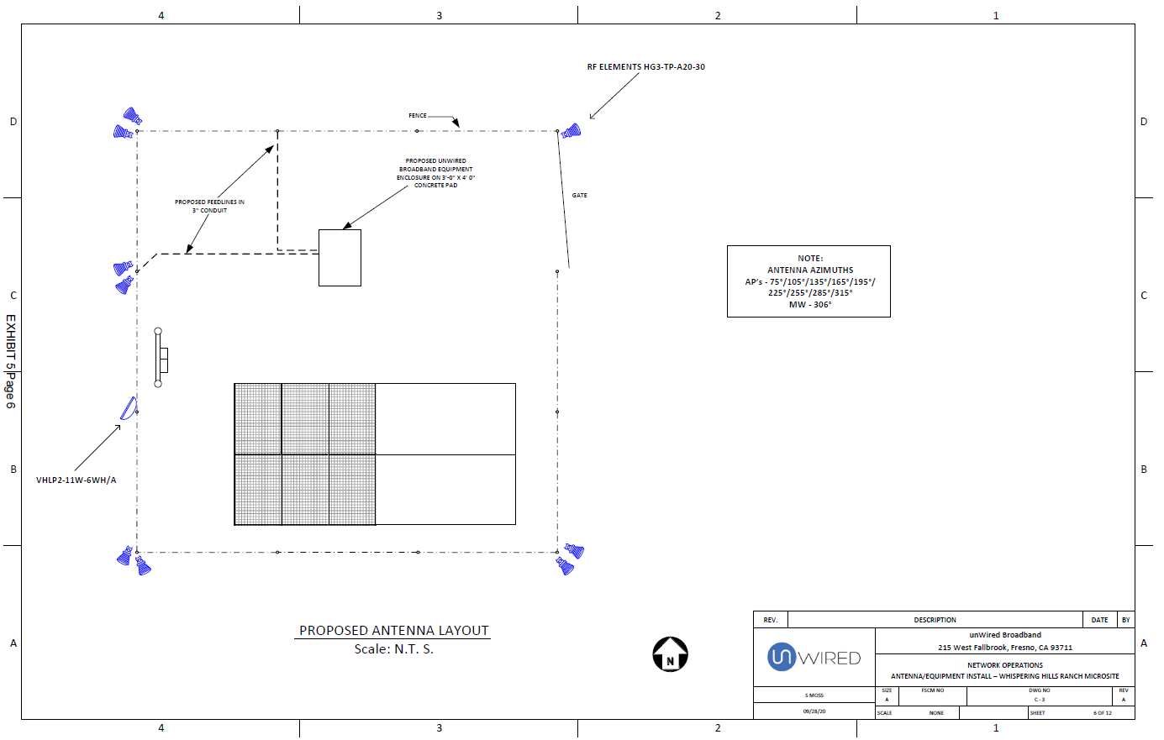

Slide 7
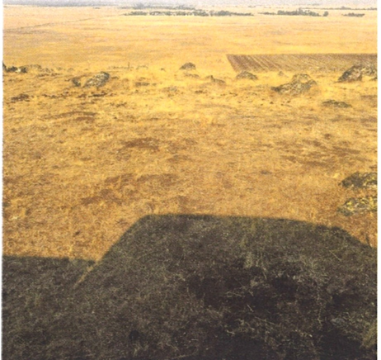
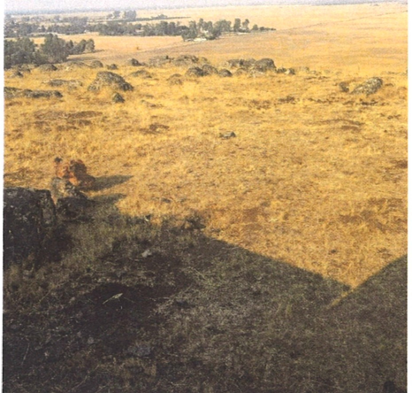

Slide 8
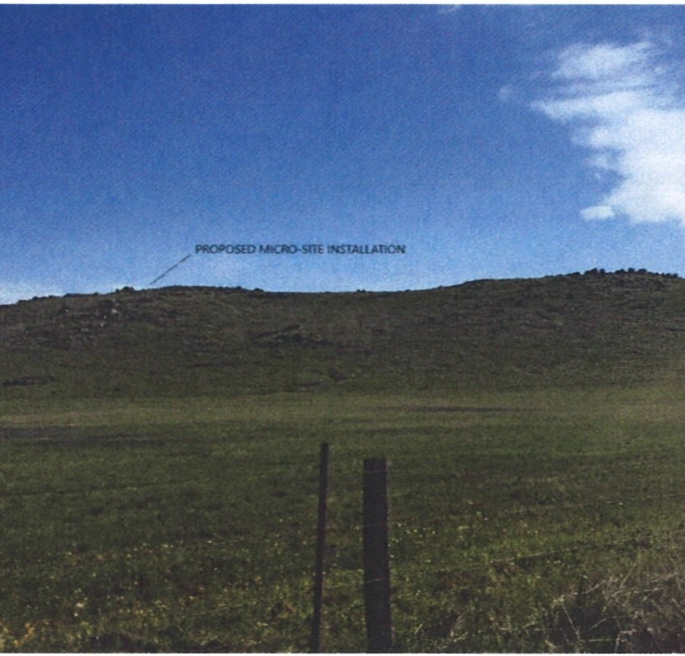
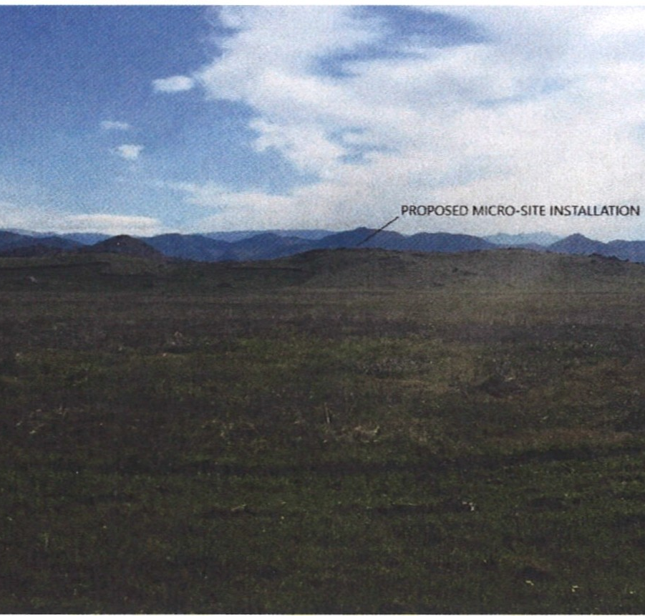
View from E Shepard Ave
View from N Academy Ave

Slide 9
5-mile radius: Road Mountain Tower already collocated

Slide 10
Findings | Description | Findings Met
1 | Parcel’s size and shape adequate | YES
2 | Site can accommodate negligible traffic increase | YES
3 | No adverse effect on surrounding neighborhood | YES
4 | Consistent with General Plan | YES
5 | Condition necessary for public health, safety, and general welfare | YES

Slide 11
Recommended Motion (Approval Action)
Move to determine the required Findings can be made as recommended by the Staff Report and move to approve Conditional Use Permit No. 3712, subject to the Conditions of Approval and Project Notes listed in Exhibit 1; and
Direct the Secretary to prepare a Resolution documenting the Commission’s action
Alternative Motion (Denial Action)
Move to determine that the required Findings cannot be made (state basis for not making the Findings) and move to deny Conditional Use Permit No. 3712; and
Direct the Secretary to prepare a Resolution documenting the Commission’s action.

