Slide 1
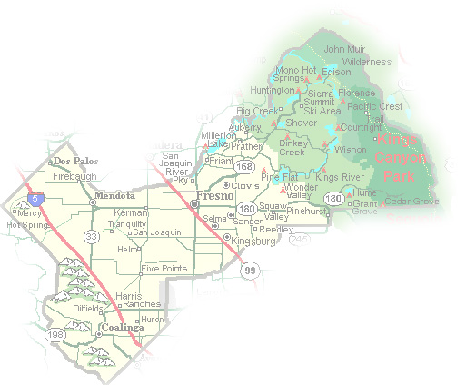
DEPARTMENT of PUBLIC WORKS and PLANNING
DEVELOPMENT SERVICES DIVISION
CUP 3555
Scarlet Solar Energy Project
EIR 7230
September 9, 2021

Slide 2
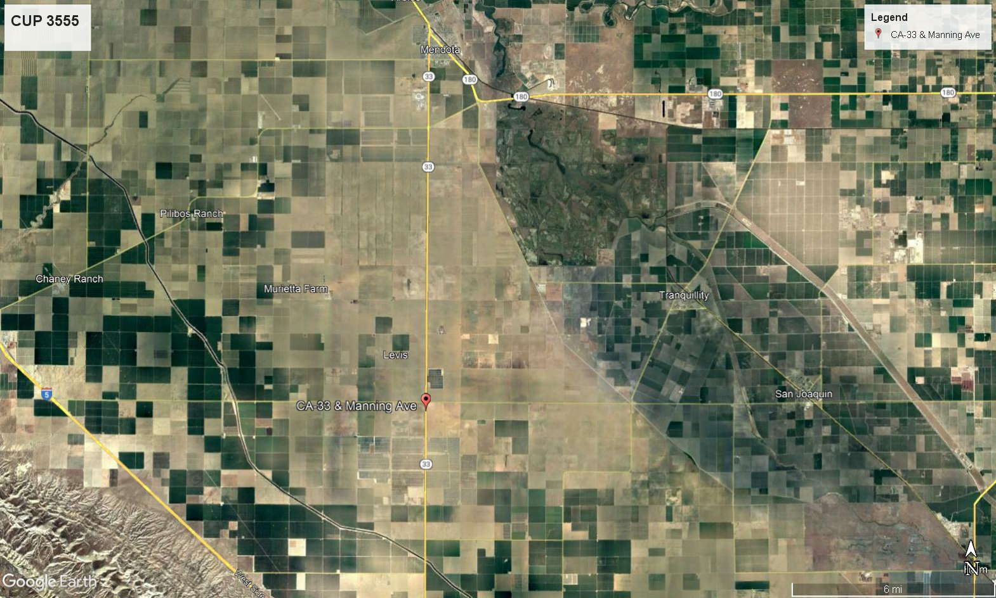
MENDOTA
STATE ROUTE 33
TRANQUILLITY
SAN JOAQUIN
STATE ROUTE 5
PROJECT SITE

Slide 3
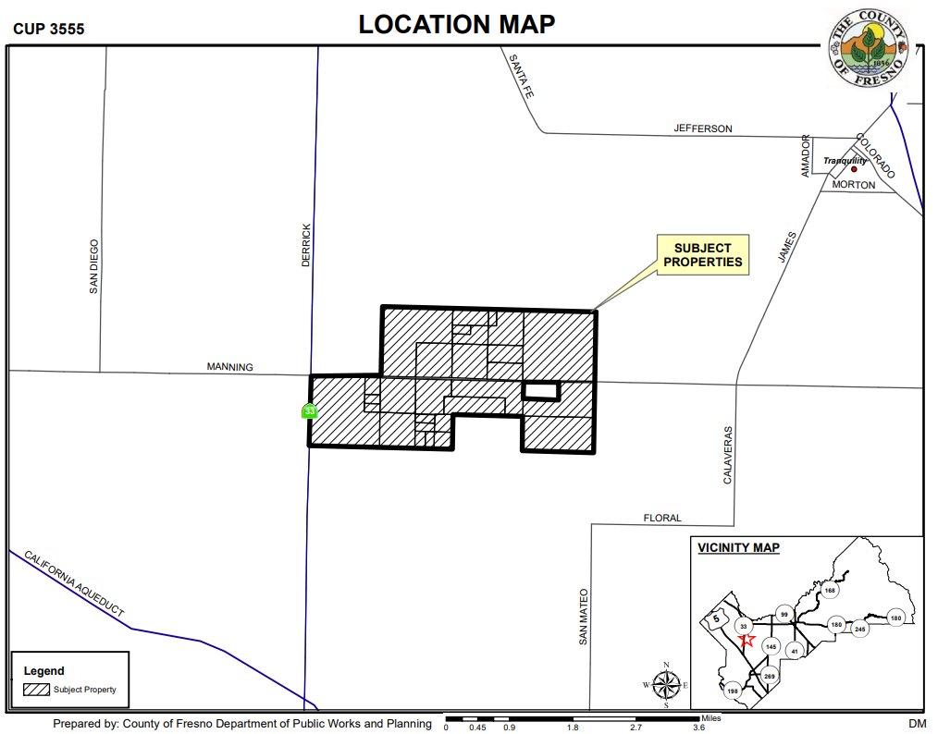

Slide 4
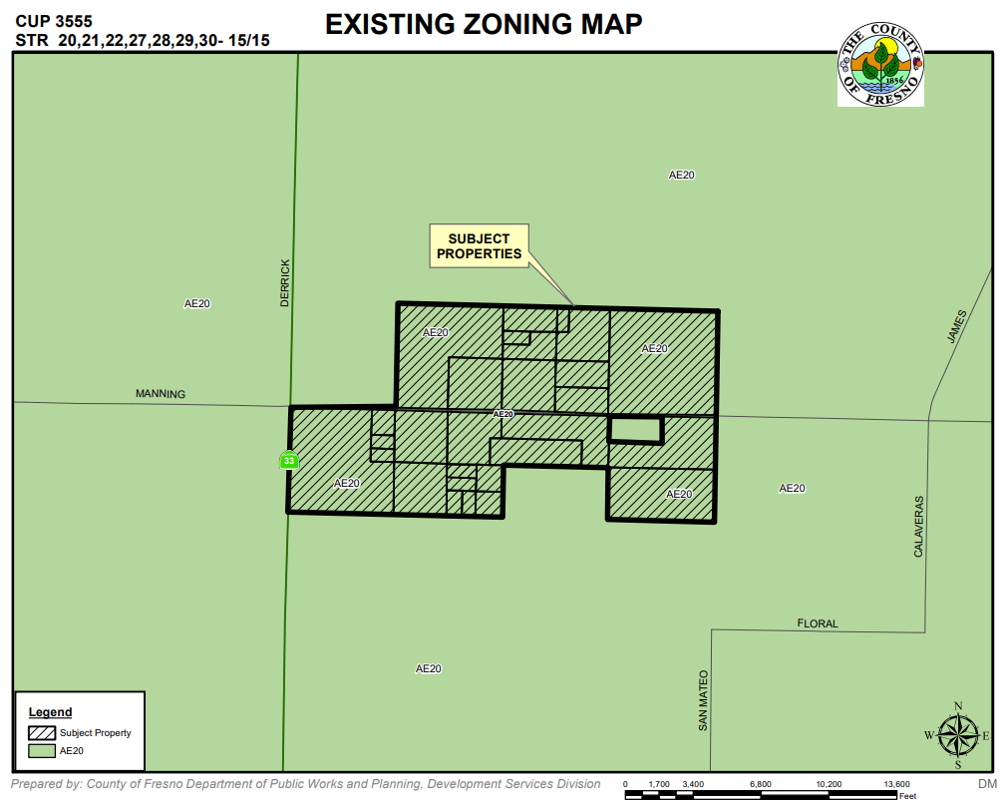

Slide 5
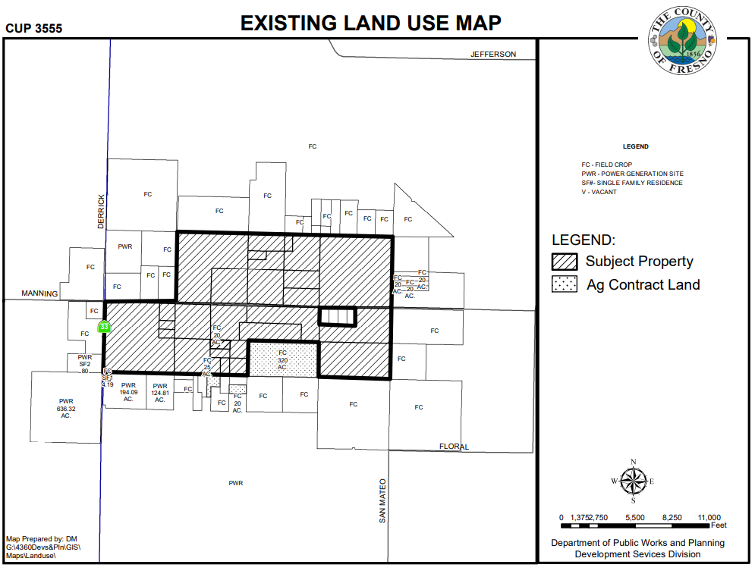

Slide 6
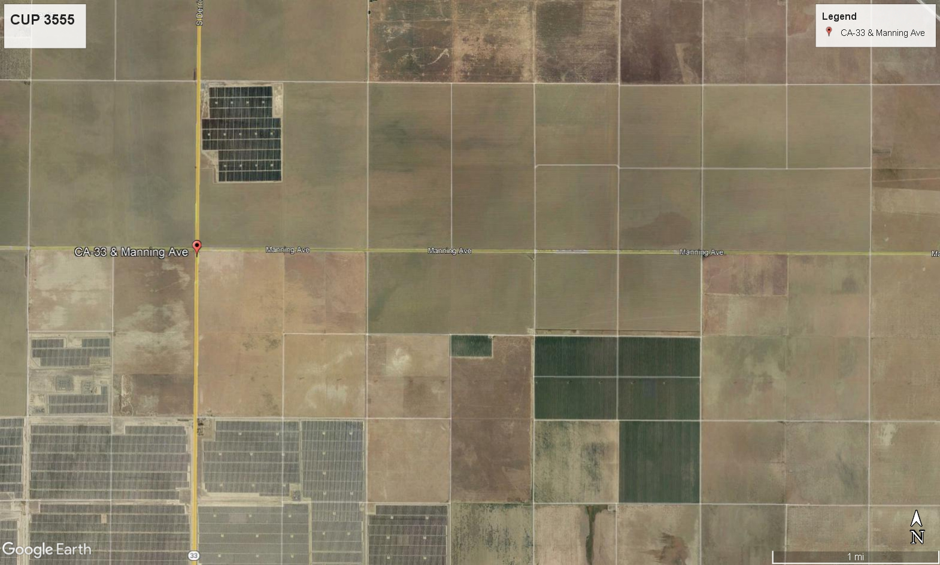
W. SOUTH AVENUE
MONTEREY AVENUE
DERRICK AVE (ROUTE 33)
MANNING AVENUE
PG&E Switching Station (E)
NOT A PART
SAN MATEO AVENUE
S. OHIO AVENUE
GEN-TIE LINE (P)
DINUBA AVENUE
GREAT VALLEY SOLAR (E)
PROJECT SITE
Scarlet Solar (P)

Slide 7
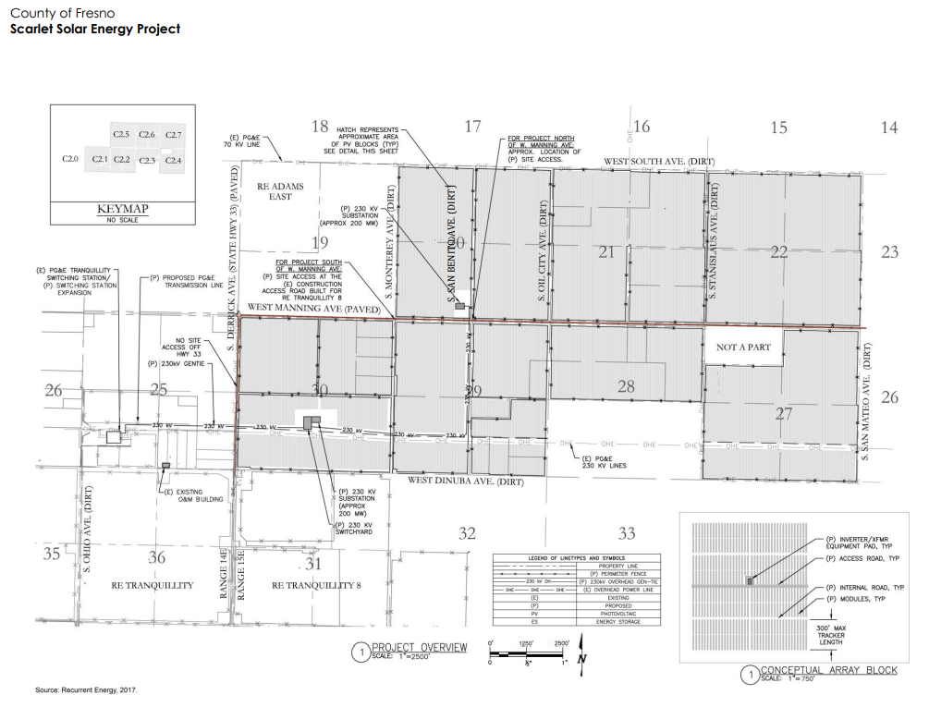

Slide 8
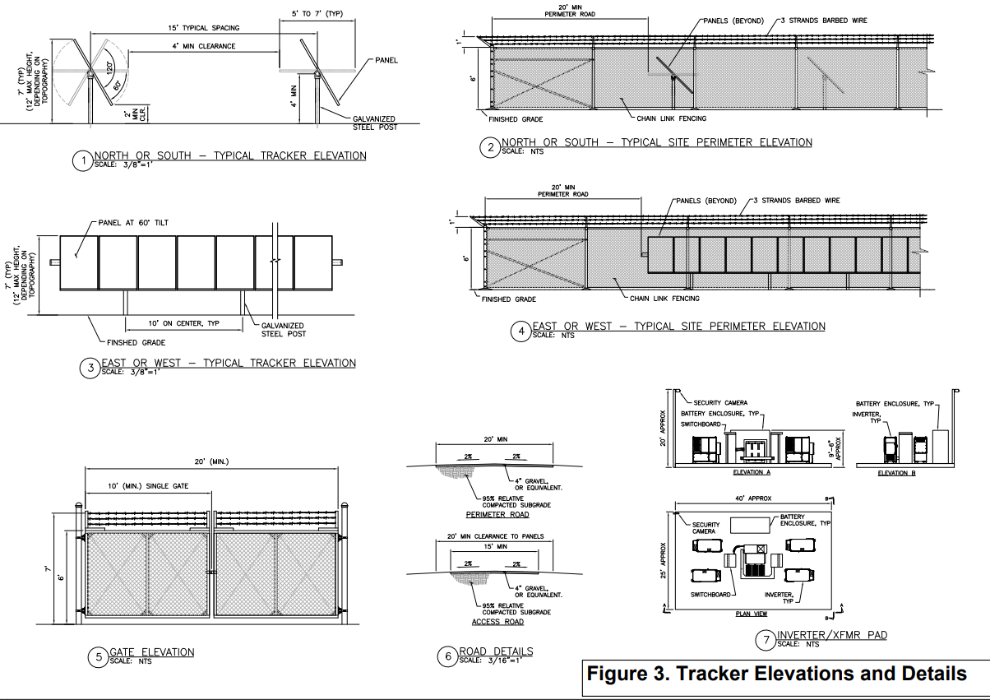

Slide 9
5 Required Findings for a CUP
Adequate Size & Shape
That the site of the proposed use is adequate in size and shape to accommodate said use and all yards, spaces, walls, and fences, parking, loading, landscaping, and other features required by this Division, to adjust said use with land and uses in the neighborhood;
That the site for the proposed use relates to streets and highways adequate in width and pavement type to carry the quantity and kind of traffic generated by the proposed use;
That the proposed use will have no adverse effect on abutting property and surrounding neighborhood or the permitted use thereof; and
That the proposed use is consistent with the Fresno County General Plan.
That the conditions stated in the resolution are deemed necessary to protect the public health, safety, and general welfare.
Adequate Streets & Highways
Not Adverse Effect on Neighborhood
Consistent with General Plan
Conditions are Necessary for Public Welfare

Slide 10
DEPARTMENT of PUBLIC WORKS and PLANNING
DEVELOPMENT SERVICES DIVISION
CUP 3555
Scarlet Solar Energy Project
EIR 7230
September 9, 2021

Slide 11
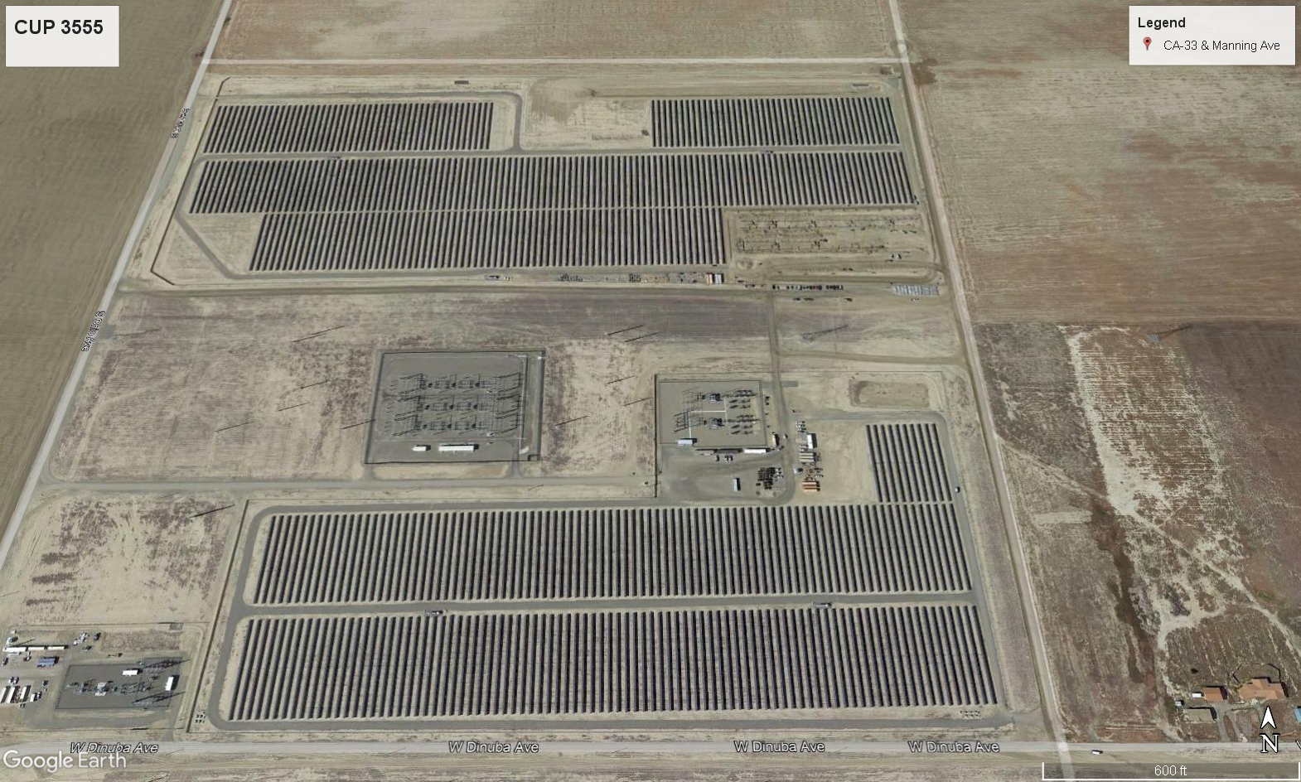
GEN-TIE LINE ROUTE (P)
PG&E SWITCHING STATION (E)

Slide 12
W. SOUTH AVENUE
MONTEREY AVENUE
DERRICK AVE (ROUTE 33)
MANNING AVENUE
PG&E Switching Station (E)
NOT A PART
SAN MATEO AVENUE
S. OHIO AVENUE
GEN-TIE LINE (P)
DINUBA AVENUE
FINDINGS (CUP 3555)
Adequacy of the Project Site
Adequacy of the Streets & highways
No Adverse Effects on the Surrounding Properties
General Plan Consistency
Project Conditions Deemed Necessary to Protect Public Health, Safety and General Welfare
GREAT VALLEY SOLAR (E)
PROJECT SITE
Scarlet Solar (P)

