Slide 1
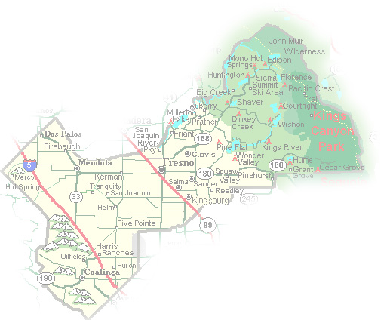
DEPARTMENT of PUBLIC WORKS and PLANNING
DEVELOPMENT SERVICES DIVISION
VA 4110

Slide 2
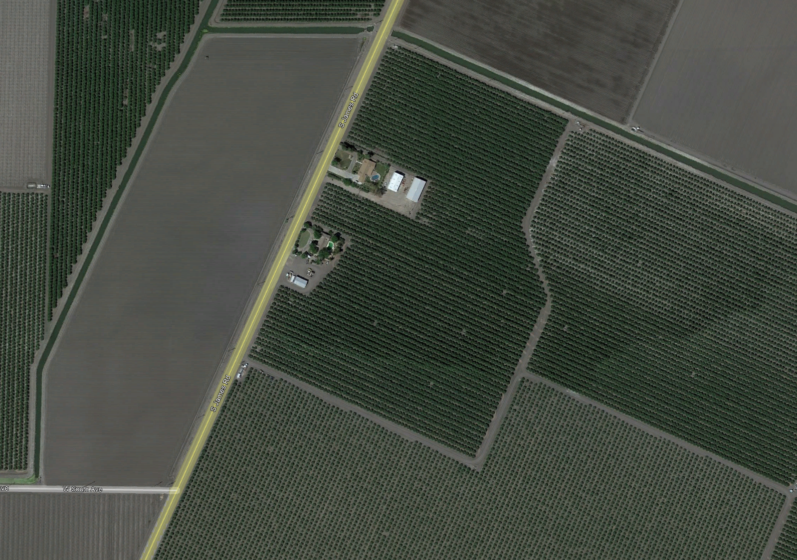
0.88 Acres
Subject parcel 20.88 acres

Slide 3
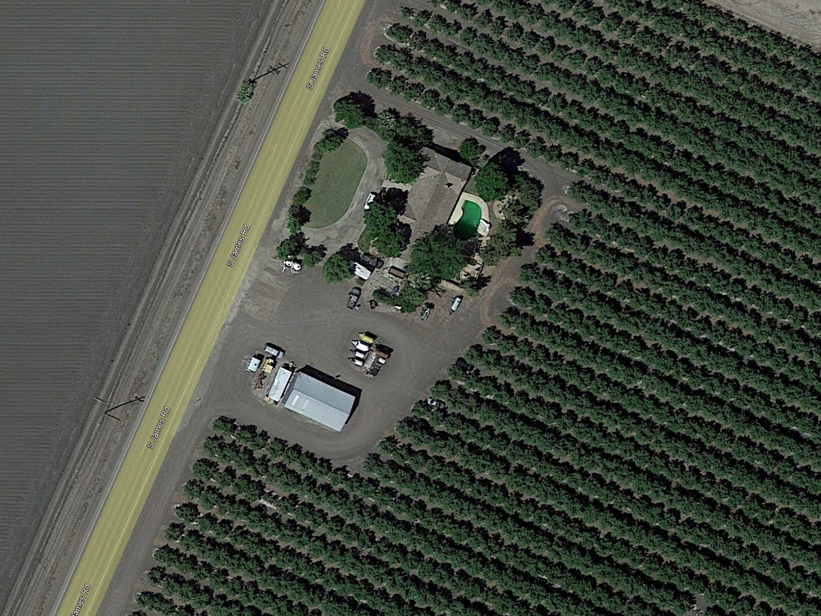
Proposed 0.88-acre parcel
Proposed 20.0-acre parcel

Slide 4
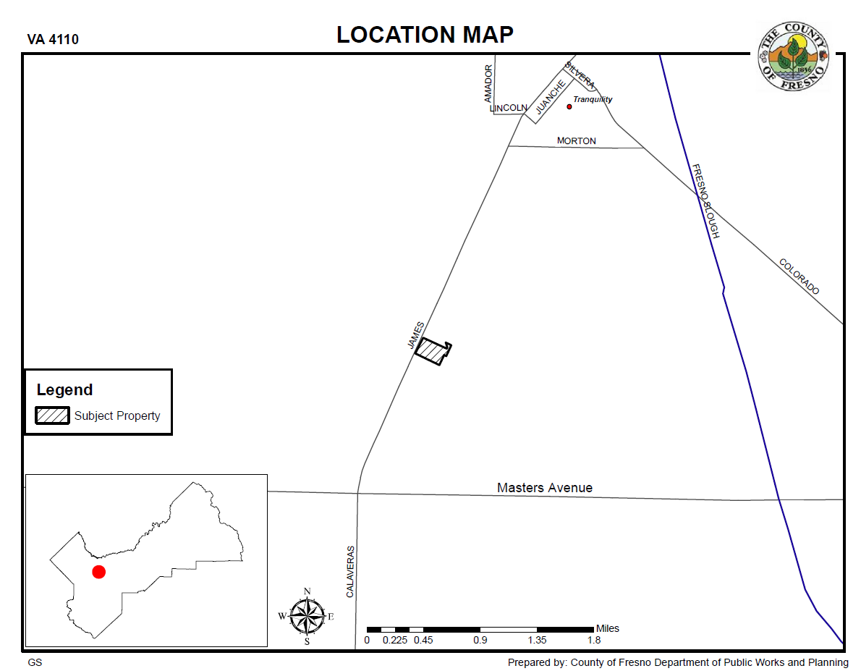

Slide 5
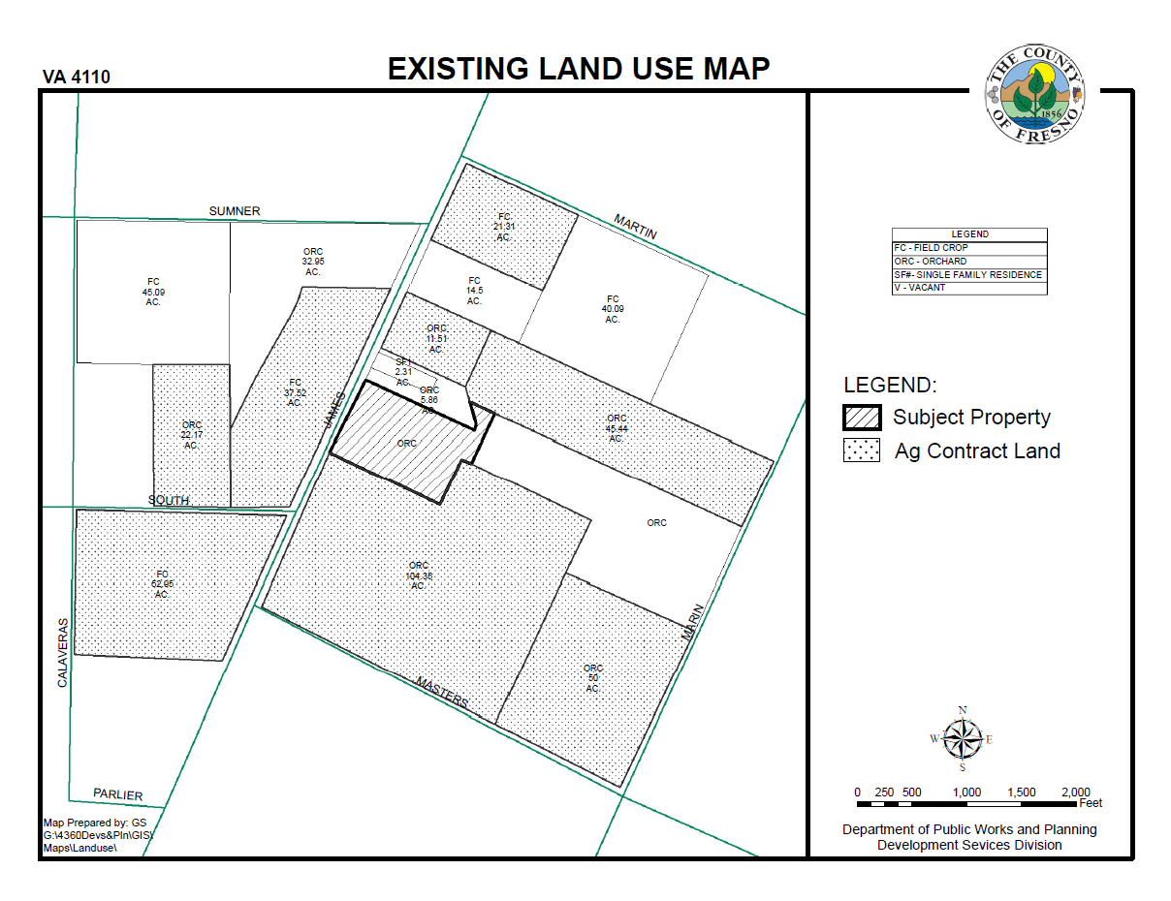

Slide 6
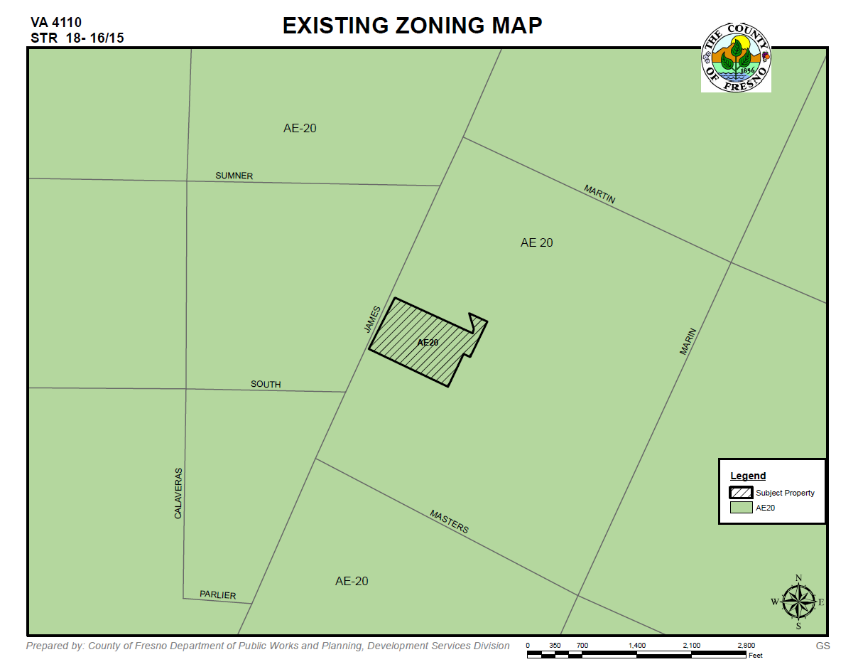

Slide 7
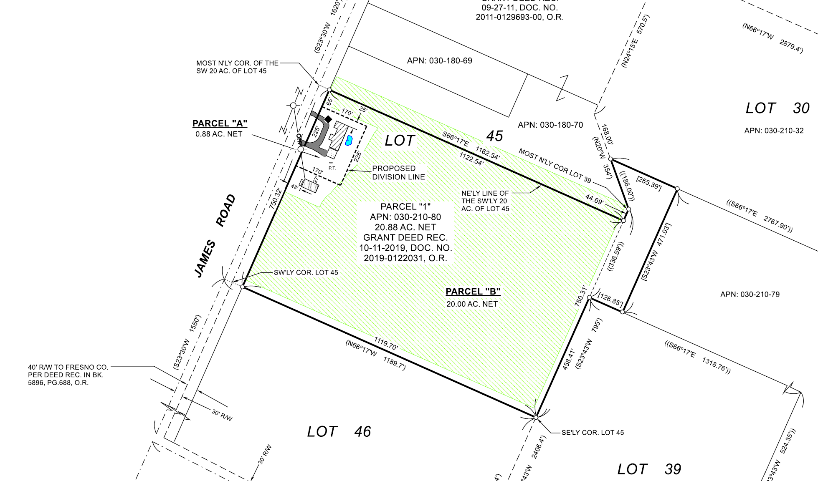

Slide 8
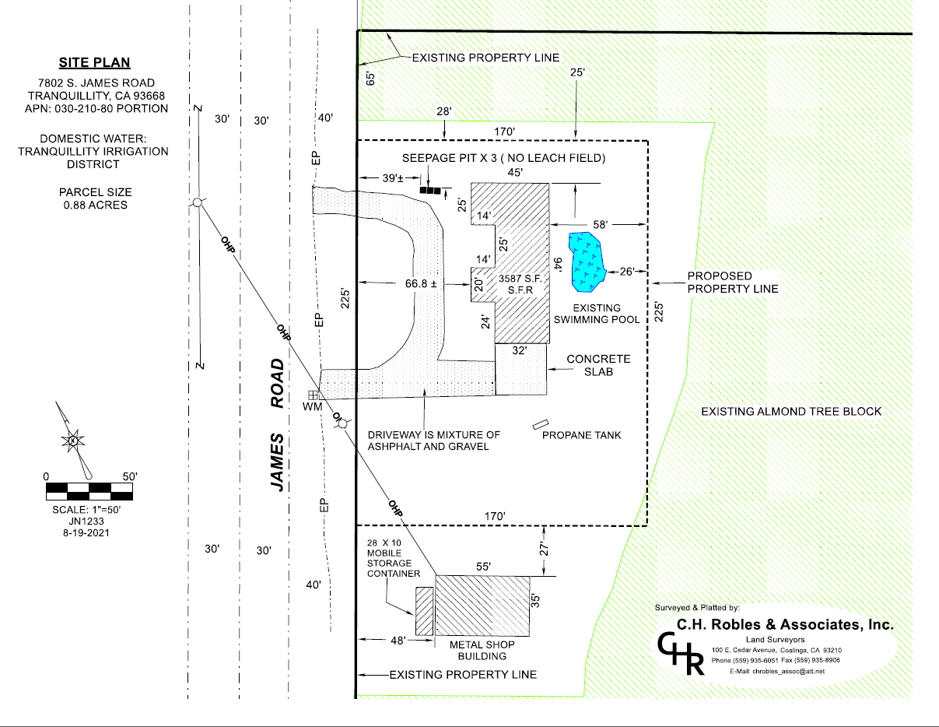

Slide 9
Proposed 0.88-acre parcel
Variance Findings
There are exceptional or extraordinary circumstances or conditions applicable to the property involved which do not apply generally to other properties in the vicinity having the identical zoning classification.
Such variance is necessary for the preservation and enjoyment of a substantial property right of the applicant, which right is possessed by other property owners under like conditions in the vicinity having the identical zoning classification.
The granting of the variance will not be materially detrimental to the public welfare or injurious to property and improvement in the vicinity having the identical zoning classification.
The granting of such a variance will not be contrary to the objectives of the General Plan.
Proposed 20.0-acre parcel

Slide 10
DEPARTMENT of PUBLIC WORKS and PLANNING
DEVELOPMENT SERVICES DIVISION
VA 4110

Slide 11
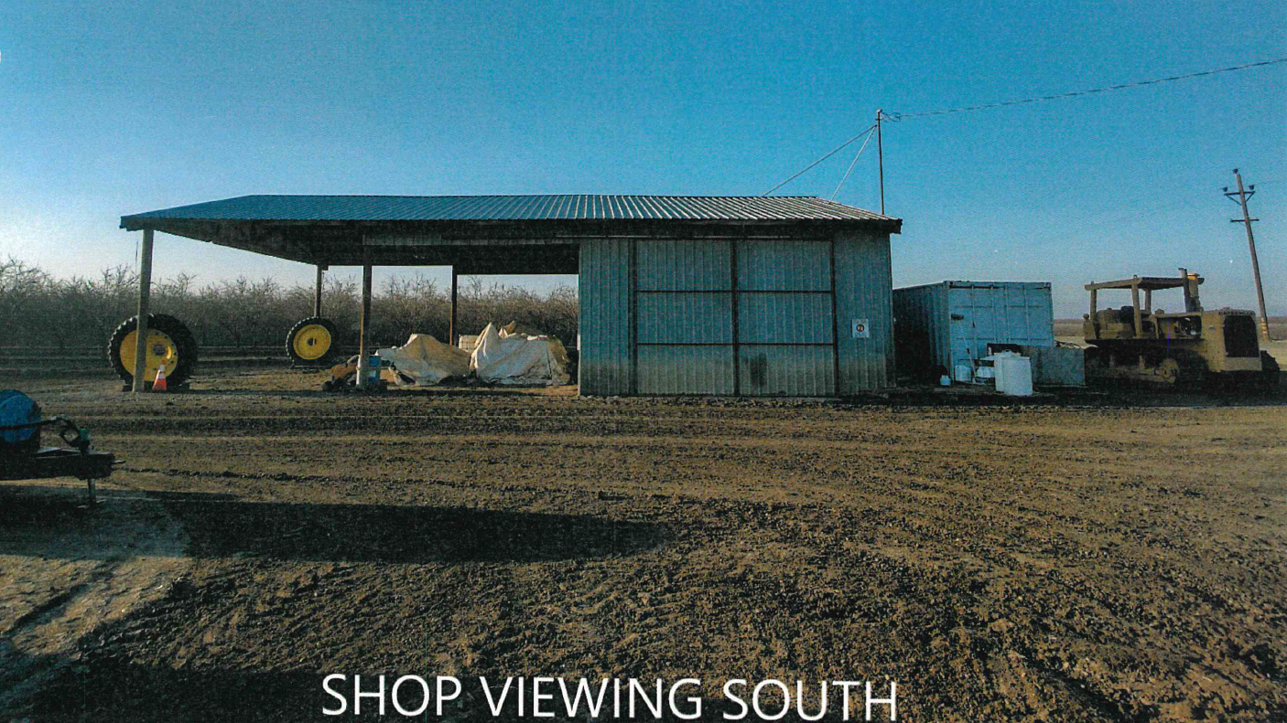

Slide 12
Residence viewing northeast

