Slide 1
NOTICE OF ADVERSE BENEFIT DETERMINATION TRAINING FOR DIRECT SERVICE PROVIDERS
Fresno County Mental Health Plan
Revision Date 12/10/2021

Slide 2
Training Goal & Objectives
Goal
Improve your understanding of Notice of Adverse Benefit Determination (NOABD) requirements and utilization of templates.
Objectives
Learn the background and purpose of a NOABD.
Know the different types of NOABDs.
Know when to complete a NOABD.
Know the steps to complete a NOABD, both electronically and manually.

Slide 3
Background & Purpose
In 2018, the Department of Health Care Services (DHCS) issued MHSUDS Information Notice No.: 18-010E. The information notice updated Notice of Action (NOA) templates and renamed them Notice of Adverse Benefit Determination (NOABD).
A NOABD tells a Medi-Cal beneficiary (hereinafter referred to as a person served), in writing:
What we did (or if we did it in time).
Why we did it.
What they can do about it.
What their rights are and how we protect their rights.
Since a NOABD provides information to a person served about their appeal rights and other rights under the Medi-Cal program, you must make sure the person has active Medi-Cal coverage before issuing a NOABD. A NOABD is only required when Medi-Cal is primary.

Slide 4
Adverse Benefit Determinations
Effective July 1, 2021, all Fresno County Mental Health Plan (FCMHP) county-operated and contracted programs (including individual providers) are responsible for issuing a NOABD related to the following adverse benefit determinations:
The denial of a requested service, including determinations based on the type or level of service.
The reduction, suspension, or termination of a previously authorized service.
The failure to provide services in a timely manner.

Slide 5
Types of NOABDs
The NOABDs related to the adverse benefit determinations identified are:
NOABD Delivery System
NOABD Denial Notice
NOABD Termination Notice
NOABD Timely Access Notice
Combined into one NOABD

Slide 6
NOABD – Paper Templates
You may complete a NOABD using a paper template, but this requires additional work because some automatic functions will not be available to you. NOABD paper templates are fillable forms and available on the Department of Behavioral Health’s website: https://www.co.fresno.ca.us/departments/behavioral-health/home/providers/contract-providers/contract-provider-forms
(Departments » Behavioral Health » Providers » Contract Provider Resources)
If you complete a NOABD on paper, you must:
Retain a copy of the NOABD and place it in the person’s served chart.
Send a copy of the NOABD and all the required enclosures to Managed Care within one business day to:
Mail: Fresno County Managed Care
PO Box 45003
Fresno, CA 93718-9886
Email: mcare@fresnocountyca.gov, Attn: “NOABD Submission – Provider Name”
Emails must be encripted or password-protected.

Slide 7
NOABD – Electronic Templates
If you have access to FCMHP’s “Avatar”, it is strongly recommended that you complete the NOABD in Avatar so that you are not required to retain a copy of the NOABD in the person’s served chart or send a copy to Managed Care.
To complete a NOABD in Avatar:
1. Log into Avatar.
2. Search forms for “NOABD”.
3. Select one of the NOABD types.
4. Click “Open”.
5. Select your program.
6. Click “Select”.
7. Your program will be identified on top left corner.
8. Click “add”.

Slide 8
NOABD – Electronic Templates
When using Avatar, please remember:
You will need the following information to access the NOABD in Viewer:
The program code that the notice was created under.
The language that the notice was created using.
The LetterID, which is the unique identifier that the NOABD is attached to.
When you select a program, you must use your program/organization’s billing program code instead of a generic code.
When you create a NOABD, you may view/distribute it in English, Spanish or Hmong.
You may create a NOABD in Avatar, even if the person served does not have an Avatar ID.
The first time you complete a NOABD in Avatar, it takes approximately 15 minutes to generate the notice. The second time, it takes less than one minute.
To delete a NOABD in Avatar, email the NOABD type, LetterID or name of person served, program code and language to kammonds@fresnocountyca.gov.

Slide 9
When To Send a NOABD Delivery Notice
Is Medi-Cal the primary payer for the person served?
Is the person served considered “new” to FCMHP?
Is the person served requesting mental health services?
Is the initial screening, pre-assessment?
Is the type of service being requested a non-specialty mental health service?
If you answer yes to all the questions above, a staff member within the assigned program will:
Complete the combined NOABD Denial Notice/Delivery System (Select Option #1).
Within two business days, provide it to a person served in person, by mail or through an encrypted/password protected email.

Slide 10
When To Send a NOABD Denial Notice
Is Medi-Cal the primary payer for the person served?
Is the person served considered “new” to FCMHP?
Is the person served requesting mental health services?
Did you complete a mental health assessment?
Did the assessment determine that the person served does not meet the criteria to be eligible for specialty mental health services though the FCMHP?
Is the person served over age 21?
Note: Under Early & Periodic Screening, Diagnosis & Treatment, children and adolescents under age 21 may meet criteria for specialty mental health services regardless of the level of severity of their mental health needs. As such, many children with impairments that may be considered mild or moderate meet medical necessity criteria to access SMHS, and these services are to be provided by FCMHP.
If you answer yes to all the questions above, a staff member within the assigned program will:
Complete the combined NOABD Denial Notice/Delivery System (Select Option #2, #3, #4, or #5).
Within two business days, provide it to a person served in person, by mail or through an encrypted/password protected email.

Slide 11
NOABD Delivery System/Denial Notice - Scenarios
Scenario 1: Person calls in asking for legal advice only and we refer them to legal resources – NOABD not required because the person is not requesting mental health services.
Scenario 2: Person calls in for mental health services and does not have Medi-Cal, only Medicare, and we refer them to community mental health services, - NOABD not required because the person does not have Medi-Cal.
Scenario 3: Person calls in for mental health services and we refer them to mild to moderate community services and we are unable to get their address for some reason – NOABD is required and must be created but it does not have to be mailed.
Scenario 4: Person calls in for mental health services, they are over the age of 21, have primary Medi-Cal and we have their address, but we refer them to mild to moderate resources in community – NOABD is required.

Slide 12
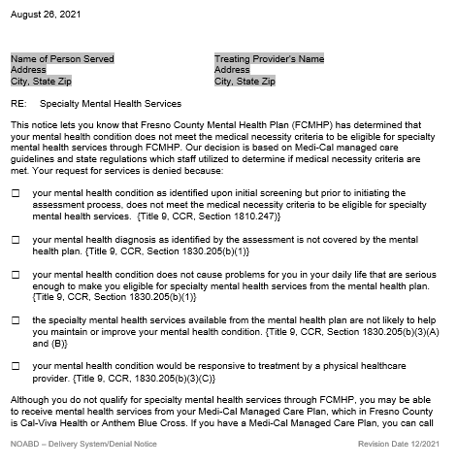
NOABD Delivery System/Denial Notice (Paper Template)
Select Issue Date.
Person Served:
For an adult, type the name of the adult.
For a minor, type “To the parent or guardian of ….”
For the address, type the mailing address. If there is no address on file, you must still create and save the NOABD, but you do not have to mail it.
Treating Provider: Type your, the group, or the organization’s information.
Select the Check Box option that states why the mental health condition did not meet medical necessity criteria to be eligible for specialty mental health services through FCMHP.
For NOABD Delivery Notice, select Option #1
For NOABD Denial Notice, select Option #2, #3, #4, or #5

Slide 13
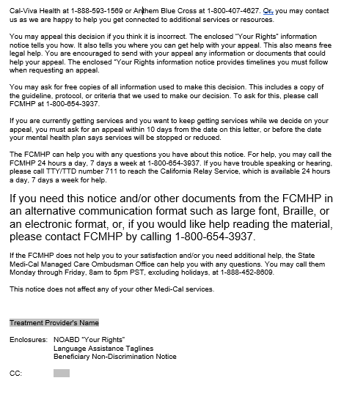
NOABD Delivery System/Denial Notice (Paper Template)
Type your, the group, or the organization’s information.
Indicate if copy of NOABD sent to another addressee, if applicable.

Slide 14
NOABD Delivery System/Denial Notice (Avatar Version)
Enter date.
Does person served have a PATID?
If yes, use person served look up.
If no, enter information manually.
Select the Service Denial Reason.
Proofread - There is no spelling or grammar check so please make sure information entered is accurate.
Click Submit.
Once the notice generates, you can print and issue or export to PDF and email.

Slide 15
When To Send a NOABD Termination Notice
Is Medi-Cal the primary payer for the person served?
Is there an active treatment plan?
Are you terminating, suspending, or reducing one or more service(s) in the active treatment plan?
Does the person served disagree with your decision?
If you answer yes to all the questions above, a staff member within the assigned program will:
Complete the NOABD Termination Notice.
Within two business days, provide it to a person served in person, by mail or through an encrypted/password protected email.

Slide 16
NOABD Termination Notice
Common scenarios include when the person served is:
Not participating/engaging in treatment.
Not adhering to program rules.
No longer meeting medical necessity for SMHS and does not agree with the transition to lower levels of care.
The NOABD Termination Notice and the 10-Day Discharge Letter have been merged. If the NOABD Termination Notice is not required, it may still be issued as an alternative to the 10-Day Discharge Letter.

Slide 17
NOABD Termination Notice
Exceptions to the 10-day notification are allowed under 42 CFR 431.213.
You do not have to issue a NOABD Termination Notice if the following applies:
Confirmed death of the person served.
Person served provided a written statement declining further services.
Ineligibility for further services (such as, loss of Medi-Cal).
A change in the level of medical care is prescribed by the person’s served physician (facility Medical Director).
The person’s served whereabouts are unknown with no known address and failed outreach efforts.
If person served verbally declines further services, a NOABD Termination Notice is not required because they agree with the termination.

Slide 18
NOABD Termination Notice
Exceptions to the 10-day notification are allowed under 42 CFR 431.214:
Advance notice may be shortened to five days before the date of action if ‒
The Department of Behavioral Health has facts indicating that action should be taken because of probable fraud by the person served; and
The facts have been verified, if possible, through secondary sources.

Slide 19
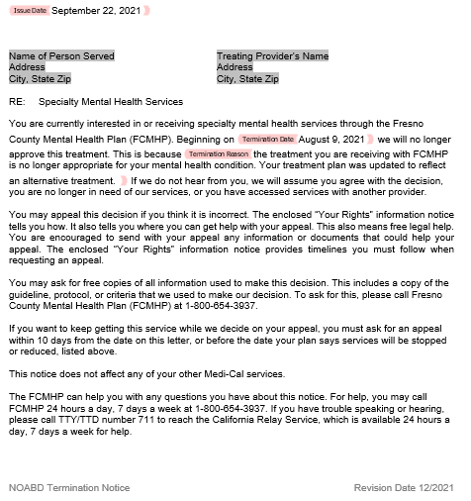
NOABD Delivery Termination Notice (Paper Template)
Select the termination date, which is the effective date of the termination. Do not provide a termination date earlier than 10 days unless it falls under one of the exceptions. The day the NOABD is issued, counts as Day 1. By adding 10 to the starting number, you will get the correct termination date. The count is based on calendar days.
Select one of the following reasons from the drop-down list:
We have not been able to reach you. We would like a chance to be able to meet with you to discuss your request for services. Please contact us if you are still interested in receiving services.
You do not have any future appointments scheduled at this time. If you are still interested in receiving services, please contact us to schedule an appointment.
Your mental health condition has improved and no longer meets the medical necessity for specialty mental health services. Please contact us as we are happy to help you get connected to additional services or resources.
You are not participating/engaging in treatment. The focus of the FCMHP is to support you in reaching your wellness goals. Please contact us if you are still interested in reaching your wellness goals.
You have not been adhering to program rules. Adhering to program rules is an important factor in the treatment outcome of any mental health condition. Please contact us if you are still interested in receiving services.
The treatment you are receiving with FCMHP is no longer appropriate for your mental health condition. Your treatment plan was updated to reflect an alternative treatment.

Slide 20
NOABD Termination Notice (Avatar Version)
Enter date.
Does person served have a PATID?
If yes, use person served look up.
If no, enter information manually.
Enter the Termination Date.
Select the Reason for Termination Notice.
Is the Decision Maker an Avatar User?
If yes, use Avatar User look up.
If no, enter the name of the individual, group, program or organization. You do not have to include title or direct line.
Proofread - There is no spelling or grammar check so please make sure the information entered is accurate.
Click Submit.
Once the notice generates, you can print and issue or export to PDF and email.

Slide 21
NOABD Timely Access
If FCMHP fails to offer services within a timely manner, a NOABD Timely Access Notice is required.
FCMHP must offer services within the standardize timelines below:
For an assessment - 10 business days from the initial request for services.
For psychiatric evaluation - 15 business days from the initial request for services.
For an urgent service that does not require prior authorization – 48 hours from the initial request for services.
For an urgent service that does require prior authorization – 96 hours from the initial request for services.
When the above requirement is met, a staff member within the assigned program will:
Complete the NOABD Timely Access.
Within 2 business days, provide it to a person served in person, by mail or through an encrypted/password protected email.

Slide 22
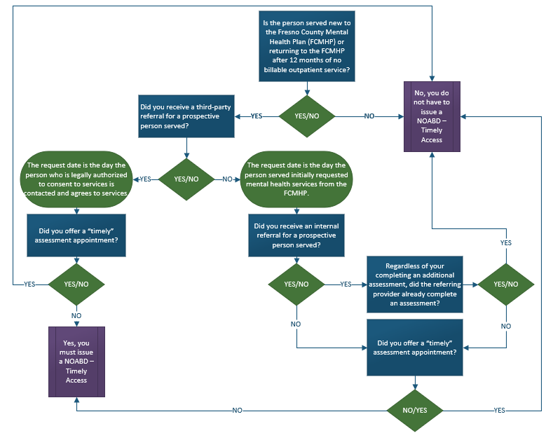
When To Send a NOABD Timely Access Notice

Slide 23
NOABD Timely Access - Scenarios
Scenario 1: If the assessment or psychiatric med evaluation appointment is not offered within 10 days/15 days then the NOABD Timely Access must be issued.
Scenario 2: If the assessment or psychiatric med evaluation appointment is offered within 10/15 days then the NOABD Timely Access need not be issued.
Scenario 3: If the assessment or psychiatric med evaluation appointment is offered within 10/15 days, but the person served declines the appointment then the NOABD Timely Access need not be issued.
NOABD Timely Access refers to the appointment being offered within the established time frames.

Slide 24
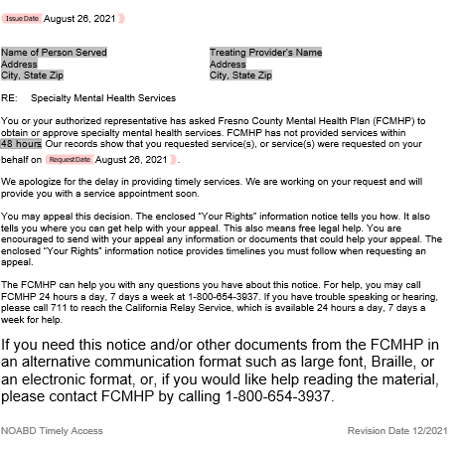
NOABD Timely Access (Paper Template)
Select one of the following reasons from the drop-down list:
48 hours
96 hours
10 working days
15 working days
Select Request Date. The Request Date is the date that the person served initially requested services OR the date that the person who is legally authorized to consent to services is contacted and agrees to service.

Slide 25
NOABD Timely Access Notice (Avatar Version)
Enter date.
Does person served have a PATID?
If yes, use person served look up.
If no, enter information manually.
Enter Service Request Date.
Select Days to meet timeliness.
Proofread - There is no spelling or grammar check so please make sure information entered is accurate.
Click Submit.
Once the notice generates, you can print and issue or export to PDF and email.

Slide 26
Required Enclosures
The NOABD “Your Rights Under Medi-Cal” attachment informs a person served of critical appeal and State hearing rights.
The “Nondiscrimination Notice” attachment provides information regarding the Mental Health Plan not discriminating based on race, color, national origin, sex, age, or disability.
The “Language Assistance” taglines provide prompts in multiple languages to alert persons served that documents are available in different languages at no cost to the them.
NOABDs revised 12/2021 include all required enclosures.

Slide 27
Completion of NOABDS
NOABDs and required enclosures are on State provided templates that have been customized for Fresno County users. Do not change anything outside of the grey boxes, including the letterhead.
Templates are available in the threshold languages of Fresno County (English, Hmong, and Spanish).
Large prints are available from Managed Care Division, upon request.
Do not use acronyms unless the word was previously spelled out somewhere in the NOABD.
Always proofread.

Slide 28
Mental Health Plan Contacts
For questions or training requests, please contact:
County-Operated Programs
Clinical Program Support, Keisha Ammonds
Email: kammonds@fresnocountyca.gov or Phone: (559) 600-6837
Individual and Group Contracted Providers
Managed Care Division, Bla Fang
Email: blafang@fresnocountyca.gov or Phone (559) 600-4646
Contracted Organizations
Contracted Services Division
Please contact your Contract Staff Analyst

