Slide 1
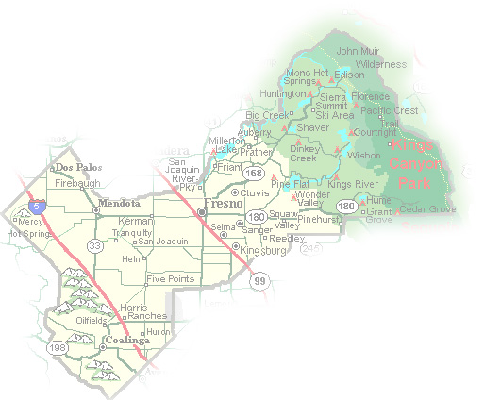
DEPARTMENT of PUBLIC WORKS and PLANNING
DEVELOPMENT SERVICES DIVISION
CUP 3681

Slide 2
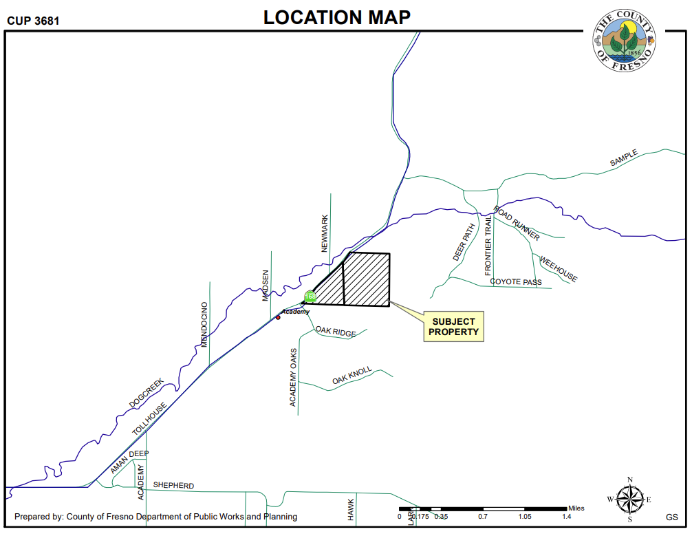

Slide 3
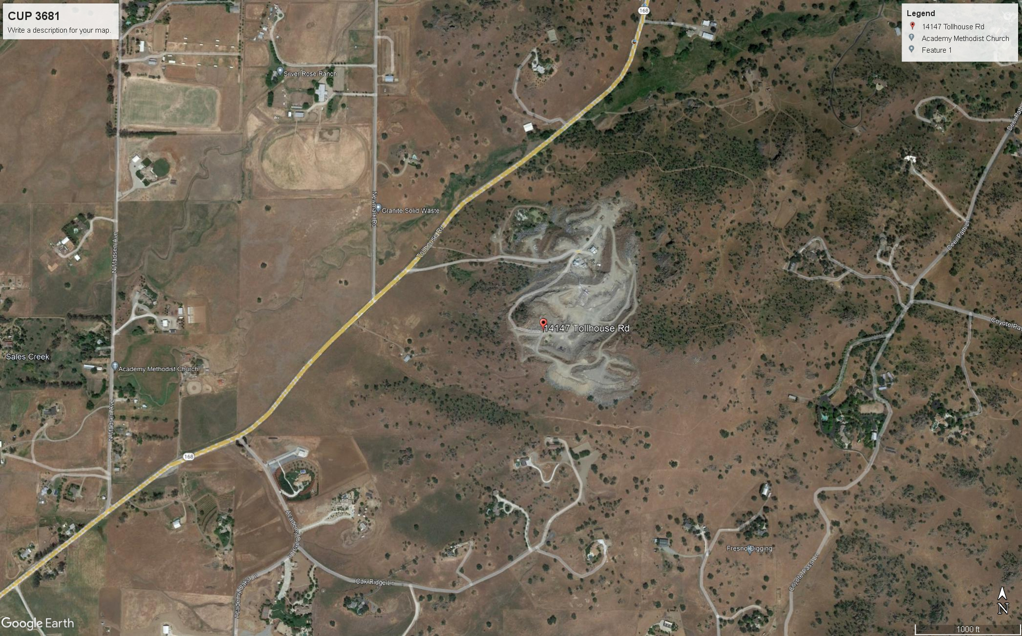
PROJECT SITE (142 Acres)
FINDINGS
Adequacy of Project Site
Adequacy of Streets and Highways
No Adverse Effects on Surrounding Properties
General Plan Consistency
Consistency with the County Mining Ordinance
Conditions to protect public health, safety and general welfare

Slide 4
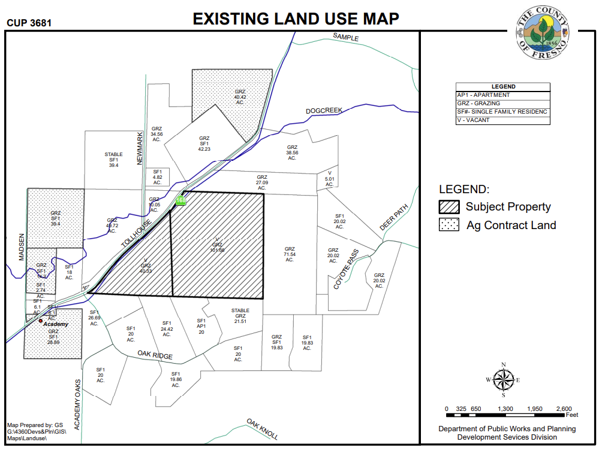

Slide 5
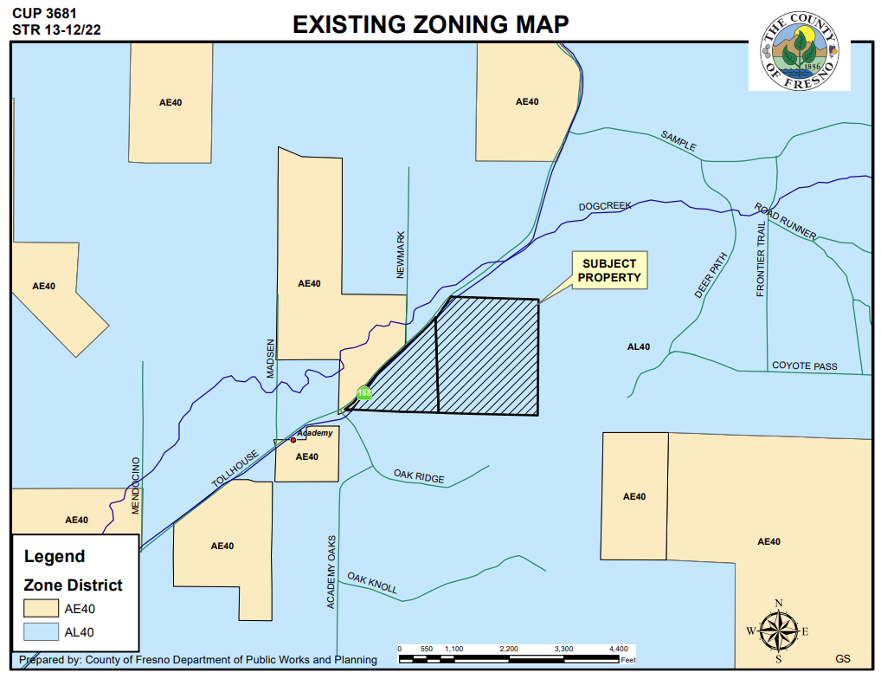

Slide 6
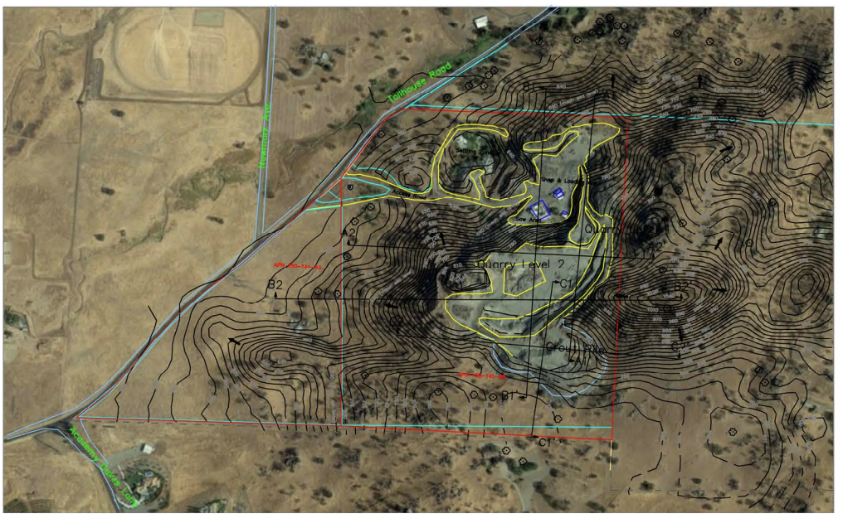
SOUTH VIEW
EAST VIEW
WEST View
NORTH VIEW

Slide 7
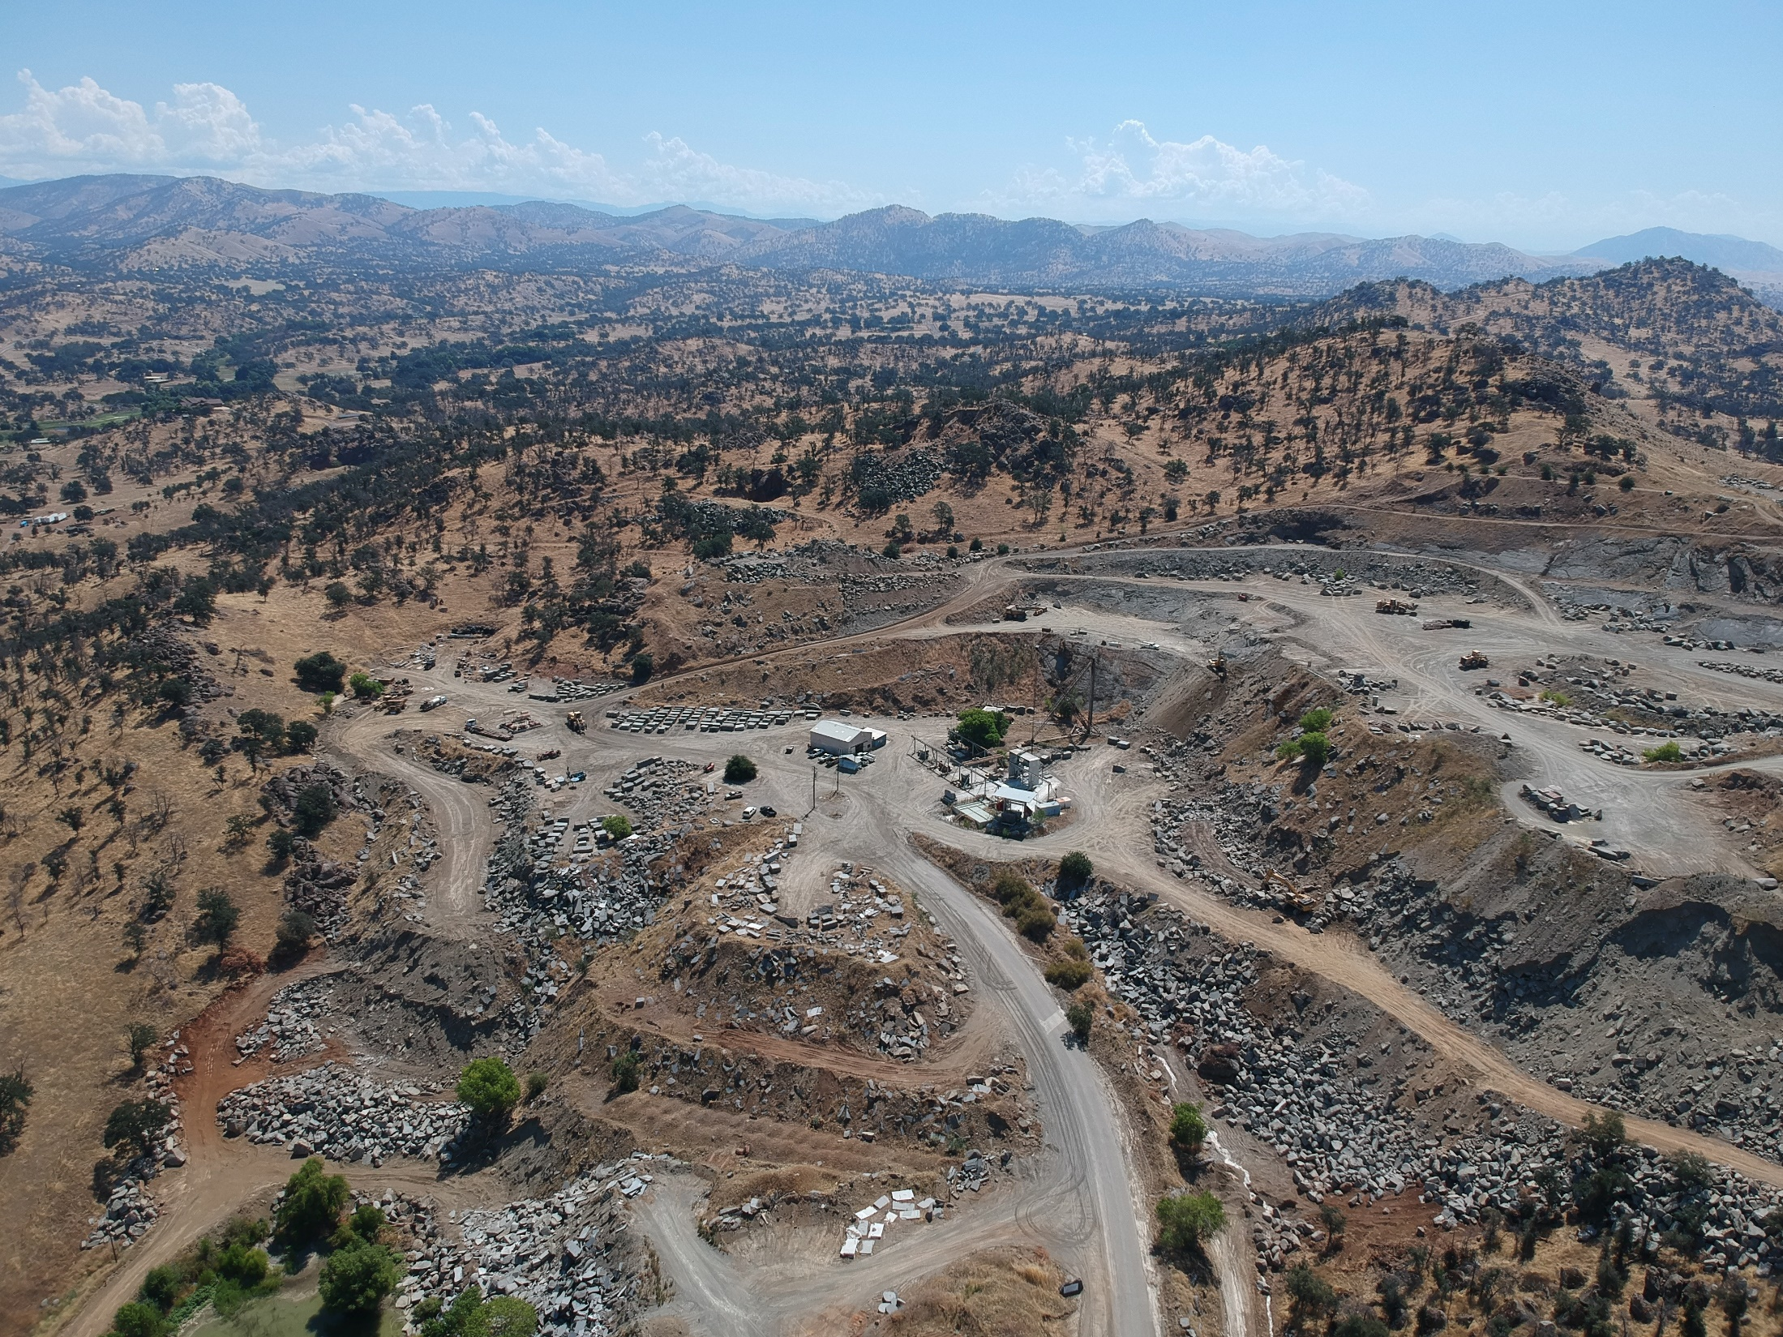
EAST VIEW

Slide 8
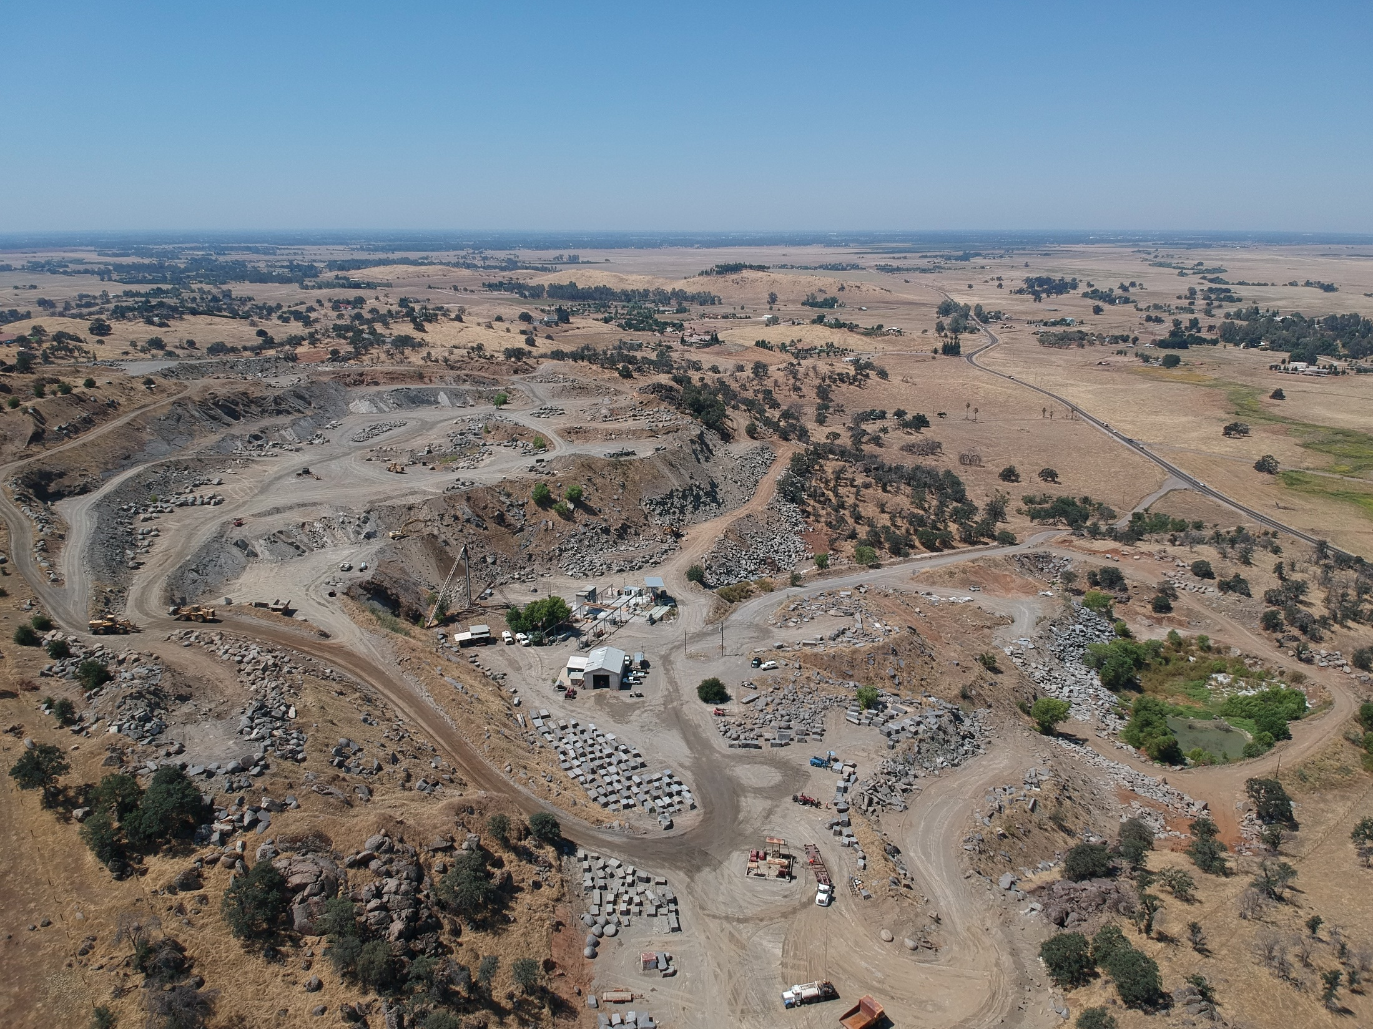
Tollhouse Road
SOUTH VIEW

Slide 9
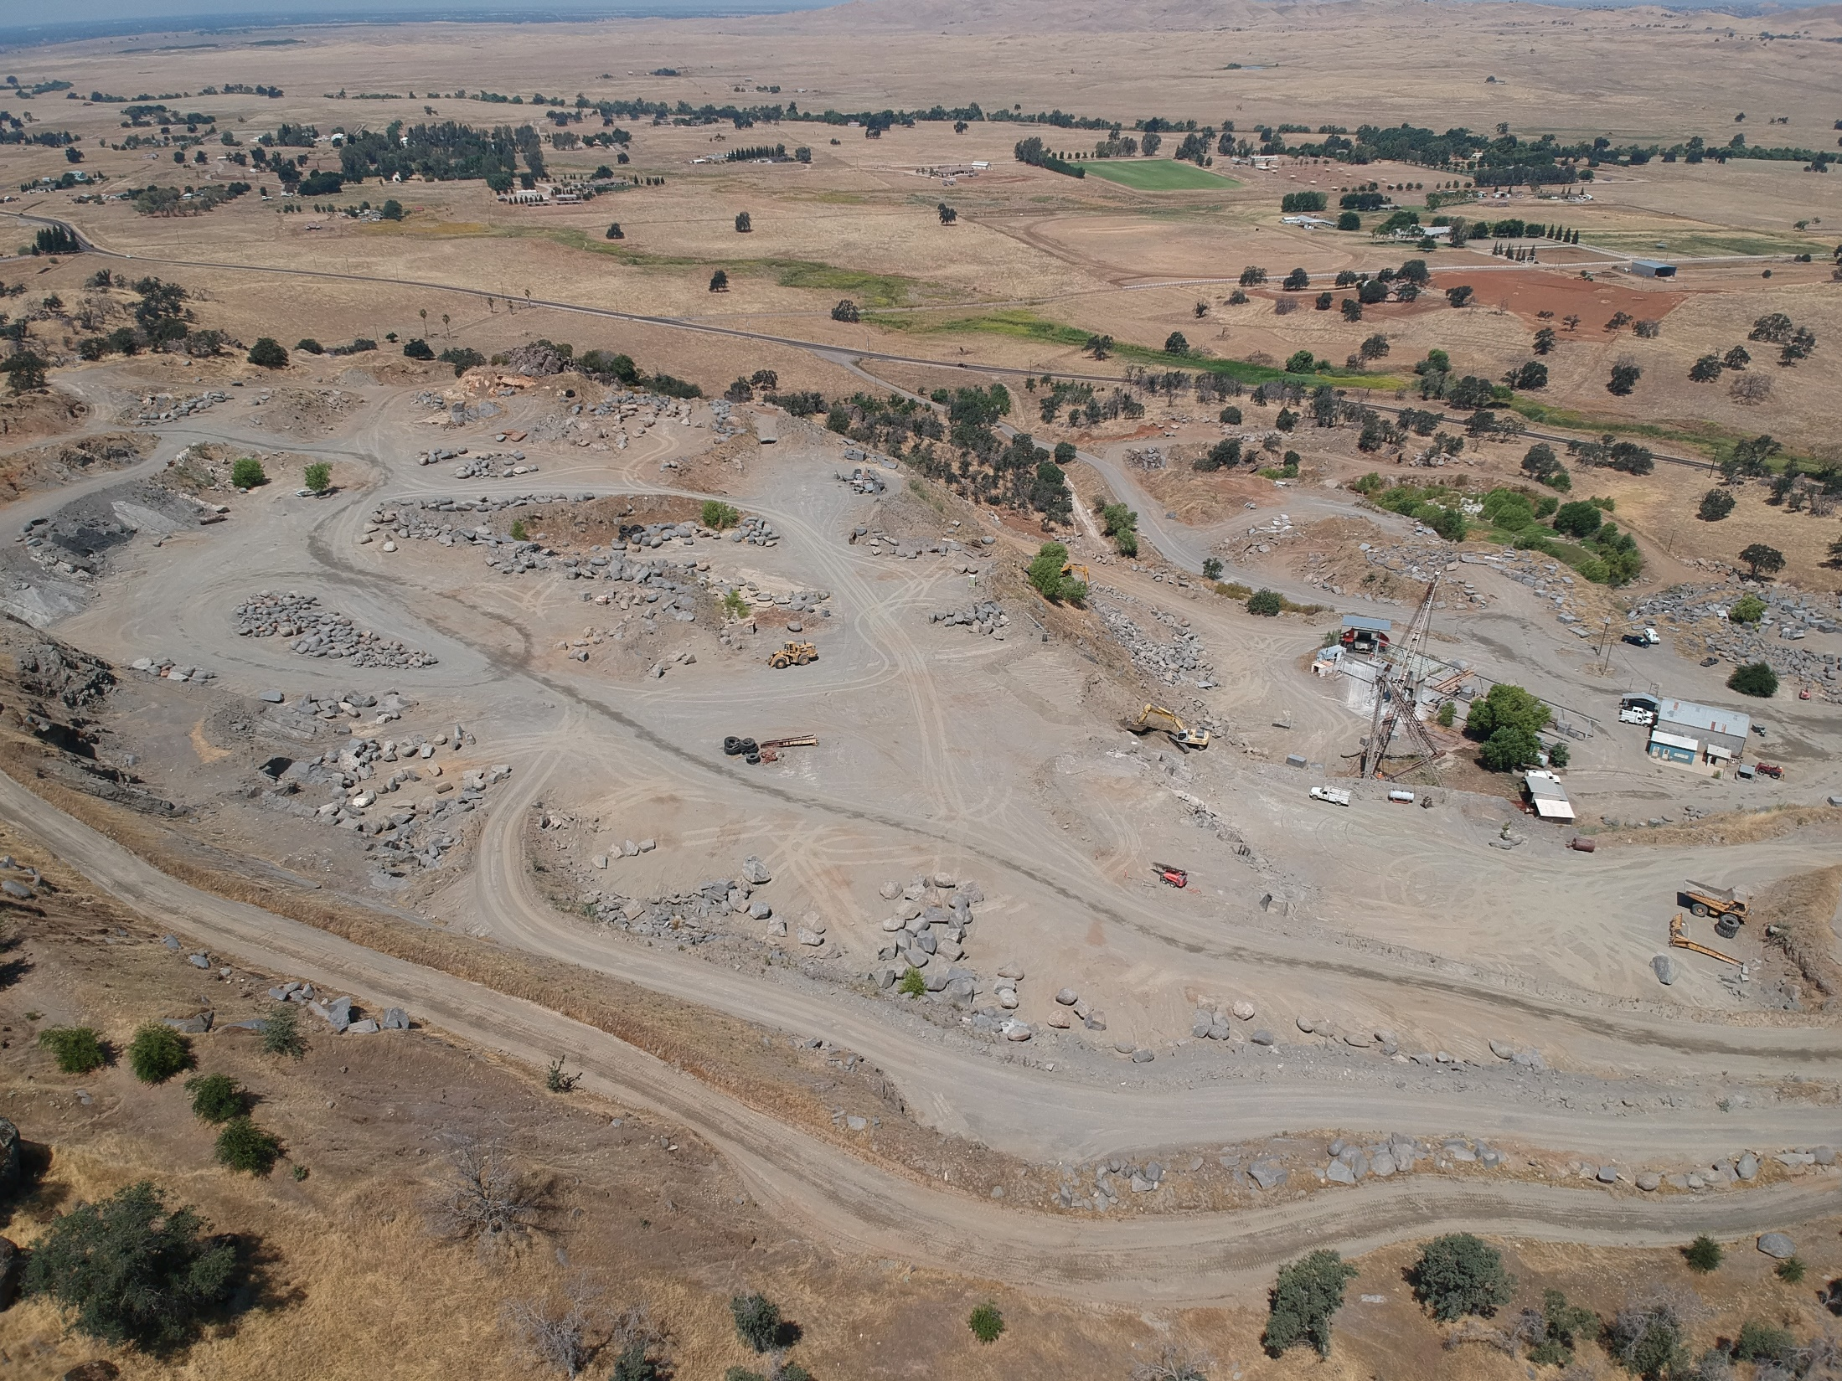
Tollhouse Road
WEST VIEW
Notes:
West View

Slide 10
PROJECT SITE (142 Acres)
FINDINGS
Adequacy of Project Site
Adequacy of Streets and Highways
No Adverse Effects on Surrounding Properties
General Plan Consistency
Consistency with the County Mining Ordinance
Conditions to protect public health, safety and general welfare

Slide 11
DEPARTMENT of PUBLIC WORKS and PLANNING
DEVELOPMENT SERVICES DIVISION
CUP 3681

Slide 12
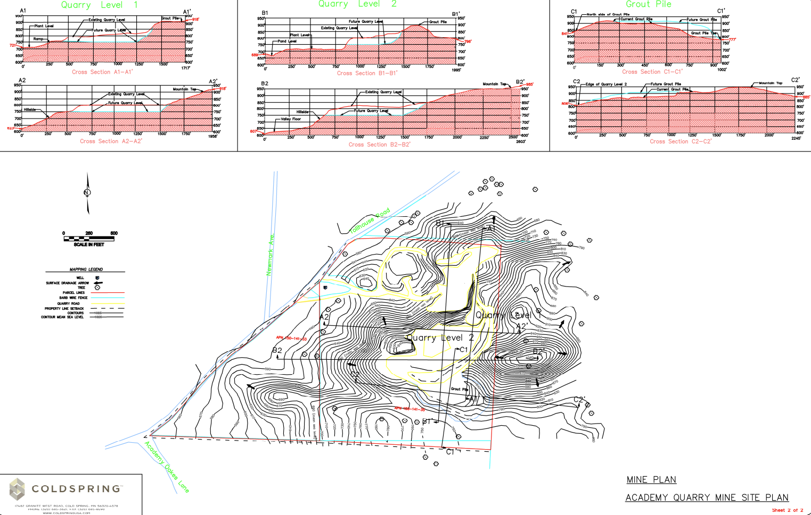

Slide 13
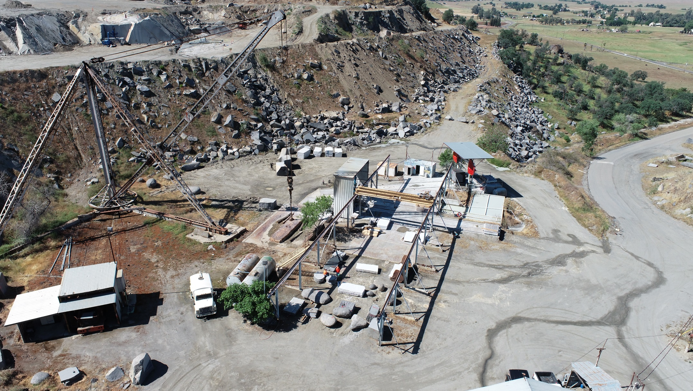

Slide 14
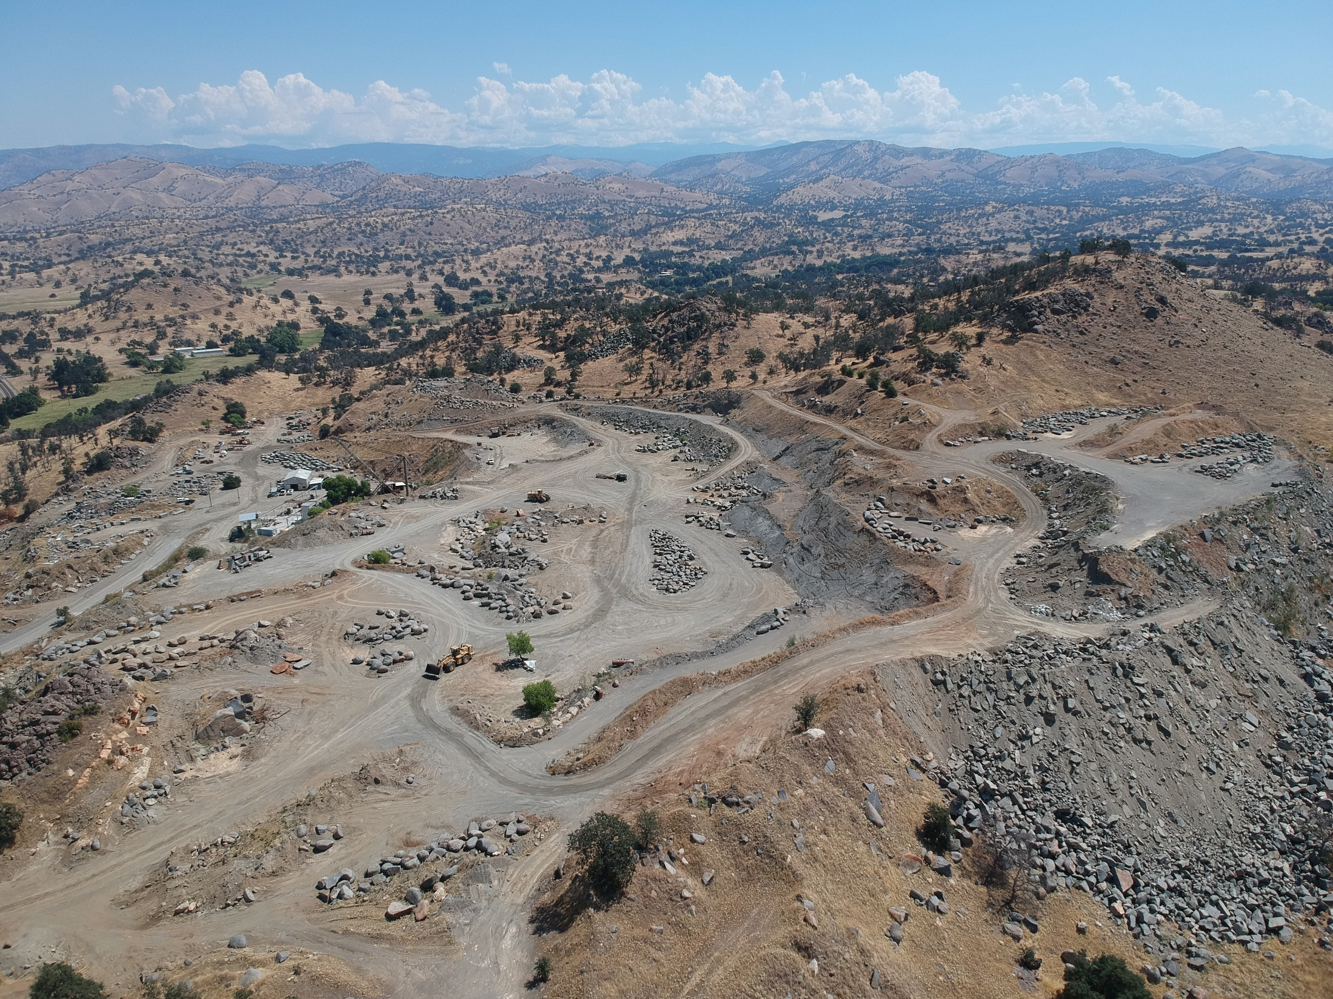

Slide 15
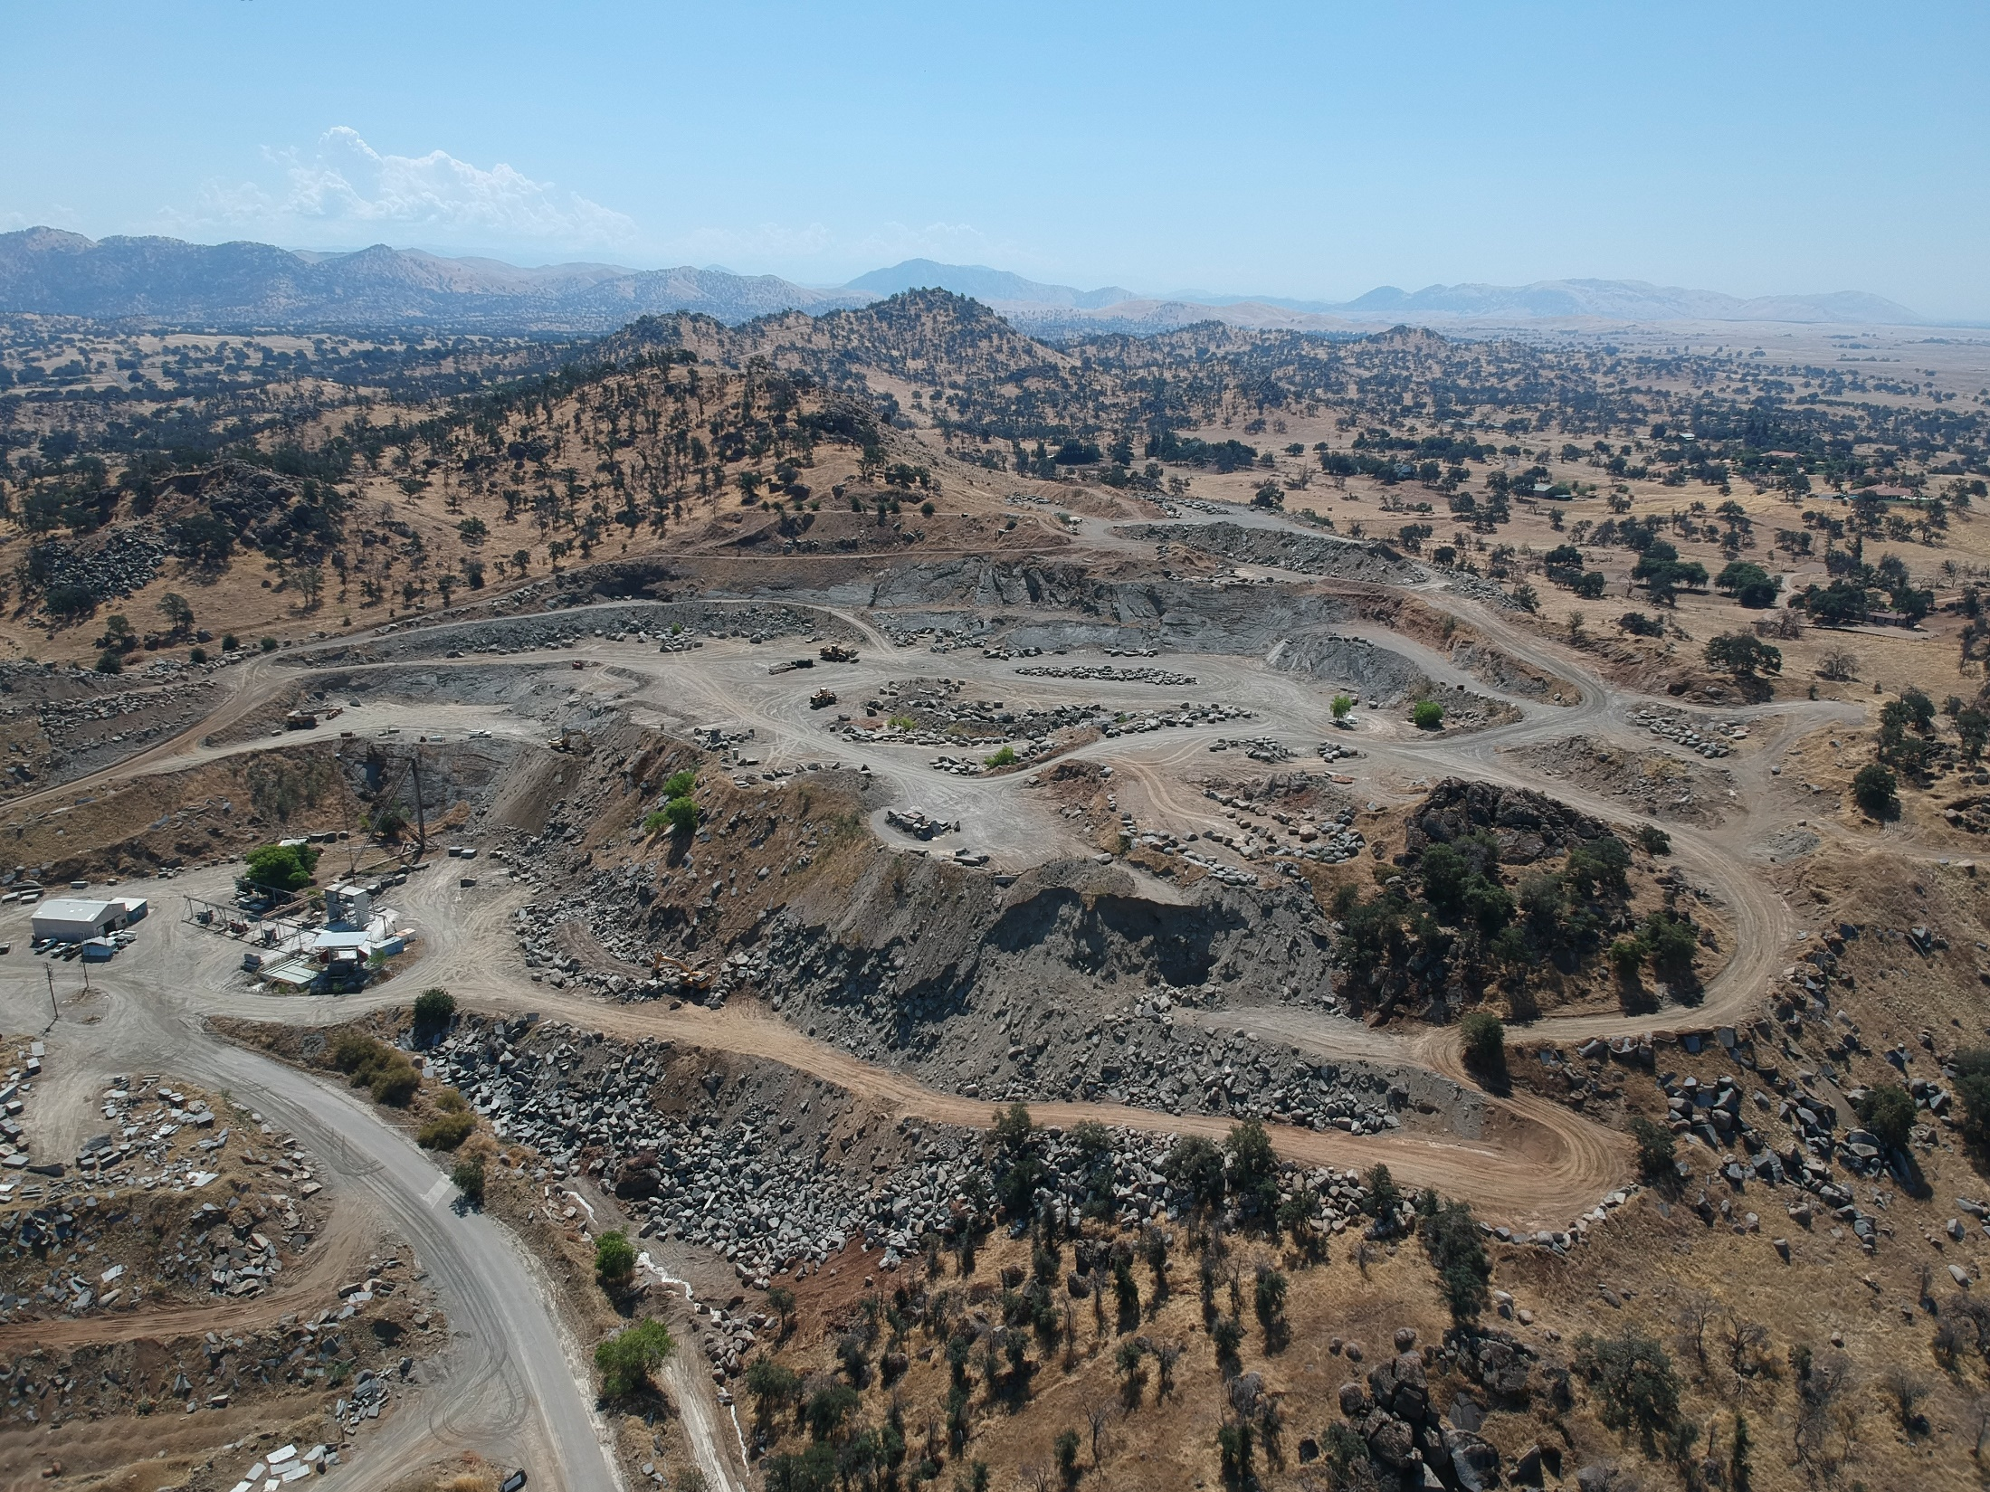

Slide 16
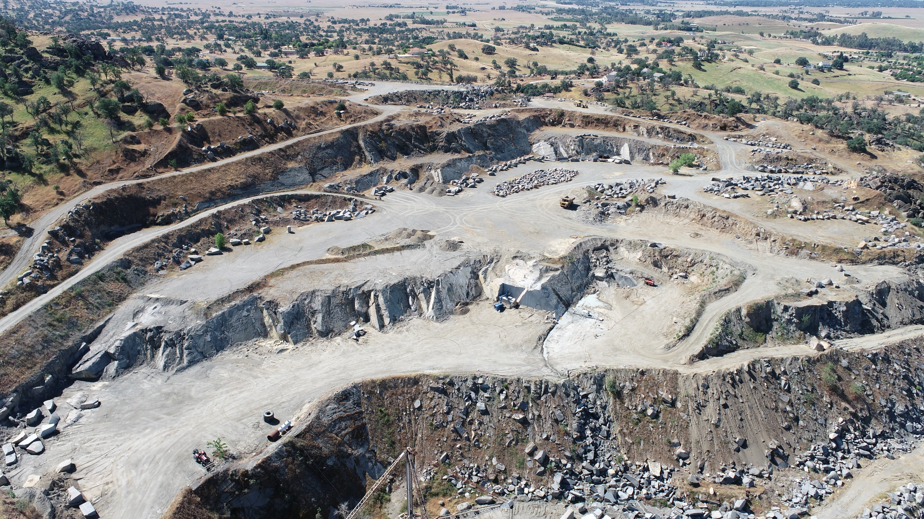

Slide 17
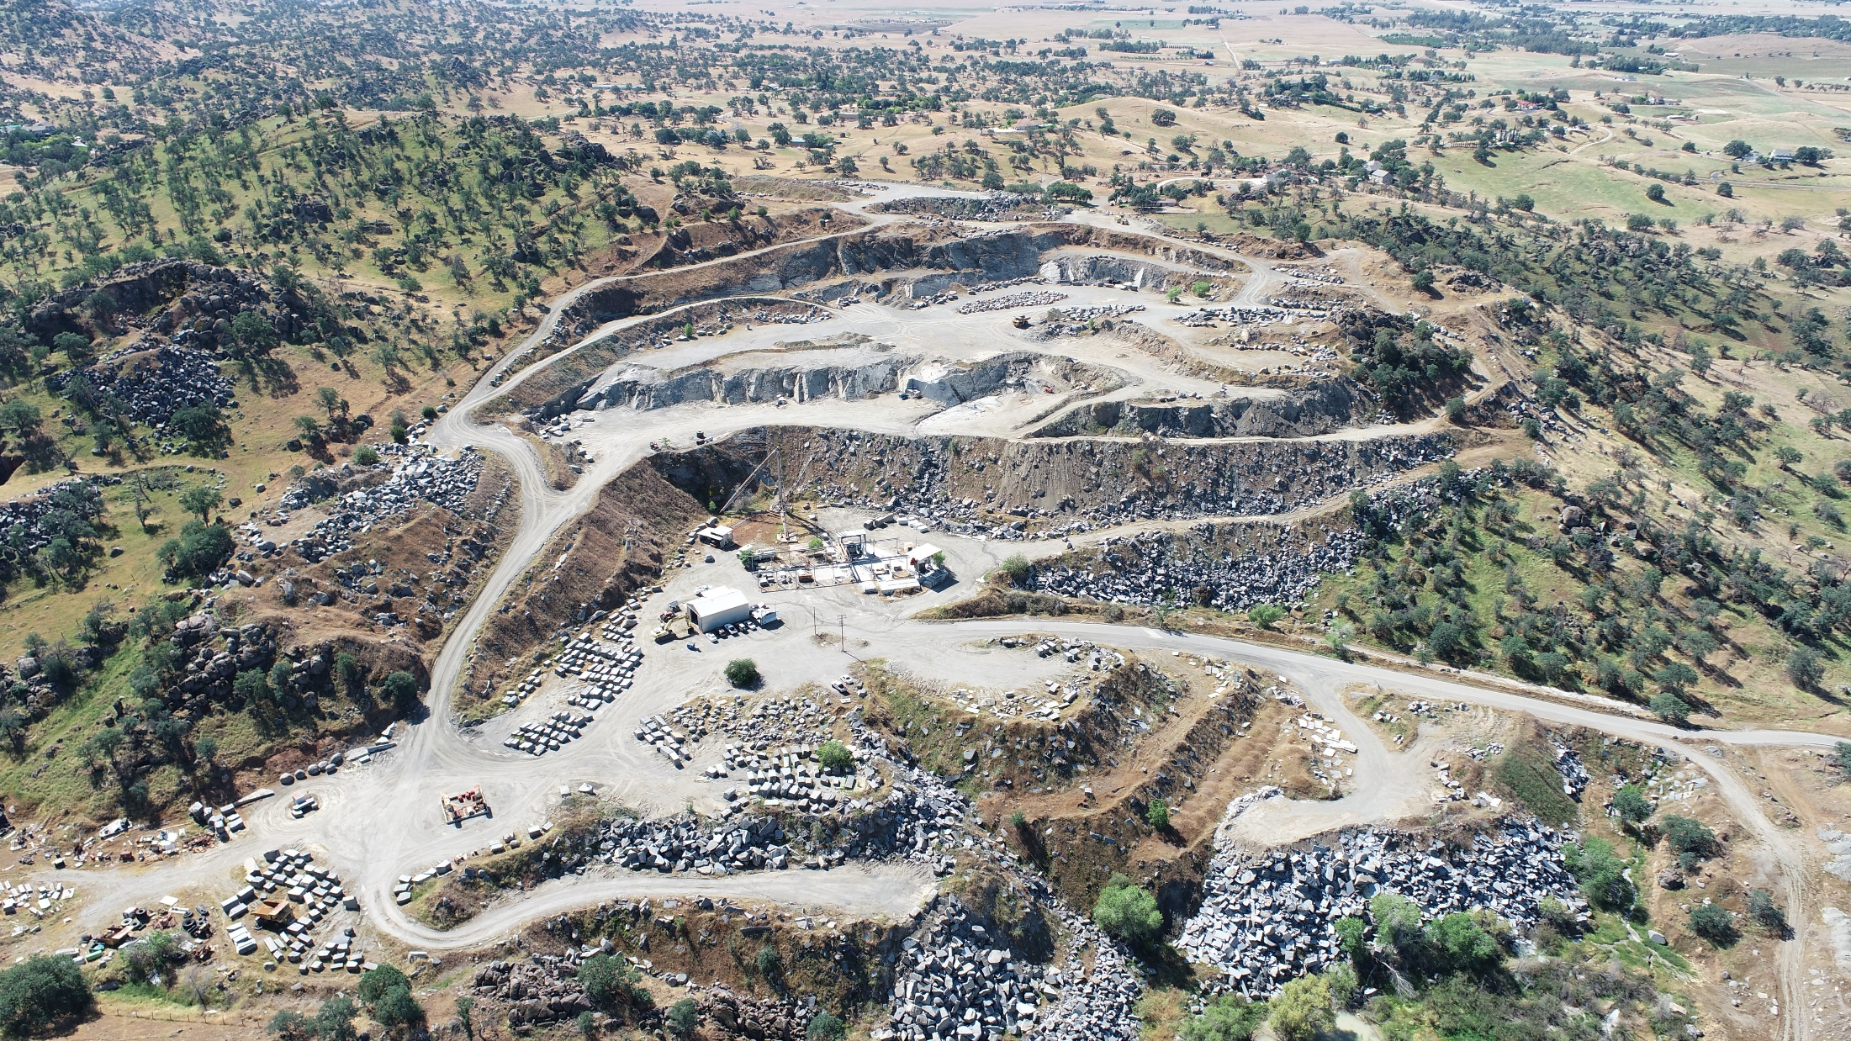

Slide 18
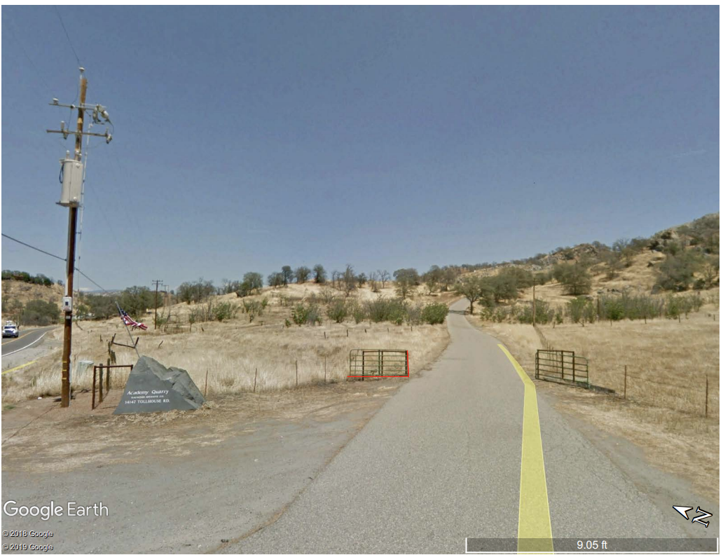

Slide 19
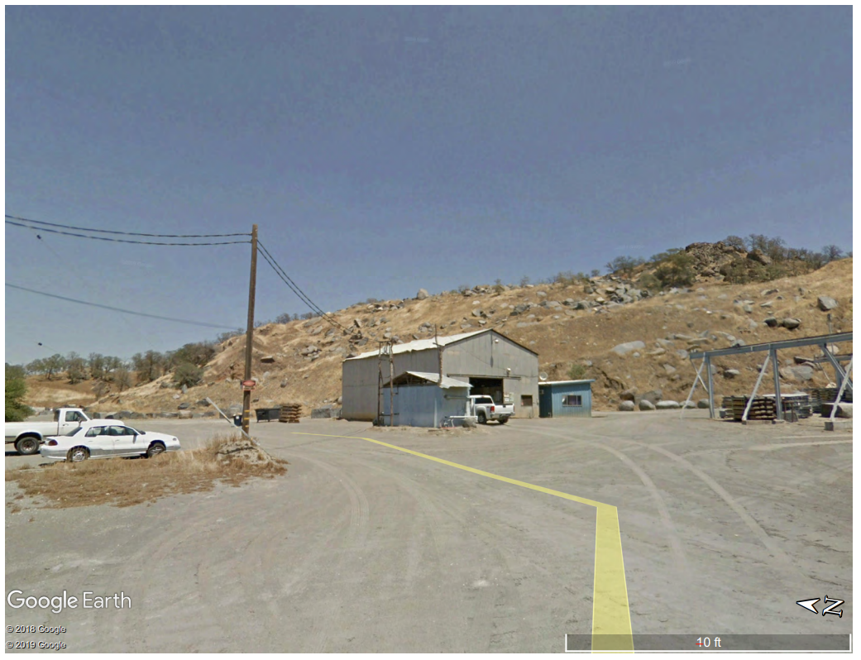

Slide 20
