Slide 1
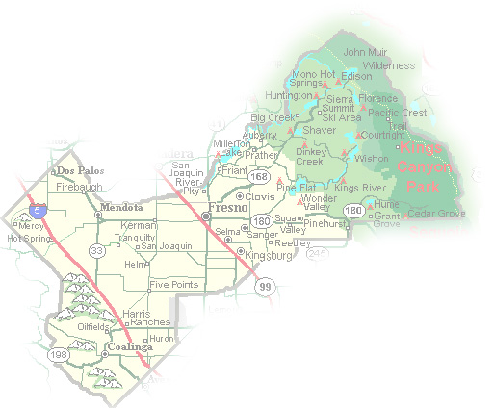
DEPARTMENT of PUBLIC WORKS and PLANNING
DEVELOPMENT SERVICES DIVISION
VA 4076

Slide 2
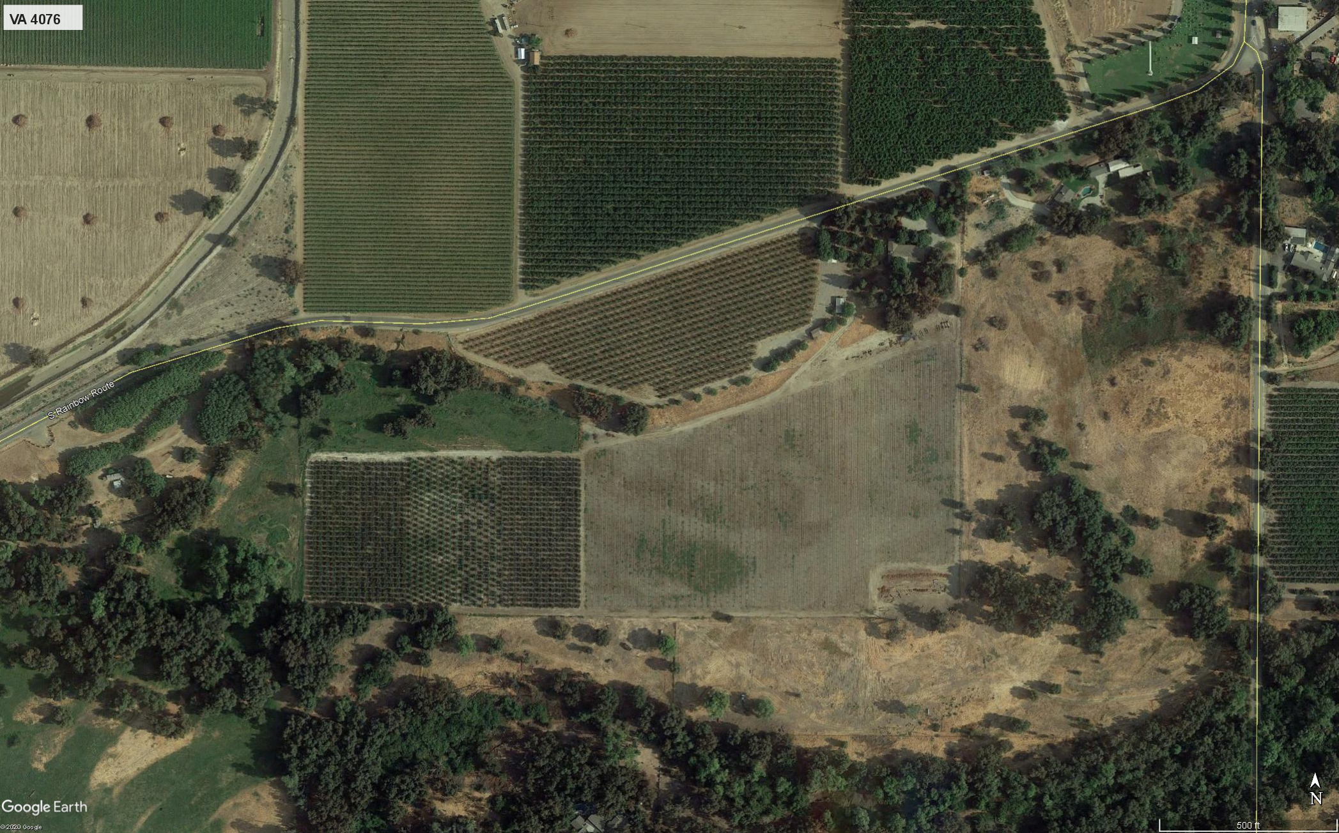
Approximate Location of Subject Parcel

Slide 3
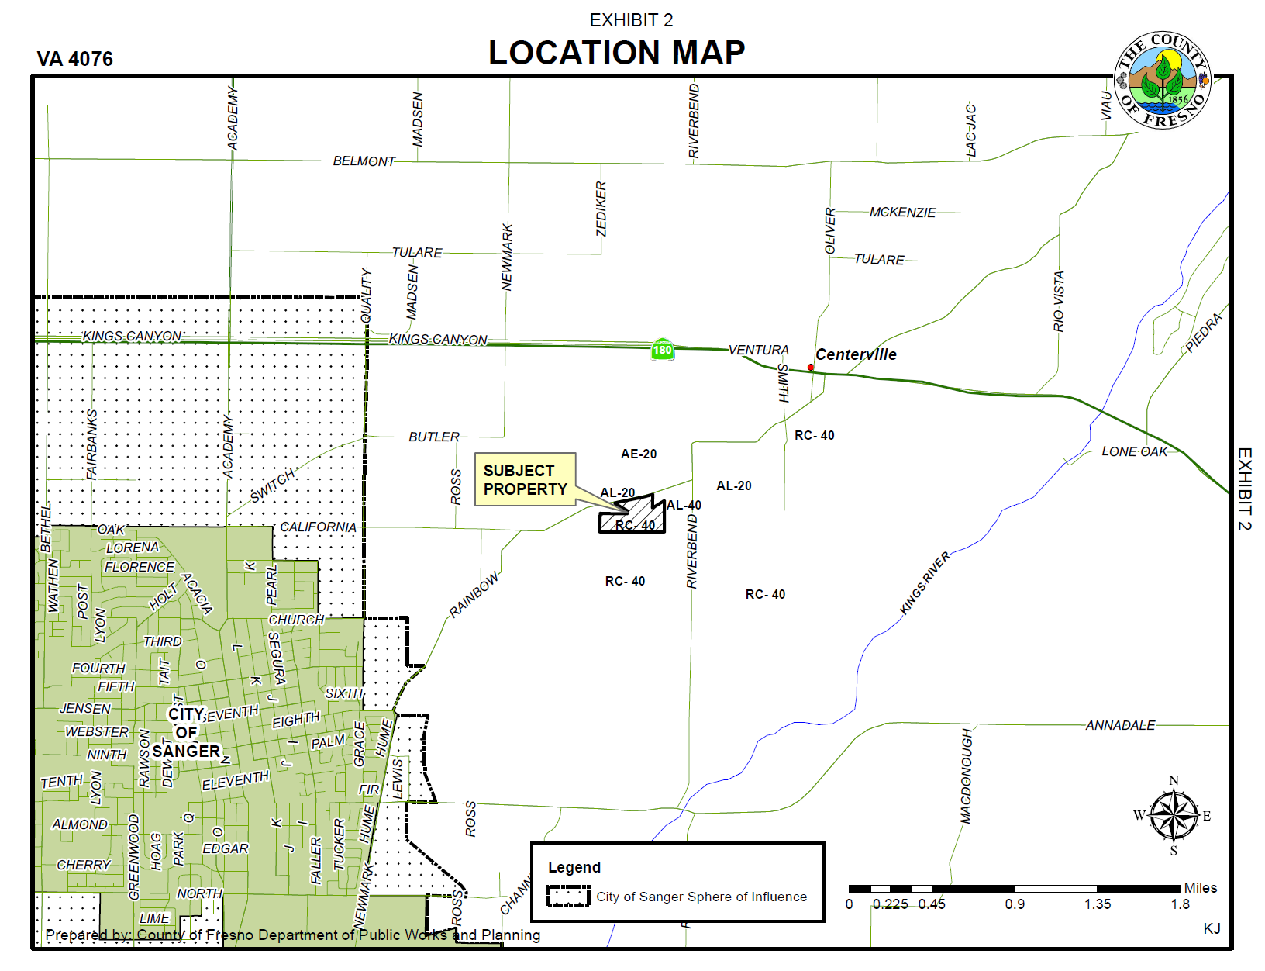

Slide 4
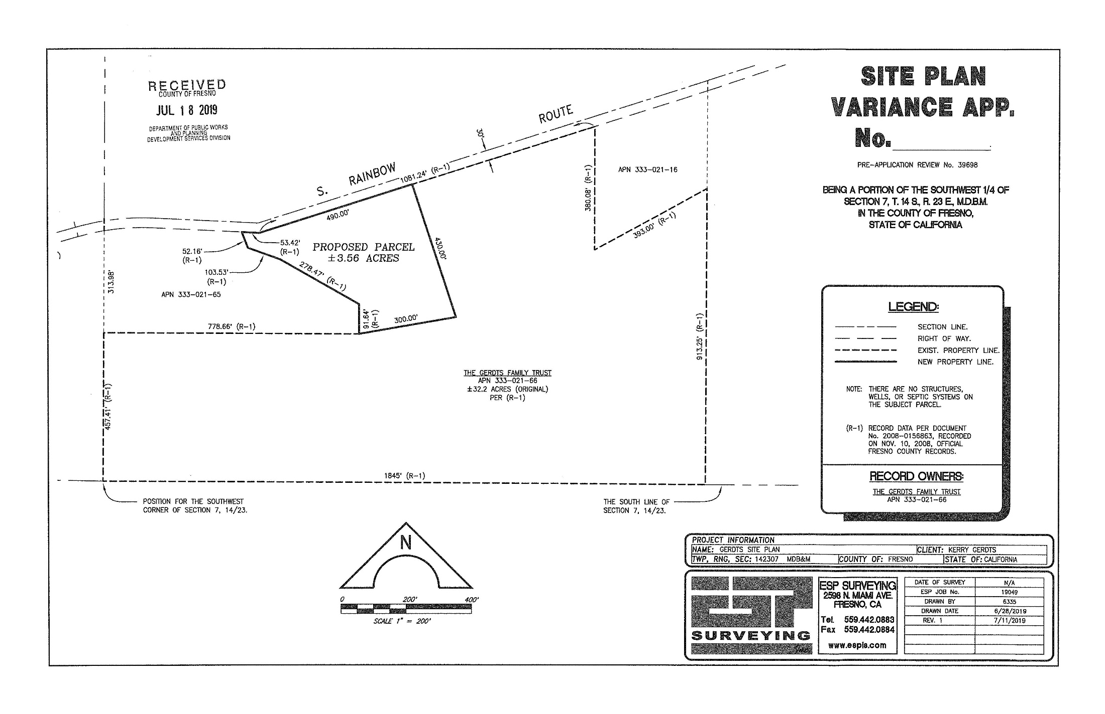

Slide 13
Findings | Description | Findings Met
1 | Exceptional or extraordinary circumstances or conditions | NO
2 | Necessary for the preservation and enjoyment of a substantial property right of the applicant | NO
3 | No adverse effect on surrounding neighborhood | YES
4 | Not contrary to the objectives of the General Plan | NO

Slide 14
Government Code Section 65906
THIS WOULD BE A SPECIAL PRIVILEDGE
Inconsistent with Government code section 65906 “…shall constitute a grant of special privileges inconsistent with the limitations upon other properties in the vicinity and zone in which such property is situated.”

Slide 15
PLANNING COMMISSION MOTIONS:
Recommended Motion (Denial Action)
Move to determine that required Findings 1, 2, & 4 cannot and move to deny Variance Application No. 4076; and
Direct the Secretary to prepare a Resolution documenting the Commission’s Action.
Alternative Motion (Approval Action)
Move to adopt the Negative Declaration prepared for Initial Study Application No. 7677; and
Move to determine the required Findings can be made (state basis for making the Findings) and move to approve Variance Application No. 4076, subject to the Conditions of Approval and Project Notes listed in Exhibit 1; and
Direct the Secretary to prepare a Resolution documenting the Commission’s action.
Recommended Conditions of Approval and Project Notes:
See attached Exhibit 1.

