Slide 1

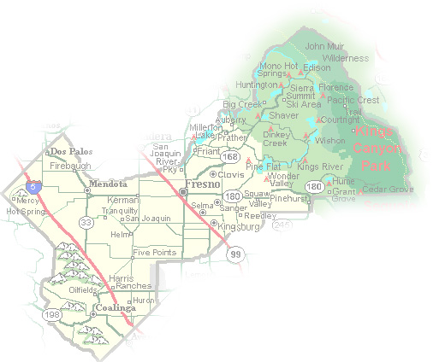
DEPARTMENT of PUBLIC WORKS and PLANNING
DEVELOPMENT SERVICES DIVISION
VA 4130

Slide 2
Current Parcel Size 4.82-acres | Applicant Desire Parcel A: 2.80-acres Parcel B: 1.007-acres Parcel C: 1.007-acres
Current nonconforming status does NOT ALLOW FOR FURTHER SUBDIVSION

Slide 3
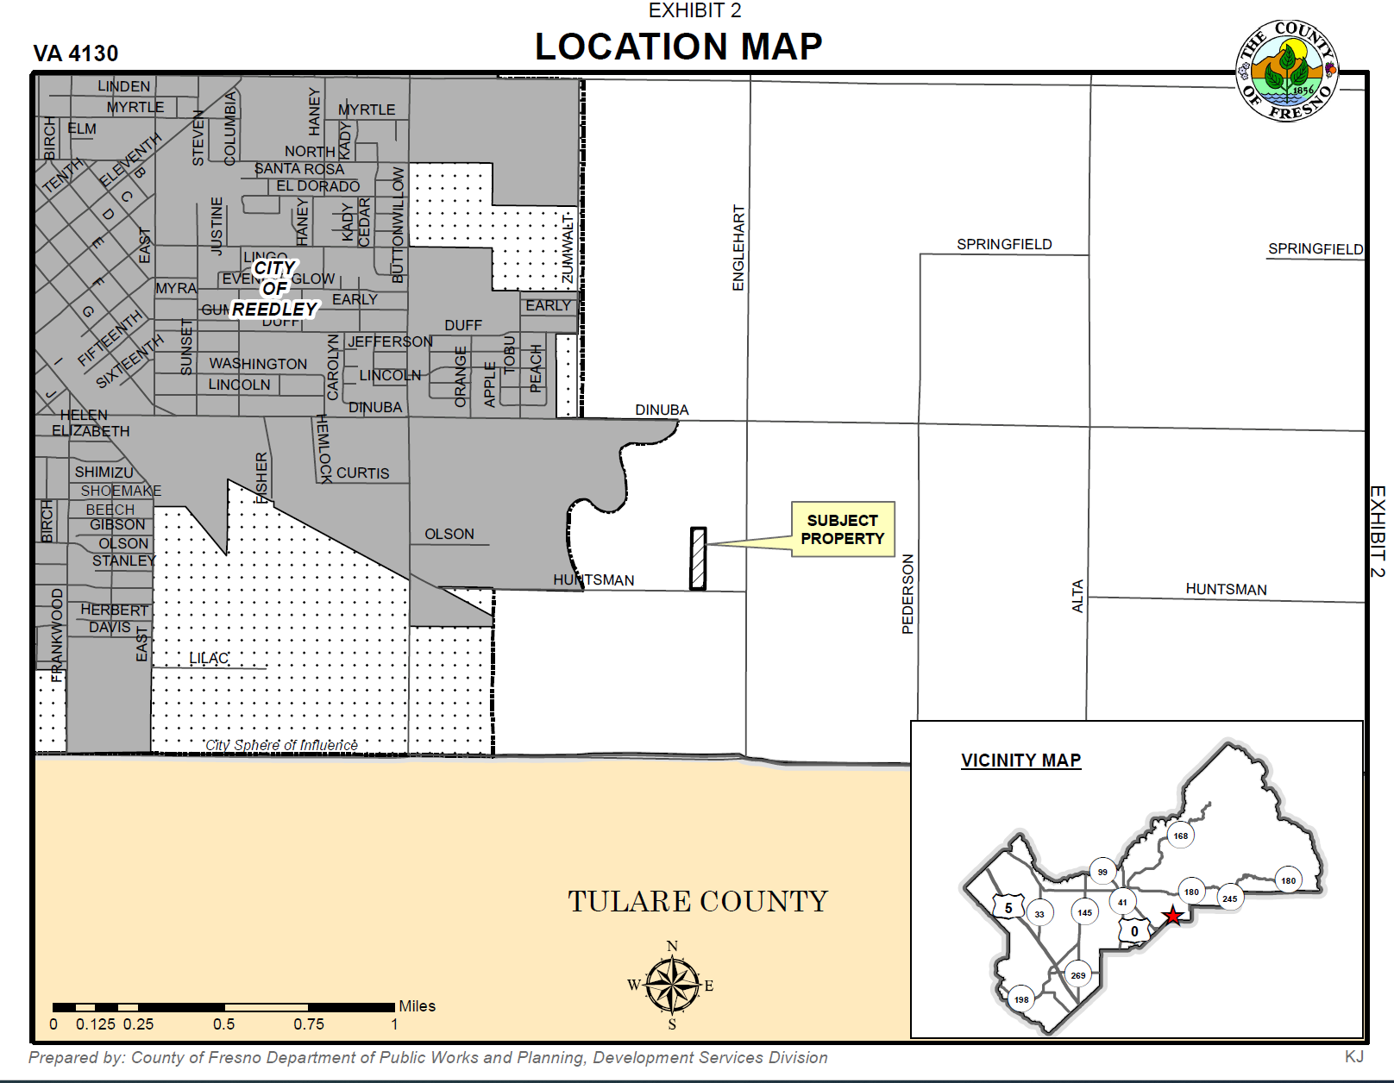

Slide 4
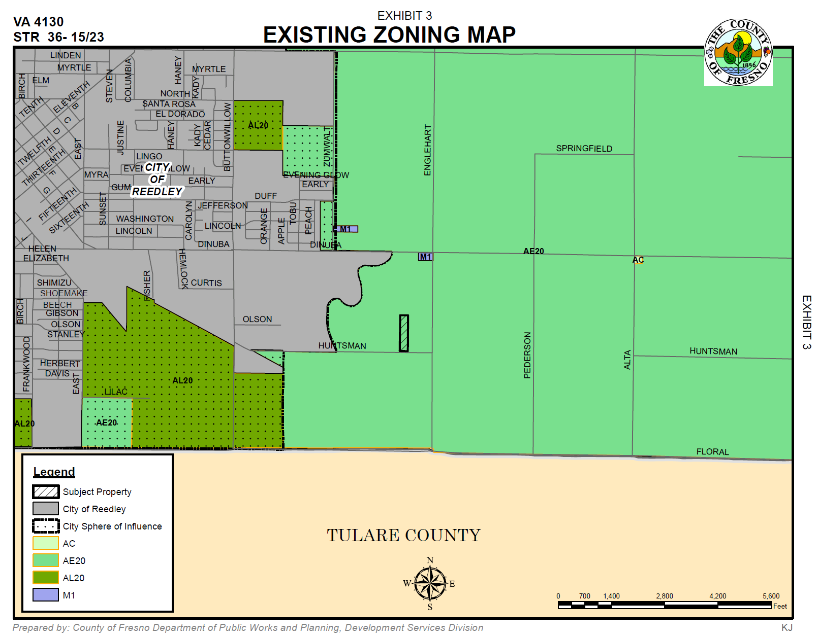

Slide 5
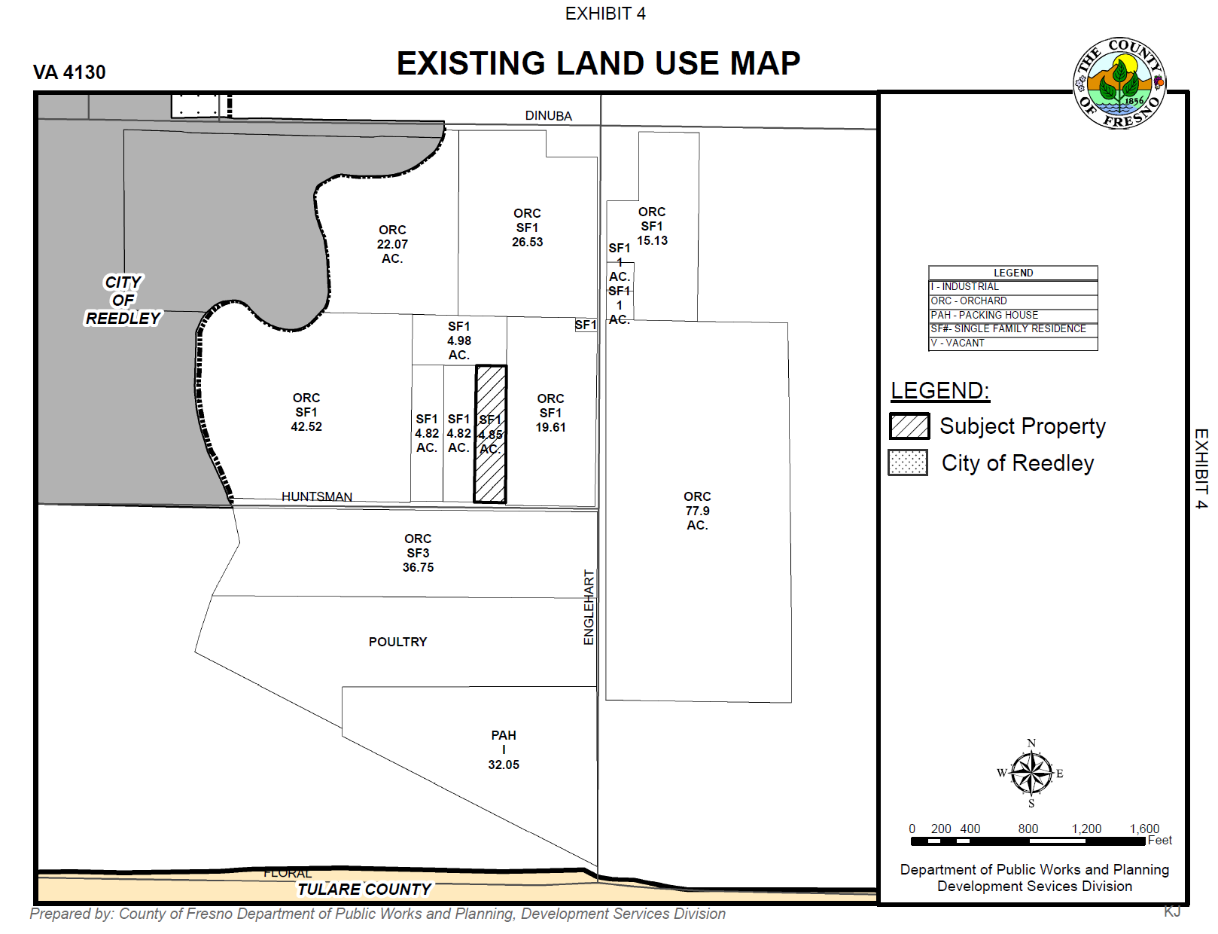

Slide 6
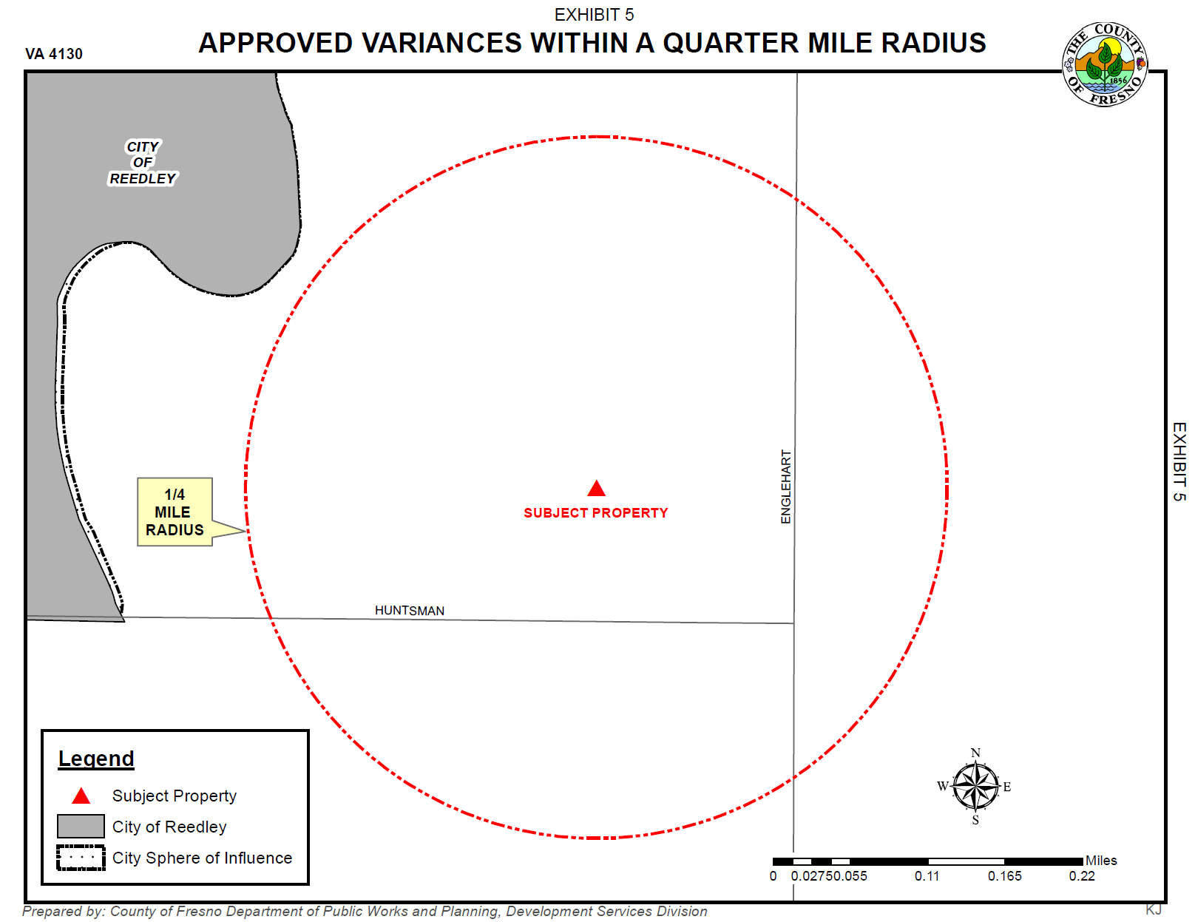

Slide 7
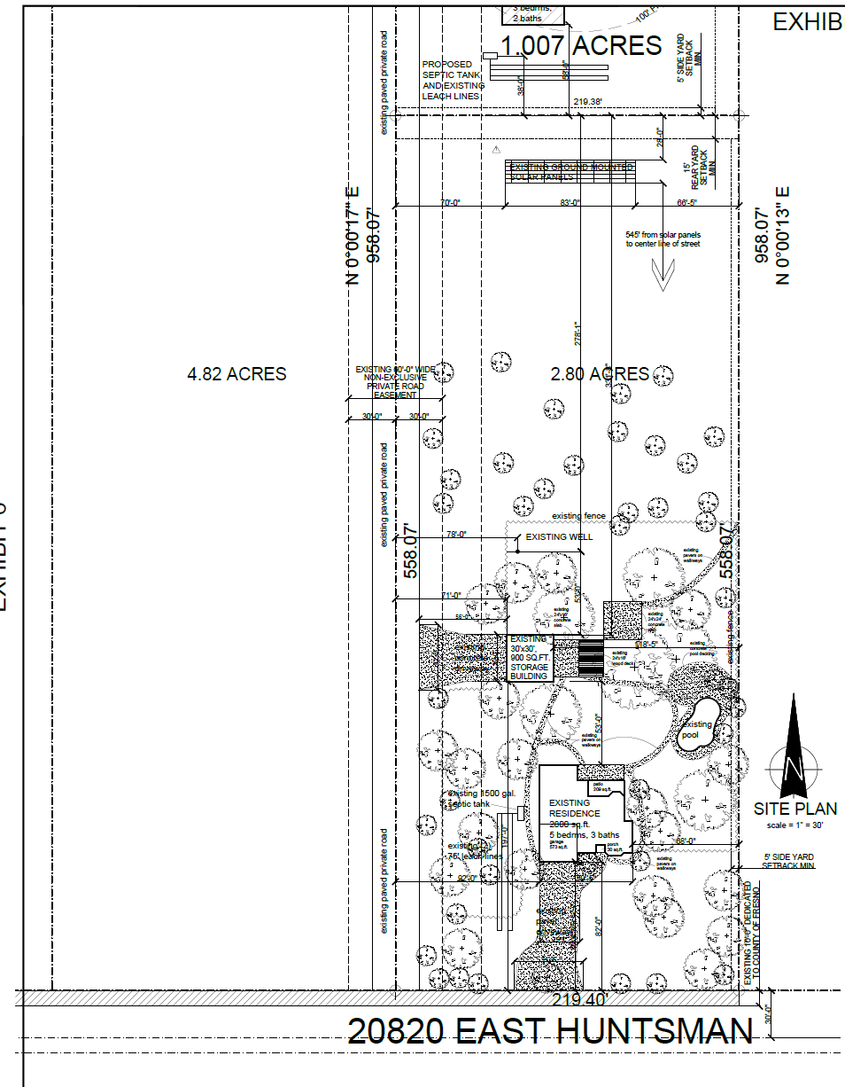

Slide 8
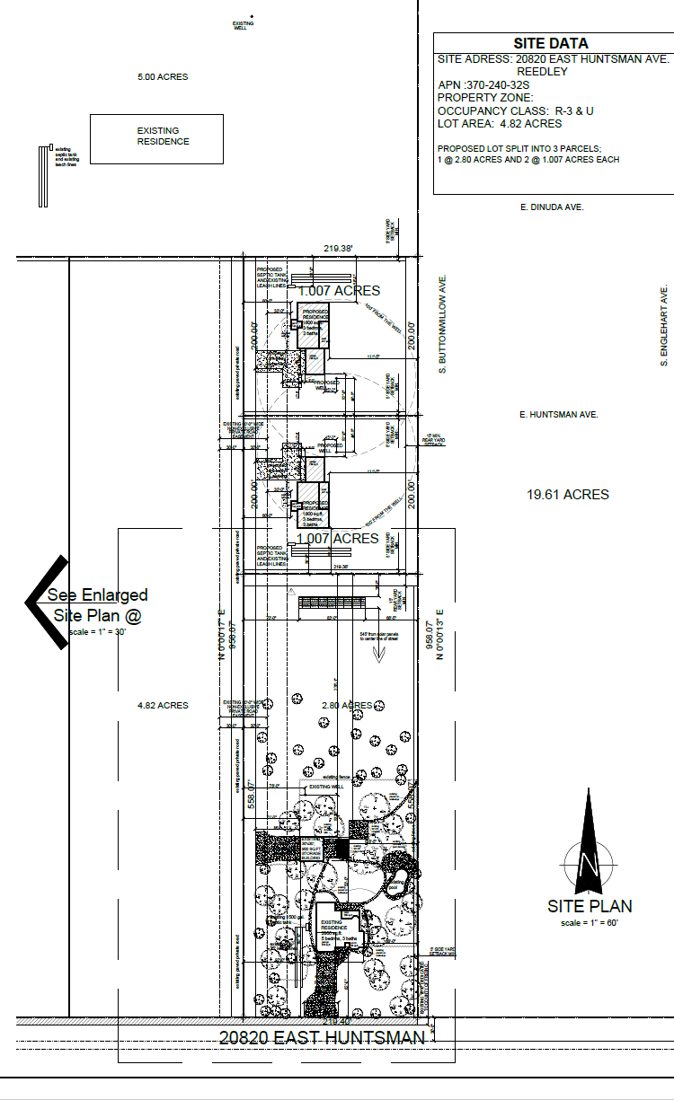

Slide 9
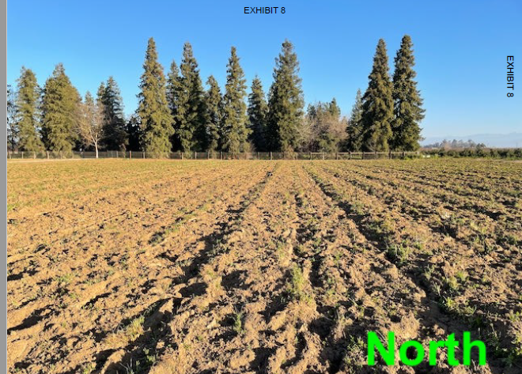

Slide 17
Findings | Description | Findings Met
1 | Exceptional or extraordinary circumstances or conditions | NO
2 | Necessary for the preservation and enjoyment of a substantial property right of the applicant | NO
3 | No adverse effect on surrounding neighborhood | YES
4 | Not contrary to the objectives of the General Plan | NO

Slide 18
Government Code Section 65906
THIS WOULD BE A SPECIAL PRIVILEDGE
Inconsistent with Government code section 65906 “…shall constitute a grant of special privileges inconsistent with the limitations upon other properties in the vicinity and zone in which such property is situated.”

Slide 19
PLANNING COMMISSION MOTIONS:
Recommended Motion (Denial Action)
Move to determine that the required Findings cannot be made and move to deny Variance Application No. 4130; and
Direct the Secretary to prepare a Resolution documenting the Commission’s action.
Alternative Motion (Approval Action)
Move to determine the required Findings can be made and move to approve Variance Application No. 4130, subject to the Conditions of Approval and Project Notes listed in Exhibit 1; and
Direct the Secretary to prepare a Resolution documenting the Commission’s action.
Recommended Conditions of Approval and Project Notes:
See Exhibit 1

